Slide 1
Convenors Guide for Hybrid Sessions

Slide 2
Summary:
All Presenters - Please tell the session Chair whether there is any specific information you would like them to share when introducing you (particularly if it does not align with your Sched profile), and what your preferred pronouns are.
All Presenters - Please ensure you are speaking into a microphone, and you can be clearly heard by the in room and online attendees. Please check to ensure any content you wish to be seen by the online audience is shared via Zoom. Guidance for sharing PowerPoint slides is available here and for keynote slides here. If you are playing a video please remember to share your sound. More guidance available here.
Online presenters - Check your mic and camera are working when you enter the meeting space. If you have any problems, there is some guidance here with audio advice here
Q&A – If the online audience are struggling to hear questions asked in the session room please repeat the question into the microphone for their benefit.
All Presenters – Sharing Video on Zoom: There is guidance on sharing and playing a video here

Slide 3
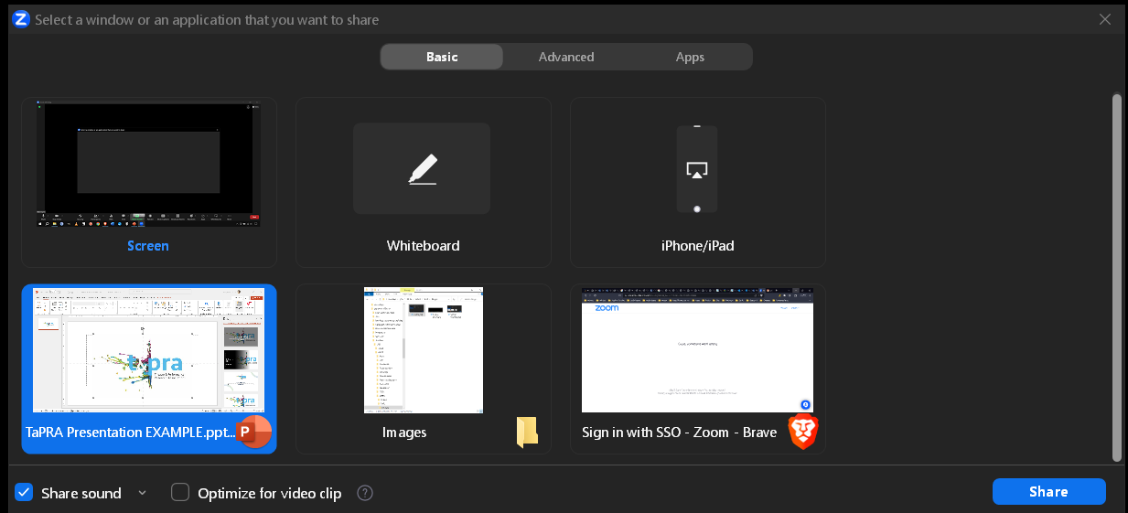
Sharing content
Key points:
In-person slides/video/audio etc. must be shared using the desktop computer in the room you have been assigned
Convenors should follow the steps on this page to ensure that content is visible and audible to online and in-person audiences
Online presenters in the WG Zoom room should also follow these steps to ensure their content is visible and audible for in-person and online audiences
The “Share sound” option should be selected when presentations are being shared
Click “Share” on the bottom right
Start your presentation in full-screen from the beginning by clicking F5 on a windows computer or ⌘+Shift+Return on a Mac
If sharing all content through a single programme (e.g. PowerPoint):
Open your PowerPoint presentation
Click on the green Share Screen button in the menu bar at the bottom of the screen
If you intend to use more than one programme in your presentation (e.g., navigate to a website or play a video that isn’t inserted into your slideshow):
Follow the steps above but select “Screen” after clicking “Share Screen”
This means that everything you do on your computer will be visible to your audience until you choose to stop sharing your screen
Select the PowerPoint project you want to share
Make sure that the “share sound” option is selected
Enter full screen

Slide 4
Guidance for Session Chairs / Presenters
Key points:
Session chairs/hosts should assume the presence of an online audience that will need some accommodations to be properly included in the session
A member of the WG should take responsibility for supporting online participation and presentations
Share guidelines and best practice for hybrid audiences with presenters in advance
Questions and contributions might need to be repeated into a microphone to be audible to online participants
Sharing content and files:
A desktop computer in the room you have been assigned will be signed into the Zoom room for your WG. All media needs to be shared through this computer. It is not possible for in-person speakers to use their personal computer and share content with the online audience.
Please communicate with speakers to ensure that, either:
All files are shared with the convenors and transferred to the desktop in advance, or
Speakers bring their presentations on a USB
Audio: All rooms are equipped with standard lecture streaming technology. This means that, unless we have communicated with you in advance, live speech will only be audible for online participants if the person speaking is at the front of the room (or wearing a lapel mic/using a handheld mic where available).
Please consider this when running your sessions. It may be necessary to repeat questions from the floor or re-cap key points of an extended response to ensure the online audience is up-to-speed with the discussion.
Consider visiting your room before your first session to check the specific configuration and test the online audio.
Online participation:
Consider assigning an ‘online convener’ to log on from their own laptop, manage people entering the Zoom room, and facilitate queries/Q&A contributions that come up through the chat. This person should mute their laptop sound and microphone on Zoom.
To help manage the Zoom room, you should provide clear guidance for how you would like participants to use features such as cameras and online chat during presentations and Q&A sessions
If online speakers are screen sharing, they often won’t see the chat or a visual signal to indicate they are coming to time. A verbal cue is often more effective.

Slide 5
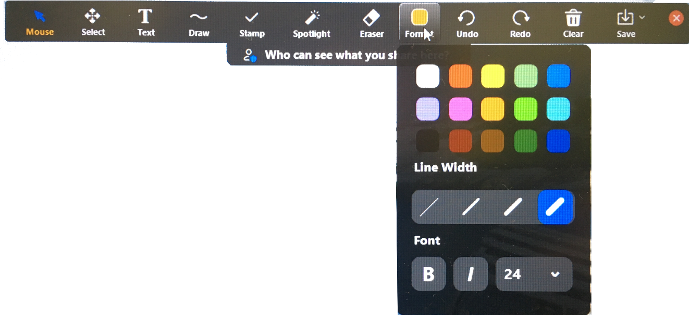
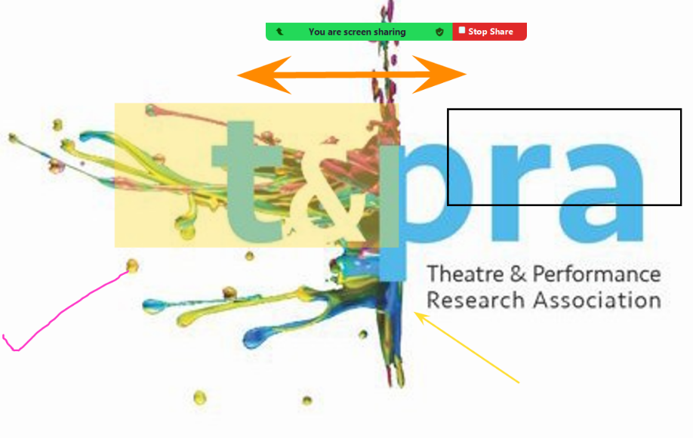
Using Zoom’s “Annotate” features
Key points:
Zoom’s built in Annotate features are visible to online and in-person audiences. In-room visual cues are less accessible for online participants
Zoom annotates a shared screen, not individual slides. Annotations must be cleared between slides
Clear annotations by clicking on the trash can labelled “Clear” and selecting “Clear All Drawings”
Close annotation and return to a slide show by clicking the red “X” at the right of the menu and then clicking on the slide show
Prompt the menu to open by hovering the cursor over the green “You are screen sharing” bar at the top of the screen and clicking “Annotate”
Spotlight:
Lazer pointer (left)
Movable arrow (middle)
Disappearing free draw pen (right)
Draw features:
Shaded boxes
Outlines
Also allows for colour and line width to be changed and for text boxes for annotation (“Text”)
Free drawing
Arrows

Slide 6
Recording sessions
It is possible for convenors to record presentations and sessions, if required
To record, click the circular button in the menu bar
WG convenors should explain the intended use of any recordings and ensure that everyone involved in the session gives permission to be recorded
Recording sessions may mean some delegates choose not to participate, and you should be conscious of this in your decision to record
Files are stored locally, on the desktop computer in the room
If you choose to record, please contact Corin Nanton (confadmin@leeds.ac.uk) after the conference to receive a link to download your files

Slide 7
Accessibility and Inclusion
Captions and Microphones: Zoom provides live transcription that can be turned on using the “Show Captions” button on the menu bar. Please remind online participants of this feature and consider turning on captions in your session to support attendees.
Note that the quality of the captions are dependent on the quality of the audio. Ask in-person delegates to be aware of the positioning of the in-room microphones when presenting, and ensure that contributions from the floor are either picked-up by the microphone or repeated.
Content notes: if you plan to make use of content notes, please collect these from your speakers in advance and ensure they are circulated to your participants with enough time for them to make an informed decision about how to participate. Specific guidance (e.g. “contains one references to domestic violence in the first 5 minutes of the presentation. This provides context but is not central to the discussion”) are more useful than blanket statements (e.g. “Includes reference to domestic abuse”).
Flashing images: Please check with presenters as to whether they are using any flashing images in their presentations and warn all session attendees in advance if flashing images or lights are going to be used in the session.
Charing with sensitivity:
Please remember that there are a wide variety of reasons why participants may not want (or be able) to have their cameras or even their microphones on.
Exercises that involve looking into people’s eyes (e.g. some ‘Getting to know you’ exercises) can cause discomfort and anxiety, especially, though not exclusively, for neurodivergent colleagues.
While it may seem ‘natural’ for people to introduce themselves with reference to their institutional affiliations, in times of precarity, requiring people to introduce themselves with reference to their institution can also be a source of discomfort and anxiety.
Pronunciation of names: Please ensure that you are able pronounce all presenters’ names. If in doubt, please ask the presenter rather than guessing.
Visual Description: Please start your introduction by offering a brief visual self-description, and encourage presenters to provide visual descriptions of themselves and the images they are presenting. This helps make sessions inclusive to blind and visually impaired participants. See VocalEyes for more information.

Slide 8
Summary:
All Presenters - Please tell the session Chair whether there is any specific information you would like them to share when introducing you (particularly if it does not align with your Sched profile), and what your preferred pronouns are.
All Presenters - Please ensure you are speaking into a microphone, and you can be clearly heard by the in room and online attendees. Please check to ensure any content you wish to be seen by the online audience is shared via Zoom. Guidance for sharing PowerPoint slides is available here and for keynote slides here. If you are playing a video please remember to share your sound. More guidance available here.
Online presenters - Check your mic and camera are working when you enter the meeting space. If you have any problems, there is some guidance here with audio advice here
Q&A – If the online audience are struggling to hear questions asked in the session room please repeat the question into the microphone for their benefit.
All Presenters – Sharing Video on Zoom: There is guidance on sharing and playing a video here

Slide 9
Getting Set up
Between 09:00 – 11:00 on the 30th of August we will be providing support for WG convenors to access their dedicated WG rooms, to access their desktop computers and AV equipment and have a chance to set up.
We will be working to the following schedule:
09:00 – 09:30
WG Convenors will register at the registration desk in the Refectory, building 29 on the campus map
09.30 – 11:00
WG convenors to make their way to their WG room.
Student helpers and technical support will be on hand to help WG convenors familiarise themselves with the Zoom controls and instructions for using the cameras, microphones and screen share.
Support
The quickest way to get technical support during the conference is to speak to one of the session room assistants who will be covering the area of the building you are in.
Alternatively, you can contact Corin Nanton on 07538 601 287 or email confadmin@leeds.ac.uk
Auditorium EBS2.2

