Slide 1
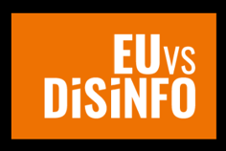
Eastern partnership Youth Engagement Summit
2-3 july 2020

Slide 2
East Stratcom Task Force AT THE EUROPEAN EXTERNAL ACTION SERVICE
ANNELI AHONEN, head of the task force

Slide 3
East stratcom task force
MANDATE
Communicating EU policies effectively
Strengthening media environment
Forecasting & responding to disinformation
OBJECTIVES

Slide 4
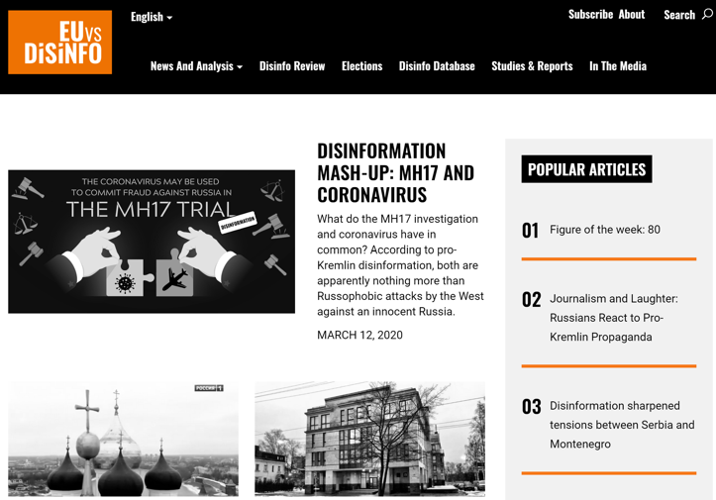
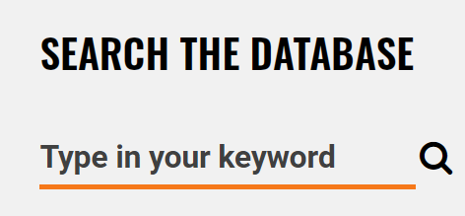

Slide 5
1. Disinformation ABOUT COVID-19

Slide 7
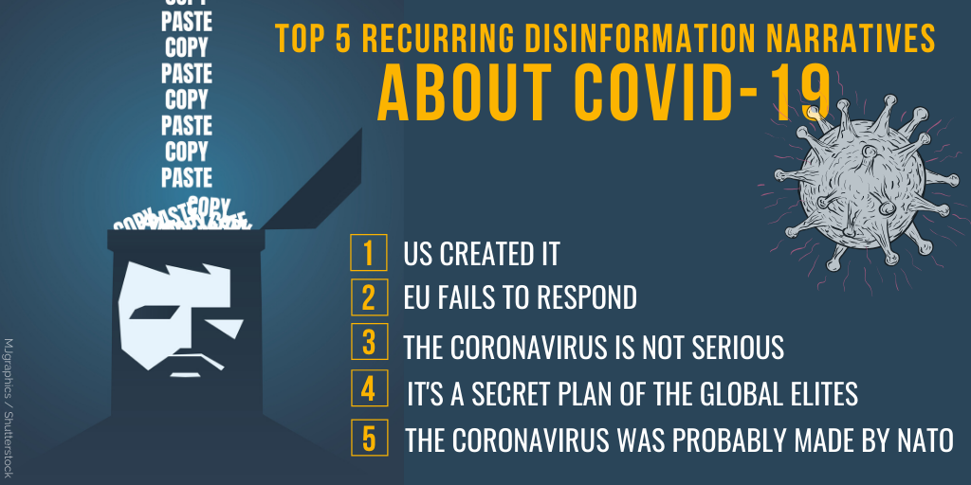
Disinfo trends
Notes:
Trends – evolutions of COVID-19 disinfo

Slide 8
Disinfo trends
Notes:
Trends – evolutions of COVID-19 disinfo + EU response

Slide 9
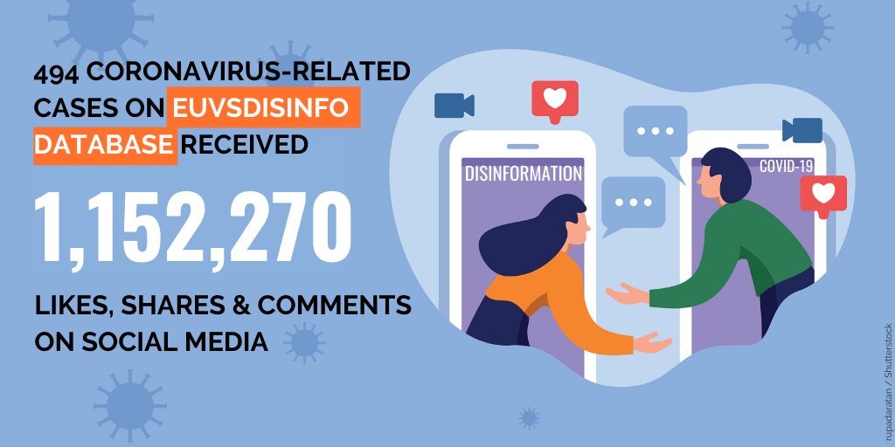
Disinfo trends
Notes:
Coronavirus disinformation published by Chinese and Russian state media outlets in France, Spain, and Germany is in some cases reaching a greater audience on social media than news coverage of the global pandemic produced by major domestic media outlets in those countries, according to a study by the Oxford Internet Institute (OII).
The study, released by OII on June 29, found that the Russian international news network RT has achieved up to five times the number of engagements per article share on Twitter and Facebook with its French-language coronavirus coverage than the major French daily Le Monde.
China Radio International (CTI), meanwhile, has generated four times the number of engagements per shared article than the leading Spanish newspaper El Pais.
RFE/RL's Coronavirus Crisis Archive
Features and analysis, videos, and infographics explore how the COVID-19 pandemic is affecting the countries in our broadcast area.
"Many of these state-backed outlets blend reputable, fact-based reporting about the coronavirus with misleading or false information, which can lead to greater uncertainty among public audiences trying to make sense of the COVID-19 pandemic," OII research assistant Katarina Rebello said in a press release.
The co-author of the study, OII Director Philip Howard, said that along with Russia and China, state-backed media from Iran and Turkey were also targeting "French, German, and Spanish-speaking social-media users around the world with news on coronavirus."
OII researchers found that the disinformation varied depending on the language and source country.
For example, Russian outlets disseminating coronavirus coverage in French and German "consistently emphasized weak democratic institutions and civil disorder in Europe."
Russian and Iranian media produced "polarizing content" intended for Spanish-speaking social-media users in the United States and Latin America.
Live Map: The Spread Of The Coronavirus
Updated constantly with the latest figures
And Chinese and Turkish outlets promoted their countries' respective "global leadership in combating the pandemic" in disseminating Spanish-language content.
The OII studied output from Russia's RT and Sputnik news agency, China's Global Television Network, China Radio International, and the Xinhua News Agency for its study, along with content from Iranian and Turkish media outlets.
It covered each outlet's 20 most popular stories from May 18 to June 5. A previous OII study found that heavily politicized news stories from some state media from Russia, China, Iran, and Turkey could have 10 times the impact as news organizations such as the BBC.

Slide 10
Disinfo trends
Notes:
Avaaz study

Slide 11
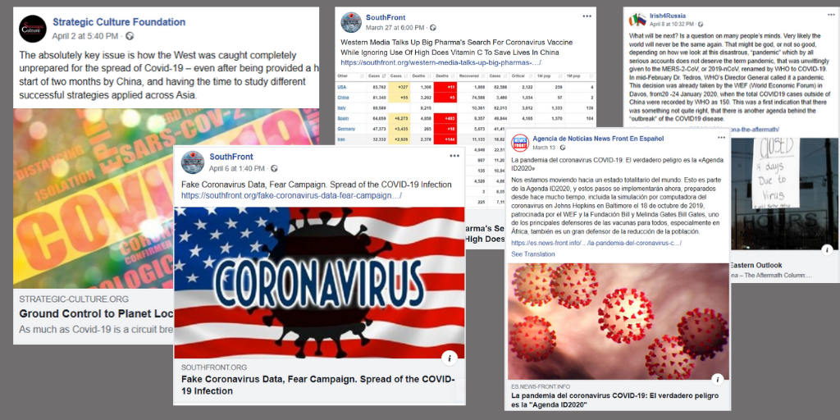
Disinfo trends
Notes:
Social media action

Slide 12
Disinfo trends
Notes:
The ESTF has been an instrumental part of the EU efforts to tackle disinformation in the wake of the COVID-19 pandemic. It shifted the focus of its monitoring and analysis fully on COVID-19 related disinformation in March, and a dedicated section on COVID-19 disinformation was created on the EUvsDisinfo website. Regular translations were launched, apart from English and Russian, also into French, German, Italian and Spanish. EUvsDisinfo published four EEAS Special Reports on disinformation around the COVID-19 pandemic in close cooperation with other Task Forces at the EEAS Strategic Communications and Information Analysis division. The reports reached beyond pro-Kremlin disinformation and covered influence operations related to COVID-19 by relevant foreign actors, including China. In March and April 2020 the EUvsDisinfo website consistently attracted over 10,000 visitors a day, showing its relevance for broad international audiences. In total, since the beginning of the 2020 EUvsDisinfo had 1,000,000 visitors . The increased traffic is a result of several factors: an improved structure of our website data, which made EUvsDisinfo more visible to the Google search engine; and an increasing demand for coronavirus related content.
With the help of resources provided by the European Parliament, East Stratcom Task Force and EUvsDisinfo campaign were in the beginning of 2020 backed by regular, professional monitoring and analytical capacity and means to reach out to new, wider audiences. This enabled quick and efficient response to COVID-19 disinformation, with first examples of pro-Kremlin disinformation detected as early as 22nd of January 2020. In parallel the new resources made it possible to step up raising awareness through a dedicated campaign targeting new local audiences in the EU and EaP, including training young people how to respond to disinformation and a joint media briefing by DG NEAR and EEAS for 54 EaP media outlets.
International recognition
The increased demand for EUvsDisinfo content is related to growing international media attention to the work of the ESTF and EEAS Strategic Communications division, especially in the context of the COVID-19 pandemic. The EEAS Special report about disinformation on the coronavirus was widely quoted by top international media, including Financial Times, Washington Post, Reuters, Bloomberg, The Guardian, El Pais, Deutche Welle, YLE, Berlingske and others.
ESTF has a sizable presence in the social media.
Since the beginning of 2020 the number of TW followers surpassed 51,000 (an increase of 8%). This year EUvsDisinfo followers on Twitter were most engaged with a video outlining 5 years of lies about the downing of the flight MH17 (21,300 thousand views), an article on how BBC challenged pro-Kremlin disinformation about COVID-19 in Italy, a timeline, illustrating the evolution of COVID-19 disinfo in the pro-Kremlin media outlets.
Since the beginning of 2020 the number of EUvsDisinfo followers on Facebook increased to 43,000 (an increase of 7%). The followers were most engaged with a video reports in English and Russian on pro-Kremlin disinformation targeting the Lugar lab in Georgia. The video in Russian was viewed over 264,000 times, in English – 88,000 times.

Slide 13
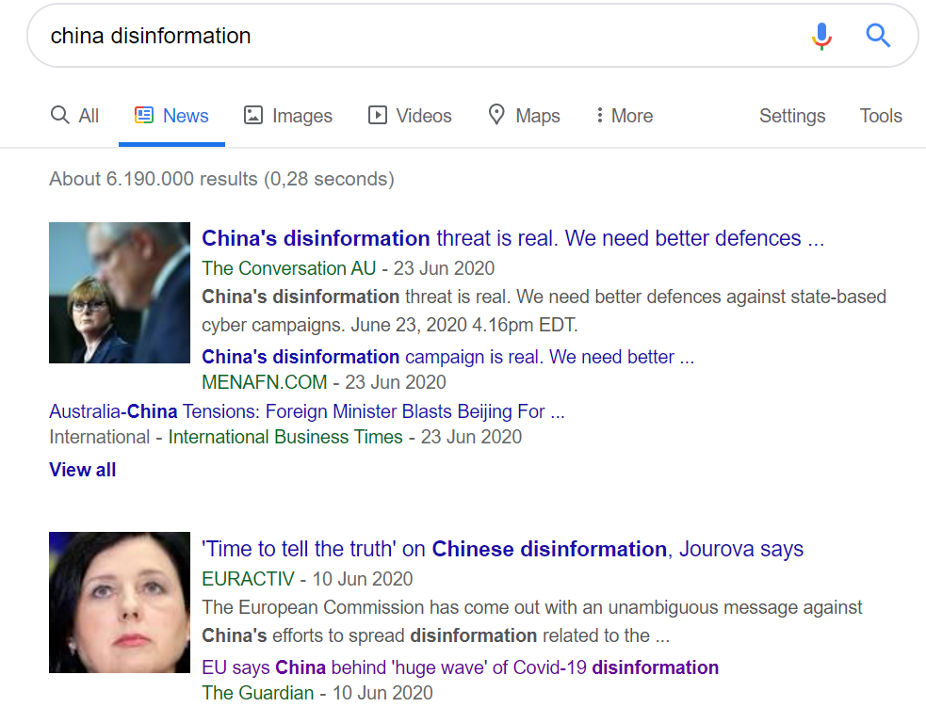
Disinfo trends
Notes:
Today, the Commission and the High Representative are assessing their steps to fight disinformation around the coronavirus pandemic and are proposing a way forward. This follows the tasking by European leaders in March 2020 to resolutely counter disinformation and reinforce resilience of European societies. The coronavirus pandemic has been accompanied by a massive wave of false or misleading information, including attempts by foreign actors to influence EU citizens and debates. The Joint Communication analyses the immediate response and proposes concrete action that can be quickly set in motion.
High Representative/Vice-President Josep Borrell said: “Disinformation in times of the coronavirus can kill. We have a duty to protect our citizens by making them aware of false information, and expose the actors responsible for engaging in such practices. In today's technology-driven world, where warriors wield keyboards rather than swords and targeted influence operations and disinformation campaigns are a recognised weapon of state and non-state actors, the European Union is increasing its activities and capacities in this fight.”
Vice-President for Values and Transparency Věra Jourová said: “Disinformation waves have hit Europe during the Coronavirus pandemic. They originated from within as well as outside the EU. To fight disinformation, we need to mobilise all relevant players from online platforms to public authorities, and support independent fact checkers and media. While online platforms have taken positive steps during the pandemic, they need to step up their efforts. Our actions are strongly embedded in fundamental rights, in particular freedom of expression and information.”
The crisis has become a test case showing how the EU and its democratic societies deal with the disinformation challenge. The following aspects are key for a stronger and more resilient EU:
Understand: First, it is important to distinguish between illegal content and content that is harmful but not illegal. Then, there are blurred boundaries between the various forms of false or misleading content: from disinformation, which is defined as intentional, to misinformation, which can be unintentional. The motivation can range from targeted influence operations by foreign actors to purely economic motives. A calibrated response is needed to each of these challenges. Furthermore, there is a need to provide more data for public scrutiny and improve analytical capacities.
Communicate: During the crisis, the EU has been stepping up its work to inform citizens about the risks and to enhance cooperation with other international actors to tackle disinformation. The Commission has been rebutting myths around the coronavirus, which have been viewed more than 7 million times. The European External Action Service, together with the Commission, enhanced strategic communication and public diplomacy in third countries, including the EU's neighbourhood. Foreign actors and certain third countries, in particular Russia and China, have engaged in targeted influence operations and disinformation campaigns in the EU, its neighbourhood, and globally. For example, the EEAS East Stratcom Task Force detected and exposed more than 550 disinformation narratives from pro-Kremlin sources on the EUvsDisinfo website.
Cooperation has been an important cornerstone of the fight against disinformation:
With the European Parliament and the Council and between EU institutions and Member States, by using established channels, such as the Rapid Alert System and the EU integrated political crisis response. These channels will be further developed to strengthen capacities, to improve risk analysis and vital reporting in times of crisis.
With international partners, including the WHO, the G7 Rapid Response Mechanism, NATO and others. This led to an increased sharing of information, activities and best practices. It should be intensified to better address foreign influence and disinformation.
The EU will step up support and assistance to civil society actors, independent media and journalists in third countries as part of the ‘Team Europe' package, and enhance support for monitoring violations of press freedom and advocacy for a safer media environment.
Finally, many consumers were misled to buy overpriced, ineffective or potentially dangerous products, and platform have removed millions of misleading advertisements. The Commission will continue to cooperate with online platforms and support the Consumer Protection Cooperation network of national authorities to fight these practices that infringe consumer protection law.
Transparency: The Commission has closely monitored the actions of online platforms under the Code of Practice on Disinformation. There is a need for additional efforts, increased transparency and greater accountability:
Platforms should provide monthly reports that include more detailed data on their actions to promote authoritative content, improve users' awareness, and limit coronavirus disinformation and advertising related to it. They should also step up their cooperation with fact-checkers - in all Members States, for all languages - and researchers, and be more transparent about implementation of their policies to inform users that interact with disinformation.
The Commission strongly encourages other relevant stakeholders that are not yet signatories to the Code to participate in this new monitoring programme.
Building on the work of the newly established European Digital Media Observatory, the EU will further strengthen its support to fact-checkers and researchers.
Ensuring freedom of expression and pluralistic democratic debate is central to our disinformation response. The Commission will continue monitoring the impact of emergency measures taken by Member States in the coronavirus context, on EU law and values. The crisis demonstrated the role of free and independent media as an essential service, providing citizens with reliable, fact-checked information, contributing to saving lives.The EU will strengthen its support to independent media and journalists in the EU and around the world.The Commission calls upon Member States to intensify efforts to ensure that journalists can work safely and to make the most of the EU's economic response and recovery package to support media heavily hit by the crisis, while respecting their independence.
Empowering citizens, raising citizens awareness and increasing societal resilience implies enabling citizens to participate in the democratic debate by preserving access to information and freedom of expression, promoting citizens' media and information literacy, including critical thinking and digital skills. This can be done through media literacy projects and support to civil society organisations.
Next steps
The actions proposed today will feed into future EU work on disinformation, notably the European Democracy Action Plan and the Digital Services Act.

Slide 14
2. Communicating EU policies effectively

Slide 15
Developing
communication strategies & campaigns
Pooling resources for professional communication
Trainings, workshops
Working
with governments
Improving EU funded projects’ communication

Slide 16
3. Strengthening media environment

Slide 17
Working closely with the European Commission,
the DG for Neighbourhood and Enlargement
Supporting European Endowment for Democracy
Steering the Open Media Hub project
Developing next regional programme to support independent media. New needs assessment study and Media Business Forum in Latvia on 13-14 November 2019

Slide 18
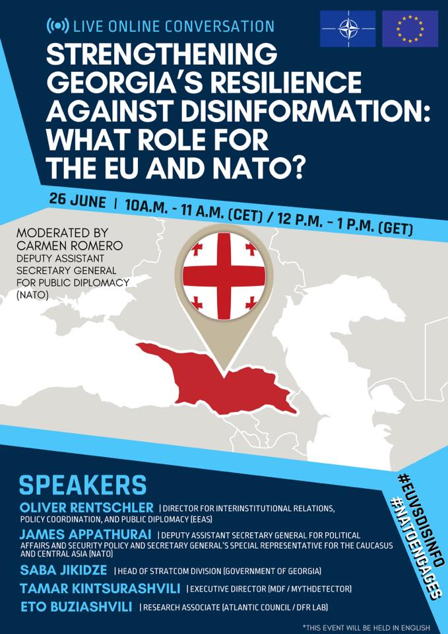

Slide 20
EU NEIGHBOURS east Communicating for a stronger partnership
Silvia Grant, Team Leader
Anneli Kimber Lindwall, Strategic Communication Adviser

Slide 21
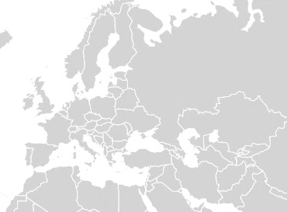
AT GLANCE
PUBLIC DIPLOMACY
To contribute to a better understanding of the European Union & to illustrate the impact of cooperation on daily life of people
Coordinate Streamline
Complement
& Enhance Communication
YEAs
initiative
EU NEIGHBOURS
east
Eastern Neighbourhood countries
2015
/
2020
SOCIAL MEDIA
MEDIA OUTREACH
OPINION POLLING
Notes:
Swap these around so that Stronger Together is at the top

Slide 22
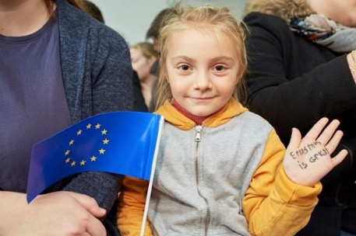
HIGHLIGHTS 2015-2020
Strategic communication approach applied consistently
Introduction of the overarching thematically structured campaigning
35+ thematic communication campaigns under #strongertogether successfully implemented
Creating engaging content about results/impact of EU- EaP cooperation
‘Going local’ and ‘4D Storytelling’ communication approach introduced
Concentrated communication efforts on the ‘soft centre’
740+ YEAs and 500+ YEAs civic engagement activities implemented
New creative communication formats introduced (eCards, UGC, Bloggers, Podcasts, ‘peer to peer direct dialogues activities’, ‘media think tanks’)
Outstanding results of media outreach efforts (50mln+ reached) with 450+ media partnerships & cooperation developed and new modalities of working with media introduced (joint campaigning, joint production, tailored media info packages, etc..)
Great outreach through social media approach (34mln+ reached with 19mln+ in 2019 and 12,5mln+ in 2018 - the baseline data of 2017 was 2,5mln) and online engagement, as well as new formats of working with audiences introduced (UGC, Instagram takeovers, working with influencers, etc..)
Strengthened cooperation, coordination and synergies with EU funded projects (EU4Youth, EU4Business, EU4Digital, EUDEL coms contractors (Ukr, Md, Geo) and development of a network of communication experts (150+)
‘EU NEIGHBOURS’ website fully up to date and continuous enrichment with content
Annual Surveys 2016,2017, 2018, 2019 and 2020 carried out and three years of media monitoring in Belarus
Development and deployment of EUDIGITOOL

Slide 23
OVERALL APPROACH
Target audiences & how we reached them
CAMPAIGNS
YOUTH
WOMEN
CIVIL SOCIETY
LOCAL AUTHORITIES
GENERAL PUBLIC
MEDIA OUTREACH
PARTNERSHIPS
TV REPORTAGES
RADIO PROGRAMMES
INFLUENCERS
SOCIAL MEDIA
TARGETED CONTENT
EIGHT LANGUAGES
UGC
INFLUENCERS
SIX COUNTRIES
5Cs
4 PILLARS
Messages:
STRONGER ECONOMY
STRONGER GOVERNANCE
STRONGER CONNECTIVITY
STRONGER SOCIETY
YOUTH ACTIONS
DIALOGUE-DRIVEN ACTIVITIES
USER-GENERATED CONTENT
FEATURE STORIES &
AUDIO-VISUAL &
WEBSITE CONTENT
POSITIVE COMMUNICATION
EIGHT LANGUAGES
STRATEGIC COMMUNICATION

Slide 24
EU NEIGHBOURS east
MEDIA OUTREACH

Slide 25
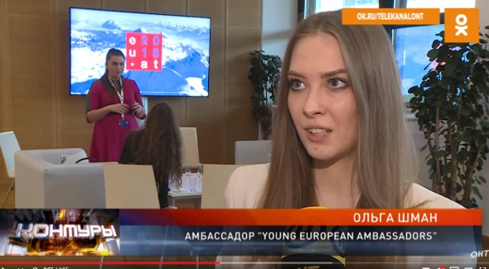
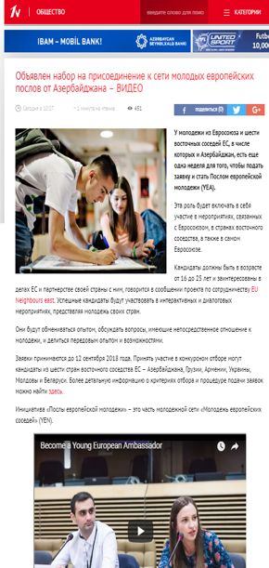
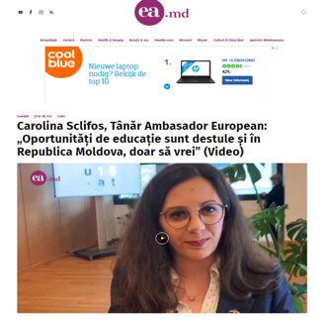
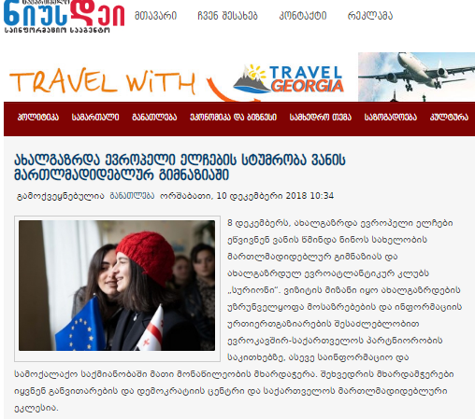
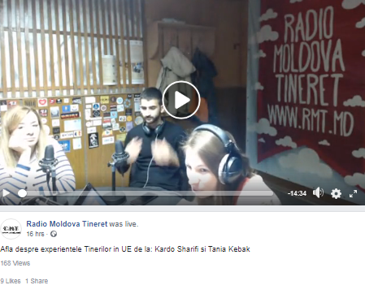
MEDIA OUTREACH:
Promoting youth
Some examples
250+
Appearances on TV, radio and online media
25

Slide 26
EU NEIGHBOURS east
SOCIAL MEDIA

Slide 27
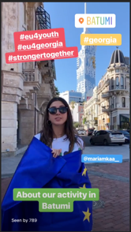
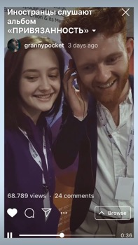
in SOCIAL MEDIA
Consistent posting:
Minimum 1 post per channel/per day
Regular campaigns
2,153+ posts in only
Community engagement:
Active discussion via comments & messages
YEAs takeovers => 100+ in 2019 only
Crowdsourcing UGC => #GoGreenHalloween challenge where 200,000 were reached with the ads budget of 50 EUR (e.g. it was the result of a successful - at no cost -cooperation with bloggers)
From FB page to FB group
Strategic partnerships:
32 influencers engaged in 2019
IG stories => 50,000 views on average in February 2019 only
#EaP media event blogger reach => 800,000 users
116,000
8,200
3,800
7,600
1,200
people reached
137,000+
Total followers/
core audience
Notes:
Swap these around so that Stronger Together is at the top

Slide 28
EU NEIGHBOURS east
Young
European
Ambassadors

Slide 29
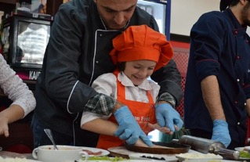
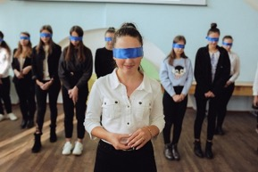
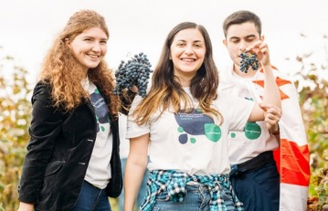
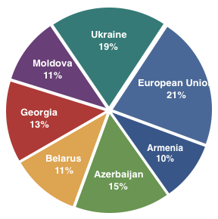
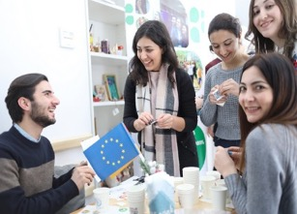
YEAs since 2016
50.000+
face to face contacts
7
publications
in local media
2016
2019
2017
2018
100
200
478
748
500+
Civic engagement activities
1700+
YEAs in civic actions
Active in 34 Countries
29

Slide 30
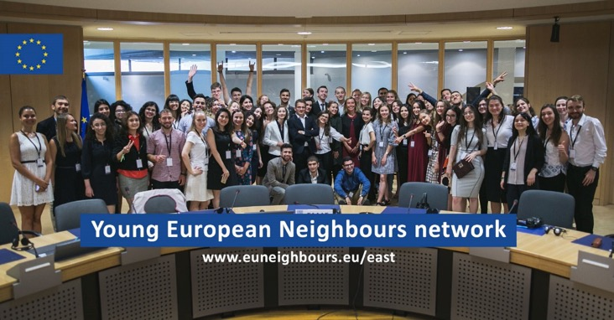
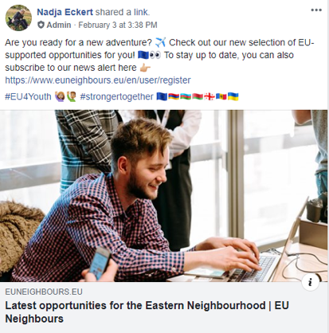
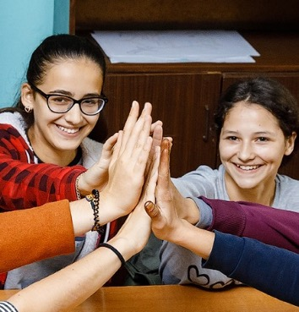
YOUTH ENGAGEMENT
Facebook group
JOIN US!
NEWS
CONTESTS
QUIZZES
OPPORTUNITIES
EVENTS
BLOG
…
AND MORE!
‘Young European Neighbours’ network Facebook group
7,164+ members
1700 (+550) posts
27K (+10K) reactions
Notes:
Swap these around so that Stronger Together is at the top

Slide 31
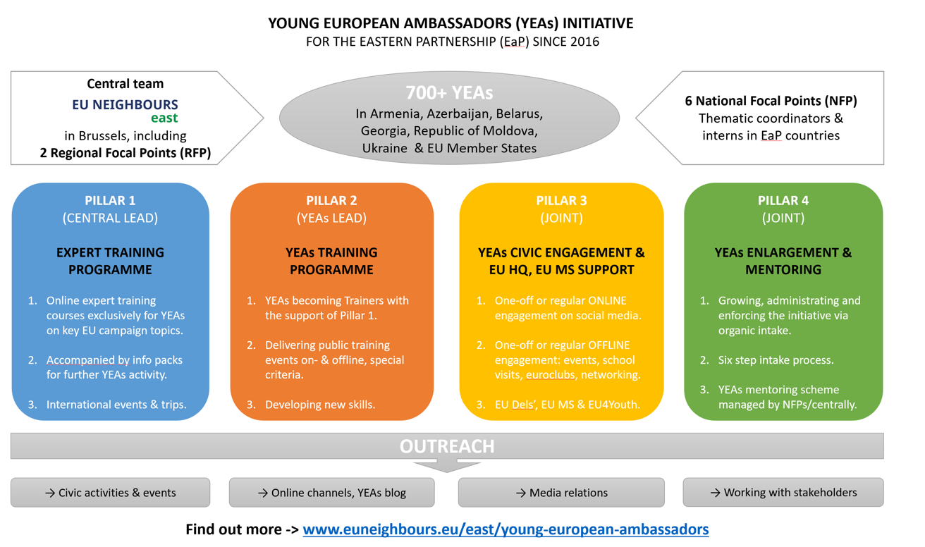
NEW FRAMEWORK
Notes:
Swap these around so that Stronger Together is at the top

Slide 32
EU NEIGHBOURS east
CAMPAIGNS

Slide 33
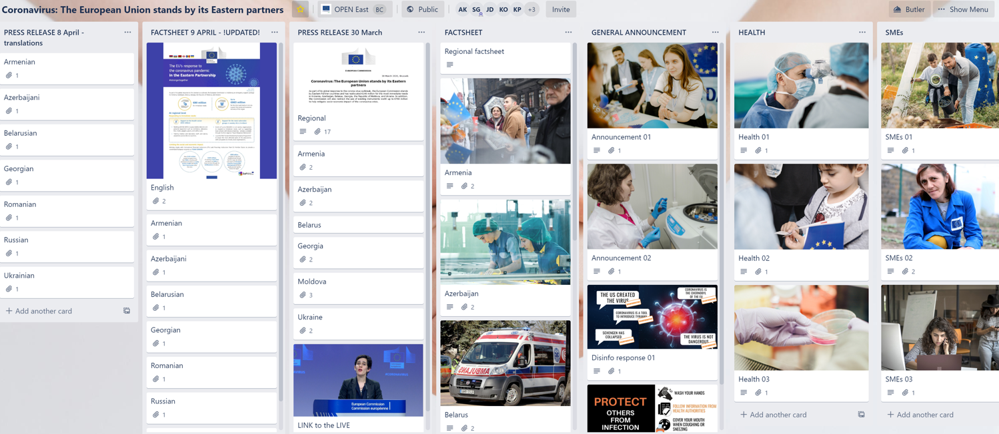
#strongertogether
#CORONAVIRUS
Some examples
https://trello.com/b/UBbzqwGL/coronavirus-the-european-union-stands-by-its-eastern-partners

Slide 34
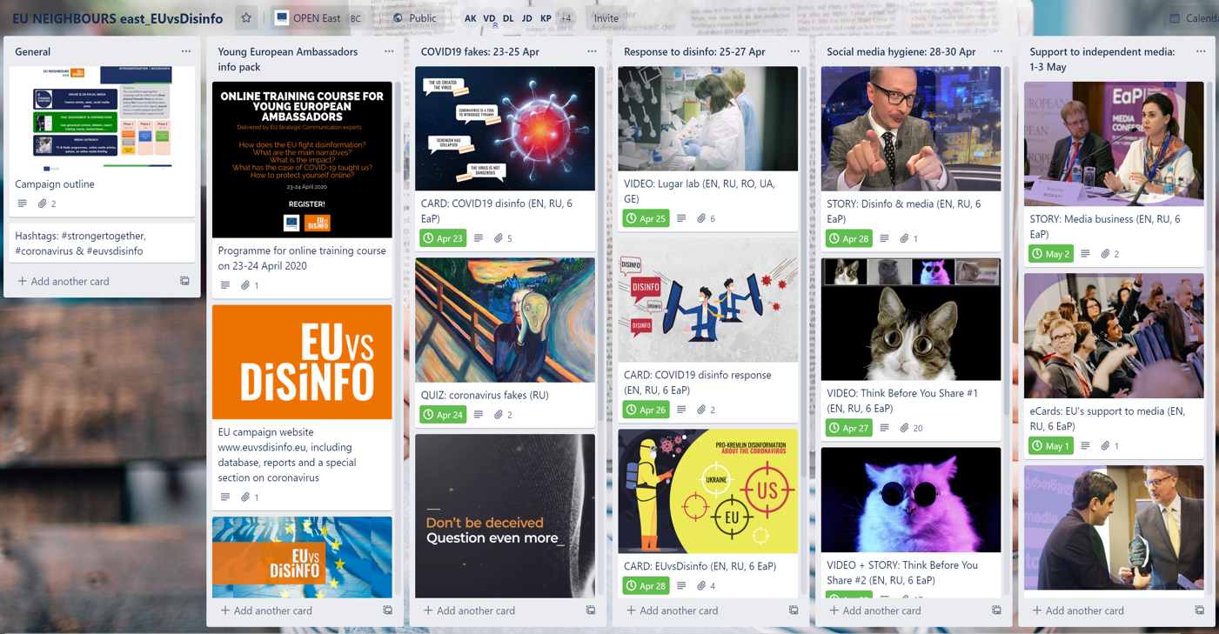
#strongertogether
#EUvsDISINFO 2020
Some examples
https://trello.com/b/PuSSbruM/euvsdisinfo-strongertogether

Slide 35
EU NEIGHBOURS east
Annual surveys 2016, 2017, 2018, 2019 and 2020 carried out, reported & results promoted across the region
35 overview reports (country and regional)
105 factsheets (infographic presentation) of the results issued in English and the other 7 languages of the EaP region
OPINION POLLING

Slide 36
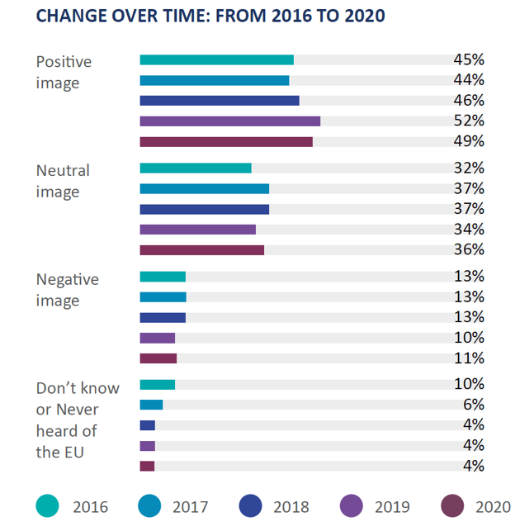
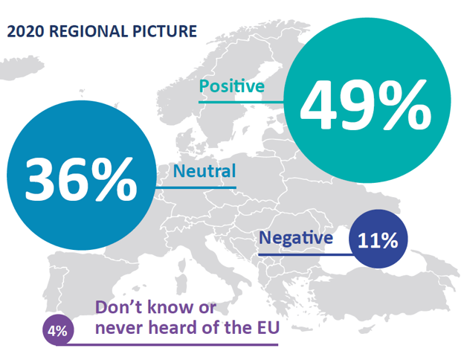
KEY FINDINGS
GENERAL PERCEPTIONS
EU NEIGHBOURS east
+4% on 2016 baseline
&
+8% on 2014 Neighbourhood Barometer
Findings consistent with last years’ survey (Spring 2016)
44% Positive (45% in 2016)
37% neutral (36% in 2016)
13% dislike (13% in 2016)
Highest: 59% Georgians
Lowest: 35% Belarus
Every 2nd citizen of Belarus takes a neutral position (53%)

Slide 37
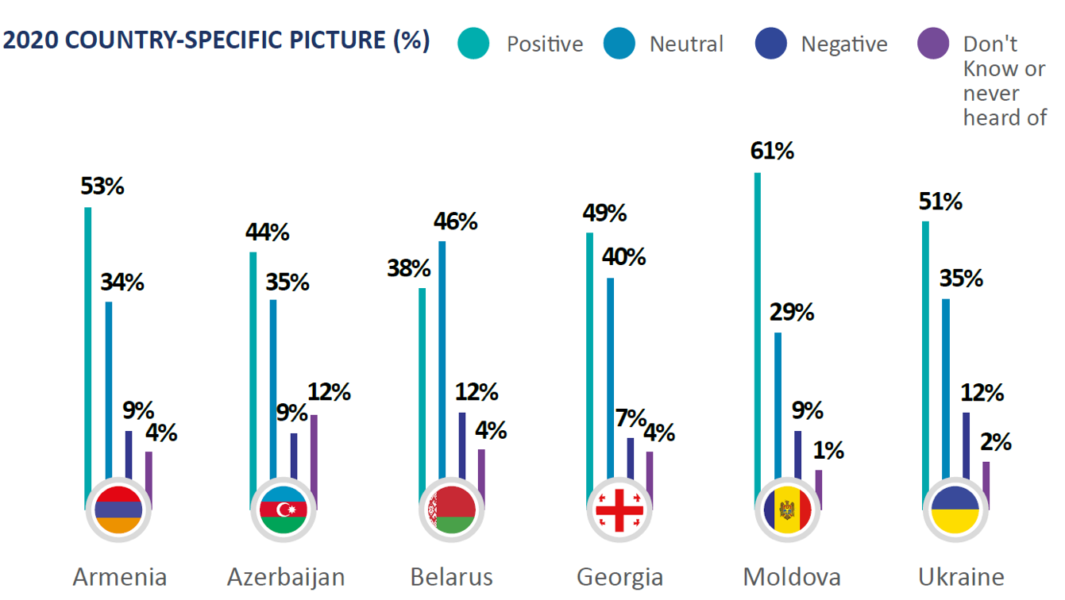
KEY FINDINGS
GENERAL PERCEPTIONS
EU NEIGHBOURS east
Findings consistent with last years’ survey (Spring 2016)
44% Positive (45% in 2016)
37% neutral (36% in 2016)
13% dislike (13% in 2016)
Highest: 59% Georgians
Lowest: 35% Belarus
Every 2nd citizen of Belarus takes a neutral position (53%)

Slide 38
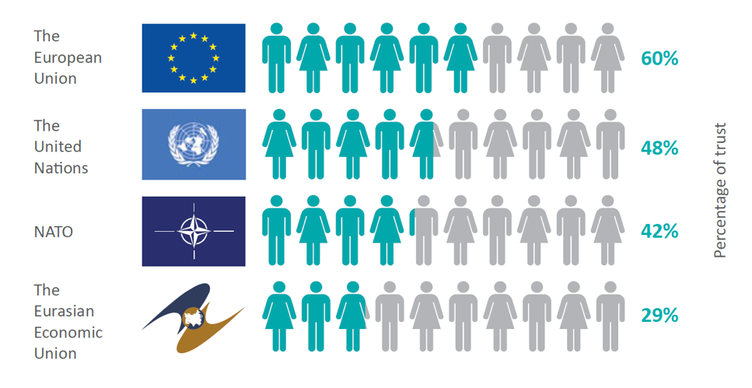
KEY FINDINGS
TRUST towards the EU
EU NEIGHBOURS east
Some examples
Trust towards different institutions in 2019
The EU is the most trusted foreign institution in all EaP countries andthe only one trusted by over 50% of the EaP population
Highest level of trust towards the EU recorded in Georgia (69%), Ukraine (66%), Moldova (63%) & Armenia (60%)
Lowest level of trust towards the EU is in Azerbaijan (41%) & Belarus (45%) (versus 20-25% for UN, NATO, EEU)

Slide 39
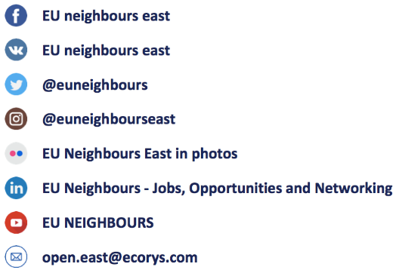
THANK YOU!
THANK YOU!
EU NEIGHBOURS east
ԱՎԵԼԻ ՈՒԺԵՂ ՄԻԱՍԻՆ
BİRLİKDƏ GÜCLÜYÜK
ВМЕСТЕ – СИЛЬНЕЕ
ჩვენ ერთმანეთს ვაძლიერებთ
MAI PUTERNICI ÎMPREUNĂ
СИЛЬНІШІ РАЗОМ
KEEP IN TOUCH

