Slide 1



(Agenda )
Tuesdays
From 10:00 to 12:00 CET
Thursdays
From 10:00 to 12:00 CET
15/09
Grand Opening –
Get key content on Sustainable Urban Development and on participatory & integrated Action-Planning
Discover URBACT community and meet peers from other Networks
17/09
Engaging Stakeholders –
Discover method and tools for identifying relevant stakeholders, reaching them and building a collaborative group
22/09
24/09
Analysing problems –
Get knowledge on how to properly analyse a problem, get the right diagnosis and develop adequate and integrated solutions, in a collaborative way
Planning Actions #1 –
Try your hand at creating a shared vision in the group by combining stakeholders’ perspectives
29/09
Generating & Co-creating ideas - Learn to build effective and efficient group collaboration, creating a safe space for stakeholders to come to an agreement about the actions to be implemented
01/10
Planning Actions #2 –
Try your hand at designing a meaningful set of actions thanks to practical tools
06/10
08/10
Grand Finale –
Reflect on how to make sense of everything experienced during the UeU and on how to apply this knowledge.
Making results visible –
Get key content on indicators, in order to assess the progress and results of an action.
Notes:
Genreal slide with the UeU programme. Please move the white pin accordingly.

Slide 2
Reflecting on the future for better decisions in the present
Anamaria Vrabie
Notes:
Slides 3 to 6: introductory slides
Presentation slide
Here you can add your twitter account if you have one. Otherwise, you can delete the orange box.

Slide 3
Where do we START
Notes:
You can use this slide for quotes

Slide 4
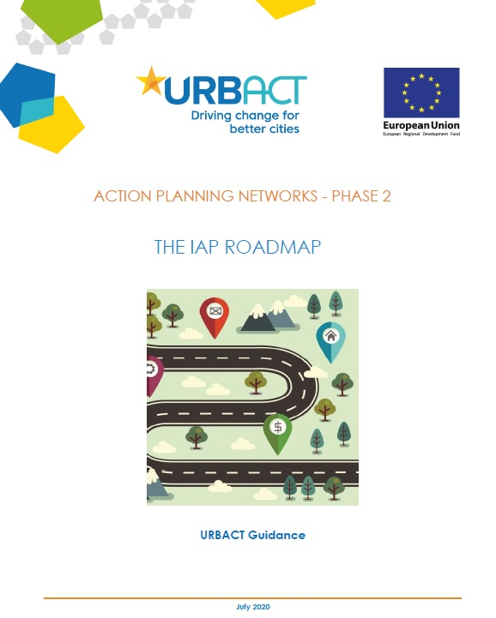
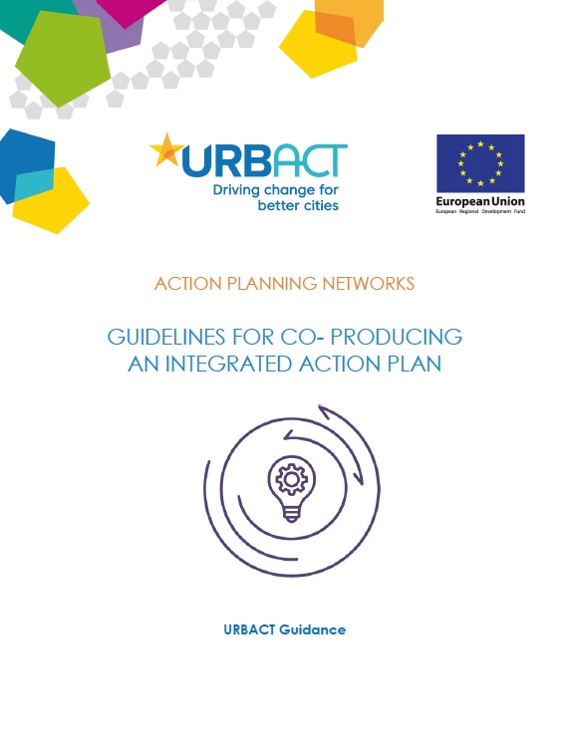
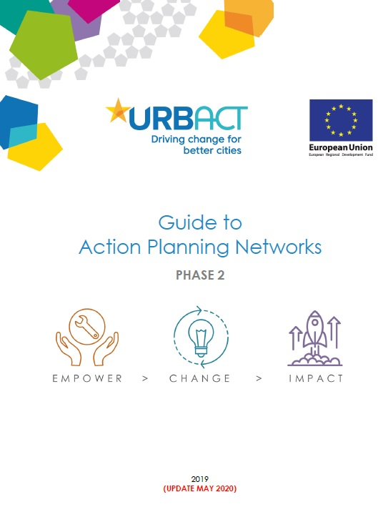
<insert image here>
URBACT guidance

Slide 5
Milestones and deadlines

Slide 6
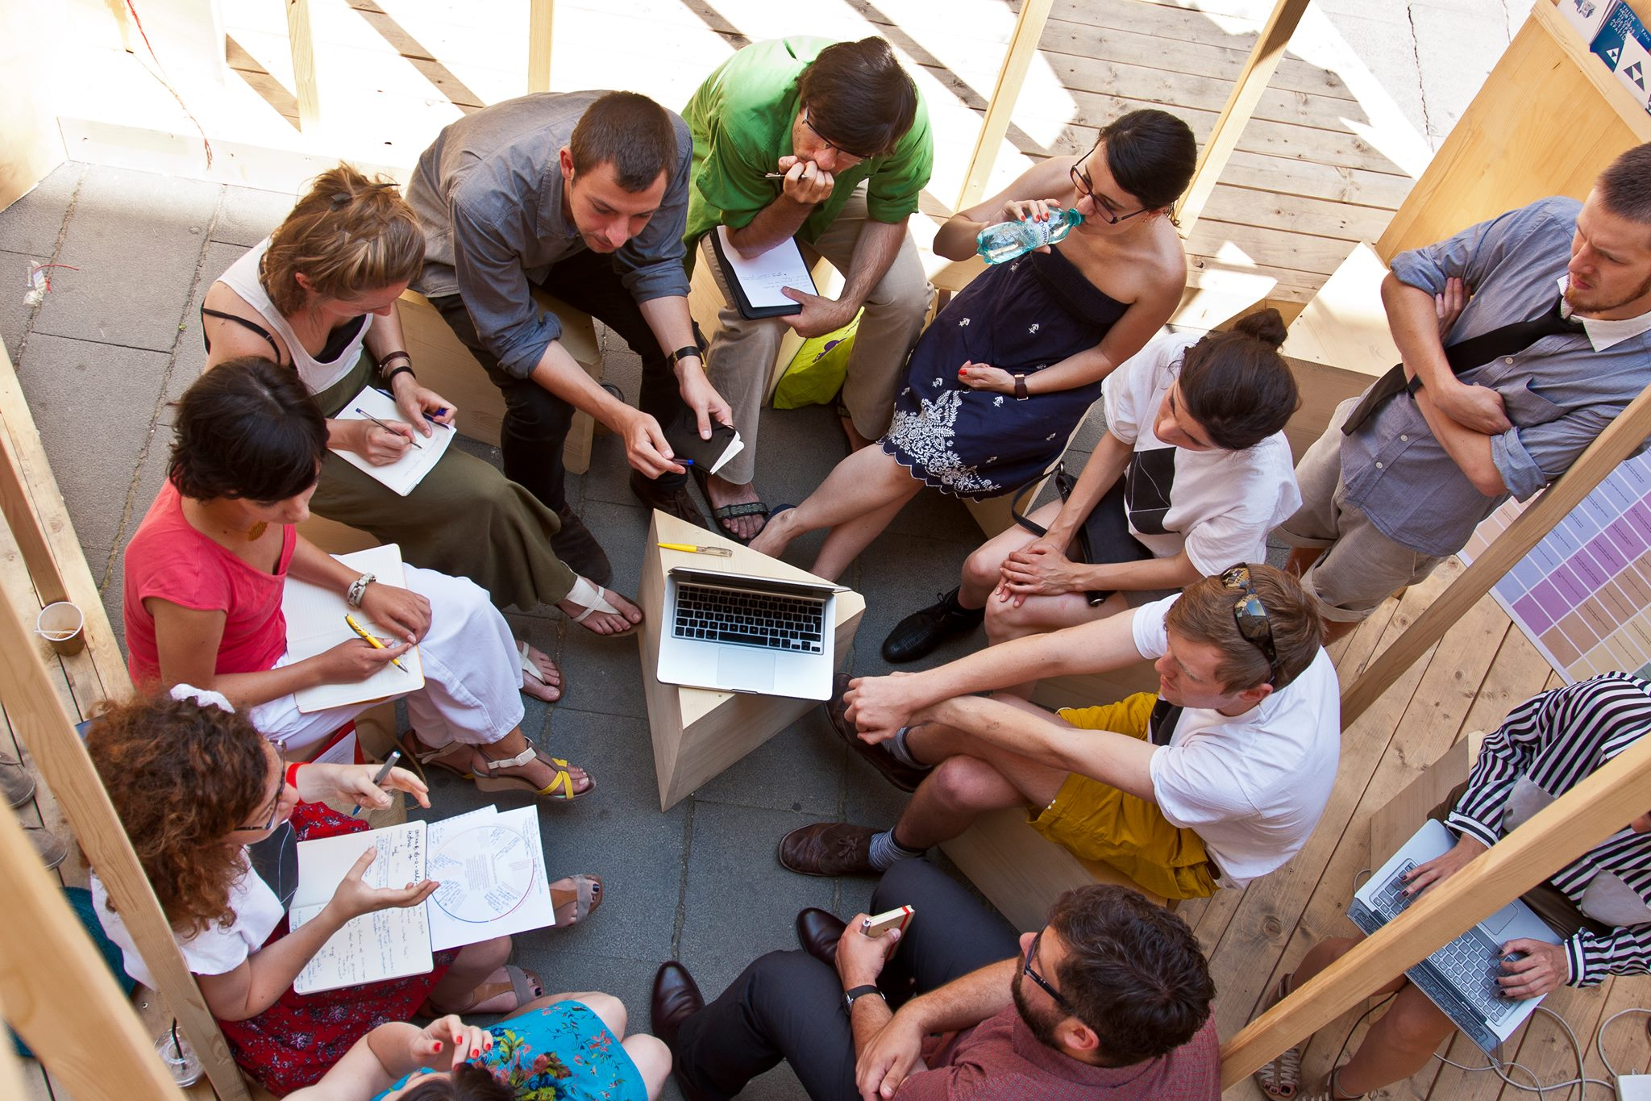
The big picture for Action Planning Networks (APN):
driving change in our cities, using the Integrated Action Plan (IAP) as a TOOL and a PROCESS for co-producing with local stakeholders a concrete and coherent set of actions to address a local policy challenge.

Slide 7


( Making guidelines work for
the big picture )
Premortem scenarios
Group workshop
<insert image here>
Guidelines for co-producing an IAP: turning checklists into 5 major challenges formulated as failure scenarios.
Table 4- Checklist of the 14 identified elements of integrated action planning, pp 17 ,IAP co-creation guidelines
Breakout rooms discussions- focused on things to do in the present
Notes:
Presentation of the agenda

Slide 8
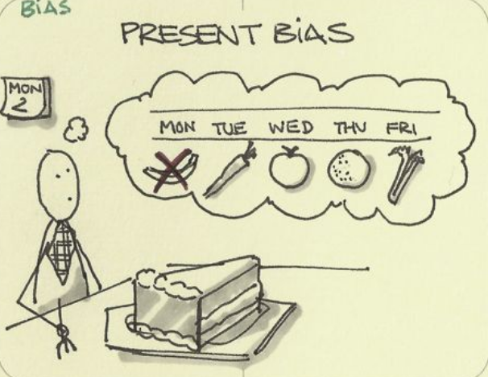
(Present bias)
We, as humans, do not take decisions based on efficacy. We are high subjective and irrational.
“A list of biases”
• We are present biased.
• We suffer more from losses than we enjoy equivalent gains.
• We evaluate riskiness based on how easy examples come to our mind.
• We stick to the status quo.
• We have a preference for fairness.
• Our emotions and visceral states influence our decisions.
• …
Notes:
Present bias. We have a tendency to think that we’ll be able to act differently in the future.

Slide 9
Why imagining and talking about possible failure in the future can help better decisions in the PRESENT
Notes:
You can use this slide for quotes

Slide 10

#1
Key challenge: The local IAP co-creation process failed to take into account the COVID-19 pandemic.
(Present) Ways of tackling:
Acknowledge and make uncertainty part of the narrative. No superheroes.
Consider new connections for your thematic focus with areas that were not on your radar before (safety, urban design, emergency response preparedness etc.)
Build regular check-in moments to integrate updates in the IAP development and APN plan
Use Small Scale Actions to allow ULG members to test ideas
Communicate how you have integrated feedback received

Slide 11
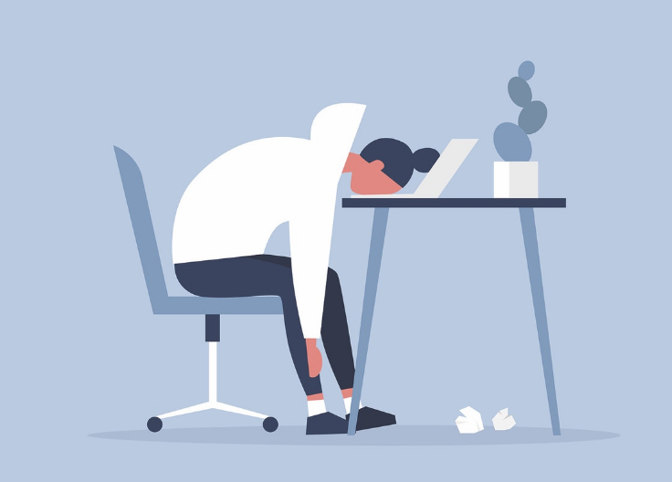
#2
Key challenge: There was little inspiration from transnational exchange and learning, because of the COVID-19 pandemic.
(Present) Ways of tackling:
Mix online and physical meetings and activities
Capitalize on the power of your APN networks to offer peer support and expertise.
Arrange more 1:1 meetings or in small groups with cities in your network
Make use of the URBACT tools to animate digital meetings and the Digital Support Expertise
Hold the space for emotional wellbeing and psychological safety: talk about frustrations and remember that laughter is a good medicine

Slide 12

#3
Key challenge: Actions in the IAP did not have a clear financing plan and did not address all three pillars of sustainable development in terms of economic, social
and environmental objectives.
(Present) Ways of tackling:
Host trainings and workshops, with key stakeholders that can explain the new EU funds, priorities and buzz words.
Involve your local budget team in the IAP development
Invite potential funders to your meetings, involve them in the process, eg Managing Authorities of ERDF/ESF.
Publicize criteria and prioritized list of projects as soon as possible; plan for integrating feedback.

Slide 13
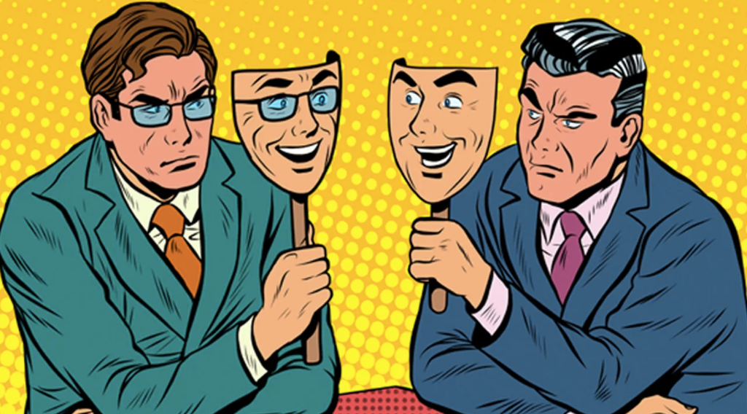
#4
Key challenge: There was no strategic local support for the actions in the IAP.
(Present) Ways of tackling:
Leverage your APN and local communication forums/channels (e.g. ULG meeting takeaways, ULG- meet the press/community events, press releases, newsletters, mayoral addresses, all hands meetings) to build an audience and attention on the topic and the process
Increase capacity of the ULG to act as a main body to advocate changes
Cultivate relationships and teamwork
Make sure your APN project is associated with a diverse team and group of stakeholders, not a single person

Slide 14
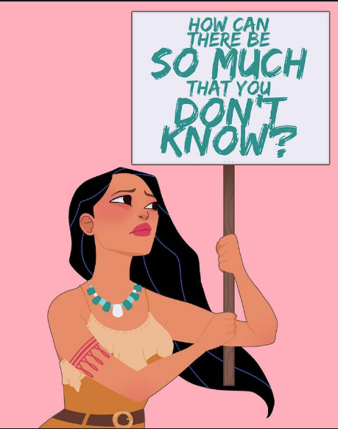
#5
Key challenge: There was strong
criticism that the IAP did not involve key relevant stakeholders.
(Present) Ways of tackling:
Make information easy to find about your APN ULG’s work at local level
Create the space for new members to join the local ULG
Remember the Guide to Multi Stakeholder working, and the ULG assessment tools
Make tools and rules available on how to: respect the process and decisions taken previously in the ULG, give feedback and bring a constructive proposal
Build milestones for celebrating small successes within the ULG

Slide 15
Driving CHANGE in Cities
(when change is constant)
Notes:
You can use this slide for quotes

Slide 16
CHANGE is Social
Notes:
You can use this slide for quotes

Slide 17
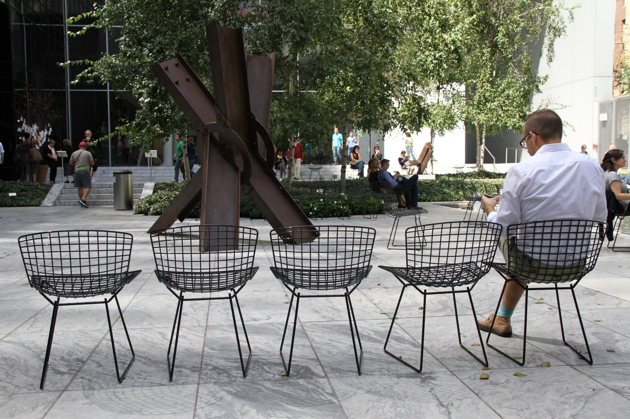
Fence sitters

Slide 18
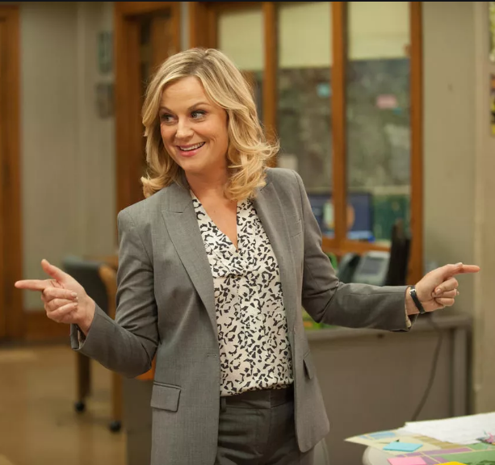
Champions
Notes:
Present bias. We have a tendency to think that we’ll be able to act differently in the future.

Slide 19
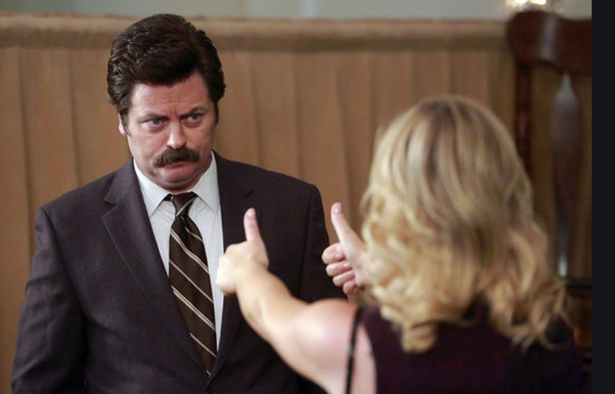
Cynics

Slide 20
CHANGE is Emotional
Notes:
You can use this slide for quotes

Slide 21
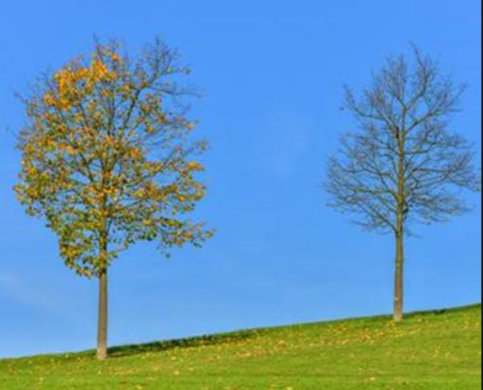
Change implies also LOSS
Control
Narrative
Time
Competence
Familiarity

Slide 22
Control | Delegate decisions
Narrative | Explain the why
Time | Deprioritize
Competence | Provide learning opportunities
Familiarity | Share what’s staying the same

Slide 23
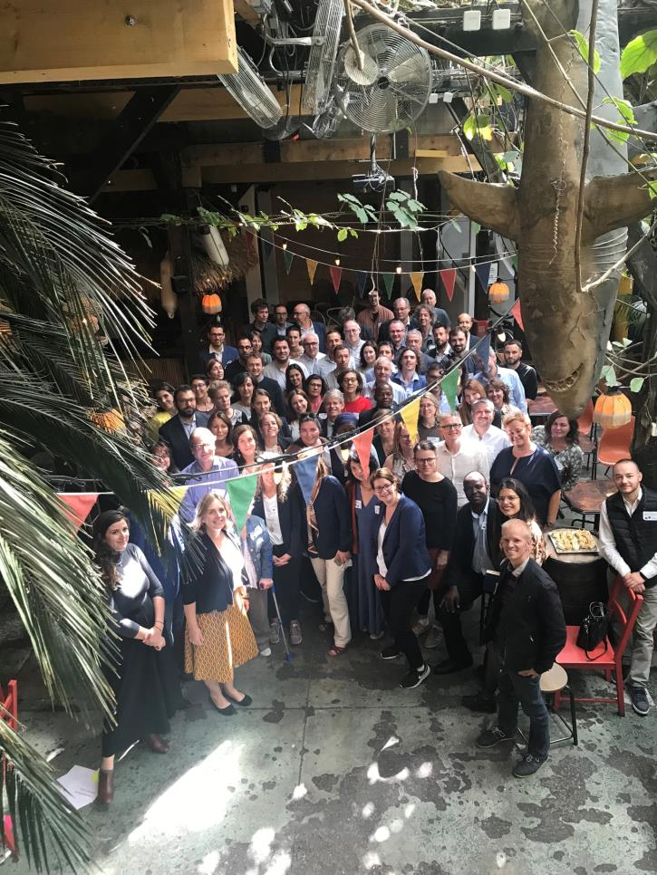
Familiarity
URBACT community
URBACT method
All of us experiencing change

Slide 24


Quick Recap
Notes:
Transition slide

Slide 25
(Ue-U 2020 )
Ue-U was a TRAILER
for the next 22 months
15/09
Grand Opening –
Get key content on Sustainable Urban Development and on participatory & integrated Action-Planning
Discover URBACT community and meet peers from other Networks
17/09
Engaging Stakeholders –
Discover method and tools for identifying relevant stakeholders, reaching them and building a collaborative group
22/09
24/09
Analysing problems –
Get knowledge on how to properly analyse a problem, get the right diagnosis and develop adequate and integrated solutions, in a collaborative way
Planning Actions #1 –
Try your hand at creating a shared vision in the group by combining stakeholders’ perspectives
29/09
Generating & Co-creating ideas - Learn to build effective and efficient group collaboration, creating a safe space for stakeholders to come to an agreement about the actions to be implemented
01/10
Planning Actions #2 –
Try your hand at designing a meaningful set of actions thanks to practical tools
06/10
08/10
Grand Finale –
Reflect on how to make sense of everything experienced during the UeU and on how to apply this knowledge.
Making results visible –
Get key content on indicators, in order to assess the progress and results of an action.

Slide 26
Milestones and deadlines
First milestone approaching: IAP Roadmap- December 2020

Slide 27

Limitations of tools:
Change is SOCIAL
Change is EMOTIONAL
Remember “coffee diplomacy”

Slide 28
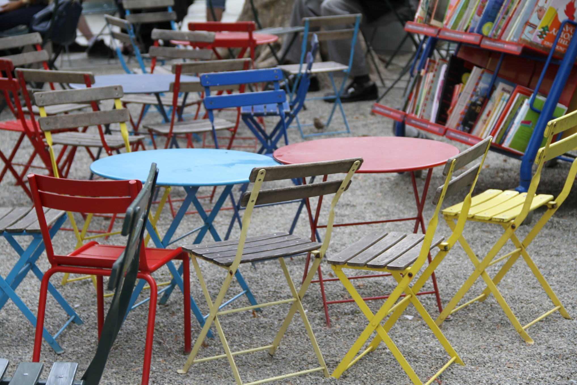
Importance of diversity of your ULG groups
a group is as capable as the people around the table

Slide 29
Our work together
Notes:
Transition slide

Slide 30
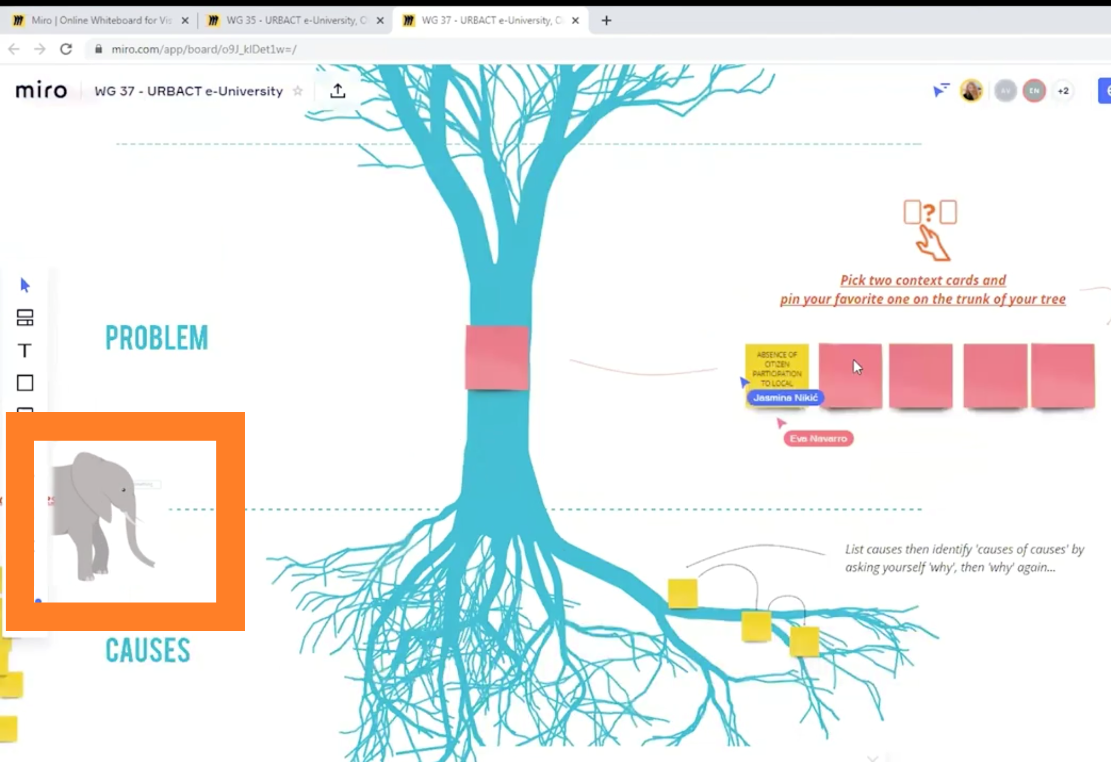
We are biased ;)
Sometimes we miss things in plain sight when we only stat focused on objectives and deadlines.
Our Action Planning Networks journey is about bringing change in cities
Embrace change in your storytelling.
Enjoy the ride
URBACT video snapshot>
Notes:
+ Remember that sometimes we miss things in plain sight when we stay just focused on objectives/deadlines. Your APN journey is about bringing change in cities, and surprising elements and contributions will need to be integrated along the way...for example, a global pandemic...
Point on Story telling

Slide 31
Thank you!
Reflecting on the future for better decisions in the present
Anamaria Vrabie
Notes:
Thank you slide

