Slide 1
Supporting Broadband Development in the EaP Region
EU4Digital Initiative – Broadband Strategies
State of play and closing activities
EaPeReg 16th Plenary Meeting – 3 December 2020

Slide 2
Overall objective
Support all EaP partner countries in their development and early implementation of national broadband strategies, in line with similar EU strategies, by providing technical assistance and capacity building support.
EU4Digital
Broadband Strategies - Technical Assistance

Slide 3
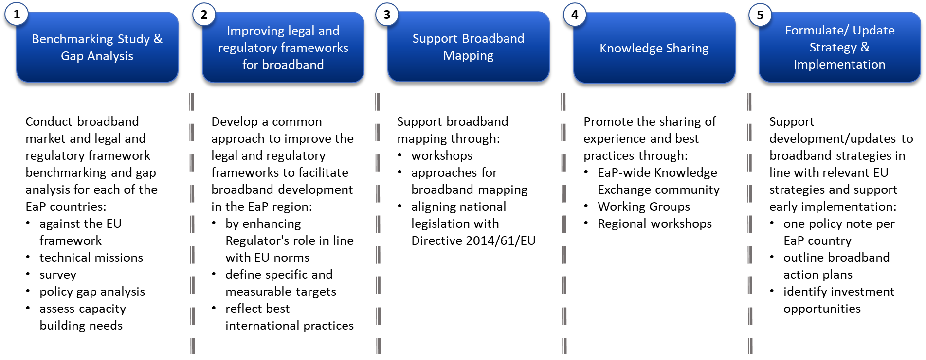
EU4Digital Broadband Strategies:
Overview of activities and milestones
Delivered in December 2019
Delivered in July 2020
Draft delivered, final by December 2020
Ongoing, due by December 2020
Ongoing, different stage per country

Slide 4
Project Status per Component
Report 1 – delivered in December 2019.
Report 2 – delivered in July 2020 incorporating the feedback as received; informing the next stage of engagement especially on legal/regulatory reform assistance
Report 3 – the WB team engaged with UKE (Poland) colleagues to deliver this activity focused on broadband mapping. Draft reports delivered and bilateral discussions ongoing. Final virtual workshop scheduled for December 9. Final report to be delivered by mid-December 2020.
Report 4 – summary of knowledge sharing activities delivered, including virtual workshops delivered throughout 2019 and 2020. To be delivered by mid-December 2020. We are organizing a webinar on 5G on December 9. We also propose a final webinar on “enabling private investment in broadband” tentatively for December 17.
Report 5 – on recommendations for national broadband strategies, work mostly complete (more details in subsequent slides). Final reports to be delivered by mid-December 2020 for all six countries.

Slide 5
Project Status per Country
AM | Recommendations on a national BB strategy (on track, draft recommendations shared with NP, revised final version undergoing quality assurance, to be delivered by mid-December) Providing TA on rural broadband program design (draft shared) TA on updates of Electronic Comms law (ongoing, consultant being mobilized)
AZ | Workshop on upgrading of broadband infrastructure completed Recommendations to develop BB strategy (undergoing quality assurance, to be delivered by mid-December)
BY | Provided early inputs to draft smart cities strategy Recommendations to develop BB strategy and 5G (draft shared, undergoing quality assurance, to be delivered by mid-December)
GE | BB strategy recommendations delivered (adopted by Govt in Jan 2020) Policy dialogue on regulatory reforms (completed) Legal reforms on infra sharing (draft law submitted to Parliament) Financing of rural broadband connectivity program approved (Log-In Georgia, to start in January 2021)
MD | Inputs provided on broadband strategy (done) Ongoing TA on implementation on EU Directive 61 Ongoing TA on implementation of uninterrupted power supply to mobile broadband networks
UA | Inputs provided to Electronic Communications Law (adopted 30/09/2020) Inputs to BB vision (done) BB strategy recommendations and rural broadband plan options (submitted to the GoU, undergoing quality assurance, final version to be delivered by mid-December)

Slide 6
Example of impact: Georgia
EU4Digital supported development of National Broadband Development Strategy (adopted Jan. 2020)
Targets aligned with the EU Gigabit Society targets for 2025, with indicative action plan to:
Increase Competitive Pressure
Attract Investment
Build Digital Skills and Demand
EU4Digital assisted in early implementation of high priority legal and regulatory actions (2019-2020)
Technical assistance to the NP and NRA on:
Development of infrastructure legal framework, under Parliamentary consideration, aligned with the EU BCRD framework
Advisory support on ex ante competition regulation for wholesale markets
EU4Digital influenced the mobilization of financing to support broadband market development (2019+)
Financial assistance to Georgia to:
Implement the “Open Net” program, modeled on Lithuania’s RAIN Project, and to support wider adoption of broadband-enabled services
Support adoption of legal framework for alignment of Georgia’s legal framework on cost reduction

Slide 7
Next steps and closing activities
Final steps on broadband mapping
A couple of remaining bilateral discussions with NRAs and NPs are being scheduled
Final report including key recommendations for implementation of mapping to be delivered by mid-December
Final knowledge sharing activities
Proposed final webinar on enabling private investment in broadband tentatively on Dec. 17
Finalize country-specific work on broadband strategies
Armenia: Finalize strategy recommendations
Azerbaijan: Finalize strategy recommendations, including focus on rural broadband
Belarus: Finalize strategy recommendations, including focus on 5G deployment
Georgia: Continue to support strategy implementation (legal reforms, financing of rural broadband)
Moldova: Continue to support strategy implementation (especially BCRD)
Ukraine: Finalize work on strategy recommendations
Final Virtual Regional Workshop on BB mapping on December 9, 2020
Webinar on 5G (December 9, 2020)

Slide 8
THANK YOU!

