Slide 1
The European Innovation Council
“Opportunities offered by the European Innovation Council for Investment in Research and Innovation to foster economic growth and jobs”
Eric-Olivier PALLU, Policy Adviser,
EIC, EISMEA

Slide 2
A brief history…
2015: Proposed by Commissioner Moedas as an innovation equivalent of the European Research Council
2017: Recommended by Group led by Pascal Lamy in “Lab – Fab – App” report on mid-term review of Horizon 2020
2018 High level group of innovators (Chair Hermann Hauser) published “Funding - Awareness - Scale - Talent (FAST) Europe is back: Accelerating breakthrough innovation” with recommendations to set up EIC
  Fed into EIC pilot phase 2018-2020
  Commission’s legislative proposals for establishing EIC as part of Horizon Europe programme
2020 EIC pilot Advisory Board (Chair Mark Ferguson) published “A vision for the EIC: from deep-tech research to visionary innovation and scale-ups”
  Basis for first EIC Work Programme
March 2021: Launch of EIC – event with Commission President von der Leyen, President Macron, Commissioner Gabriel, et. al.

Slide 3
Europe’s most ambitious innovation initiative
€10 billion programme to identify, develop and scale up breakthrough technologies and disruptive innovations in Europe
Unique in the world to combine research on emerging technologies with Accelerator for startups, SMEs and scaleups
EIC Fund largest VC deep-tech investor in Europe (over €3 billion)
Innovator-centric steered by Board of leading innovators
Pro-active approach with flexible funding
Enhances the European innovation ecosystem
Notes:
The fully-fledged EIC has been launched on 18 March, with very ambitions for years to come. It is the European Flagship in the field of innovation, that will probably be copied by other technological powers.

Slide 4
European Innovation Council – why?

Slide 5
What’s holding back European innovation?
Innovation performance
Strong research performance not translated into innovation
Lack of breakthrough/ disruptive innovations that create new markets
Innovation funding
  Financing gaps (2 “valleys of death”) in
Transition from lab to enterprise
Scaling up for high-risk innovative start-ups
Innovation ecosystem
  Many national & local ecosystems, but fragmented at European level
  Need to include all regions and all talent (especially female)

Slide 6
Funding gap for scaling up highly innovative startups and SMEs
US venture capital investments are 4-5 times higher than EU
Source: [Invest Europe, Pitchbook]

Slide 7
What is at stake: will Europe be home to future « unicorns »?
Number and market value of “unicorn” companies (valued at over €1 billion) by regions
Source: CB Insights (Jan 2021)
Notes:
This graph shows the number of unicorns (a unicorn refers to any tech start-up company that reaches a $1 billion dollar market value) across USA, Europe, Asia and other. As you can see, we have a lot of work to do to catch up with the USA and Asia.

Slide 8
What is at stake: who will lead on the next wave of strategically important technologies?
past future ?
electricity
gene therapy
hydrogen fuel cells
airplane
social media
car
antibiotics
artificial intelligence
liquid biopsies
GPS
sea container
3D printing
neurotechnologies
synthetic chemicals
semi-conductors
digital platforms
autonomous vehicles
smart phone
the cloud
CRISPR-cas
?
barcode
internet
blockchain
quantum computing
telecomms
Internet of things
new batteries
PC
EU & US lead
US lead (& Asia, EU)
Who leads?
graphene
Examples taken from WIPO, MIT, WEF, OECD, etc.

Slide 9
Experience from the EIC pilot phase (2018-20)

Slide 10
EIC pilot phase (2018-20) under Horizon 2020 programme
Budget of €3.5 billion (2018-20), €1.55 billion in 2020
Introduction of EIC pilot blended finance (2019), and set up of EIC Fund (2020)
Very high demand: ~ 14000 applications from SMEs/ startups in 2020 with request for over €40 billion support;
Special support for:
  COVID relevant innovations: 36 Startups/SMEs awarded funding of over €160m in May;
  ‘Green Deal’ innovations: 64 startups/ SMEs awarded funding of over €300m in July;
  for women innovators: at least 25% of start-ups/ SMEs invited to interview to have female CEO
First four EIC programme managers recruited

Slide 11
EIC pilot phase (2018-20) under Horizon 2020 programme
Bringing together and reform of existing instruments:
  Future Emerging Technologies (FET Open, FET Proactive) => EIC pilot Pathfinder
    Also, FET Launchpad, FET Transition to innovation as basis for EIC Transition
  SME instrument => EIC pilot Accelerator
    Primarily bottom up; face to face interviews
    Introduction of “blended finance” grant of up to €2.5 m and equity of up to €15 m in single application
  Also Fast Track to Innovation (FTI) and Prizes
Expanded Business Acceleration Services:
  Multi-corporate days (e.g. Planet.tech; energy4planet), visits to innovation hubs, overseas trade fairs, etc
  Services for Pathfinder (boot-camps, etc.)

Slide 12



Impacts of EIC pilot Accelerator (including SME instrument)
Growing support to Startups & SMEs
5500 supported since 2014
159 awarded blended finance with ~€700 million equity
Increase in startups with female CEOs
Crowding in other investors:
€9.6 billion follow up investments to EIC supported companies
10 unicorns - value €1billion+
91+ centaurs - value €100million+
90% addressing Sustainable Development Goals
Main thematics in:
30% in Green Deal
30% in Digital
30% in Health (including COVID solutions)
A pipeline of breakthrough technologies
400 research projects
800 innovations tracked
Pilot of Transition funding to follow up research results into applications

Slide 13
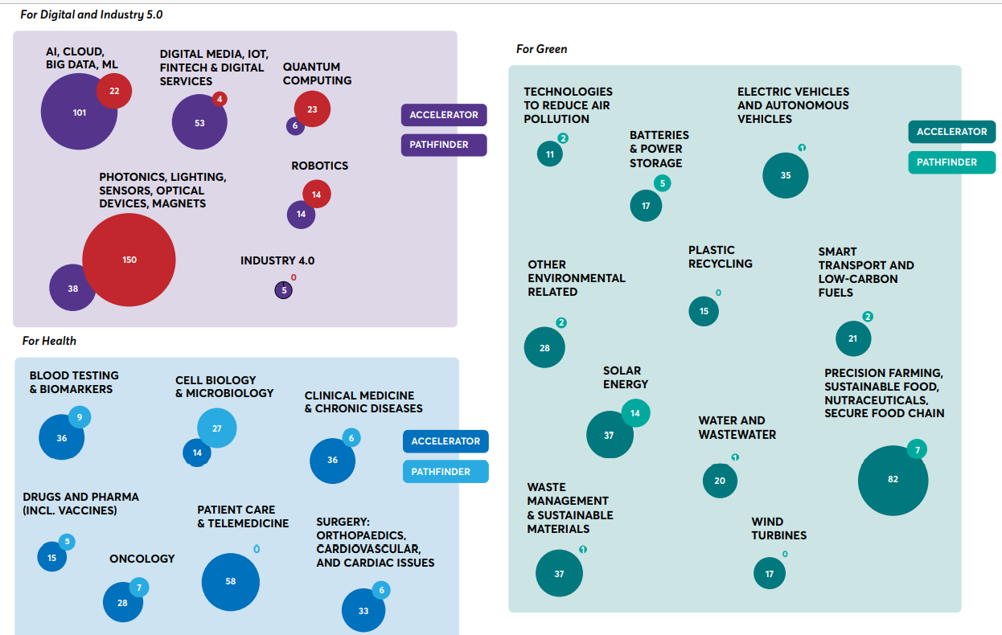
EIC PATHFINDER and ACCELERATOR Projects in main thematic portfolios [2018 – 2020 (ongoing)]
PATHFINDER

Slide 14
What does the EIC look like in Horizon Europe?

Slide 15
EIC Governance
EIC Board & President to set strategy, advise on work programme & implementation
EIC and SME Executive Agency (from 1 April 2021) to manage EIC activities
EIC Fund to manage equity investments in EIC supported companies
European Commission to appoint Board, adopt Work Programme, monitor implementation

Slide 16
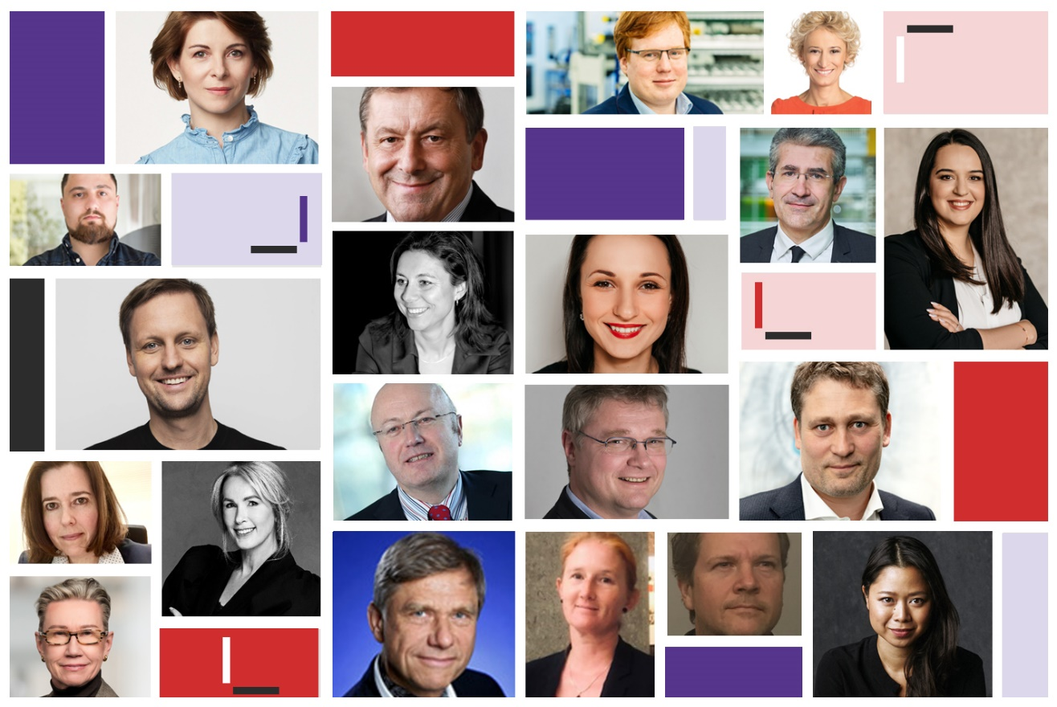
Establishment of EIC Board
Sli.Do: #EIC
Appointed on 18 November 2021 for 2 year mandate
Role to advise:
  EIC strategy,
  EIC work programme & implementation
  Broader innovation policy
Diverse expertise:
  Entrepreneurs, investors, researchers, innovation ecosystem
  Gender balance (parity), Geographic balance (20 nationalities)
First meeting on 26 November
EIC Board Statement to welcome Work Programme published 9 February

Slide 17
The EIC Board and its Working Groups
- WG improving participation of innovators from “widening countries”- to review the participation of EU “Widening countries”, including understanding behaviours, and recommend improvements
- WG communication, branding and strategic positioning - to discuss branding, outreach, and strategic positioning of EIC in the ecosystem and advise on the communication strategy – Chair
- Joint WG with the EIT Governing Board – to consolidate the Partnership with EIT, including reviewing progress under the MoU signed in January 2021 and recommend new actions.
- Joint WG with the ERC Scientific Council - to consolidate the Partnership with ERC, including to review actions so far and to recommend new actions.
- WG EIC Fund/ investments – to examine and advice on solutions for the EIC Fund, taking account of the constraints.

Slide 18
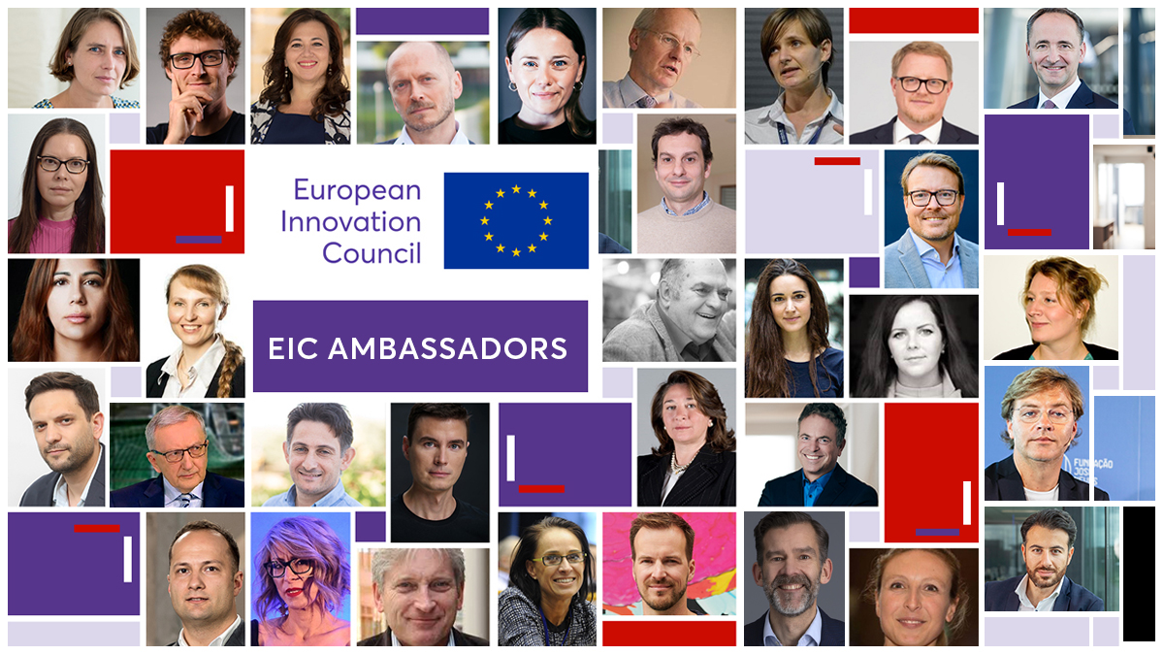
EIC Ambassadors
High level individuals form the innovation ecosystem who have direct experience of the EIC
Role to communicate about the EIC + provide feedback on improvements
First set of ambassadors nominated on 26 November 2021 (at EIC Summit)

Slide 19
The fully fledged EIC
One stop shop for breakthrough, deep-tech, market-creating innovators
Open to all innovators, in any field, at any time
Complemented by targeted funding on strategic challenges
Highly competitive for Europe’s high potential innovators
  Agile funding from idea to investment
Pathfinder for advanced research on emerging technologies
Transition from lab to commercial setting
Accelerator & EIC Fund to scale up innovations by start-ups & SMEs
  Building ecosystems and communities
Access to Business Acceleration Services (coaches, mentors, corporates, investors & knowledge partners)
EIC Programme Managers to develop visions for breakthroughs, manage portfolios, and connect to ecosystems
Crowding in other investors (VC, corporates, etc.)

Slide 20
EIC main instruments and characteristics
Pathfinder
Early stage research on breakthrough technologies
Grants up to €3/4 million
Successor of FET (Open & Proactive)
Focus on breakthrough, market-creating, deep-tech
Mainly bottom up complemented by targeted funding on strategic technologies/ challenges
Steered by EIC Board of leading innovators (entrepreneurs, investors, researchers, ecosystem)
Business Acceleration Services (coaches/ mentors, corporates, investors, ecosystem)
Pro-active management (roadmaps, reviews, re-orientations, etc) with EIC Programme Managers
Fast track access to Accelerator for results from EIC Pathfinder, EIT, ERC, Eurostars
Transition
Technology maturation from proof of concept to validation
Business & market readiness
Grants up to €2.5 million
Accelerator
Development & scale up of deep-tech/ disruptive innovations by startups/ SMEs
Blended finance (grants up to €2.5 million; equity investment up to €15 million)
Successor of SME instrument

Slide 21
EIC implementation in 2021
Accelerator - Open | Short applications - Apply any time Over 5000 in 2021 ~ 500 per month Cutoffs for full applications: 16 June ~ 800 applications, 135 interviews, 65 selected 6 October ~ 1000 applications, ~200 interviews, 99 selected | ~€593m (~grant/equity)
Accelerator – Challenges Green Deal innovations |  | ~€495m (~grant/equity)
Strategic technologies: digital & health
Pathfinder - Open | Deadline 25 May 868 proposals submitted 56 selected | ~€168m
Pathfinder - Challenges Awareness inside Measure & stimulate brain Cell & gene therapies Green Hydrogen Engineered Living Materials | Deadline 27 October 433 proposals submitted 39 selected | ~€132m
Transition – Open | 22 September 292 proposals submitted, 87 interviewed 45 selected | ~€60m
Transition – Challenges Medtech & devices Energy harvesting & storage |  | ~€40m

Slide 22
EIC main calls in 2022 - overview
Accelerator - Open | Short applications - Apply any time all year round Full applications – 3 cutoffs in 2022: 23 March – 74 projects selected 15 June – 76 projects selected 5 October | ~€623m (grant & equity)
Accelerator – Challenges Technologies for Open Strategic Autonomy (healthcare, critical raw materials, quantum, space, security etc) |  | ~€537m (grant & equity)
Technologies for ‘Fit for 55’ (energy, buildings, mobility, land use, green digital, etc)
Pathfinder - Open | Deadline: 4 May – 57 projects (consortia) retained | ~€183m
Pathfinder - Challenges Carbon dioxide & nitrogen management and valorisation; Mid-long term, systems-integrated energy storage; Cardiogenomics; Healthcare continuum technologies; DNA-based digital data storage; Alternative quantum information processing, communication, and sensing | Deadline: 19 October | ~€167m
Transition – Open | Apply any time all year round Full applications – 2 cutoffs in 2022: 4 May – 48 applicants retained for funding 28 September | ~€70.5m
Transition – Challenges Green digital devices for the future; Process and system integration of clean energy technologies; RNA-based therapies and diagnostics for complex or rare genetic diseases |  | ~€60.5m

Slide 23


Applying to the EIC Accelerator
STEP 1: Send your idea - short questionnaire, slidedeck, video pitch - any time (continuous)
First assessment by 4 evaluators (within 4 weeks)
Grant up to €2.5m
EIC Fund: due diligence on equity investment up to €15m
Business Acceleration Services
STEP 2: prepare a full application with support from EIC coaches & AI tool; submit to regular cutoff
Full assessment by 3 evaluators
(within 4 weeks)
GO
Seal of Excellence
Opportunities from other funders
Business Acceleration Services
STEP 3: Pitch in front of a Jury + answer questions
Interview with up to 6 EIC Jury Members
No GO,
Rejected
Possibility to resubmit (once)

Slide 25
Additional support for scaling up companies
EIC Accelerator call:
  Applicants can apply for investments above €15 million if in strategic area, and other sources of funding not available in Europe (Pilot in 2022 limited to 15% of budget)
EIC Scaleup 100 initiative:
  To identify 100 potential unicorns from EIC portfolio and national schemes
  To support with bespoke mentoring, matchmaking, marketing, etc
  (Follow up to EIC scalator pilot)
  High level expert group on late-stage scaleup financing:
  To assess the case for further actions

Slide 26

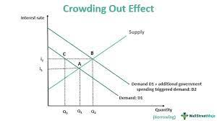
EIC Fund Strategy: the « crowd-in, not crowd-out » principle
The EIC was endowed the mission to « de-risk » innovative deep tech businesses based in Europe so that private capital market can take over as soon as possible. In case the level of risk is deemed too low, the EIC Fund does not invest.
In fact, alternative investors are never prevented to invest in EIC-supported companies, but invited to co-invest from the outset, and duly taken into account to design the EIC Fund exit strategy

Slide 27
Fast Track & Plug-in to the EIC Accelerator:
EIC’s broadest dimension
According to Horizon Europe regulation (article 48.6), projects whose excellence and impact have already been recognized can be directly submitted in the form of a full application (selection process step 2, skipping step 1).
In the case of an EIT Knowledge and Innovation Community (KIC), that is in charge of the preliminary project review and thus guarantees its quality, the Fast Track scheme applies.
In the case of a certified national or regional programme, that has the same responsabilities, the Plug-in scheme applies.

Slide 28
Three pathways to the EIC Accelerator
EIT KICs‘ projects
EIC Accelerator
(Step 2)
Fast Track
Certified national programmes’ projects
Plug in
Other projects
First Assessment (Step 1)
GO
Short proposal

Slide 29
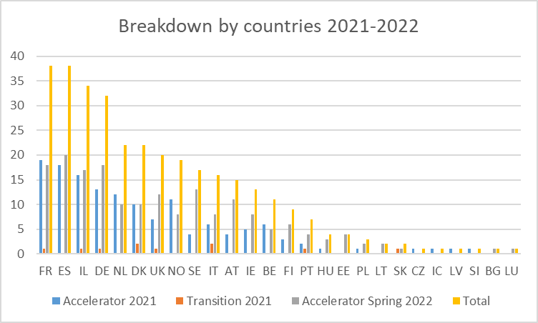
EIC Seals of Excellence under Horizon Europe: already 334 Seals awarded

Slide 30
@EUeic
#Eueic

