Slide 1
EURAXESS
4th Informal Working Group Meeting on Research and Innovation,
Tbilisi, Georgia, 20 October 2022
Slaven Misljencevic
DG Research & Innovation
European Commission

Slide 2
EURAXESS
WHAT
a European portal with a jobs, funding and hosting database
43 European complementary national portals;
43 National hubs with more than 600 associated Service centers
9 Worldwide hubs
WHEN
Launched 17 years ago (formerly known as ERA-MORE)
WHERE
Europe (43 countries) and Worldwide (9 hubs: Africa, ASEAN, Brazil, China, India, Japan, Latin America and the Caribbean, Korea and North America)
WHY
To remove the barriers to researchers’ mobility & support career development
To create conditions for open, transparent merit-based recruitment
To promote cooperation between research performing organisations
To foster attractive careers across Europe and beyond

Slide 3
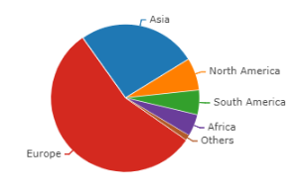
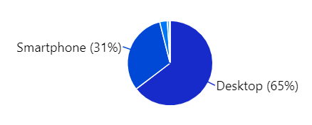
CENTRAL EURAXESS PORTAL
EURAXESS Portal
EURAXESS Services Network
EURAXESS Worldwide
EURAXESS
43 National Portals
20000+ registered organisations
60000+ researchers using the platform
80000+ job offers published yearly (average)
Visitors from 223 countries all over the world
17.417.186 PAGE VIEWS
3.427.505 SESSIONS
1.713.493 VISITORS

Slide 4
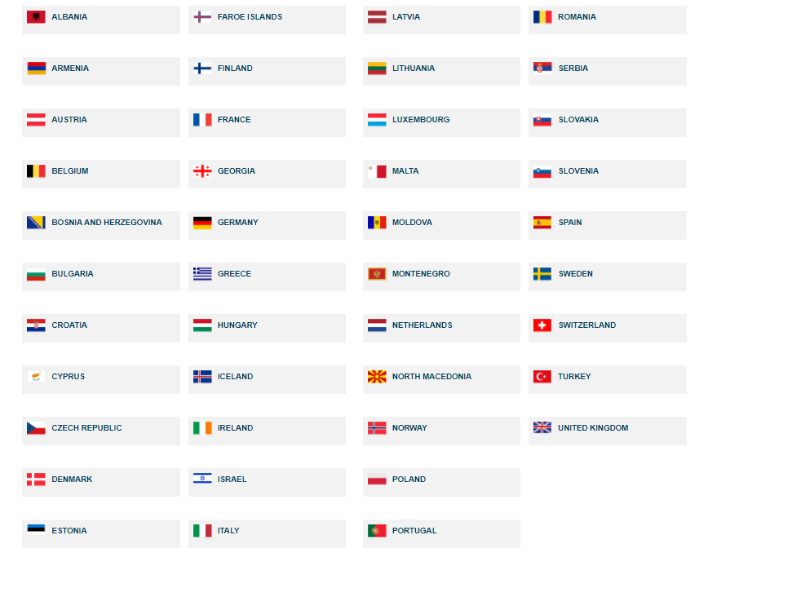
NATIONAL EURAXESS PORTALS
43 countries
600+ service centres
18 topics of support (VISA, pension, taxes etc.)
Country-specific information
Career development
Info days & other relevant events
Researcher networking & community building
>450.000 requests addressed yearly
EURAXESS Portal
EURAXESS Services Network
EURAXESS Worldwide
EURAXESS
43 National Portals
EURAXESS Portal
EURAXESS Services Network
EURAXESS Worldwide
EURAXESS
43 National Portals

Slide 5
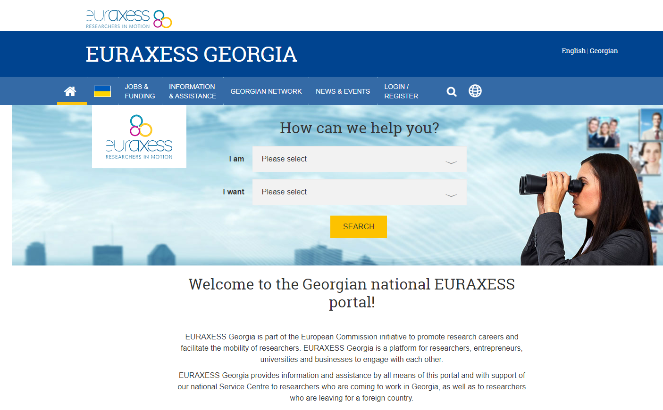
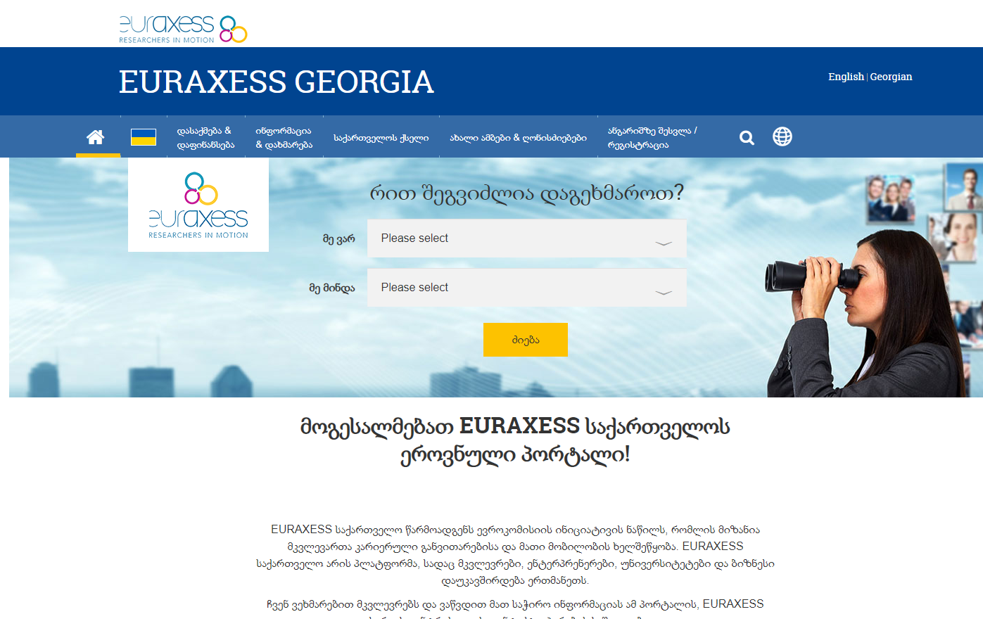
GEORGIA NATIONAL EURAXESS PORTAL
https://www.euraxess.ge/

Slide 6
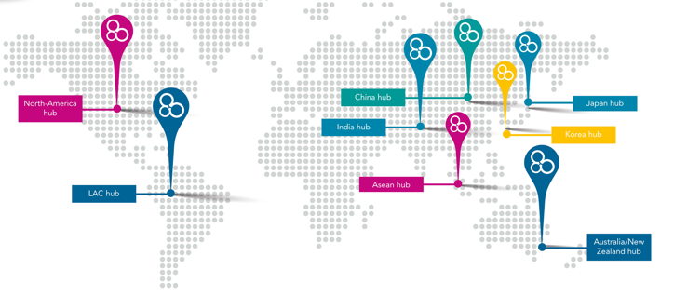
EURAXESS WORLDWIDE
EURAXESS Portal
EURAXESS Services Network
EURAXESS Worldwide
EURAXESS
43 National Portals
EURAXESS Portal
EURAXESS Services Network
EURAXESS Worldwide
EURAXESS
43 National Portals
Africa
ASEAN
Brazil
China
India
Japan
Latin America & the Caribbean
Korea
North America
200+ events organised yearly
32.500 participants to online events in 2020
46.000 researchers registered in the Worldwide community

Slide 7
FOLLOW US
SEARCH AND LIKE EURAXESS ON SOCIAL MEDIA
BROWSE THE PORTAL & CREATE YOUR ACCOUNT FOR FREE
QUESTIONS? SEND AN EMAIL TO THE FUNCTIONAL MAILBOX
RTD-ERA-TALENT-PLATFORM@ec.europa.eu

Slide 8
THANK YOU!

