Slide 1
How to increase participation in MSCA
Marija Fedotovaite
European Commission

Slide 2
Horizon Europe
EURATOM
EU Framework programme for research & innovation
Fusion
Pillar I
Excellent Science
Pillar II
Global Challenges & European Industrial Competitiveness
Pillar III
Innovative Europe
European Research Council
Health
Culture, Creativity & Inclusive Society
Civil Security for Society
Digital, Industry & Space
Climate, Energy & Mobility
Food, Bioeconomy, Natural Resources, Agriculture & Environment
European Innovation Council
Fission
2021-2027
Marie Skłodowska-Curie Actions
Clusters
European Innovation Ecosystems
EUR 6.6 billion
Research Infrastructures
European Institute of Innovation & Technology*
Joint Research Centre
Joint Research Center
Widening Participation and Strengthening the European Research Area
Widening participation & spreading excellence
Reforming & Enhancing the European R&I system
Budget: EUR 95.5 billion
Notes:
Research, science and innovation are pushing our societies and economies forward. New knowledge improves all aspects of our life. The first pillar of Horizon Europe - Excellent Science - supports frontier research and breakthrough scientific ideas, teams up the best researchers from Europe and beyond and equips them with skills and word-class research infrastructures.

Slide 3
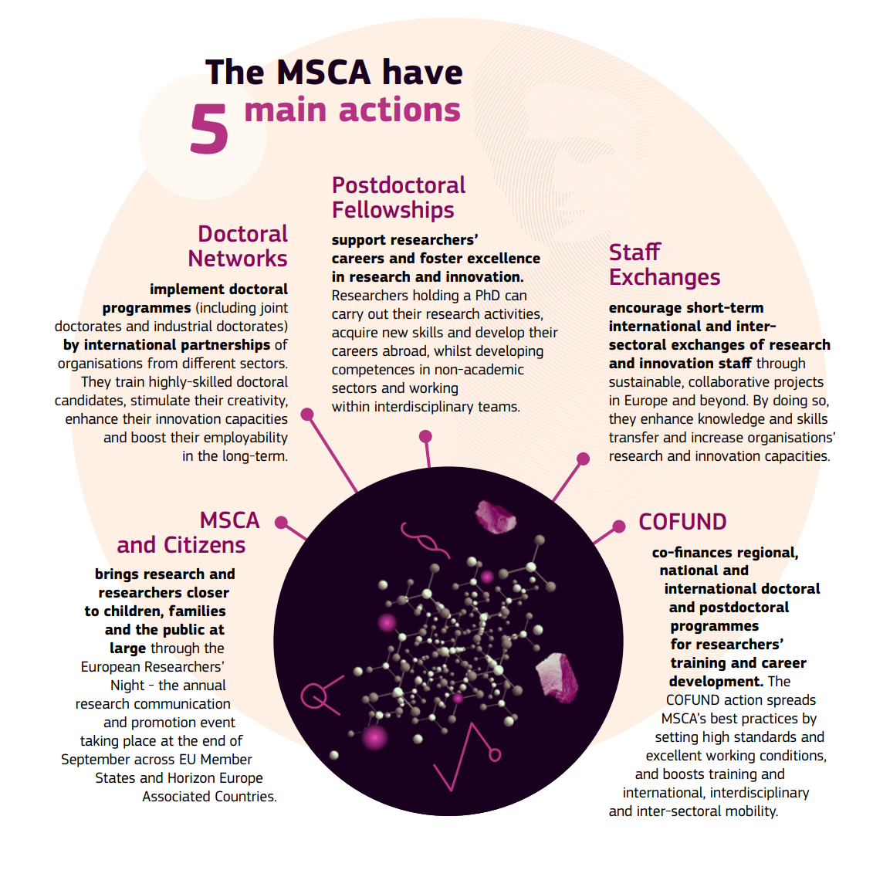
12 Nobel Prize winners involved in the MSCA between 2012 and 2020
Home | Marie Skłodowska-Curie Actions (europa.eu)

Slide 4
Key features
Researchers’ training, skills and career development (all stages of career)
Attractive working and employment conditions
Structuring impact on organisations through excellent programmes
Excellent research in all domains (bottom-up approach)
International, cross-sectoral & interdisciplinary mobility
Strong collaboration beyond academia

Slide 5
EaP in MSCA H2020
Country | Organisations | Incoming Researchers | Outgoing Researchers
Armenia | 8 | 72 | 75
Azerbaijan | 6 | 40 | 66
Georgia | 9 | 42 | 56
Moldova | 12 | 48 | 80
Ukraine | 52 | 277 | 780
Over 15 million EUR awarded to EaP organisations
The overwhelming majority of participations are in RISE
Only few IF and ITN placements
In Horizon Europe 23 organisations from EaP, majority in Staff Exchanges

Slide 6
Associated Partner VS Beneficiary
Associated partner
Contributes to the project (e.g. hosts staff or researchers)
Does not directly receive funding
Does not sign the Grant Agreement
Beneficiary
Signs the Grant Agreement with the EU
Minimum number and geographical requirements
Receives funding directly
Organisations can be from the academic or non-academic sector!

Slide 7
MSCA Doctoral Networks
MSCA Doctoral Networks implement doctoral programmes, by partnerships of
universities, research institutions and research infrastructures, businesses including SMEs, and other socio-economic actors from different countries across Europe and beyond. MSCA. Doctoral Networks are open to the participation of organisations from third countries, in view of fostering strategic international partnerships for the training and exchange of researchers.
Raise the attractiveness and excellence of doctoral training in Europe. They will equip researchers with the right combination of research-related and transferable competences and provide them with enhanced career perspectives in both the academic and non-academic sectors through international, interdisciplinary and inter-sectoral mobility.

Slide 8
MSCA Postdoctoral Fellowships
Enhance the creative and innovative potential of researchers holding a PhD and who wish to acquire new skills through advanced training, international, interdisciplinary and intersectoral mobility.
Fellowships will be provided to excellent researchers, undertaking international
mobility either to or between EU Member States or Horizon Europe Associated Countries, as well as to non-associated Third Countries.
Non-associated countries can take part as Associated Partners and host secondments.

Slide 9
European Research Area (ERA) Fellowships
The ERA Fellowships provide specific support to researchers of any nationality to undertake their fellowship in a widening country;
Increased attractiveness for researchers to entities in widening countries, by providing competitive grants and spreading attractive working and employment practices;
More postdoctoral researchers attracted to widening countries, including members of diaspora
Proposals submitted for MSCA PF call are not selected for funding automatically resubmitted for ERA fellowships

Slide 10
MSCA Staff Exchanges
MSCA Staff Exchanges promote innovative international, inter-sectoral and interdisciplinary collaboration in research and innovation through exchanging staff and sharing knowledge and ideas at all stages of the innovation chain.
The scheme fosters a shared culture of research and innovation that welcomes and rewards creativity and entrepreneurship and helps turn ideas into innovative products, services or processes. It is open to research, technical, administrative and managerial staff supporting R&I activities

Slide 11
MSCA COFUND
MSCA COFUND co-finances new or existing doctoral programmes and postdoctoral fellowship schemes with the aim of spreading the best practices of the MSCA including international, inter-sectoral and interdisciplinary research training, as well as transnational and cross-sectoral mobility of researchers at all stages of their career.
Provides complementary funding for doctoral or postdoctoral programmes managed by entities established in EU Member States or Horizon Europe Associated Countries. Those co-funded programmes must follow MSCA’s good practice in terms of international recruitment and minimum standard of employment for the recruited fellows as described in the European Charter and Code.

Slide 12
MSCA4Ukraine
Support displaced researchers from Ukraine, and enable them to continue their research activities;
Host organisations established in EU Member States or Horizon Europe Associated Countries, including Moldova;
Open to academic and non-academic organisations;
Call foreseen to be launched at the end of September.
Eligible researchers
Ukrainian nationals, stateless persons, or nationals from third countries other than Ukraine;
displaced on or after 24 February 2022, or are ready to be displaced from Ukraine;
doctoral candidates (i.e. enrolled in a doctoral programme at a higher education institution in Ukraine, leading to the award of a doctoral degree) or postdoctoral researchers (i.e. in possession of a doctoral degree by the time the fellowship is set to begin).

Slide 13
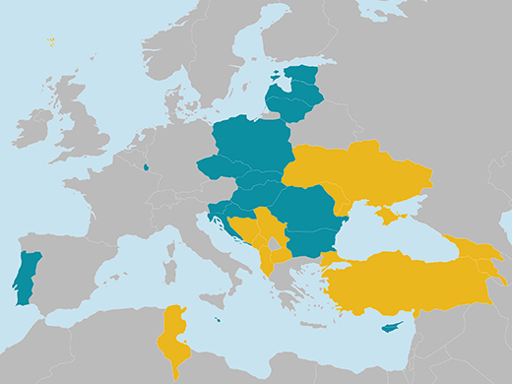
Opportunities for widening countries
Challenges to fully engage and uneven brain circulation
MSCA offers support measures to widening countries:
Dedicated support to NCPs
MSCA Seal of Excellence
ERA Fellowships
Notes:
Widening countries, however, have faced challenges to fully engage in the MSCA so far, with Southern and Eastern Member States experiencing a certain degree of brain drain. This is not a specificity of the MSCA, but a more general problem induced mainly by framework conditions.
To better support widening countries, the MSCA offer a series of measures:
→ dedicated support for National Contact Points in widening countries to improve guidance, boost participation and help them make a better use of MSCA as a tool to attract excellent researchers, including their diaspora;
→ the MSCA Seal of Excellence encourages the use of regional, national or European Structural and Investment Funds to fund researchers with very high quality proposals to the MSCA PF and COFUND Calls, but which could not be funded due to budget constraints, contributing to a more balanced circulation of knowledge and skills;
→ ERA fellowships after a successful a three-year pilot for Widening Fellowships (2018-2020) as specific support for excellent researchers not funded through the MSCA, to undertake an individual fellowship in a widening country led to a significant increase in applications and in the number of funded fellowships in widening countries

Slide 14
Takeaways
Capitalise on your previous experience in H2020
Excellence on the same footing as inclusiveness
Horizon Europe provides tools to increase competiveness but the responsibility remains within the countries how to effectively employ them
Adopting national strategy for researchers training and mobility and ensuring effective implementation
Role of National Contact Points - recommendations for Widening NCPs
Attracting back diaspora
ERA fellowships Widening fellowship successor
Dedicated MSCA Seal of Excellence schemes for postdoctoral researchers

Slide 15
Thank you!
# HorizonEU #MSCA
@MSCActions
https://ec.europa.eu/research/mariecurieactions/

