Slide 1
The European Research Council
How to make a better use of ERC funding instruments
Giuliano Scalzi
Call and Project Follow-up coordination Unit
© Art & Build Architect / Montois Partners / credits: S. Brison

Slide 2
ERC Basics:
1 researcher, 1 Host Institution, 1 project, 1 selection criterion

Slide 3
ERC Grant Schemes
Starting Grants
starters (2-7 years after PhD) up to € 1.5 Mio
for 5 years
Consolidator Grants
Consolidators (7-12 years after PhD) up to € 2 Mio
for 5 years
Advanced Grants
track-record of significant research achievements in the last 10 years up to € 2.5 Mio
for 5 years
Synergy Grants
2 – 4 Principal Investigators up to € 10.0 Mio for 6 years 1 PI can be based outside EU/AC
Proof-of-Concept
bridging gap between research - earliest stage of marketable innovation lump sum €150,000 for ERC grant holders

Slide 4
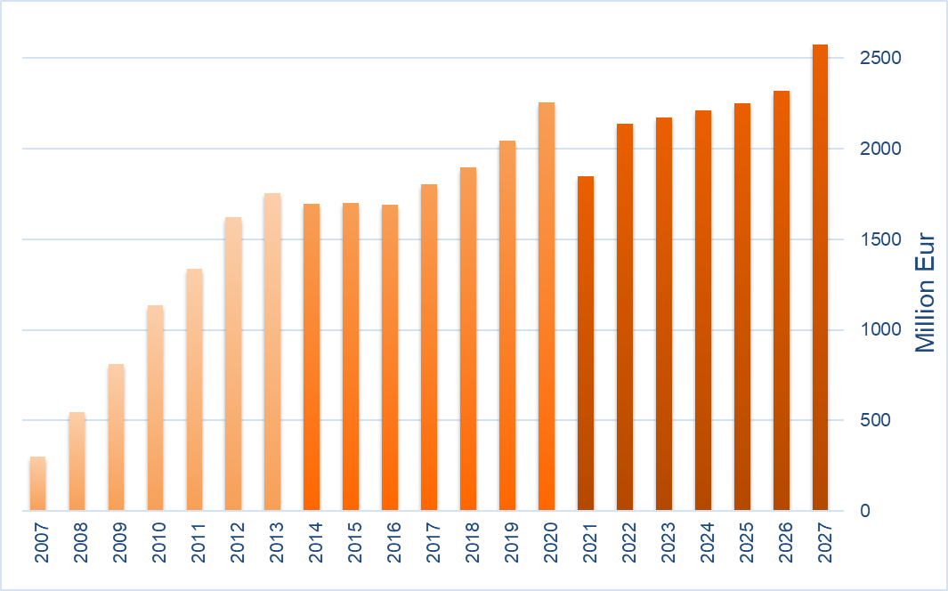
ERC Budget 2007 – 2027: EUR 36.5 billion
FP7: €7.5 billion
H2020: €13 billion
HE: €16 billion

Slide 5
Why Should one Apply for an ERC grant?
Research topic of own choice, with a team of own choice
True financial autonomy for 5 years (6 years for Synergy Grants)
Negotiate with the host institution the best conditions of work
Attract top team members (EU and non-EU) and collaborators
Portability of grants within Europe
Attract additional funding

Slide 6
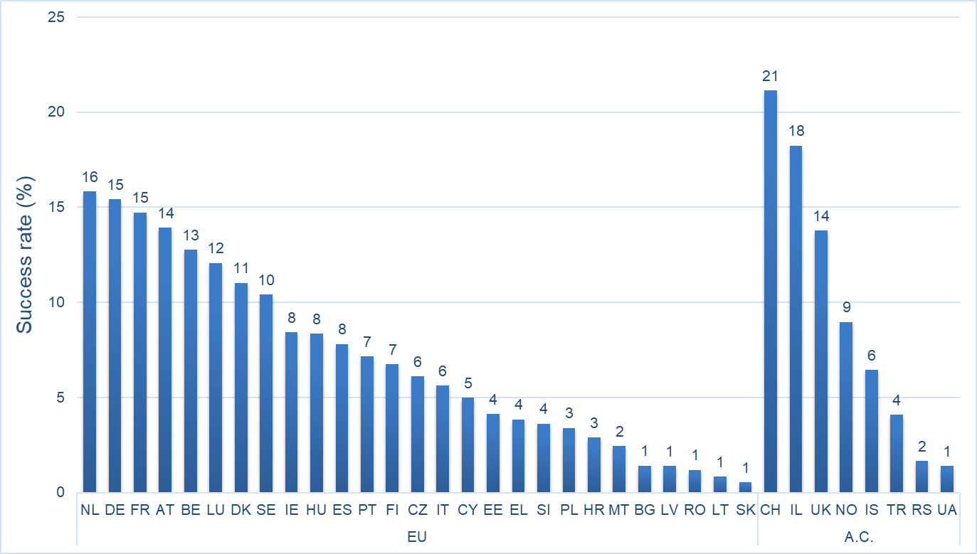
Success Rate by Country of Host Institution
Success rate (2007-2021)

Slide 7
Evaluated proposals from HI in EP countries
Only one funded proposal in Ukraine:
Prof. Pavlo MYKHAILIUK
CoG 2020 PE5
Title of project: Saturated bioisosteres of benzene and their application in drug design
Host institution Enamine LtD.
https://enamine.lookchem.com/
Submissions from 2018-2021 | HI | Nationals
Georgia | 33 | 40
Ukraine | 49 | 119
Armenia | 7 | 13
Moldova | 3 | 3
total | 92 | 175
Nationals of EP countries holding an ERC grant in other ERA countries
Nationals | Signed Grant
Georgia | 2
Ukraine | 21
Armenia | 1
Moldova | 1
total | 25

Slide 8
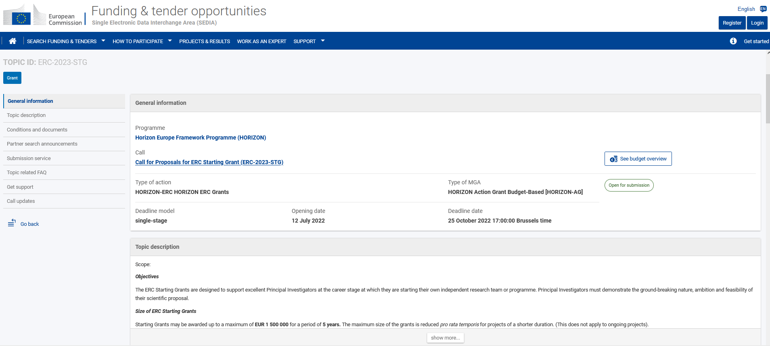
Step 1: Get the information (early on)!
Register early, get familiar with the European Commission's Funding and Tender portal and download the templates
https://ec.europa.eu/info/funding-tenders/opportunities/portal/screen/home
Read the call documents (Information for Applicants, Work Programme, Frequently Asked Questions) that explain how to prepare your proposal
National Contact Points
Talk to ERC grantees
Notes:
10/14/2022
8

Slide 9
Step 2: make sure you are eligible!
Eligibility window calculated according to the 1st of January of the year of the Call.
Extensions of eligibility window possible for StG and CoG for documented cases of:
Maternity – 18 months per child (before or after PhD)
Paternity – actual time taken off
Military service
Medical specialty training
Caring for seriously ill family members
No limit to the total years of extension
Notes:
9

Slide 10
Step 3: Decide whether to apply
Rumour: I should wait until the end of the eligibility window in order to accumulate enough seniority: only then I will be competitive.
NOT true: The success rate is virtually flat across the eligibility window (StG, CoG).
Notes:
There is no evidence whatsoever that older, more senior candidates have a higher acceptance rate. The age distribution of grantees is roughly binomial with a median of 35 years. For advanced grantees only the preceding 10 years are considered, not life-time achievements.

Slide 11
Step 4: Choose your Panel
Evaluation Panel Structure (2021-2023)
Physical Sciences & Engineering
PE1 Mathematics
PE2 Fundamental Constituents of Matter
PE3 Condensed Matter Physics
PE4 Physical and Analytical Chemical Sciences
PE5 Synthetic Chemistry and Materials
PE6 Computer Science and Informatics
PE7 Systems and Communication Engineering
PE8 Products and Process Engineering
PE9 Universe Sciences
PE10 Earth System Science
PE11 Materials Engineering
Life Sciences
LS1 Molecules of Life: Biological Mechanisms, Structures and Functions
LS2 Integrative Biology: From Genes and Genomes to Systems
LS3 Cellular, Developmental and Regenerative Biology
LS4 Physiology in Health, Disease and Ageing
LS5 Neuroscience and Disorders of the Nervous System
LS6 Immunity, Infection and Immunotherapy
LS7 Prevention, Diagnosis and Treatment of Human Diseases
LS8 Environmental Biology, Ecology and Evolution
LS9 Biotechnology and Biosystems Engineering
Social Sciences and Humanities
SH1 Individuals, Markets and Organisations
SH2 Institutions, Governance and Legal Systems
SH3 The Social World and Its Diversity
SH4 The Human Mind and Its Complexity
SH5 Cultures and Cultural Production
SH6 The Study of the Human Past
SH7 Human Mobility, Environment, and Space
Transfer of proposals may happen only in the best interest of the applicant

Slide 12
Step 5: Start writing
PART A – Administrative forms online
Section 1 Proposal and PI info
Section 2 Host Institution info
Section 3 Budget
Section 4 Ethics and Security
Section 5 Call-specific Questions
PART B1 – submitted as .pdf
Abstract and Cross-Panel explanation 1 p.
Extended Synopsis 5 p.
(Recommended Model) CV 2 p.
Funding ID 1 p.
Track Record 2 p.
Seen by the panel
Annexes – submitted as .pdf
Statement of support of HI
copy of PhD or equiv. (StG & CoG)
If applicable:
document for extension of eligibility
window (StG & CoG)
explanatory info on ethical issues
PART B2 – submitted as .pdf
Scientific Proposal 14 p.
Resources (budget) 2 p.
Notes:
10/08/12
12

Slide 13
DORA principles adopted by the Scientific Council
Review of funding strategy in light of DORA principles discussed by the Standing Committee on Panels. Regarding the WP the following advice was integrated in the text:
Journal Impact Factor not accepted anymore among the field relevant bibliometric indicators that may be included as part of the publications track record required for applications to the main frontier research grants,
The track record should specify that the list of achievements under each Principal Investigator profile is not exclusive, other types of achievements can be included if relevant to the research field and project proposal,
Within the existing proposal template and page limits, Principal Investigators can provide a short narrative description of the scientific importance of the research outputs submitted as part of the proposal, and of the role that the Principal Investigator played in their production.

Slide 14
Step 6: Proof-read and Submit
A submitted proposal can be revised until the call deadline by submitting a new version and overwriting the previous one.
Once you submit, all you need to do is wait!
It's our turn to do the work!
Notes:
10/08/12
14

Slide 15
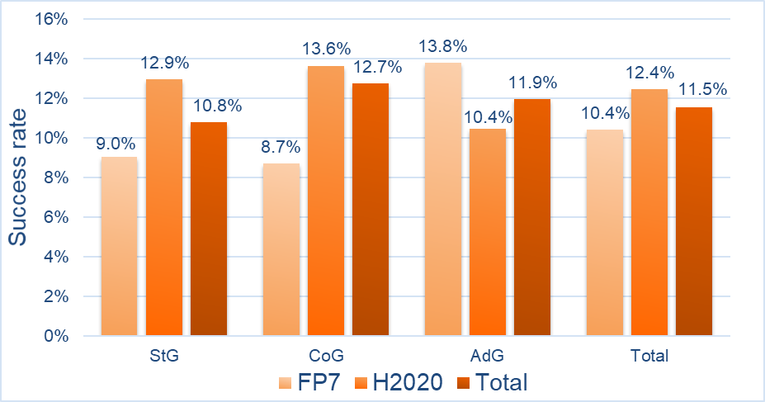
ERC Success Rate

Slide 16
ERC Widening Participation Policy

Slide 17
ERC Visiting Fellowship Programmes (VFP)
ERC promotes the efforts of national and regional authorities that set up and fund mobility programmes to allow potential ERC candidates to visit and gain experience with ERC-funded teams
VFP in few points:
Duration of visits 1-6 months
Visiting fellows commit to apply for an ERC grant in specified timeframe
Visiting fellows need to have a letter of support of the proposed host researcher and institution when applying
National/regional funding agencies cover the travel and salary costs of the fellows for the duration of the visit

Slide 18
ERC VFP participation
12 countries/regions participate(d) in the scheme:
Czech Republic
Estonia
Poland (not participating since 2020)
Slovenia
Belgium (Flanders region)
Slovak Republic
Croatia
Georgia
Hungary (re-joined in 2022)
Romania
Republic of Serbia
Italy
StG2017

Slide 19
ERC Mentoring Initiative
ERC wishes to contribute to national programmes that support ERC applicants in less performing countries
These national programmes often lack access to international expertise to mentor ERC applicants
To address the problem, ERC identifies a pool of mentors among its grantees and former evaluators, available to provide training, scientific feedback, and other forms of mentoring to ERC applicants in less performing countries
How: ERC launches yearly calls for interest among its grantees and former evaluators. The list is provided to target countries via the National Contact Points

Slide 20
Last but not least…..
If rejected, KEEP TRYING!!!!!
Reapplications have a much higher success rate
Benefit of using feedback from evaluation reports
Notes:
Writing a good proposal is a learning process, do not give up!

Slide 21
Thank You!
More information: https://erc.europa.eu/funding/additional-opportunities
ERC MI support: ERC-MENTORING-INITIATIVE@ec.europa.eu
ERC VFP support: ERC-VISITING-FELLOWSHIP-PROGRAMMES@ec.europa.eu
National Contact Point: erc.europa.eu/national-contact-points
Follow us on
www.facebook.com/EuropeanResearchCouncil
twitter.com/ERC_Research
www.linkedin.com/company/european-research-council
https://www.youtube.com/c/EuropeanResearchCouncil
Notes:
I will leave you mentioning that the VFP 2023 internal call for expression of interest will be launched in June and will stay open one month.
You can find more info regarding the ERC mobility programmes and the MI on our additional opportunities web page and you can always contact our FMB.
Thank you for your attention!

Slide 22
Thank You!
More information: erc.europa.eu
National Contact Point: erc.europa.eu/national-contact-points
Sign up for news alerts: erc.europa.eu/keep-updated-erc
Funding & Tender Opportunities: https://ec.europa.eu/info/funding-tenders/opportunities/portal/screen/home
Follow us on
www.facebook.com/EuropeanResearchCouncil
twitter.com/ERC_Research
www.linkedin.com/company/european-research-council
https://www.youtube.com/c/EuropeanResearchCouncil

Slide 23
The ERC for Refugees Initiative
In March 2022 ERC appealed its grantees to provide temporary employment to refugee researchers fleeing Ukraine.
ERC contacted its 5,600 current grantees and collected information on possible job opportunities.
The data was compiled and published on the ERC website and other channels.
It is up to the refugee researchers to apply and up to the PI to decide whether to select them or not, depending on project’s requirements.

Slide 24
Results as of Today
550 ERC grantees have offered job openings to Ukrainian refugees.
70 have provided feedback. Over 40 of them have been contacted by at least one refugee.
More than 110 refugees have contacted these 40+ ERC grantees and more than 70 refugees applied for the job openings advertised.
The interested refugees have a wide range of scientific profiles and experience. Most are postdocs, visiting researchers and PhD students.
At least 14 refugees received an offer. Seven are still in the evaluation process.

Slide 25
Objectives of Widening participation policy
To capitalise on the full European potential for frontier research without departing from the ERC's principle of excellence
Contribute to a truly inclusive European culture of competitiveness in science
Strengthen participation in ERC calls by researchers from less research-performing regions
Facilitate policy dialogue with relevant stakeholders to promote national and local support to promising scientists in less research-performing regions
│ 25
Notes:
25

Slide 26
How: Inspiring Reform
11 Widening Countries introduced initiatives to finance their best unfunded ERC applicants.
A number of countries established funding schemes inspired to the ERC model.
Ex:In Poland the National Science Centre (NCN) has been set up in 2010 to fund basic research, with ERC as an explicit model

Slide 27
How: Concrete Measures
Continuously monitoring the participation to the ERC calls and the success rates
Guaranteeing a fair evaluation processes in view of optimal inclusiveness
Raising awareness on ERC among potential applicants and host institutions
Providing recommendations to national policy-makers, such as:
support ERC finalists with national funding
support ERC applicants improve their proposals
make participation in ERC calls an essential component in national evaluations
ensure a truly and competitive academic environment

Slide 28
ERC Mentoring Initiative - 2
Participants in 2021:
Cyprus (Research and Innovation Foundation; coordinates NCPs)
Czech Republic (Czech National Expert Group; closely cooperates with the NCP)
Estonia (The Estonian Research Council; plays the role of the NCP)
Hungary (Hungarian Academy of Sciences; hosts NCP)
Italy (Italian National Research Council; will operate through NCPs)
Malta (Malta Council for Science and Technology; plays the role of the NCP)
Poland (NCP through NCBR, NCN, and FNP)
Slovakia (Horizon National Office in Slovakia)
Turkey (TUBITAK; plays the role of the NCP)

Slide 29
The ERC for Refugees Initiative

Slide 30
Evaluated proposals from HI in EP countries
Submissions from 2018-2021 | HI | Nationals
Georgia | 33 | 40
Ukraine | 49 | 119
Armenia | 7 | 13
Moldova | 3 | 3
total | 92 | 175
Only one funded proposal in Ukraine:
Prof. Pavlo MYKHAILIUK
CoG 2020 PE5
Title of project: Saturated bioisosteres of benzene and their application in drug design
Host institution Enamine LtD.
https://enamine.lookchem.com/
Nationals of EP countries holding an ERC grant in other ERA countries
Nationals | Signed Grant
Georgia | 2
Ukraine | 21
Armenia | 1
MD | 1
total | 25

Slide 31
Statement by the ERC Scientific Council – 8 March 2022
We, the ERC Scientific Council, condemn the Russian attack on Ukraine. We express our strongest support for Ukraine and its scientific community.
We applaud those, including many courageous Russian scientists, who have spoken out against this war. Many European research institutions are offering to host researchers from Ukraine who have had to flee their country. We encourage this and other support initiatives - they all make a difference.
We are reminded at this time that the scientific community must stand together and show solidarity.

