Slide 1
New European Research Area:
ERA Policy Agenda
2022-2024
Anna Seip,
DG R&I,
Unit.A2 – ERA Governance & Implementation

Slide 2
A new vision for the European Research Area (ERA)
What is the new ERA?
What are the objectives of the new ERA?
Boost market uptake
Strengthen the mobility of researchers and free flow of knowledge and technology
Prioritise investments in research and innovation
Widening: Improve access to excellence
Notes:
The European Research Area (ERA) is the ambition to create a single, borderless market for research, innovation and technology across the EU.
It was launched in 2000 and the process to revitalise it began in 2018.
Rationale: slowing progress towards the ERA objectives, e.g. EU R&D investment is at 2.19% of GDP in 2018, still far from its 3% target; new challenges for R&I policy, Covid-19 and the green and digital transition
Prioritising investments and reforms: requires better analysis and simplifying anthe interplay between national and European R&I systems; principle of excellence as the cornerstone of all investments (the best researchers with the best ideas obtain funding)
Translating R&I results into the economy: improving the environment for business R&I investments
Improving access to excellence: reduce the R&I divided and increase the cohesion among all Member States, based on Horizon Europe measures
Deepening the ERA: from coordination to deeper integration between national policies, connect actors and help them develop the right skills

Slide 3
European Research Area 2020 - 2022
2020
January 2021
16 July 2021
26 November 2021
2022
Commission Communication “A new ERA for Research and Innovation”, September
Council Conclusions on the new ERA , December
Establishment of the ERA Forum for Transition
13 meetings
Three workshops and R&I Days side event with ERA stakeholder umbrella organisations
Some covered topics: ERA governance framework, ERA policy agenda, four ERA pilot actions
Commission adopts proposal for a “Pact for Research and Innovation in Europe”
Principles for R&I in Europe
Priority areas for ERA joint actions
Investments and reforms
Simplified policy coordination
Council Recommendation on a “Pact for Research and Innovation in Europe”
Council conclusions on the new ERA governance & the first ERA policy Agenda (2022-2024)
Establishment of the new ERA Forum to implement the actions of the ERA Policy Agenda
Notes:
Plan for relaunching the ERA, including a roadmap of key actions
Confirmation of the vision
ERA Forum for Transition:
Provide advice on the future ERA governance frameowrk, on the Pact for R&I and to co-create the first ERA policy Agenda

Slide 4
Policy Framework
Pact for research and innovation in Europe
ERA Policy Agenda
Pact for research and innovation in Europe
ERA Governance
ERA Monitoring
ERA Governance
ERA Forum
(+ subgroups)
New ERA governance
10 values and principles
4 priority areas
Deepening ERA
Broadening ERA and relevance
Amplifying access to excellence
Advancing R&I investments and reforms
Research and development targets
Designed to contribute to the priority areas of the Pact for R&I, setting out the voluntary ERA actions which are defined and coordinated at Union level.
20 actions for 2022-24
Ensure a proper basis for evidence informed policy making
Provide evidence and analysis
Expert group for coordination and implementation of the ERA, together with EU countries, Associated countries and stakeholders
ERAC
high-level strategic policy body, providing advice
Decision making
“Owner” of Policy Agenda
Council

Slide 5
ERA Policy Agenda: 20 actions along four priority areas
DEEPENING A TRULY FUNCTIONING INTERNAL MARKET FOR KNOWLEDGE
TOGETHER FOR TWIN GREEN AND DIGITAL TRANSITION, AND INCREASING SOCIETY’S PARTICIPATION IN THE ERA
AMPLIFYING ACCESS TO RESEARCH AND INNOVATION EXCELLENCE ACROSS THE UNION
Open sharing of knowledge, incl. EOSC
Data legislation fit for research
Reform of research assessment
Strengthen research careers
Gender equality and inclusiveness
Protect academic freedom
Better knowledge valorisation
Research infrastructures
International cooperation, reciprocity
R&I Missions and Partnerships for ERA
Green energy transformation
Transition of industrial ecosystems
Empower higher education institutions
Bring science closer to society
Regional and national R&I ecosystems
EU-wide access to excellence
Strategic capacity of public RPOs
ADVANCING CONCERTED R&I INVESTMENTS AND REFORMS
Coordination national support for ERA
ERA monitoring mechanism
Prioritisation and coordination of R&I investments and reforms
Notes:
The ERA Policy Agenda sets out voluntary ERA actions for the period 2022-2024 to contribute to the priority areas for joint action defined in the Council Recommendation on a Pact for Research and Innovation in Europe).
It is a first step to address/translate the priority areas set out in the Pact for R&I into concrete actions. Subsequent editions of the ERA Policy Agenda will further complement these actions and translate other priority areas into action in the long term.

Slide 6
Pact Priority Area: Deepening the ERA
Deepening a truly functioning internal market for knowledge
Open sharing of knowledge, incl. EOSC
Data legislation fit for research
Reform of the research assessment system
Strengthen research careers
Gender equality and inclusiveness
Protect academic freedom
Better knowledge valorisation
Strengthen research infrastructures
Promote international cooperation
Notes:
Four broad priority areas of the Pact and how they have been translated into concrete actions:
Each of them has an explanatory document to show in more detail what is envisioned, which is the basis of discussion
Span a wide area of topics, co-created between different units, sometimes across the DGs and with MS
Action 3:
Current research assessment system often relies on ver narrow measures of quality, e.g. number of publications and their journal impact factors
Instead: want qualitative judgement with peer-review
Action: creation of European research funders‘ and research performers coalition drafting an agreement on reforming the research assessment; implementation plan of the coalitioni, analysis of legal and administrative barriers

Slide 7
Pact Priority Area: Broadening the ERA
Taking up together the challenges posed by the twin green and digital transition, and increasing society’s participation in the ERA
R&I Missions and Partnerships for ERA
Green energy transformation
Transition of industrial ecosystems
Empower higher education institutions
Bring science closer to society
Notes:
Action 13:
Higher education sector has an essential role to play in Europe‘s post-pandemic reovery and shaping sustainable societies and economies
Follows the European Strategy for universities and aims at:
Supporting more inclusive and deeper cooperation between higher education institutions
Aligning EU countries‘ efforts to strengthen global competititiveness
(study, policy support through mutual learning exercises, task force with experts, WIDERA programme)

Slide 8
Pact Priority Area: Widening the ERA
Amplifying access to research and innovation excellence
across the Union
Regional and national R&I ecosystems
EU-wide access to excellence
Strategic capacity of Europe’s public research performing organisations
Notes:
- Reducing the research and innovation divide in Europe

Slide 9
Pact Priority Area: Prioritising investments and reforms
Advancing concerted research and innovation investments and reforms
Coordination national support for ERA
ERA monitoring mechanism
Prioritisation and coordination of R&I investments and reforms
Notes:
Action 19: review an dupdate the ERA monitoring system to better capture progress made towards the indivual ERA priorities and for evidence-based policy-making
Several elements:
Online policy platform: for reporting on the implemenetation of the action
ERA scoreboard and dashboard to monitor progress
Reports on the implementation of the ERA Policy Agenda

Slide 10
ERA Monitoring Process

Slide 11
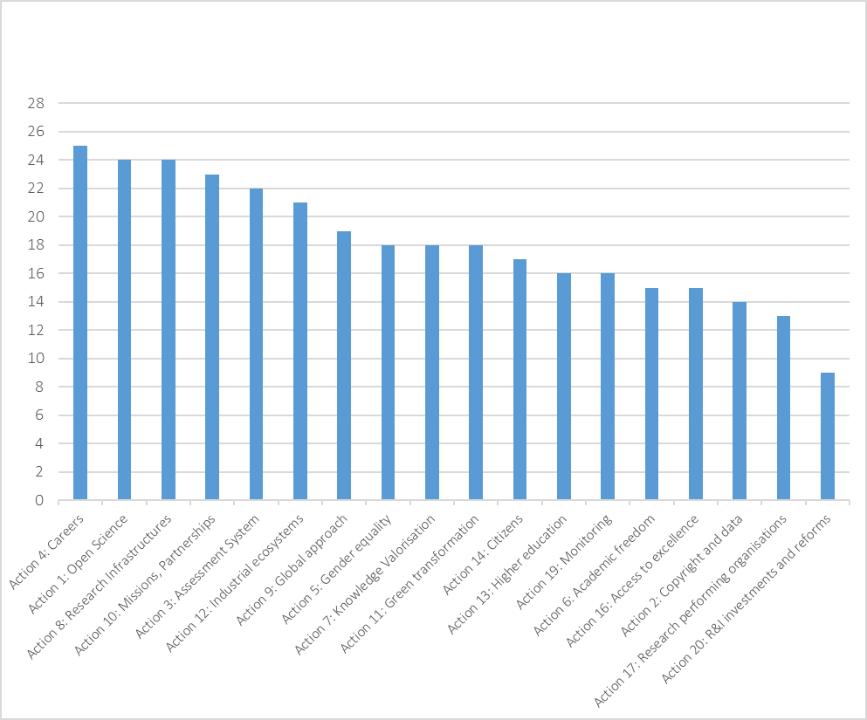
ERA Policy Agenda: State of Play
The Council conclusions on the future governance of the ERA (November 2021) require the commitment of at least half of the Member Statest within the first semester 2022:
16 actions have reached the treshold.
Notes:
Based on the Council conclusions on the future governance of ERA, Member States have expressed their commitments to the actions through templates over the summer (you can see on the slide the state of play on commitments).
On 23 September, the ERA Forum met in Ljubljana taking forward the implementation of the ERA actions.

Slide 12
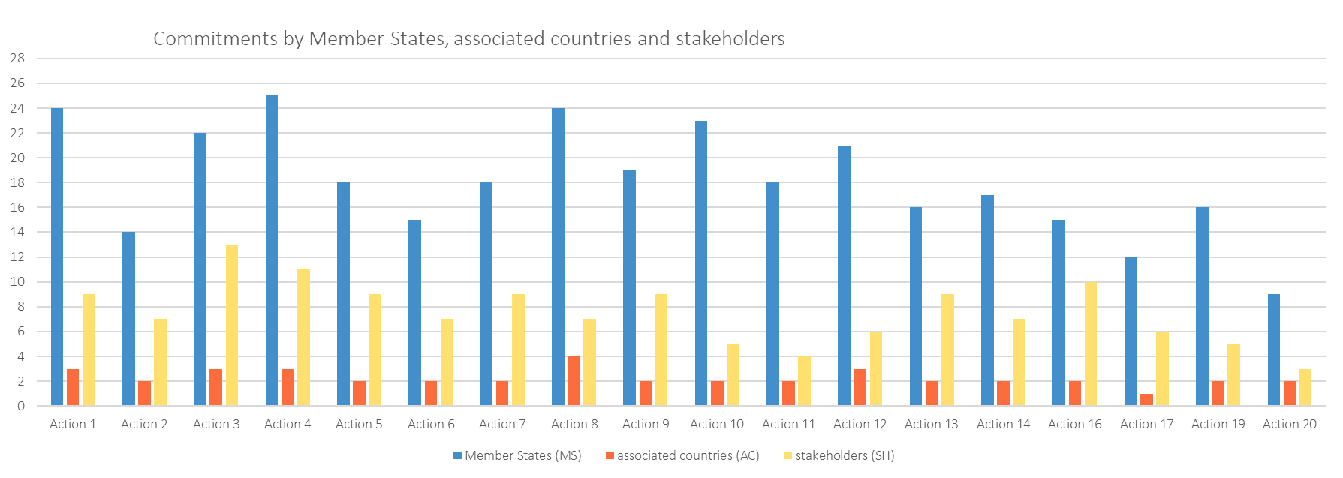
Commitments to actions (state of 16.Sept. 2022)
Notes:
We just successfully concluded the process of asking EU Member States, Associated Countries and stakeholder organisation to commit the actions of the ERA Policy agenda. Most actions reached the critical mass of political support, which gives the green light for the implementation phase that is now starting.
Out of 18 actions (Actions 15 and 18 are not in the graph as Action 15 has been postponed and Action 18 was integrated into other actions), 16 actions reached the required threshold of at least 14 EU Member State commitments.
Acton 17 & 20 are below threshold
(4 Associated countries committed: AR, GA, IS, NO)

Slide 13
Thank you!

