Slide 1
International cooperation
in the European Research Area – values and principles.
EXPERIENCE FROM UKRAINE
Dr. Igor Taranov
Director General of the Directorate for Science and Innovations,
Ministry of Education and Science of Ukraine
taranov@mon.gov.ua

Slide 2
About the Consequences of the Aggression of the Russian Federation
In conditions of aggression of the Russian Federation sphere of science and innovation of Ukraine suffered significant losses:
- staff,
infrastructure,
functioning scheme,
conditions to carry out scientific and research activities
Despite this Ukraine applied to join the EU.
Damaged building of the Ministry of Education and Science of Ukraine after massive missile strikes on October, 10, 2022

Slide 3
About the Roadmap for Ukraine's Integration into the European Research Area
Roadmap for Ukraine's Scientific and Innovative System Integration into the European Research Area (ERA-UA) has been approved on February, 10, 2021.
The ERA-UA Roadmap stipulates six key priorities:
1. Effective national research systems
2. Joint solution of problems caused by global challenges and public investments in research infrastructures
3. Opened labour market
4. Gender equality in science
5. Transfer of scientific knowledge and open innovations
6. International cooperation
Currently, Ukraine has reached 40% of the indicators of the Roadmap.

Slide 4
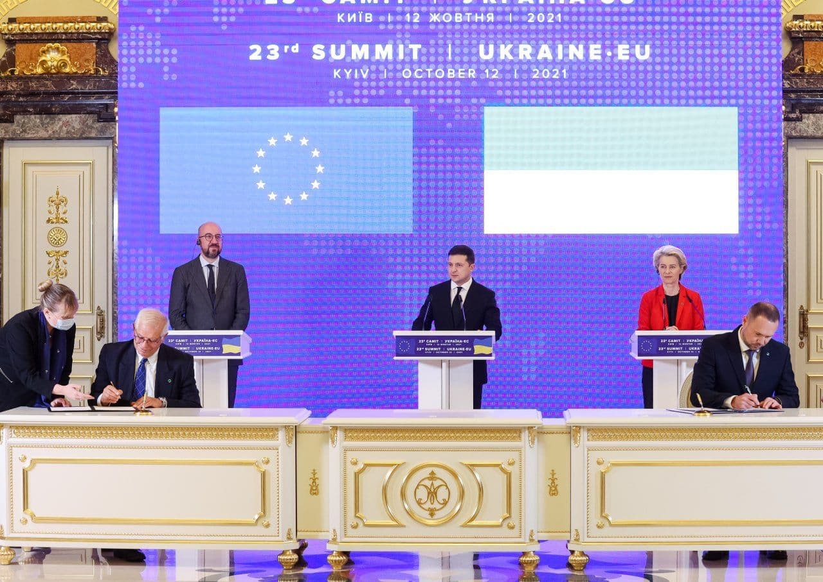
About the Agreements for Ukraine's Integration into the European Research Area
Horizon Europe and Euratom
Agreement
The Agreement between the European Union and European Atomic Energy Community of the one part and Ukraine of the other part, on the participation of Ukraine in Horizon Europe – the Framework Programme for Research and Innovation and the Research and Training Programme of the European Atomic Energy Community (2021-2025) complementing Horizon Europe – the Framework Programme for Research and Innovation was signed in Kyiv, on 12 October, 2021
EU-Ukraine Scientific and
Technological Cooperation
Agreement
On July 15, 2021, the Verkhovna Rada of Ukraine adopted the Law on the Ratification of the Agreement (in the form of an exchange of notes) between Ukraine and the European Union on the renewal of the Agreement between Ukraine and the European Community on Scientific and Technological Cooperation (No. 1673-IX). In June 2022 took place an official exchange of notes.
Signing of the Agreement on October, 12, 2021

Slide 5
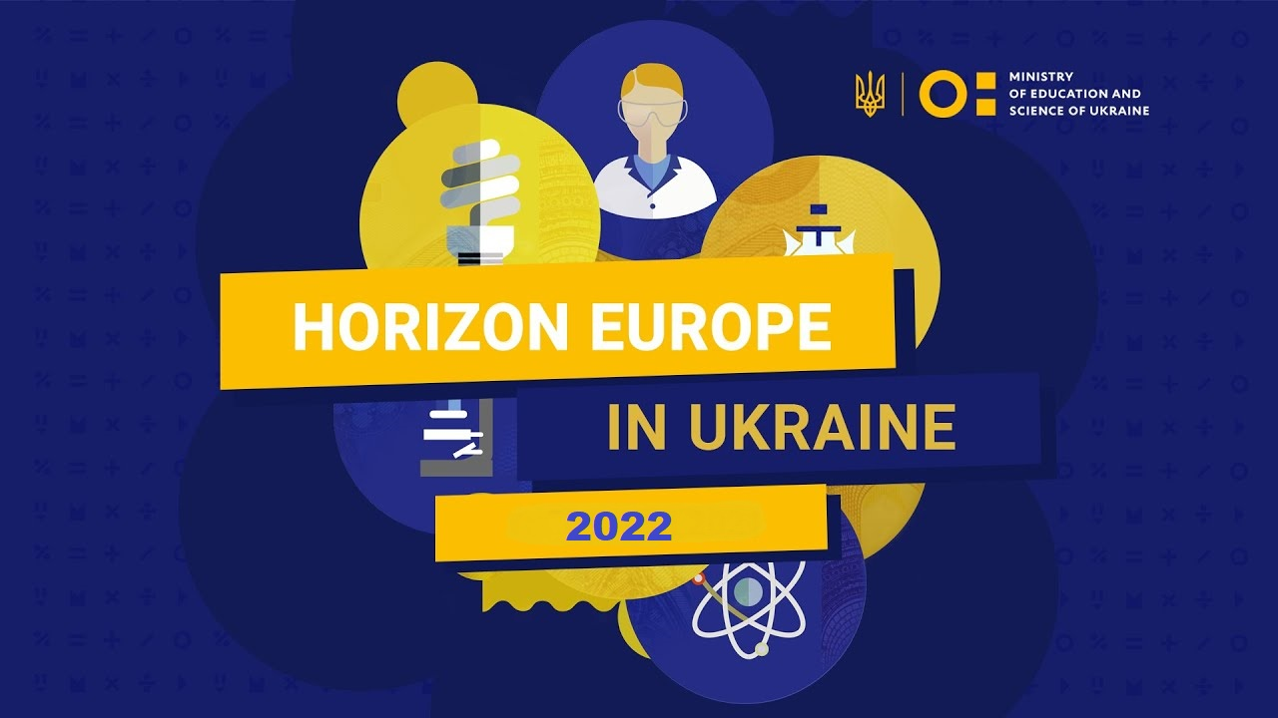
About the Success of Ukraine's Participation in Horizon Europe
Ukrainian organizations are currently implementing 104 projects within the "Horizon 2020" Programme.
Ukrainian organizations are already implementing 19 projects within the "Horizon Europe" Programme. The total budget of projects is 4.8 million euros.
«Horizon Europe Launch Day in Ukraine» was held virtually in both Brussels and Kyiv on 3 December 2021. More than 4,000 participants watched the event

Slide 6
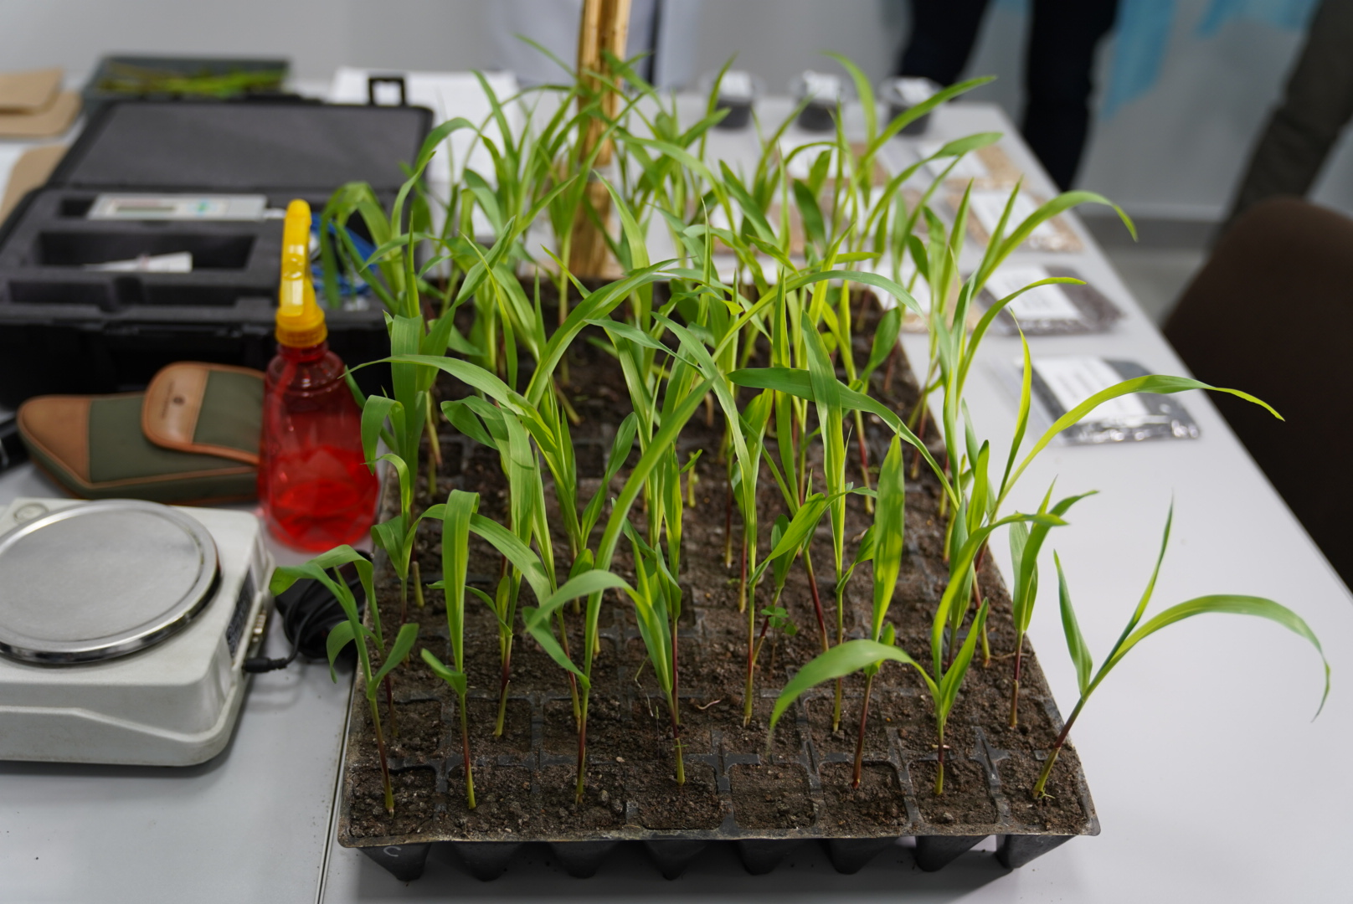
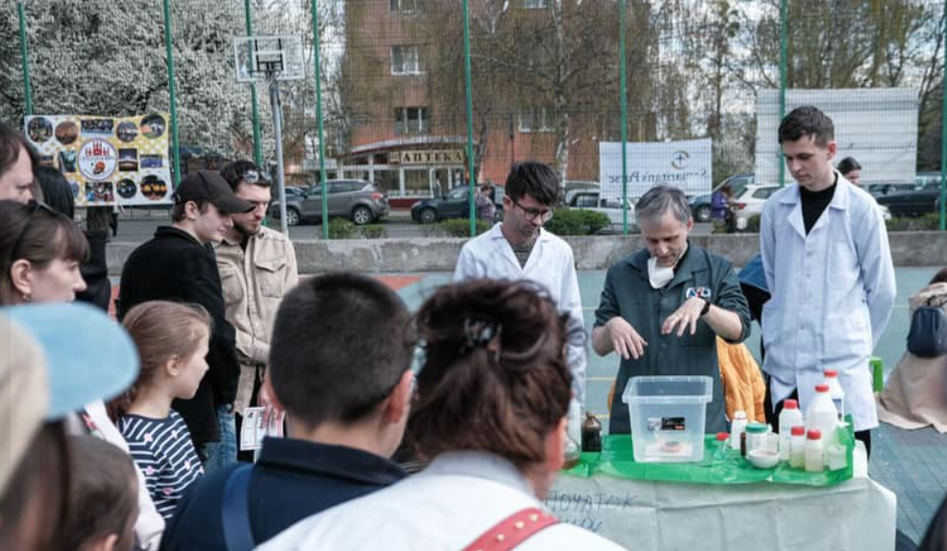
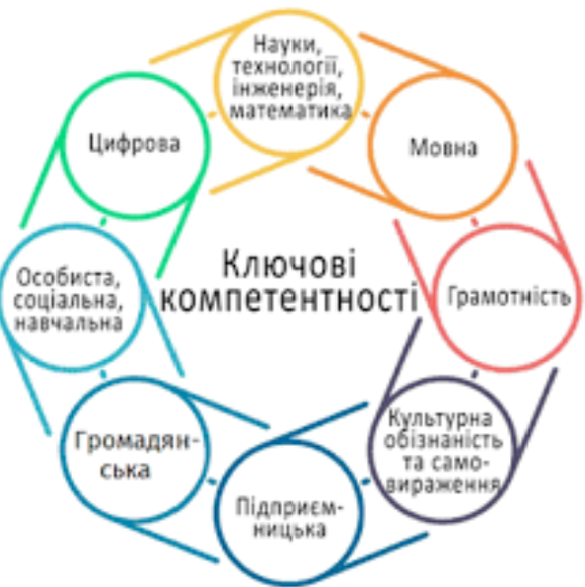
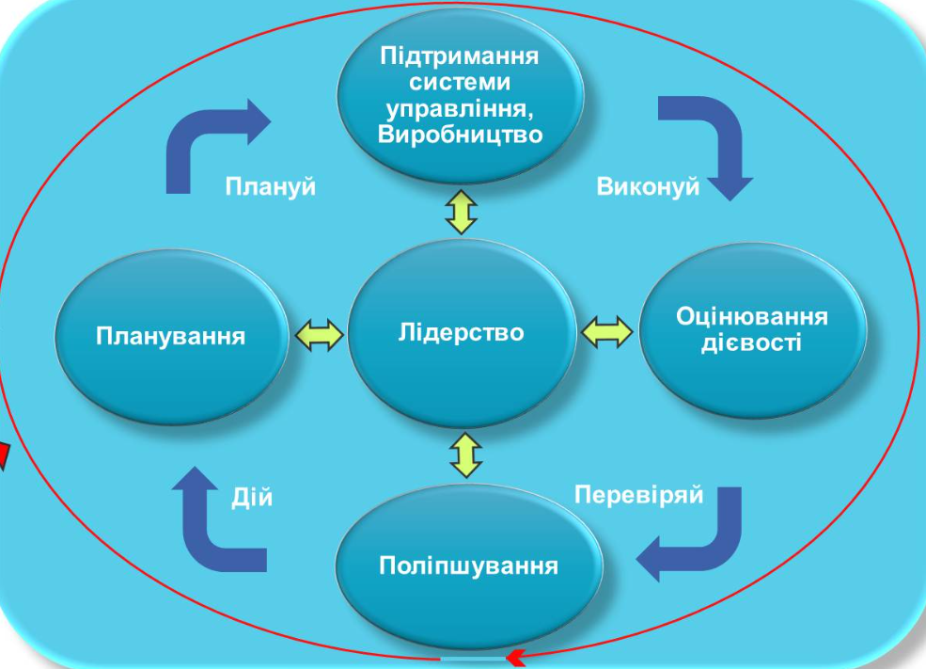
About the Legal Framework to Implement the Horizon Europe Agreement
The National Plan on Open Science was approved by the Government on October, 8, 2022
National Plan Open Science. Tasks
1. Providing open access to scientific results, scientific and technical information
2. Providing open access to research infrastructure
3. Creation of conditions for effective work with scientific and technical information and objects of research infrastructure that are in public access
4. Promotion of science, widening of scientific knowledge and citizen science
5. Improvement of system of evaluation of the quality of scientific, scientific and technical activity
6. Raising awareness and formation of competence in open science

Slide 7
About the Legal Framework to Implement the Horizon Europe Agreement
Updating the list of representatives and experts of Ukraine in the Programme Committees of the "Horizon Europe" Programme (in draft)
Creation of the Coordination Center and the network of national contact points of the "Horizon Europe" Programme (in draft)
Developing a project of the Law of Ukraine "On Support and Development of Innovative Activities“ (in draft)
State Program for the Development of Research Infrastructures
(in draft)

Slide 8
About the Call by Cost Reimbursement Under Horizon 2020
The Call of scientific, scientific and technical projects which will be financed by cost reimbursement under "Horizon 2020" projects by the end of the year.
The purpose of Call is to increase the competitiveness of Ukrainian organizations in calls of the "Horizon Europe" Programme.
156 projects were submitted,
several dozen projects will be financed,
a total amount of Call is 115 million UAH,
a new Call will start in 2023

Slide 9
About the European Cooperation in Science and Technology (COST)
COST Ukraine
On March 30, Ukraine became the 39th full member of the COST Association, which provides innovators and researchers with networking opportunities to strengthen their ability to solve scientific, technological and societal challenges.
A COST National Coordinator and Committee of Senior Officials Members have been appointed, and candidates to the Scientific Committee for COST have been nominated. The appointment of the MC in the COST Actions is in progress.
Current number of Actions with Ukraine involvement - 74
Percentage of Actions with country involvement
Current number of MC delegates - 25
Current number of Working Group members - 116
30.2

Slide 10
Bilateral Cooperation as Part of Integration into the European Research Area
Active Ukraine’s Bilateral Cooperation
in 2022
Austria
Czech Republic
Latvia
Lithuania
Slovakia
France
Number of Joint R&D projects

Slide 11
About the Digital Tools for Science and Innovation
Goals
Activities
To bring together research and education communities from EU and Eastern partner countries
Implementation of the international technical assistance project EU4Digital: Connecting research and education communities (EaPConnect2)
To facilitate the understanding of terms of cooperation
Creation of a National Portal of International Scientific and Technical Cooperation
To collect, form, process, store, use data and information about the sphere of scientific and scientific and technical activity of Ukraine
Creation of a Ukrainian Research Information System (URIS)

Slide 12
About the Consequences of the Aggression of the Russian Federation
Bank details of the Ministry of Education and Science of Ukraine for reconstruction and restoration
Since the beginning of the full-scale russian invasion of Ukraine, more than 2.500 educational institutions have been damaged and destroyed, and the material and technical base has also been mutilated.
As part of the initiative of President Volodymyr Zelensky United24, the National Bank of Ukraine has opened an account for the Ministry of Education and Science, this step will help to solve urgent problems in the area. Donations can be made in national and foreign currency (US dollars, euros, pounds sterling).
More details at http://surl.li/djyur
BENEFICIARY:
Ministry of Education and Science of Ukraine
BENEFICIARY BANK BIC:
NBUA UA UX
BENEFICIARY ADDRESS:
10, Peremogy str., Kyiv, 01135, Ukraine
ACCOUNT NUMBER:
5040040066
IBAN DE05504000005040040066
CORRESPONDENT BANK NAME:
DEUTSCHE BUNDESBANK, Frankfurt
SWIFT-code:
MARK DE FF
CORRESPONDENT BANK ADDRESS:
Wilhelm-Epstein-Straße 14, 60431 Frankfurt Am Main
PURPOSE OF PAYMENT:
for acc: 32303338601027

Slide 13
Thank you
for your attention!

