Slide 1
Strategic plans and work programmes under Horizon Europe
HORIZON EUROPE
4th Informal Working Group Meeting on Research and Innovation in Georgia, 20 October 2022
Kalina Tsvetanova, Policy Officer, European Commission, DG Research and Innovation, Common Strategic Planning & Programming Service

Slide 2
HORIZON EUROPE
EURATOM
Specific Programme: European Defence Fund
Specific Programme implementing Horizon Europe & EIT*
Exclusive focus on civil applications
Fusion
Pillar I
Excellent Science
Pillar II
Global Challenges & European Industrial Competitiveness
Pillar III
Innovative Europe
Exclusive focus on defence research & development
European Research Council
Health
Culture, Creativity & Inclusive Society
Civil Security for Society
Digital, Industry & Space
Climate, Energy & Mobility
Food, Bioeconomy, Natural Resources, Agriculture & Environment
European Innovation Council
Fission
Research actions
Marie Skłodowska-Curie
Clusters
European Innovation Ecosystems
Research Infrastructures
European Institute of Innovation & Technology*
Development actions
Joint Research Centre
Joint Research Center
Widening Participation and Strengthening the European Research Area
Widening participation & spreading excellence
Reforming & Enhancing the European R&I system
* The European Institute of Innovation & Technology (EIT) is not part of the Specific Programme

Slide 3
About the Horizon Europe work programmes
Horizon Europe supports research and innovation especially through work programmes, which set out funding opportunities for research and innovation activities.
The ‘main’ work programme covers the following components of Horizon Europe:
From Pillar I: Marie Skłodowska-Curie actions and Research infrastructures
From Pillar II: all 6 Clusters and the Missions
From Pillar III: the European innovation ecosystems
From the ‘horizontal pillar’: Widening participation and spreading excellence, and reforming and enhancing the European R&I system (Widening Participation and Strengthening the European Research Area part).
Separate work programmes cover:
the European Research Council (ERC)
the Joint Research Centre (JRC)
the European Innovation Council (EIC)
The European Institute of Innovation and Technology (EIT) has its own modalities.

Slide 4
STRATEGIC PLAN 2021-2024
HORIZON EUROPE

Slide 5
Strategic planning – linking EU priorities to research and innovation actions
The Horizon Europe strategic plan 2021-2024 was adopted in March 2021. It contains:
key strategic orientations for research and innovation support, including a description of expected impacts
identification of European co-funded and co-programmed partnerships
identification of EU missions
areas for international cooperation
orientations on specific issues like gender, SSH, open science practices, etc.
detailed Cluster-specific annexes

Slide 6
Strategic Plan 2021-2024: Four Key Strategic Orientations
Key Strategic Orientation A
Promoting an open strategic autonomy by leading the development of key digital, enabling and emerging technologies, sectors and value chains to accelerate and steer the digital and green transitions through human-centred technologies and innovations
Key Strategic Orientation B
Restoring Europe’s ecosystems and biodiversity, and managing sustainably natural resources to ensure food security and a clean and healthy environment
Key Strategic Orientation C
Making Europe the first digitally enabled circular, climate-neutral and sustainable economy through the transformation of its mobility, energy, construction and production systems
Key Strategic Orientation D
Creating a more resilient, inclusive and democratic European society, prepared and responsive to threats and disasters, addressing inequalities and providing high-quality health care, and empowering all citizens to act in the green and digital transitions

Slide 7
Co-design as core element of strategic planning
“The Commission shall ensure early involvement and extensive exchanges with the Member States, and extensive exchanges with the European Parliament. The Commission shall also ensure that this is complemented by consultation with stakeholders and the general public. That will contribute to a stronger engagement with citizens and civil society”
Art. 6 of the Horizon Europe specific programme
The Commission started an intensive co-design process in 2019
Member States involvement via “shadow” Programme Committee configurations
Exchanges with Members of the European Parliament
Extensive stakeholder consultations ⇨ Report: “Orientations towards the first Strategic Plan for Horizon Europe” (December 2019)

Slide 8
FROM STRATEGIC PLAN 2021-2024 TO WORK PROGRAMMES
HORIZON EUROPE

Slide 9
From policy priorities to concrete action
Horizon Europe
Strategic Plan 2021 - 2024
Strategic Plan 2025-2027
Work Programme
2021-2022
Work Programme
2023-2024
Work Programme
Project
Project
Project
Project
Project
Project

Slide 10
From policy priorities to work programme
The work programme parts are structured in sections called ‘Destinations’
Each ‘Destination’ in the Cluster work programme parts mirrors one specific expected impact of the Strategic Plan (while also contributing to other expected impacts)
The expected impacts of the Strategic Plan cover the 4-year period 2021-2024, so are reflected in the ‘Destinations’ of the work programmes for 2021-2022 and 2023-2024

Slide 11
Putting it all together
Horizon Europe legal basis (2021-2027):
Framework Programme & Rules for Participation and Dissemination
+ Specific Programme
R&I stakeholders
European Commission priorities
Strategic Plan 2021-2024
European Parliament
Member States & Associated Countries
sequencing & gap analysis
- Programme Committee
- Exchanges with the European Parliament
- Mission Boards
- Strategic Coordination Process for Partnerships
EU Missions
Work Programme 2021-2022
Work Programme 2023-2024
European Partnerships

Slide 12
How to get involved?
Towards Strategic Plan 2025-2027

Slide 13
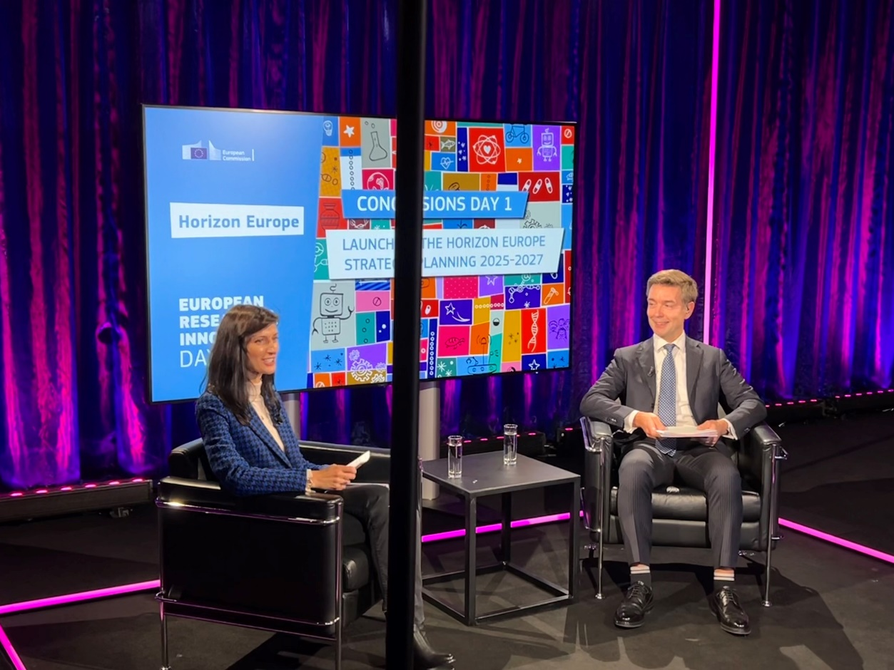
Official launch of the strategic planning process during R&I Days - 28 September
The strategic plan 2025-2027 will be covered by a public online consultation including also questions on Horizon 2020 ex-post evaluation and Horizon Europe interim evaluation
Expected timeline: November 2022 - February 2023
The consultation will be made available on the Have your say Portal
Further references:
Commission’s news article
Web page on the Strategic Plan

Slide 14
Main phases in strategic planning 2025-2027
Creating the analytical foundation for the plan; collecting data and consulting stakeholders | Until end of Q1 2023
Drafting the Strategic Plan | Q2 2023-Q4 2023
Adoption | Q1 2024

Slide 15
Thank you for your attention!

