Slide 1
Joint Research Centre

Slide 2
JRC cooperation activities with EaP countries in Technology Transfer
A TT study in the EU Eastern and
Southern Neighborhood 2019-2020
20 October 2022
Alessandro Fazio, Head of Competence Centre on Technology Transfer, JRC, European Commission

Slide 3
TT in Eastern and Southern neighbourhood
A JRC study on TT in the Eastern Partnership countries and EU Southern Neighbourhood was carried out in the period 2019 – 2020 by an Expert Group on Technology Transfer.
Countries:
Objective:
Algeria
Armenia
Azerbaijan
Belarus
Egypt
Georgia
Morocco
Republic of Moldova
Tunisia
Ukraine
informing policy-making in TT
Notes:
The JRC study on TT in the Eastern Partnership countries and EU Southern Neighbourhood was carried out in the period 2019 – 2020 by an Expert Group on Technology Transfer.
The key objective was to to inform policy making and future programming by identifying innovation-related subjects and fields requiring EU support and assistance in the Eastern and Southern neighboring countries.

Slide 4
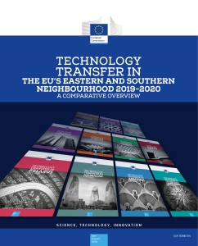
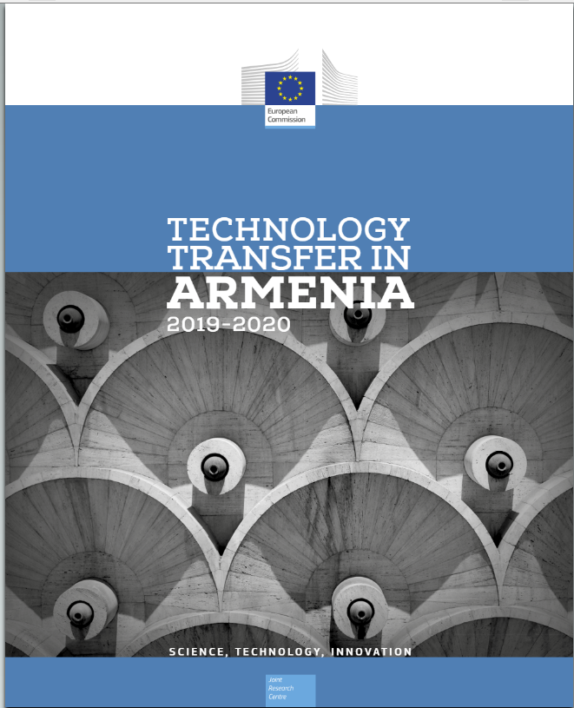
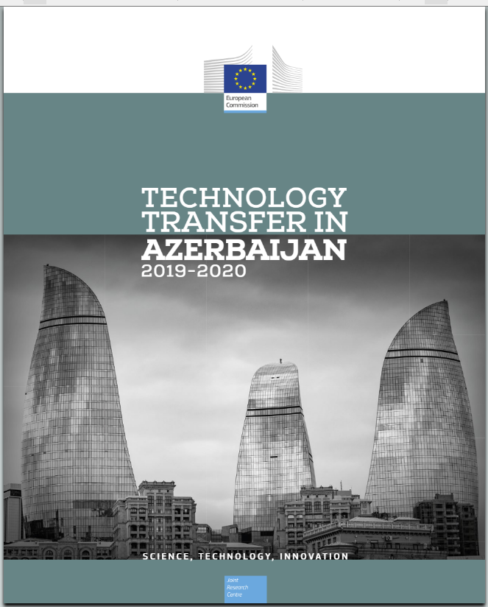
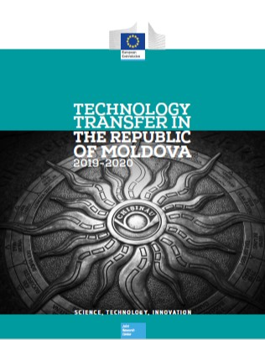
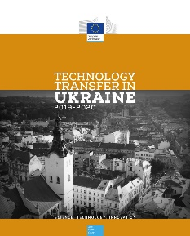
TT in Eastern and Southern neighbourhood
Country-specific diagnostic reports
Benchmarking report
Analysis of TT landscape: relevant stakeholders, players and TT model
Strengths and weaknesses of national ecosystems
Country recommendations
Comparative overview of TT in the countries
Notes:
The study resulted in the adoption of:
1. country-specific diagnostic reports analysing the TT national landscapes and providing targeted recommendations
2. and in a benchmark report highlighting the differences and similarities across the various TT ecosystems.

Slide 5
Approach and methodology
Desk research
Questionnaires & On-site interviews
Diagnostic & Benchmark report
Identification of relevant policies, laws, and literature related to TT – assessing the status of TT activities, mapping key stakeholders groups, and identifying main issues and potential prospects for improvement.
Notes:
1. For the conduction of the TT study and the drafting of country reports, the Expert Group conducted a first exploratory desk research investigating the relevant policies, laws, and literature related to TT – assessing the status of TT activities, mapping key stakeholders groups, and identifying main issues and opportunities for improvement.

Slide 6
Approach and methodology
Desk research
Questionnaires & On-site interviews
Diagnostic & Benchmark report
Actors involved were relevant Ministries, Innovation Agencies, Universities, Academies of Sciences, private investors, companies, and other innovation actors such as Science Parks and incubators.
Notes:
2. Subsequently, questionnaires were submitted to relevant stakeholders. Then, on-site interviews and visits to the study countries followed, involving relevant Ministries, Innovation Agencies, Universities, Academies of Sciences, private investors, companies, and other innovation actors such as Science Parks and incubators. When this was not possible, on-line interviews were held instead.

Slide 7
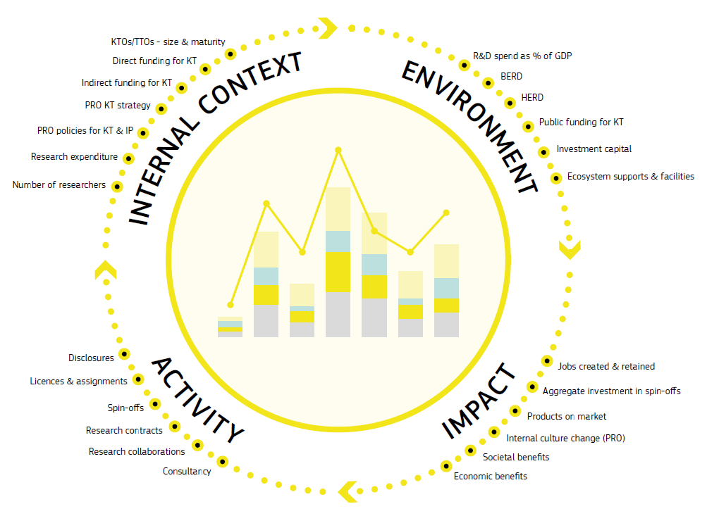
Approach and methodology
Desk research
Questionnaires & On-site interviews
Diagnostic & Benchmark report
Evaluation methodology based on categories of Knowledge Transfer indicators (developed in previous JRC study):
Internal context
Environment
Activity
(Impact)
Notes:
13. Building on the findings of the country reports, the benchmarking exercise applied an evaluation methodology based on categories of indicators consisting of Knowledge Transfer inputs and outputs:
- Internal context (taking into account KTOs and TTOs size and level of maturity, funding, and strategy, as well as researcher population and research expenditure);
- Environment (considering the role of government in fostering innovation, industry involvement, maturity of the spin-off and start-up ecosystem, and the overall public and private funding provided to the innovation ecosystem);
- Activity: due to the insufficient level of KT activities in the region, it was limited to the volume of patents and scientific publications. Similarly, the Impact indicators originally included as part of the methodology were not applied.

Slide 8
Results
Overall, the TT system in the area is in early stages of development.
Gaps in the ecosystem:
Promising trends:
Inconsistent legislation inhibiting TT/innovation in some countries (e.g. Ukraine)
Reliance on (insufficient) public funding
Low absorption capacity of industry
PROs lacking innovation potential:
Low R&D investments
Insufficient support to researchers in TT activities
limited KTOs/TTOs professional skills and lack of TT networks
Poor patent activity
Government adoption of measures supporting innovation/TT
Growing spin-off and start-up ecosystems
Positive trend for scientific publications and H index
Notes:
The benchmarking report shows that the TT systems across countries are heterogeneous, but overall in early stages of development.
The main gaps identified in the TT ecosystems are:
Some countries, such as Ukraine, presented inconsistent legislation actively inhibiting TT and innovation;
There is a general reliance on public funding, which is on average insufficient; activity of risk-inclined investors varies across countries;
The industry consists mostly of micro and small enterprises, and has low absorption capacity and interest in innovation;
KTOs/TTOs professional lack skills, and TT networks are scarce.
PROs seem to remain weak sources of innovation, due to insufficient R&D expenditure, reduced researcher personnel, and lack of sufficient support to researchers in TT activities.
The patent activity is overall very low compared with countries in EU and worldwide.
There are also some positive signs, such as governments commitment to adopt reforms and measures to support innovation and TT, a growing spin-off and start-up ecosystem, and a positive trend in scientific publications (with the exception of Georgia and Moldova) and H index.

Slide 9
Recommendations
Legislative reforms: simplify legislations and ensure enforceability of IPR, incentivise researchers entrepreneurship (e.g. shared ownership)
Maintain national investments in research and TTOs (e.g. PoC funds, innovation vouchers for industries)
Development of TT skills (capacity building and mentoring)
Regional and international cooperation (e.g. TTOs twinning)
Strengthening scientific collaboration in non-ICT related sciences
Notes:
To increase the absorptive capacity of the innovation ecosystems and attract international R&D, human and capital resources, the study recommends that governments in all countries maintain and increase the current effort in simplifying legislation and investing in research and TTOs, for example through the establishment of financial instruments in early and growth stages (e.g. PoC and scale-up funds), innovation vouchers for businesses, etc.
It also advises promoting the development of TT skills through mentoring programmes, and fostering regional and international cooperation, for example through twinning of TTOs.
Finally, it suggests to strengthen scientific collaboration in non-ICT related sciences, to increase diversification.

Slide 10
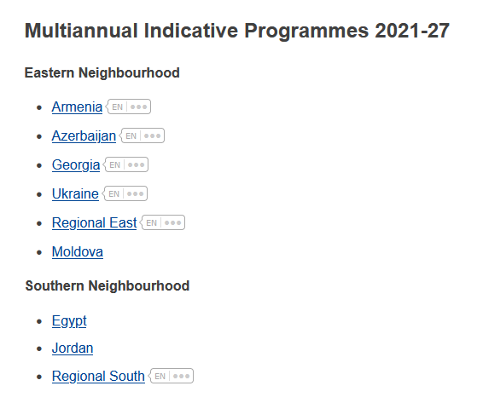
Future developments
2021-2027 MIPs
Technology Transfer Roadmaps identifying national priority areas of intervention to increase innovation capacity in EaP countries.
Neighbourhood, Development and International Cooperation Instrument – Global Europe (NDICI – Global Europe), https://neighbourhood-enlargement.ec.europa.eu
Notes:
As part of the 2021-2027 Multiannual-Indicative Programmes (MIPs), Eastern neighbourhood countries are expected to develop Tech Transfer Roadmaps identifying future national priority areas of intervention, contributing to the increase of the overall innovation capacity in the area.
(MIPs are strategic documents laying down EU cooperation priority areas and specific objectives for Neighbourhood partner countries and regions. For each objective, they identify expected results, indicators and baselines for evaluation, as well as indicative financial allocations).

Slide 11
Thank you
© European Union 2021
Unless otherwise noted the reuse of this presentation is authorised under the CC BY 4.0 license. For any use or reproduction of elements that are not owned by the EU, permission may need to be sought directly from the respective right holders.
Notes:
Update/add/delete parts of the copy right notice where appropriate.
More information: https://myintracomm.ec.europa.eu/corp/intellectual-property/Documents/2019_Reuse-guidelines%28CC-BY%29.pdf

