Slide 1

Horizon Europe National Office of Georgia
4th Informal Working Group Meeting on Research and Innovation
20-21, October 2022
Tbilisi, Georgia
Nino Inasaridze, NCP coordinator, Georgia
n.inasaridze@rustaveli.org.ge

Slide 2

ASSOCIATION AGREEMENT - EU RESEARCH AND INNOVATION FRAMEWORK PROGRAMME
In December 2021, Georgia signed the Association Agreement with “Horizon Europe” (2021 – 2027).
In April 2016, Georgia signed the Association Agreement with "Horizon 2020“. This was an important step for cooperation between the European Union and Georgia.

Slide 3
HORIZON EUROPE – GEORGIA
FACT SHEET
Founded with the support of the Ministry of Education and Science of Georgia and personally Minister Dr. Mikheil Chkhenkeli, in December, 2021. State Program : Promoting the involvement of Georgian scientists in international programs Subprogram: Promoting the involvement of Georgian scientists in the European Union research and innovation framework program Horizon Europe (2022 ) (subject for approval on an annual basis) Total annual budget for Horizon Europe in 2021 - 2022 is equal to 700 000 EURO Source of funding for the State Program including Horizon - Horizon Membership Fee returned funds (50% of fees paid on an annual basis) Currently the HE office is functioning under the umbrella of the Shota Rustaveli National Science Foundation and supported by the State Program Georgia’s Development Strategy 2030 and its action plan also foresees the support Georgia’s participation in EU framework programme for research and innovation Unified Strategy of Education and Science of Georgia for 2022-2030 and its two year Action Plan foresees the support of Georgia’s participation in Horizon Europe programme

Slide 4
National Office “Horizon Europe”
Mission
Strengthening the integration of Georgia
in the EU research and innovation framework programme Horizon Europe
through increased participation of Georgian stakeholders
in European consortia

Slide 5
National Office “Horizon Europe”
Objectives:
  Establishing and Coordination of the NCP Network
  Development of a National Network in Universities and Research Institutions
  Information and Awareness Raising via Info Days, Trainings, Individual consolations etc.
  Assisting and Advising of potential applicants and implementers
  Supporting Partnership development/partner search
  Providing Analysis and Feedback

Slide 6
National Office “Horizon Europe” - Structure
Coordinator 1
Pillar 1
Coordinator 2
Pillar 2
Coordinator 3
Pillar 3
Coordinator 4
Widening
NCP + PC Members
School of Science Management

Slide 7
NCP Capacity Building Activities
Science Management School
Science Management School an integral unit of HE office
Supports NCPs/Grant Offices Capacity Building activities in cooperation with NCP’s and thematic coordinators.
Cooperates with other development programmes and projects such as the Research "Support to Georgia's Researcher Mobility", Horizon Europe funded projects (Bridge2HE), etc.
Developing/organizing the LLL courses/Webinars/Workshps etc. for the wider public/potential beneficiaries covering cross cutting issues such as successful proposal writing, gender dimension, open science principles, etc.
________________________________________________________
The National Office is currently involved in the planning and implementation of three NCP Capacity building projects, under Bridge2HE, in the directions of: EU Missions; Widening; Legal and Financial Aspects.
A memorandum is in the process of being signed with the RICH Europe Project for Research Infrastructures NCP capacity building.

Slide 8
STRATEGIC SUPPORT UNITS
1.
2
NCP Volunteer Network
3.
University Grant Offices
Programme Committee Membership
4.
Thematic Expert Groups

Slide 9
NCP NETWORK IN GEORGIA
At initial stage NCPs are nominated by the Georgian Ministry of Education and Science - opinion leaders in the field, not reimbursed, NCPs represent different organizations.
Selection through open calls started by May 2022 (several rounds took place)
Criteria: excellent knowledge of English, PhD degree, experience in research project implementation.
Total Number of NCPs employed: 14 persons
Total Number of Volunteer NCPs: 13 persons

Slide 10
PROGRAMME COMMITTEE MEMBERS – GEORGIA
Process lead by the Georgian Ministry of Education and Science
PC members are selected on the basis of consultations with the relevant ministries, universities and research institutions
Number of PM varied based on complexity of topics per cluster/pillar

Slide 11
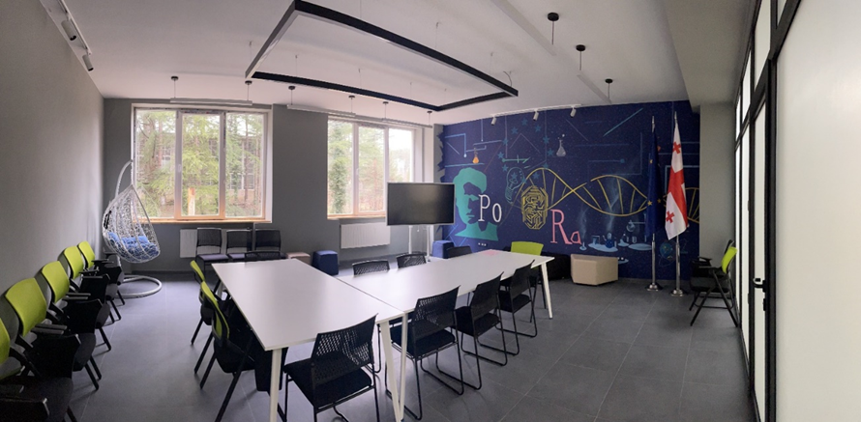
University Grant Offices (self funded)
Established in 14 State and Private universities
1.
2
Identification of external sources of research funding
3.
Facilitating in partner search and consortium building
Identification of institutional and regional priorities
4.
Assisting researchers in the preparation and implementation of projects
5
Cooperation with NCP Network and National Office “Horizon Europe”
STRATEGIC GOAL – INCREASED PARTICIPATION IN RESEARCH PROJECTS

Slide 12
Communication flows
HE office
NCPs
PC M
Experts Groups
Grant Offices+HEIs Research Institution
Government, Private Sector,/Industry, local Authorities, NGOs etc.
Wider Public

Slide 13
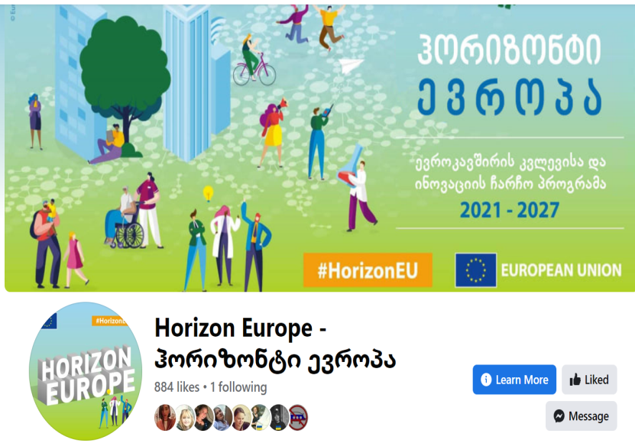
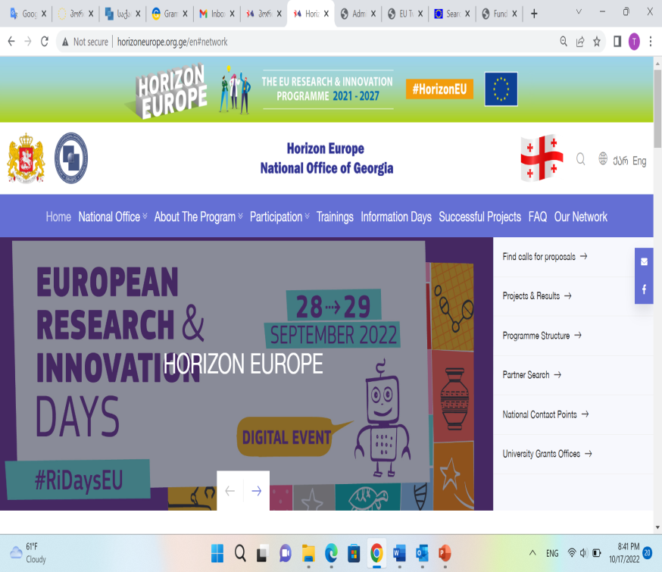
Outreach strategy
Participation in national research and innovation support events
Direct partnership meetings with key stakeholders
Info Days
Individual meetings/round tables
FB Page –
HorizonEuropeGeorgia
Web Site – launched,
Horizoneurope.org.ge
Planned Activities:
Mass media - Radio, TV, Social Media (Linked In, Twitter, etc.)

Slide 14
Target Audience
Target Audience (currently direct recipients of HE info)
47 Higher Education Institution and Research Institutions:
14 University Grant Offices;
20 Universities where there are no Grant Offices (Among them: Academy of Arts, Tbilisi Medical Academy, National Defense Academy, etc.);
13 LSE Research Institutions (Including Delta Institutes, State Silk Museum, Agricultural Scientific Research Center, National Center of Georgian Manuscripts, Georgian Art History and Monument Protection National Research Center, Ivane Beritashvili Center for Experimental Biomedicine, G. Eliava Institute of Bacteriophages, Microbiology, and Virology).
Ministries (Partnership scheme): with the help of MES
Planned - Private Sector, NGOs, and Local Government

Slide 15
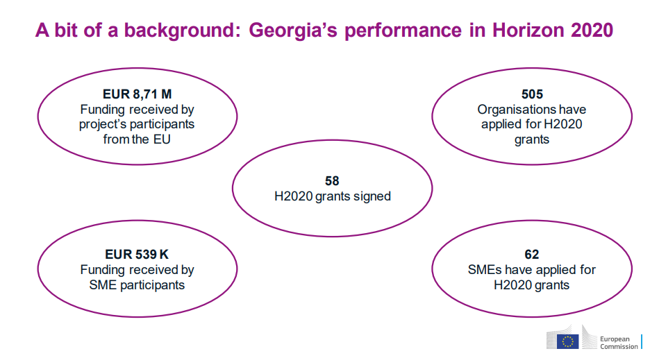
Forerunner Horizon 2020 –
AA signed in 2016

Slide 16
Horizon Europe Participation
2021-2027
14 projects with Geo participations have been awarded so far European Union grant amounts to 2295540.30 million. I
Culture, creativity and inclusive society
Digital, Industry and Space
Food, Bioeconomy Natural Resources, Agriculture and Environment
Health
Marie Skłodowska-Curie Actions (MSCA)
Reforming and enhancing the European R&I System
Research infrastructures
Widening participation and spreading excellence
In addition, 93 proposals have been submitted by 70 different legal entities. The success rate for submitted applications is 14.16%.

Slide 17




GEORGIA: Areas of application and success/ source: Silvia Bojinova presentation
Pillar II
GLOBAL CHALLENGES & EUROPEAN INDUSTRIAL COMPETITIVENESS
Health
Culture, Creativity & Inclusive Society
Civil Security for Society
Digital, Industry & Space
Climate, Energy & Mobility
Food, Bioeconomy, Natural Resources, Agriculture & Environment
Pillar III
INNOVATIVE EUROPE
Pillar I
EXCELLENT SCIENCE
European Research Council
8 Proposals / 2 Grants
European Innovation Council
11 Proposals / 0 Grants
1 Proposal / 0 Grants
31 Proposals / 4 Grants
Clusters
European Innovation Ecosystems
Marie Skłodowska-Curie
5 Proposals / 0 Grants
21 Proposals / 2 Grants
7 Proposals / 2 Grants
2 Proposals / 0 Grants
1 Proposal / 0 Grants
European Institute of
Innovation & Technology
Research Infrastructures
/
3 Proposals / 1 Grants
11 Proposals / 2 Grants
WIDENING PARTICIPATION AND STRENGTHENING THE EUROPEAN RESEARCH AREA
Widening participation & spreading excellence Reforming & Enhancing the European R&I system
9 Proposals / 1 Grant
3 Proposals / 2 Grants
Total applications: 113; Retained applications: 16; Success Rate: 14,16%%.
Scarce participation in Pillar III;
Active participation in Pillar II.

Slide 18

Pillar I
Excellent Science
European Research Council
National Contact Point
Dr. Ekaterine Sanaia
E-mail: esanaia@gmail.com

Slide 19
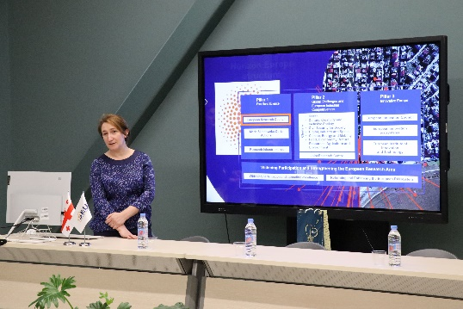
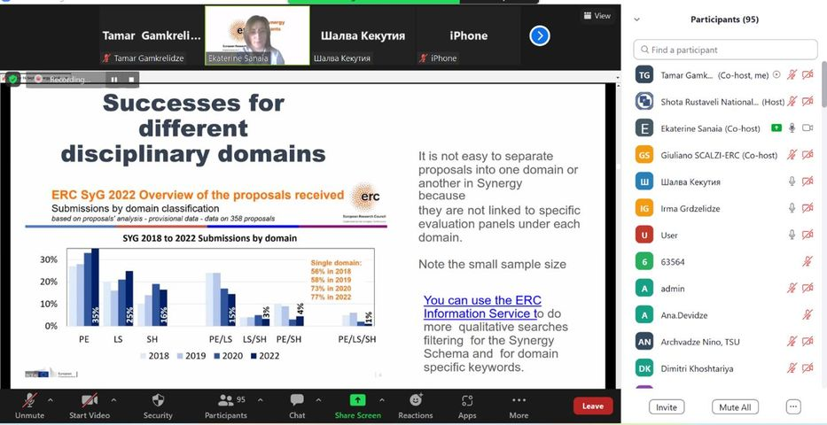
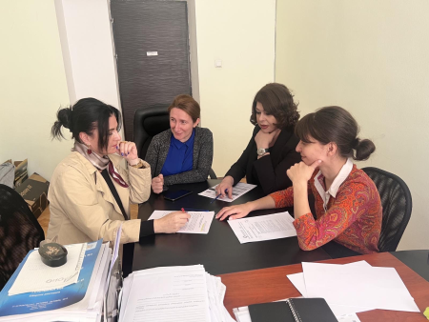
Stakeholders
Applicants from Governmental Universities (including research Institutions) with Horizon Grant Office | Applicants from Private Universities without Horizon Grant office
TSU- 1 applicant | Black Sea University -3 applicant
GTU- 4 applicant (1 from Research Institution) | SEU -1 applicant
ISU -2 applicant (1 from Research Institution)
Research Institutions Under MES of Georgia without Horizon Grant Office | Research Institution Under Ministry of Defense without Horizon Grant Office
LEPL Iv. Beritashvili – 1 applicant | LEPL SIPT ( NCP)- 1 applicant
Total | 13 Potential Applicant
On September 16, 2022 Info day for ERC Starting and Synergy Grants with participation about 130 individuals from 30 Institution
Individual consultations /regularly
ERC Starting and Synergy Grant potential applicant -13

Slide 20
Key Findings

Slide 21
Pillar I
Marie Sklodowska-Curie Actions
National Contact Point
Teona Maisuradze, PhD
E-mail: tmaisuradze@rustaveli.org.ge

Slide 22
Key Findings
July 7th, 2022 - Info Day conducted in Georgian Technical University –
“Preparation Of Young Researchers For The Upcoming Academic Year Under Marie Sklodowska Curie Actions “
Hybrid event – total of up to 150 participants
Target Audience – Doctoral Students and Phd Programme Coordinators of different Universities.
22 Universities from Tbilisi and Regions (10 from regions) and 7 Research Institutions.
A segment was held on Euraxess and its role in supporting MSCA actions.
Doctoral Networks – Ilia State University currently working to develop
Postdoctoral Fellowships – individual consultations made, submitted -
Staff Exchange – Shota Rustaveli Foundation in process of negotiation with international partners.
  Several meetings with possible partner institution were held, in the process of creating consortium and drafting the application
COFUND – no interest at this point
MSCA and Citizens – program studied, online attendance, preparations for 2023

Slide 23
Challenges (if any) and vision
Doctoral Networks
  Challenge: University level involvement needed, encouragement by university administration of heads of PhD programs needed
  Plans: organize specific workshop for program heads/coordinators
Postdoctoral Fellowships
  Challenge: not many scholars have personal profiles or use portals
  Plans: through personal consultations to encourage scholars to use connecting portals, training should be offered at PhD level in universities
Staff Exchange
  Challenge: encourage nonacademic institutions to partner with academic entities
  Plans: use experience of already existing cooperation and share the example
COFUND
  Challenge: Institution needs to be interested to contribute funds
  Plans: program needs to be studied further and success stories prepared to help educational institutions see the benefit.
MSCA and Citizens
  Challenge: various activities should be organized in various places to reach a wider audience and preparations should start
  Plans: prepare a proposal of activities and participating institutions

Slide 24
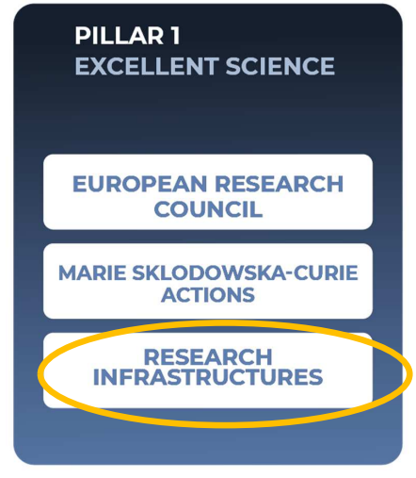
Pillar I
Research Infrastructures
NCP Dr. Mariam Razmadze
Email: mrazmadze@rustaveli.org.ge

Slide 25




Key Achievements
Research Infrastructures, including the EOSC are crucial enablers of research and technological innovation and drivers of multidisciplinary and data-intensive science.
Contributing to workshop “Advancing Open Science in Georgia”- organized by SRNSFG in the framework of twinning project, 11-13 October of 2022;
RESEARCH INFRASTRUCTURES CONSORTIUM OF NCPS IN HORIZON EUROPE – Horizon Europe National Office Sign the MoU with RICH Europe project. I became a member of Extended RI NCP Team since September 29th ;
Joining the UNESCO Open Science Team. Became a member of UNESCO’s Working Group on Open Science Monitoring since September 15th ;
Join the national OS initiatives, curated by the Ministry of Education and Science of Georgia. Became a member of National Working Group on OS Policy Implementation since August 10th ;
Conducting several trainings as NCP on Open Science and FAIR principles among researcher;
Coordinate Research Institute TECHINFORMI’s team and won grant from the EOSC future grants platform.

Slide 26
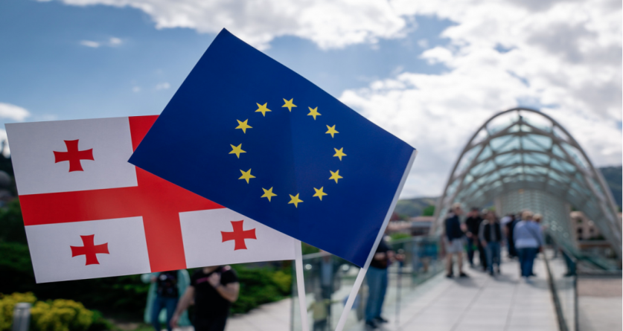







We are planning to organize an Info Day on RI 2023 calls on the last week of November/first week of December of 2022
Individual consultations were conducted with the following state and private sectors:
Key stakeholders/ potential applicants:
Georgian Research and Educational Networking Association – GRENA;
Shota Rustaveli National Science Foundation of Georgia (SRNSFG);
Institute for Scientific and Technical Information-TECHINFORMI;
National TB Center (center for tuberculosis and lung disease);
Research Institutions (MICM, Institute of Cybernetics, Ivane Beritashvili Center of Experimental Biomedicine, etc.);
National Science Library and
Kutaisi State University
1.SRNSFG - is one of the strategic state stakeholders in the upcoming RI calls. It is a national foundation whose main aim is to support science and researchers at all level of it’s development. ( Destination2 -INFRAEOSC)
2.TECHINFORMI – organization which maintain a unique national scientific data’s and databases, and the development of single national scientific cloud area is the priority number one. (Destination2 -INFRAEOSC)
3.GRENA – private organization, which strives and successfully developing the main communication channels between the local and global research infrastructures. (Destination2, 5 –INFRAEOSC, INFRANET)
4.National Science Library - which is developing an open access repositories at the national level.
5.Kutaisi International University - (where the Hadron Therapy Center will be established in 2023 -2024. This research center will offer its facilities for the scientific research in particle physics, radiation physics and biophysics, as well as support operations of the Proton Therapy Center. ( Destination3 - INFRASERV)

Slide 27
Present plans:
On November 14-17 as RI NCP we will participate in EOSC Symposium 2022 (Czech Republic, Prague) where we will present the main obstacles and demonstrate the strategic vision of the Ministry of Education and Science of Georgia regarding the implementation of OS principles, EOSC&FAIR;
Participating in online - International Conference on Research Infrastructures 2022 (19-21 October 2022, ICRI 2022)- online participation.
Challenges:
Communication with target groups (researchers, academics, universities and research institutes, from PhDs to directors ( identify the best strategy in this regard);
Make scientific knowledge openly available, accessible and reusable for everyone at the national level
(develop a FAIR policy) ;
Vision and next steps:
Develop clear strategic vison of implementation of OS policy (involving all decision makers/ key players at the national level).
Promoting and extending the FAIR principles at national level and inclusion of potential stakeholders in this process; Integration of FAIR practices into the research ecosystem of Georgia;
Develop a single platform (national G-OSC) and offer full range of scientific, digital services for science and researchers in Georgia; Support for /development of international, regional and thematic open science platforms for sharing of knowledge and best practices.
Federation of national G-OSC with Research Infrastructures & e-infrastructures in EOSC

Slide 28
Pillar II
Global challenges and European industrial competitiveness
Direction Coordinator
Dr. Lela Mirtskhulava E-mail: lmirtskhulava@rustaveli.org.ge

Slide 29
Pillar II/Clusters - NCPs
Cluster I – Health
NCP - Dr. Lela Mirtskhulava + A member of the Program Committee
Cluster III: Civil security for society
New NCP - Dr. Paata Surguladze + Program Committee Member
Activities:
European Research and Innovation Days | Research and Innovation - European Commission &
Program Committee Meetings.
Cluster V: Climate, Energy and Mobility
New NCP – Dr. Zurab Bregvadze + Program Committee Member
Activities:
October 18, 2022 - EaP Informal Working Group Meeting on Research and Innovation - Rustaveli Foundation
October 13, 2022 - Horizon Europe Widening Pillar Information Day - Contests and Funding Opportunities - Rustaveli Foundation
October 4, 2022 - Horizon Europe Coordinators' Day on Grant Management - online meeting
September 28-29, 2022 - European Research and Innovation Days 2022 - online meeting
September 27, 2022 - Webinar session: Avoiding errors in declaring personnel costs in Horizon 2020 grants (September 27, 2022) – online meeting
September 23, 2022 Horizon Europe Georgia staff meeting - Kostava office
September 16 - ExPaNDS & PaNOSC - Virtual Infrastructure for Scientific Analysis (VISA) Workshop – online meeting
September 13, 2022 - CETPartnership Joint Call 2022 Infoday – online meeting
September 9, 2022 - Introductory meeting of Horizon Europe Georgia employees - Kostava office
September 7, 2022 - Bridge2HE training "Digital tools for NCPs" how to make your webinars and online trainings more interactive – online meeting
September 6, 2022 - Brainstorm session BRIDGE2HE – online meeting
August 30, 2022 - Horizon Europe Georgia employees' online meeting Planning work in Microsoft outlook calendar
August 29, 2022 - Introductory meeting with employees of Horizon Europe Georgia.
Cluster 2: Culture, Creativity and Inclusive society
New NCP - Dr. Manana Mikadze
Activities:
9.09.2022 - European Research Area Forum
16.09. 2022 - Information Day on the European Research Council Synergy Grants and Initial Grants
27.09 Avoid errors in declaring personal costs in Horizon 2020 grants
04.10 Horizon Europe coordinators' Day in Grant Management
20.10 Lump Sun funding in Horizon Europe: How does it work? How to write a proposal?
Cluster IV: Digital, Industry, and Space
New NCP – PhDc Luka Kemoklidze
Activities:
Horizon Group Meeting - September 8, 2022
Civil Security Cluster 3 workshops - September 16, October 21 (as a member of the program committee)
Lump Sum funding in Horizon Europe: managing proposals and grants, 20 October 2022
September 21-23 - Training for NCPs and COOs
Cluster VI: Food, Bioeconomy, Natural Resources, Agriculture and Environment
NCP – Dr. Tamar Berberashvili

Slide 30

Organizations/stakeholders met/consulted
Up to 100 hundred meetings with around 60 different entities/units
Individual Consultations with key Stakeholders
Faculty of Business and Economics, Iv. Javakhishvili Tbilisi State University
Director of the International Environmental Protection Research Center
Deputy Executive Director of GREDA-Georgian Renewable Energy Development Association
Faculty of Informatics and Control systems at Georgian Technical University
Georgian Astrophysical Observatory
Introductory meeting at the "Horizon Europe" national office: presentation about Pillar II and individual clusters.
informational meeting "Horizon Europe" at the national office, Iv. R. of Javakhishvili Tbilisi State University. with the director of the Institute of Inorganic Chemistry and Electrochemistry named after Agladze
Online meeting with the Head of Academic Research and Creative Development Department of Tbilisi State Academy of Arts
Online Meetings with the Coordinators of the Grant Offices
Potential applicants identified
GREDA-Georgian Renewable Energy Development Association –International Environmental Protection Research Center
Institute of Inorganic Chemistry and Electrochemistry named after Agladze
Research and Educational Universities

Slide 31
Attended and Upcoming Training and Meetings
9-12 June 2022 - Bauhaus Festival in Brussels
9-12 June 2022 - Consultations with Silvia Bojinova in Brussels
9-12 June 2022 Meetings with European Commission European Commission DG R&I in Brussels
Digital tools for NCPs – how to make your webinars and online trainings more interactive
Brokerage Event
EOI for Follow up BRIDGE2HE project
The Health NCP Net 3.0(HNN 3.0) project and to attend the online event on October 6, 2022
Avoiding errors in declaring personnel costs in Horizon 2020 grants
Horizon Europe Coordinators' Day on Grant Management Lump Sum Funding in Horizon Europe: How does it work? How to Avoiding errors in declaring personnel costs in Horizon 2020 grants
EOSC Workshops

Slide 32
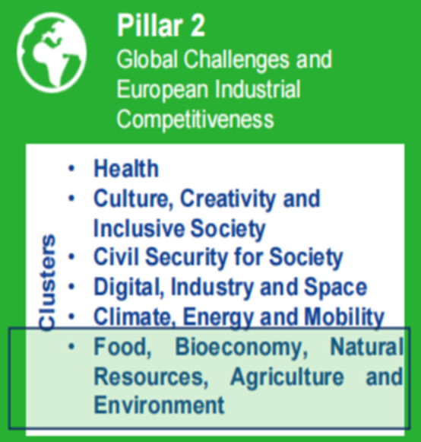
Pillar II
Cluster 6:
Food, Bioeconomy, Natural Resources, Agriculture and Environment
CL 6 NCP Tamar Berberashvili

Slide 33











Individual consultations with stakeholders/potential applicants:
The Ministry of Environmental Protection and Agriculture of Georgia
Georgian Academy of Agricultural Sciences
Georgian Academy of Natural Sciences
Georgian Technical University
Tbilisi State University
Agrarian University
Institute of Mineral Resources
Institute of Materials Research
Engineering-physical problems institute
The Center of Experimental Biomedicine
Environmental Information and Education Center
Scientific Center
National Food Agency
Hydrogen Technology LLC (A Limited Liability Company)
Advancement Science LLC
International Innovative Technologies NPIS (non-profit institution)

Slide 34



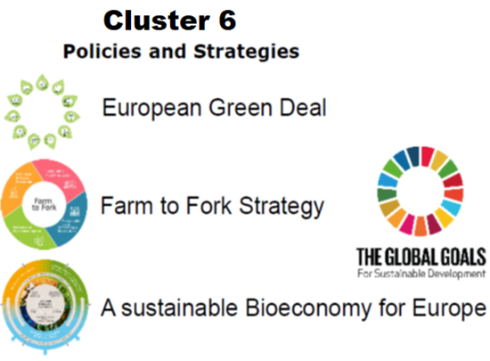










Individual consultations Key topics

Slide 35



Trainings and workshops attended:
Lack of knowledge in:
Missions
Partnerships
The activities of the Joint Research Centre (JRC)
Spotlight on European Missions, 28/04/22;
Ethics & Security, 05/05/22;
European Partnerships in HE, 11/05/22;
IP in Horizon Europe, 19/05/22;
Lump Sum Funding in Horizon Europe: How does it work? How to write a proposal?, 19/05/22;
Info session on Horizon Results Booster – steering research towards a strong societal impact, 25/05/22;
CETPartnership Joint Call 2022 Infoday, 2/09/22;
CARE4BIO: The EU Network for Cluster 6 National Contact Points, 5/09/22;
Brainstorm session BRIDGE2HE, 06/09/22;
Digital tools for NCPs – how to make your webinars and online trainings more interactive, 7/09/22;
Coordinators day 2022, 12/09/22;
CETPartnership Joint Call 2022 Infoday, 13/09/22;
Annual Research Conference 2022. 20-21/09/2022;
6 sessions:Building sustainable and resilient food systems in times of crisis; Startup village: leaving no one behind; From lab to market: connecting research, technology and innovation; Stream the STE(A)M: gender equality 4 studies and careers;Youth for a healthy ocean;Youth at the heart of the green transition, 28/09/2022 ;
The European Research and Innovation Days 2022, 29 /09/22;
Horizon Europe Coordinators' Day: Grant Management, 04/10/22.

Slide 36
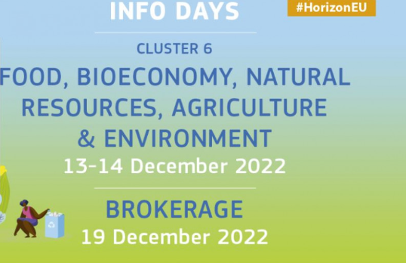
We are planning to organize an Info Days on Cluster 6 2023 calls
in the first week of November and of in the last week of December of 2022

Slide 37
Pillar III
Innovative Europe
Direction Coordinator
Zviad Miminoshvili
E-mail: miminoshvili@rustaveli.org.ge

Slide 38
Key Achievements
Individual consultations:
Individual consultation with management of the Institute of Economics
With SME's representatives - Raising awareness about Knowledge and Innovation Communities (KICs)
Agro-Ornament - Greenhouse Construction Enterprise
Digital Educational Portal "Nebula"
Ecopre - Company of Water Purification Systems & Automation of Industrial Processes
Entrepreneurs Association
Green Energy - Commercial and Residential Solar Power Plant Company (Official Representative of Huawei Inverters)
Inventors club of Georgia
Megadoors - Manufacturer of doors & combined furniture with environmentally friendly raw materials
Solar Power Generation Company "Helios-ge"
Step Solar - Solar Energy Company

Slide 39
Key Achievements
Consultations in project development:
Data Analysis Laboratory (Director: Rati Skhirtladze)
The project "Enagramm" was submitted to the service of the EIC accelerator. The project has moved to second stage of evaluation (https://enagramm.com/Home/Landing).
Private entrepreneur, Nikoloz Konstantinidi
Project - "Oxygen bay". We have already helped him to find partners.

Slide 40
Key Achievements
The key stakeholders defined
Higher educational institutions of Georgia (45 higher educational institutions, 6100 professors, 53200 students)
42 Vocational education and training Institutions of Georgia
58 Scientific Research Institutes of Georgia
More than 100 innovators and inventors (according to number of patents entered in register)
Government
Research and Innovation Council
Municipalities of cities: Tbilisi, Telavi, Kutaisi, Batumi, Akhaltsikhe, Zugdidi
The Georgian Agency for Innovation and Technology's
Produce in Georgia
Georgian Chamber of Commerce and Industry
Venture Companies
Georgian Small and Medium Enterprises Association (GSMEA)
JSC Partnership Fund (PF)
International Finance Corporation (IFC)
The Georgian Co-Investment Fund (GCF)
Business Association of Georgia (BAG)
Georgian Farmers' Association (GFA)
Small and Medium Enterprise Development Agency (SMEDA)

Slide 41












Vision - Innovation Ecosystem Actors
Ideation | Research & Development | Proof of Concept | Transition to Scale | Scaling | Sustainable Scale
1 Research Institutions | 2 Incubators and Accelerators | 3 Angel Investors | 4 Government | 5 Venture Capitalists | 6 Private Equity Firms
Friends and Family | Civil Society / Organisations | Development Agencies | Professionals (Human Capital) | Startups & Enterprises | Market Facilitators and Intermediaries

Slide 42
European Innovation Council and
European Innovation Ecosystems
National Contact Point
Ana Goletiani
E-mail: a.goletiani@rustaveli.org.ge

Slide 43
Focused on taking on the challenge and increasing the chances of participants from Georgia to compete for EIC prizes with other top innovators in Europe
Potential applicants are being searched for the following categories:
The EU Prize for Women Innovators
The European Social Innovation Competition - European Challenge Prize - “The Future of Living, Innovation for Affordable, and Sustainable Housing Districts”
EIC Accelerator - Individual Start-Ups and Small Companies to Develop and Scale Up Game Changing Innovations
Registered for the in-person participation: European Innovation Council Summit ‘22 – 7&8 December 2022, Brussels

Slide 44
Widening Participation and Strengthening the European
Research Area
Direction Coordinator
Prof. Nino Rodonaia
E-mail: nrodonaia@rustaveli.org.ge
44

Slide 45
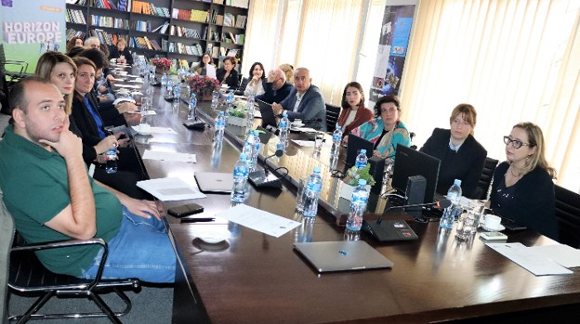
Widening Info Day - 13 October, 2022
Participants of the Info Day
Potential Applicants from different Universities
Coordinators and NCP-s of Grant Offices
Representatives of the international relations office of the Universities
Members and Head of Research Organizations
Total 130 participants
45

Slide 46
Individual Consultations:
National Center For Disease Control And Public Health
Centre for Computational Helio Studies, Ilia State University
Georgian National Energy And Water Supply Regulatory Commission
The International School of Economics at Tbilisi State University (ISET)
Child Development Institute, Ilia State University
School of Medicine, Ilia State University
46

Slide 47
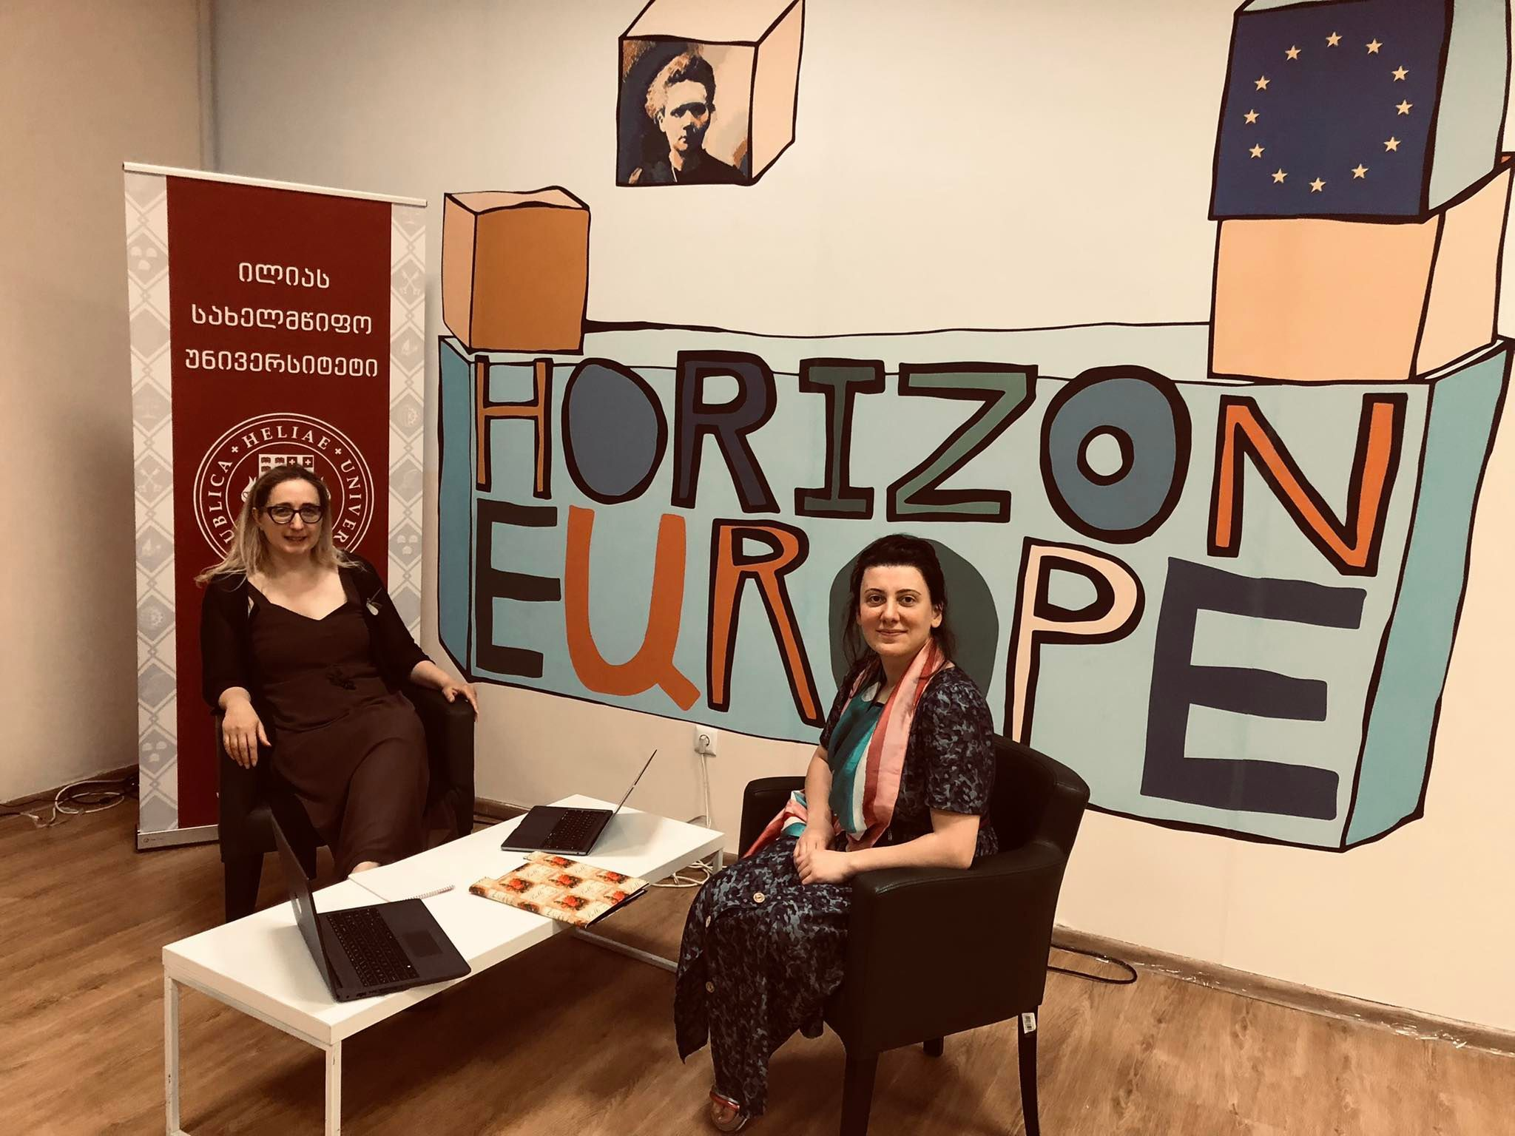
Key Stakeholders
Universities
Shota Rustaveli National Science Foundation of Georgia
Research organizations and centers, including non-university research centers
Civil society
Cultural actors
Legal Entities
47

Slide 48
Goals and Challenges
• Raise the country's interest in Widening
• Identify scientific groups that have the potential to participate in Widening
• Ultimately increase the involvement of the country in Widening
48

Slide 49
Partnerships and Missions
Partnerships:
The Horizon Europe National Office of Georgia facilitated Georgia’s participation in the European Partnership for Rare Diseases.
Commitment/ Intention Letter Ministry of Education and Science of Georgia
The letter of support provided by the Ministry of Internally Displaced Persons from the Occupied Territories, Labour, Health and Social Affairs of Georgia
Letter of Commitment from the New Vision University
Letter of Commitment from the Tbilisi State Medical University
Interest already declared:
European Partnership for Safe and Sustainable Food Systems for People, Planet and Climate
Annex I: Template for commitments to partnerships planned for 2023/24
European Partnership for Animal Health and Welfare
Missions: involved in preparation of proposal under the Missions NCP Project (HORIZON-MISS-2022-NCP-01-01)

Slide 50
Thank You for Your Attention.
Info@Horizoneurope.org.ge

