Slide 1
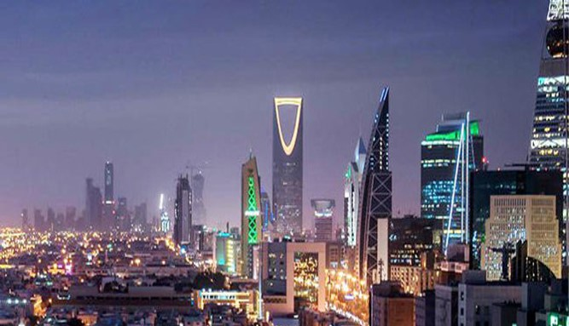
Saudi Arabia Market Overview
Healthcare and Life Science

Slide 2
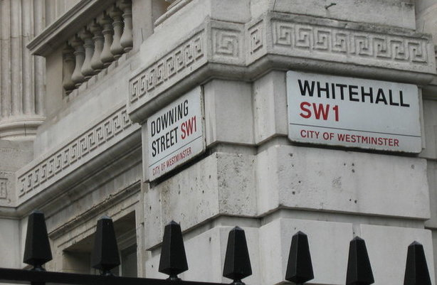
Department for International Trade Objectives
Enable and support firms to seize the opportunities of trade and international investment to establish a culture of exporting in the UK.
Ensure the UK is recognised as the best place to invest and to attract, retain and grow international investment that strengthens the economy.
Open markets, building a trade framework with new and existing partners which is free and fair.
Use trade and investment to underpin the Government’s agenda for a Global Britain and its ambitions for prosperity, stability and security worldwide.

Slide 3
Supporting UK entities
Support the strategic partnership between UK-Saudi Arabia and align that with our prosperity team who support the policy part of our engagements.
Provide a wide range of commercial and market entry advice.
Connecting companies with commercial opportunities and top stake holders.
Organise and support focused inward focused visits.
Organise trade mission with a focused themes that fits with the opportunities in the market.
Support exhibition both in Saudi Arabia and in the UK and build a marketing plan around them such as, trade mission webinar, events, round tables.
Not all of our services are for free (OMIS).

Slide 4
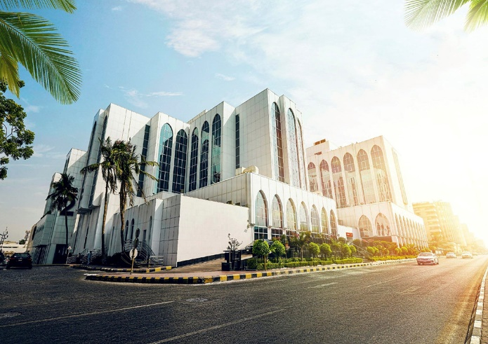
The KSA Healthcare and Life Sciences Sector
Healthcare and Life Sciences are priority sectors for Saudi Arabia. Allocated a budget of £11.6 bn for 2017.
Key Public Sector buyers are the Ministry of Health, Ministry of Interior, Ministry of Defense, Ministry of Education, and the National Guard.
The Private Sector has an increasingly important role to play, this is also highlighted under Vision 2030.
Key private sector players include: Tamer Group, Fakeeh, Batterjee, and Al-Ajou
Other, Quasi-Government players are: Saudi Aramco, Saudi Basic Industries Corporation (SABIC), Saudi Telecommunication Company (STC)
Key UK players in KSA are …

Slide 5
KSA Healthcare Opportunities
Demand for medical equipment, pharmaceuticals, digital health, and education & training.
The current market for medical devices is dominated by imports, which contribute to nearly 75% of the total medical device market.
The USA and the UK contribute the most to the imports of medical devices in Saudi Arabia. Those in demand include X-rays, CT scanners, Monitors, Ultrasound, Advanced Imaging, Surgical equipment.
The pharmaceutical market in Saudi Arabia estimated around $5.5 billion in 2017, with excepted grow to $5.6 billion by 2030. There are opportunities for Vaccines, Sterile injectables, Generics, Biosimilars, APIs.
Important to note, there is a focus on improving the domestic manufacturing of medical devices and pharmaceuticals. There are incentives for UK organizations wanting to set up local manufacturing.

Slide 6
KSA Routes to Market/Tips for Doing Business
Most common routes to market are as follows:
Agent / Distributor – Local representative (access to tenders)
Access to local technology incubators (i.e. BADIR) and technology/healthcare investment funds (i.e. Riyadh Techno Valley/PIF).
Develop networks and relationships
Overseas Delivery Partners – AEI (trade/ incubator services)
Familiarize yourself with traditions, culture, religion, customs etc.
** DUE DILIGENCE & LEGAL ADVICE RECOMMENDED**

Slide 7
Vision 2030
The program aims to restructure the health sector in the Kingdom to be a comprehensive, effective and integrated health system that is based on the health of the individual and society (including the citizen, the resident and the visitor).
The program depends on the principle of value-based care, which ensures transparency and financial sustainability by promoting public health and preventing diseases, in addition to applying the new model of care related to disease prevention.
The Privatization Program aims to enhance the role of the private sector in providing services and making government assets available.

Slide 8
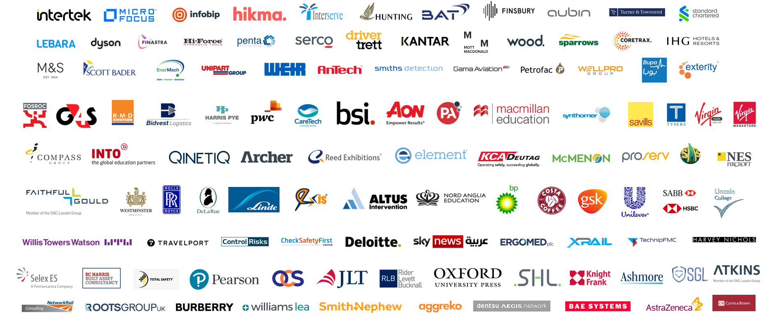
UK companies in Saudi Arabia

Slide 9
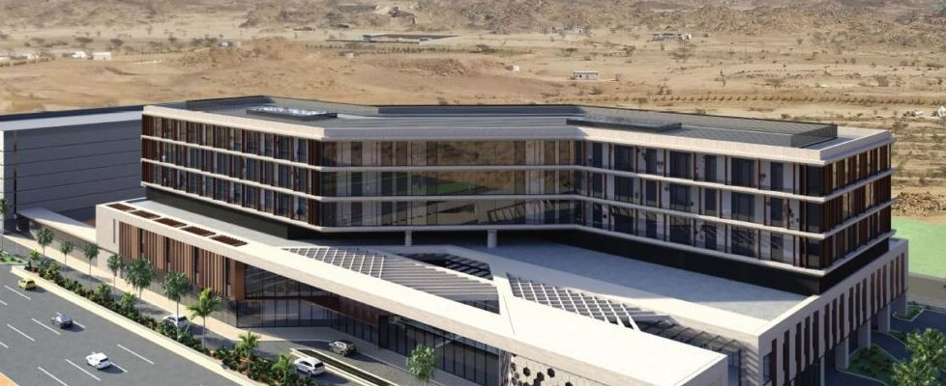
Case Study; King’s College
King’s college Launch in Jeddah, Saudi Arabia
DIT supported the entire process from their first scoping visit to the Kingdom of Saudi Arabia, in 2016, to the introduction to their now Saudi investment arm, the Bugshan group.
In 2022, The British mission in Saudi hosted a reception in Jeddah, on behalf of King’s and Ashmore to celebrate this milestone. The reception was attended by key Healthcare figures in the Kingdom
The Saudi Public investment fund (PIF) joined the Bugshan group as investors. paving the way for more wellbeing centres across the Western region of Saudi Arabia.
The first phase of the project, due to be completed in Q3 of 2023 will launch the 150 bed capacity hospital in Jeddah.
n 2024/25 The project will expand by another 100 beds.

Slide 10
Case Study Astra Zenica
The Partnership for Healthcare System Sustainability and Resilience
(PHSSR) in Saudi Arabia
The Partnership for Health System Sustainability and Resilience (PHSSR) is global collaboration between
academic, governmental, non-governmental, life sciences, healthcare and business organizations aimed
at studying and helping to build health systems that are both resilient to crises and sustainable in the
face of long-term stresses. The PHSSR was established in 2020 by the London School of Economics, the
World Economic Forum, and AstraZeneca, who were later joined by global-level partners that include
Royal Philips, KPMG, Apollo Hospitals and the Center for Asia-Pacific Resilience and Innovation. The
partnership also includes additional organisations at the regional and national levels such as the Saudi
Ministry of Health, the Ministry of National Guard Health Affairs.

