Slide 1




DIT Kuwait :
Healthcare and Life Sciences

Slide 2

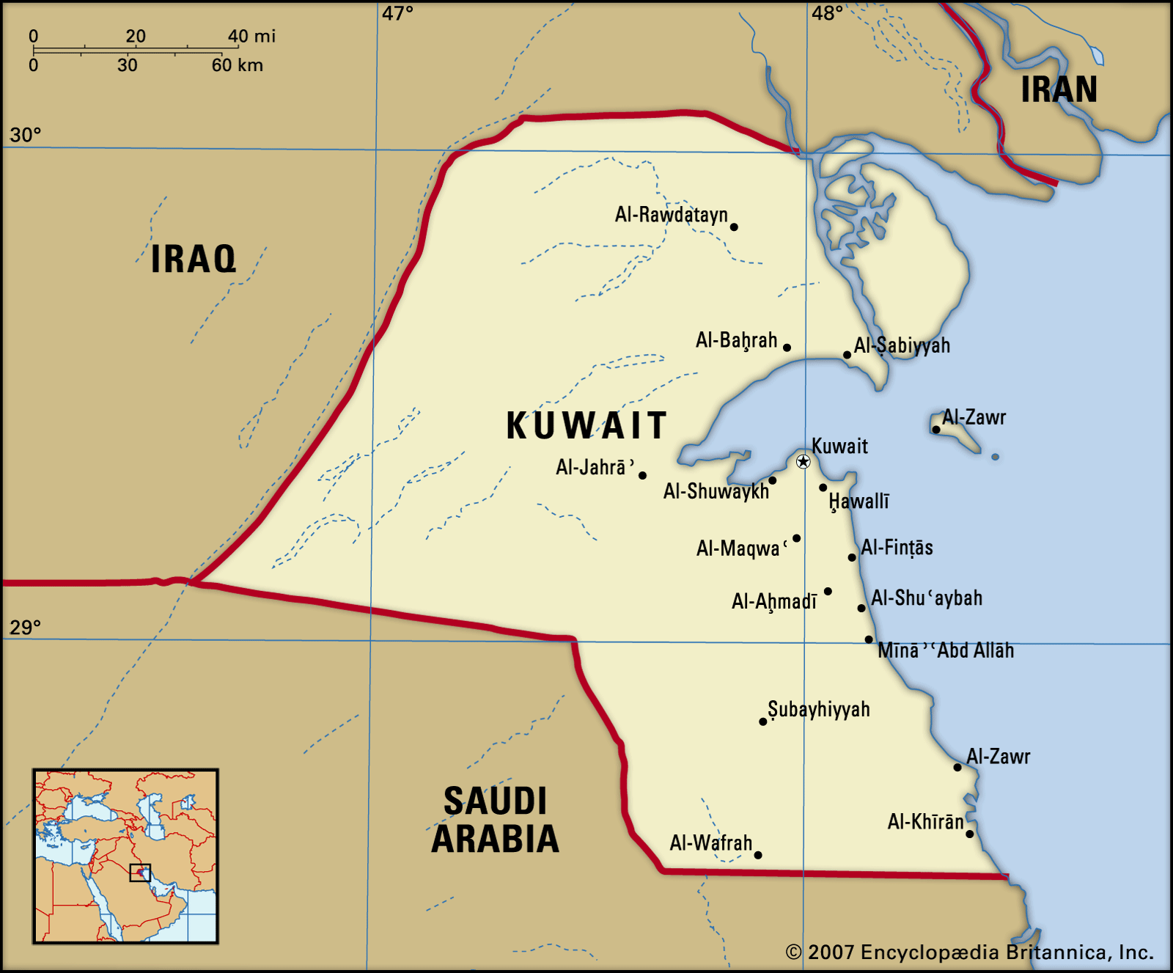
Healthcare and Life Sciences – Overview
Under-developed Healthcare system
Ambitious plans to develop capability and capacity
Be self sufficient in healthcare
Healthcare development plans – building hospitals, digitalisation of the healthcare system
Source expertise from abroad-interested in transfer of skills, know how and technology
Population/demographic
Confidence in UK standards and excellence

Slide 3
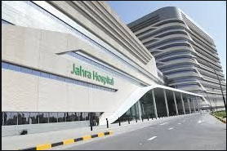
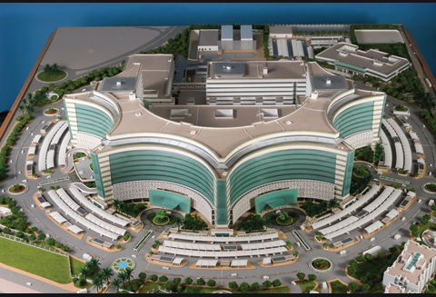

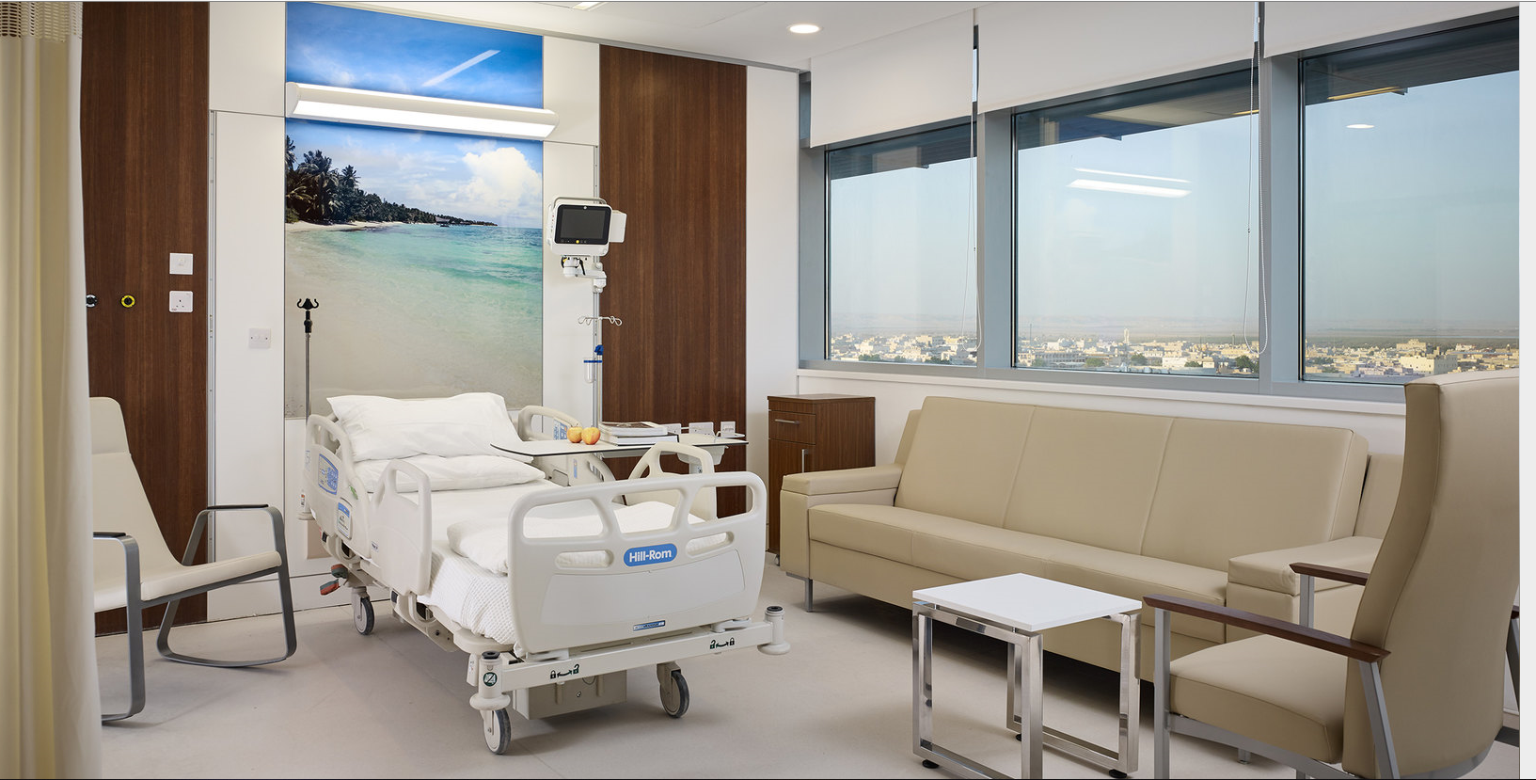
Healthcare System
The public health system in Kuwait has a number of stakeholders
Ministry of Health
Ministry of Public works
(4 new hospitals)
Diwan Al Amiri
(Al Jahra Hospital – 1234 beds)
Ministry of Defence
(Military hospital)
Kuwait Health Assurance Company (Dhaman – 3 hospitals for expats)
Kuwait Oil company
(new Ahmadi Hospital)
Private sector
3

Slide 4
Healthcare and Life Sciences - Opportunities
Hospital Management (patient-centric approach)
Medical Equipment Devices
Facilities Management
Pharmaceutical manufacturing
Generic medicine
Doctors and Nurses training for Kuwaiti doctors
Digital transition for healthcare and lifesciences
4
Notes:
The medical device market in Kuwait is expected to register a moderate grown of 11% CAGR driven by the demands of the private sector, rise in prevalence of chronic diseases and the investment in healthcare infrastructure in the country.
One of the biggest product segments to see a rise in demand will be the diagnostic imaging services.

Slide 5
Challenges for UK Companies
Lack of transparency
Procurement Procedures
Price Sensitivity
Taxation
Local customs and regulations
Competition
Delays in negotiations and decision making
5

Slide 6
Doing Business in the Kuwait
Due Diligence
Credible Partner
Regular communication with stake holders
Understand Market Challenges
Do your Research
Seek Legal Advice
PATIENCE!
Talk to DIT
6

Slide 7
How DIT Can Help You – Talk to us
Introduction to potential buyers
Bespoke visit programme
Trade Mission / Webinars / Events / Product Promotion and Marketing
Overseas Market introduction Services (OMIS)
7

Slide 8
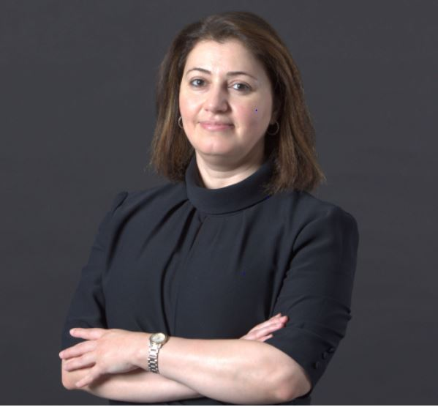
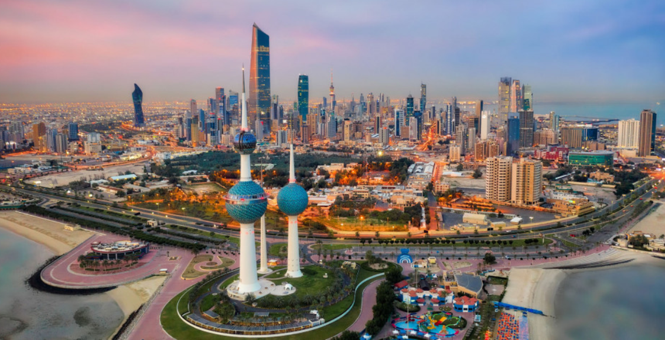
Gula Al Sharafi
Senior Trade Adviser
British Embassy, Kuwait
Email: gula.al-sharafi@fcdo.gov.uk

