Slide 1
M
The German Market
Medica 2022

Slide 2
MEDICA Trade Fair
Introduction
Only 40 days left until MEDICA 2022
MEDICA is the world’s largest event for the medical sector and takes place in November each year in Duesseldorf
For more than 40 years, MEDICA attracts several thousand exhibitors from more than 50 countries in the halls
Leading individuals from the fields of business, research, and politics grace this top-class event with their presence
.
.

Slide 3
MEDICA Trade Fair
Introduction
Main product categories:
1 - Imaging and diagnostics / medical equipment and device
2 - Laboratory equipment
3 - Diagnostic tests
4 - Physiotherapy / orthopaedic technology
5 - Disposables and consumables
6 - IT systems and IT solutions
7 - Medical Services and Publications
Main Target Group for Visitors: CEO/Managing Directors/Division Heads/Branch Heads/Head of Nursing/Skilled Worker/Hospital physician
.
.

Slide 4
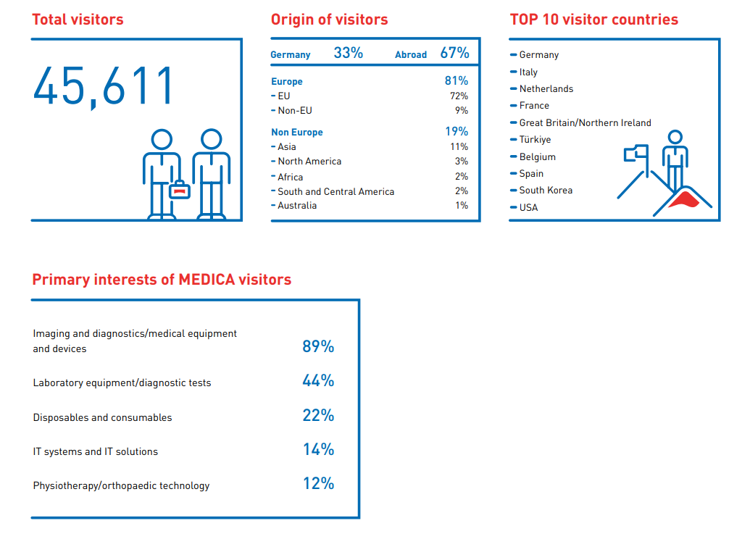
MEDICA Trade Fair
Visitor Statistics 2021
.
.

Slide 5
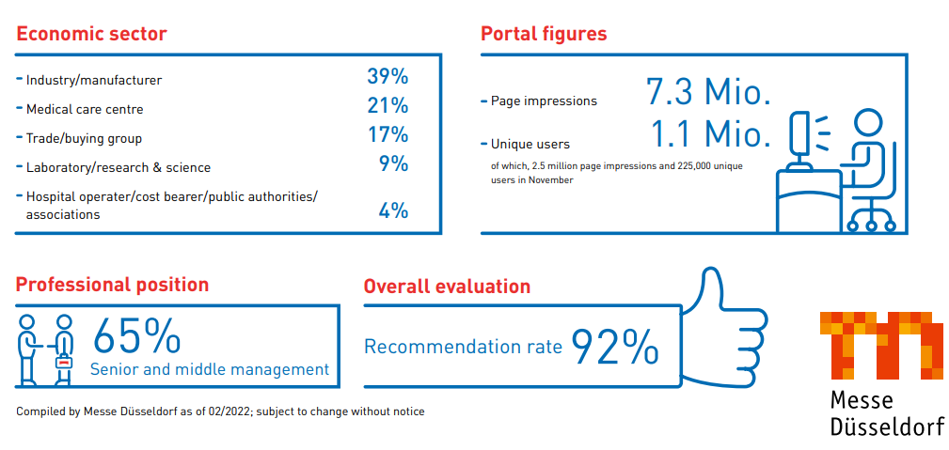
MEDICA Trade Fair
Visitor Statistics 2021
.
.

Slide 6
MEDICA Trade Fair
Comparison MEDICA 2019 to 2021
2019 | 2020
121,369 visitors from 176 countries | 45,611 visitors from 150 countries (- 62 % in visitors)
5,598 exhibitors from 68 countries | 3,523 exhibitors from 50 countries (-37% in exhibitors)
.
.

Slide 7
MEDICA Trade Fair
COVID-19 Measures
No Corona restrictions as the last two years, but measures can be reintroduced if the state of North Rhine-Westphalia identifies a localised, threatening infection situation.
Messe Düsseldorf will voluntarily adhere to hygiene and infection protection measures. The company continues to recommend wearing medical masks on its site and keeping a distance of 1.5 meters from other people.
Number of tickets will not be restricted, as there is enough space for everyone
.
.

Slide 8
MEDICA Trade Fair
COVID-19 Measures
The Federal Government no longer qualifies any countries as Corona risk areas, which means that the quarantine and registration obligations have also become obsolete, so that there are no longer any Corona-related entry restrictions to Germany for all participants of trade fairs. When entering Germany, a negative test result, proof of vaccination or proof of recovery must be presented.
More info: PROTaction - Questions & Answers (messe-duesseldorf.com)
.
.

Slide 9
The German Market
DIT in Germany
The UK’s Department for International Trade has overall responsibility for promoting trade across the world and attracting foreign investment to the UK In Germany DIT is represented in the British Embassy in Berlin and in the Consulates-General in Duesseldorf and Munich
The Life Sciences sector (Biotechnology, Pharma, Medical, Healthcare) is covered by Duesseldorf
.
.

Slide 10
The German Market
Germany Facts and Figures
Germany
has a population of 83 million (2021)
Is a highly developed industrial nation is the world’s 4th largest national economy after US, China, Japan is the largest market in Europe
offers reliable stable political and legal conditions
offers a highly developed infrastructure – easy access from the UK
.
.

Slide 11
The German Market
Germany - UK
About 1400 UK companies are operating in Germany through subsidiaries or affiliates, employing 280.000 people
Over 2500 German owned companies operate in the UK, employing nearly 450.000 people
UN Comtrade Data
Germany was the 2nd largest export market for UK medical devices companies in 2021, after the USA.
Germany has held this position for a considerable number of years.
.
.

Slide 12
The German Market
The Healthcare Sector
The German healthcare market is the largest in Europe
The German healthcare sector is one of the most important industries of the national economy.
In 2020 the level of healthcare expenditure was €440 billion which is an equivalent of 13% of the GDP
It is a job and growth motor of the economy
7.4 million employees in 2020 – every 6th job is related to health
.
.

Slide 13
The German Market
The German Healthcare System
Germany operates a dual health system with
Statutory Healthcare Insurances (97)
and Private Healthcare Insurances (42)
Contributions (14.6%) are directly related to gross income
Principle of solidarity and freedom of choice of a practitioner
.
.

Slide 14
The German Market
The German Medtech Market
The medtech sector is an important industry of the health economy
The sector is characterised by SMEs
It employs more than 235,000 people
It is an important driver for medical innovation
Medtech companies invest approx. 9% of their turnover in R&D
The export rate was 66% in 2020, the total revenue was €36 billion
.
.

Slide 15
The German Market
The German Medtech Market
The strengths of the market according to a survey amongst medtech companies - Well trained and educated staff - well trained scientists, engineers and doctors - highly developed infrastructure - high level of patient care - high standard of clinical research
.
.

Slide 16
The German Market
The German Medtech Market
The current situation: - The medtech sector slightly recovers from the corona period
- After an average decline in sales of 2.1% the industry expects to grow again
- Product areas such as surgical sets, surgical dressings and also the area of implants develop below average. The strongest growth in sales is achieved in medical equipment
The economic situation for companies has been and still is rather tight due to the risen costs for raw material, logistics and energy
.
.

Slide 17
The German Market
MDR – Medical Device Regulation
There is an ongoing discussion on the MDR. It is regarded as an obstacle for development in medtech because of
- higher costs for manufacturers / operators
- delayed market access
- patient care will suffer
- many products to disappear from the market
.
.

Slide 18
The German Market
Digitalisation
Corona has been a driver for digitalisation there is demand for digital services / equipment
Digital Healthcare Act, 2019 this is for better patient care through digitalisation and innovation - health apps on prescription - video consultations - electronic patient record - e-prescription and e-sick note
Hospital Future Act, 2019 this is an investment program to digitalise hospitals
.
.

Slide 19
Medica 2022
Medica Forums
Medica Connected Healthare Forum H12 E37
Medica Health IT Forum H12 E19
Medica Labmed Forum H1 G37
Medica Tech Forum H9 D05
.
.

Slide 20
Thank you for your attention!
Baerbel.Moeller@fcdo.gov.uk
Tugcem.Cengiz@fcdo.gov.uk

