Slide 1
Mapping of mobile networks coverage
Miguel Capela (ANACOM)
12th Independence of Regulators and Broadband
Expert Working Group Meeting
26th of November 2021

Slide 2
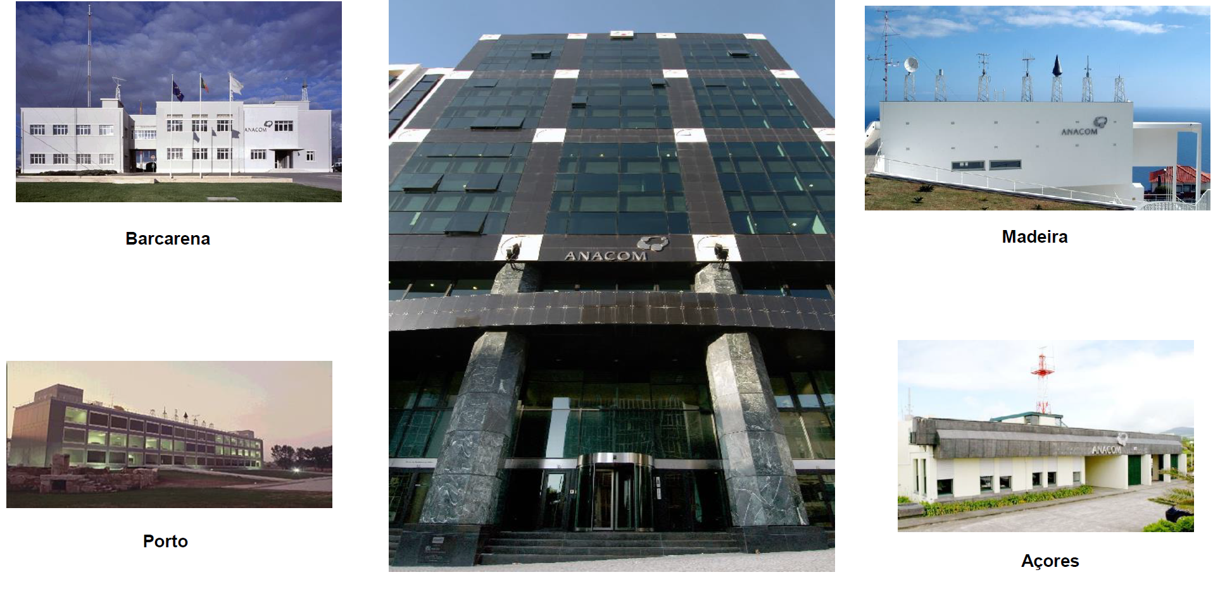
WHERE ARE WE AND WHO WE ARE
Lisboa (headquarters)
In brief …The National Communications Authority (ANACOM) regulates and
supervises the electronic and postal communications sector in Portugal, ensuring
national representation in the various relevant international fora

Slide 3
Maps … visible e invisible

Slide 4
Coverage of mobile networks - perspectives
(Theoretical) estimates of mobile network coverage
QoS (Quality of Service) – measurements by ANACOM
QoE (Quality of Experience) – measurements by consumers

Slide 5
(Theoretical) estimates of mobile network coverage – different approaches
Different approaches have been followed to create coverage maps, (information available per pixel):
Class speed is identified (e.g. 2 to 10 Mbps; 10 to 30 Mbps), but with or without the operator name?
Voice service with different quality of service levels
Data services mapped on a binary basis (ON/OFF approach), for 3G and 4G networks
Number os operators for 2G, 3G and 4G networks

Slide 6
ANACOM's project includes the participation of Portuguese mobile operators MEO, NOS and VODAFONE
Voice, SMS and MMS services are available using 2G (GSM) and 3G (UMTS) networks
Very good
Good
Acceptable
Limited
Not available

Slide 7
Data services are provided using 3G networks (UMTS/HSPA)
Fast 3G Broadband
Basic 3G Broadband
Limited access to 3G data
Not available
And … 4G (LTE)
Very Fast 4G Broadband
Basic 4G Broadband
Limited access to 4G data
Not available

Slide 8
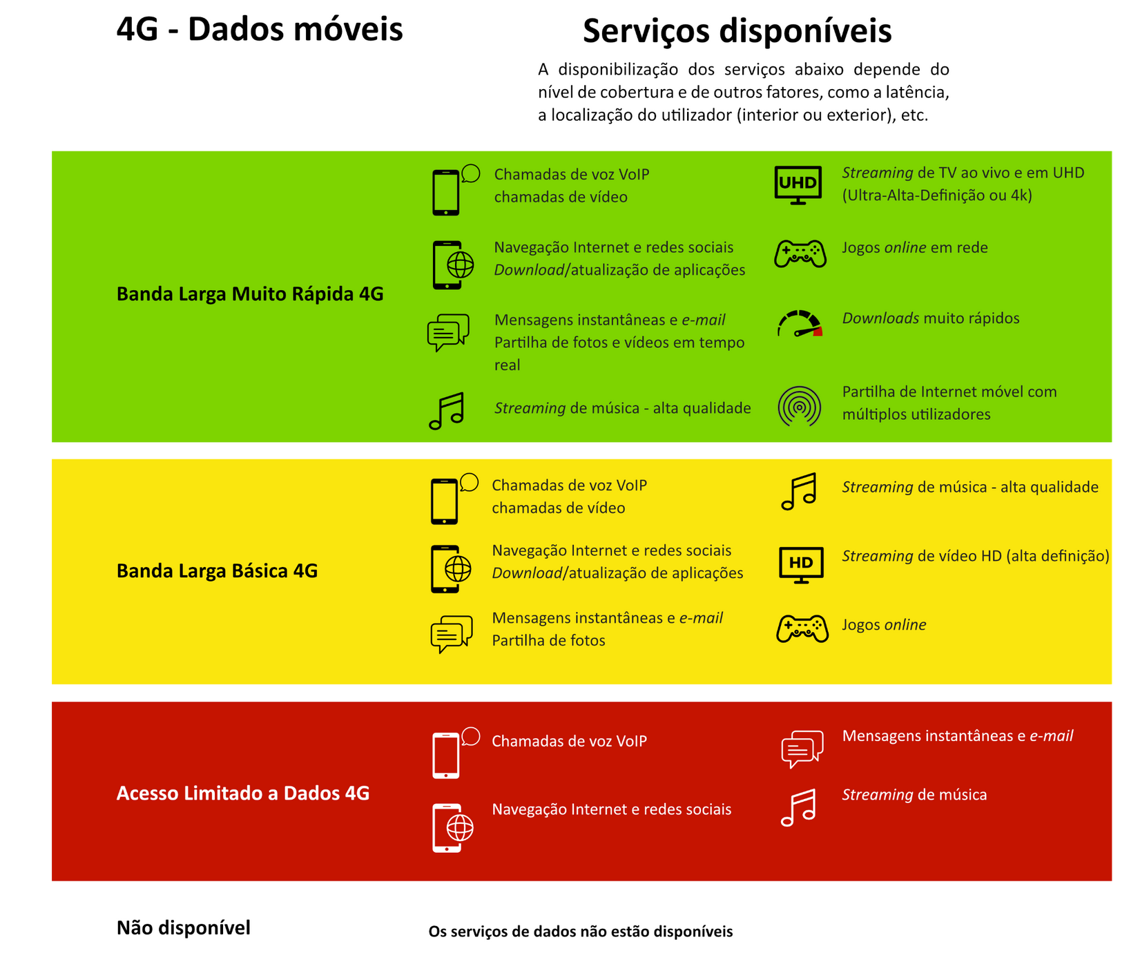
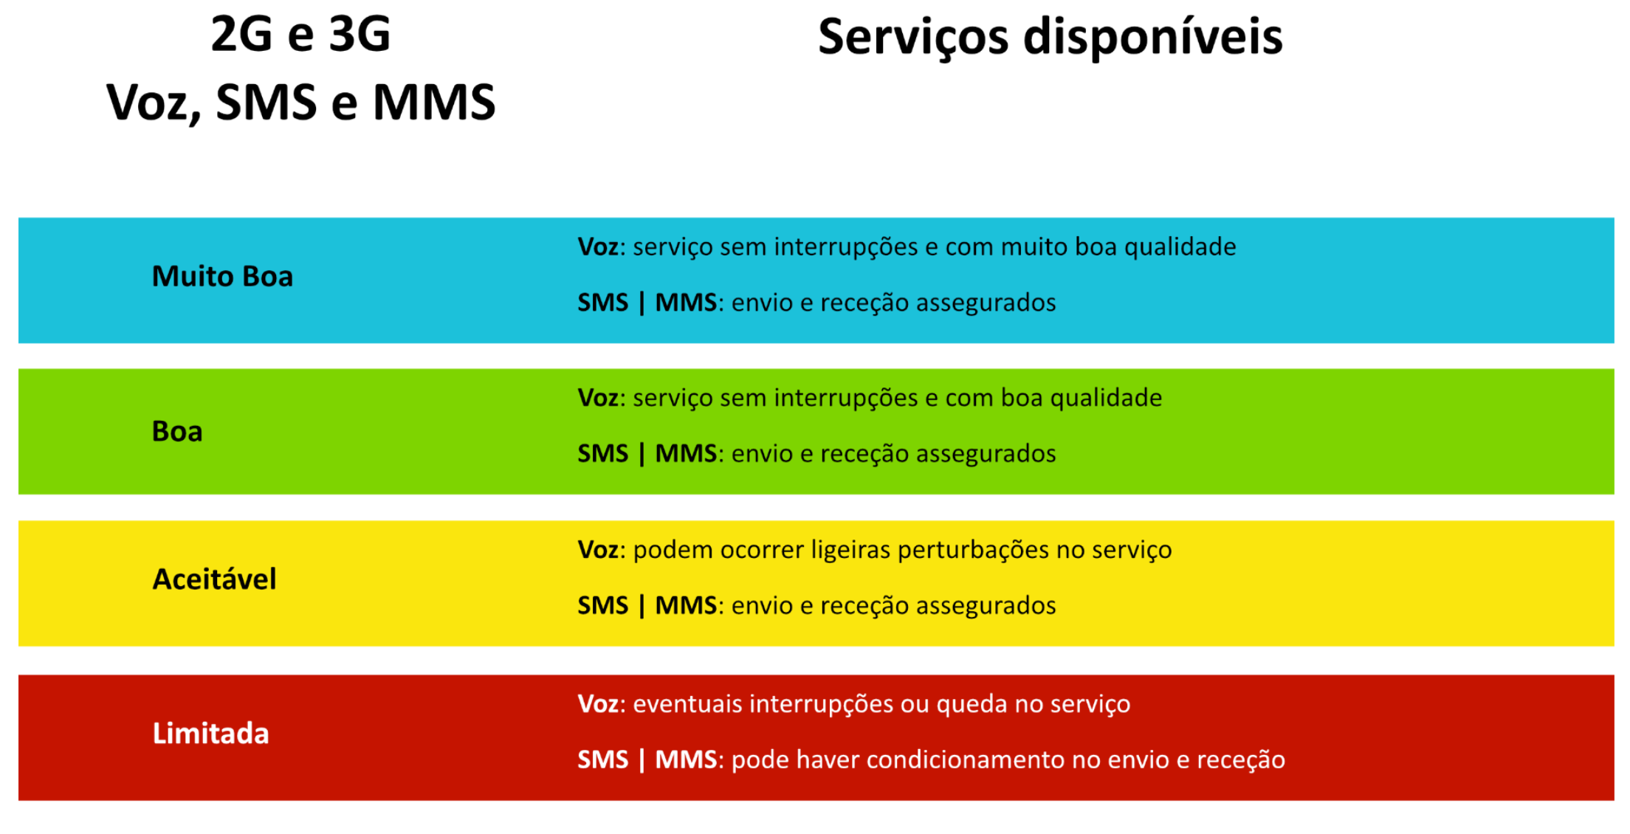
Detailed legend
Terms and conditions
Frequently asked questions

Slide 9
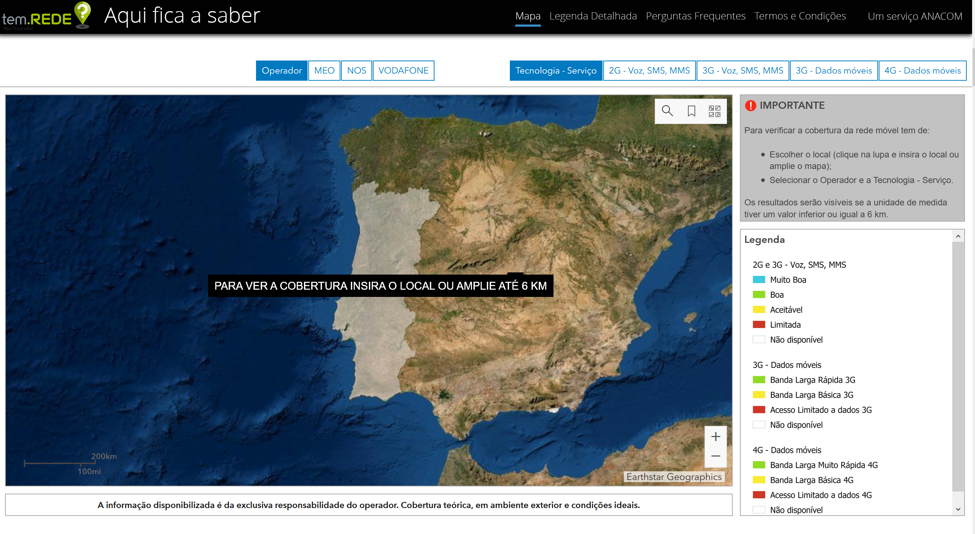
Available at www.anacom.pt and https://www.anacom-consumidor.pt/

Slide 10
ANACOM tool (It is the first tool of this type in Portugal) - only "DESKTOP version“ currently available
New version will be available soon (visualization in smartphones and without the 6 km limitation)
Contains the coverage of mobile operators' networks throughout the national territory
The information provided is exclusive responsibility of mobile operators
Mobile operators update the data coverage in tem.REDE?

Slide 11
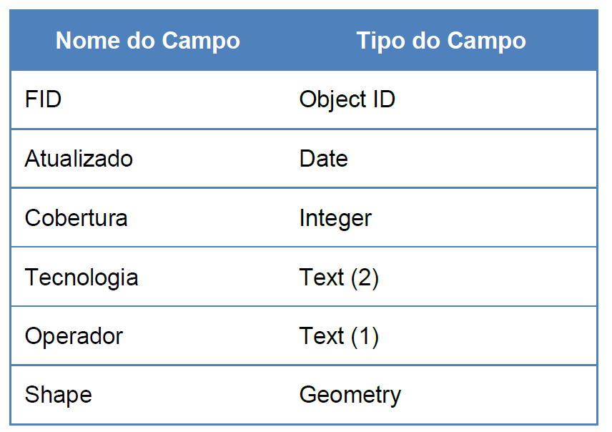
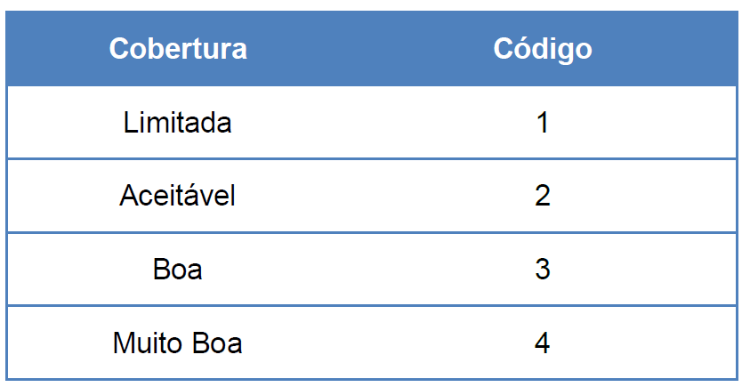
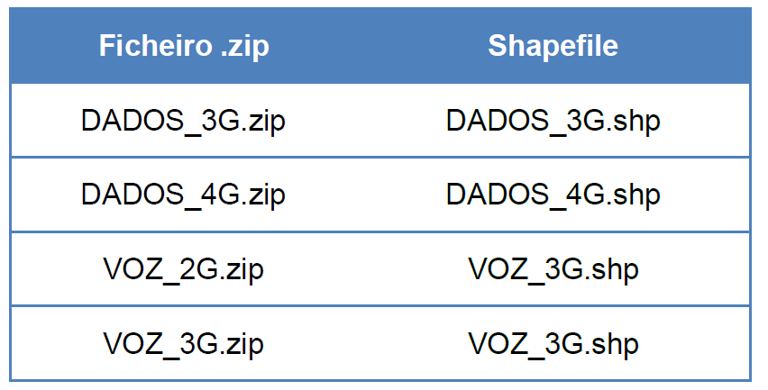
Architecture of the implemented solution
Data structure (polygons in shapefile format with WGS84 coordinates)

Slide 12
Coverage resolution: 100 by 100 meters
Coverages provided consider outdoor spaces and ideal conditions
Criteria (theoretical) previously defined and agreed between operators and ANACOM, namely the technical reception thresholds per service
Available coverage was calculated using theoretical models validated by mobile operators considering an user at 1.5 meters height
The coverage of mobile networks can vary depending on several factors such as where the users are and the number of simultaneous users

Slide 13
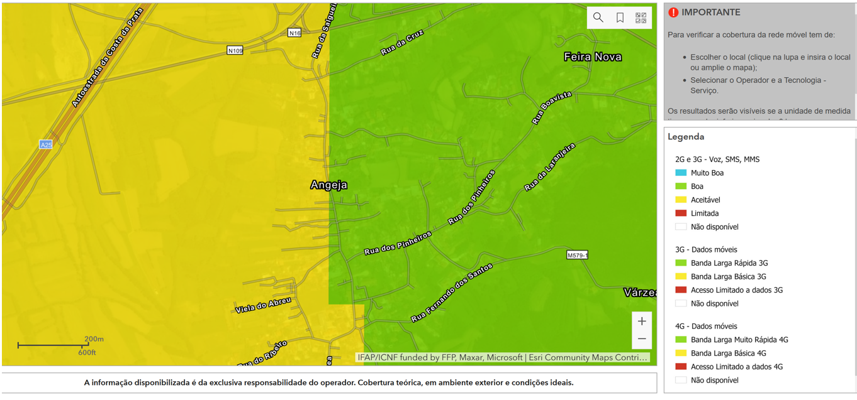
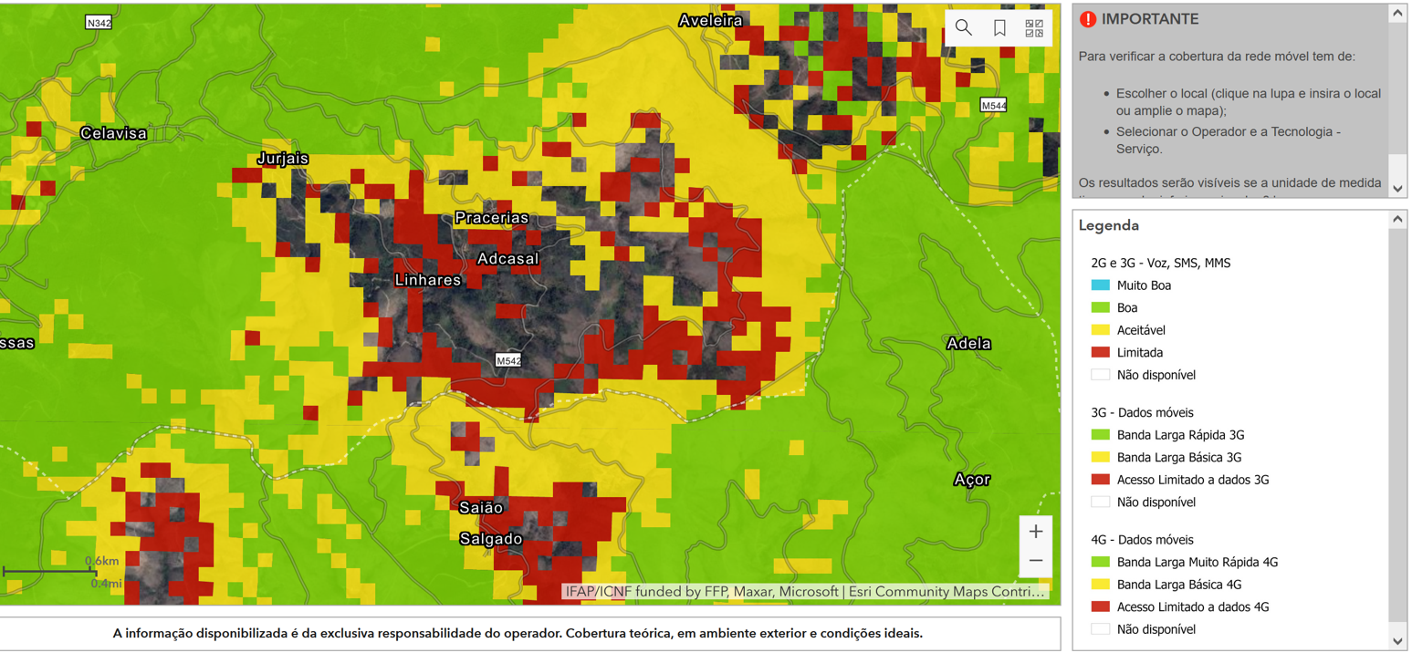

Slide 14
THANK YOU

