Slide 1
UK MedTech:
Your Partner in Healthcare
Innovation in Medical Technologies
“The Super Six”

Slide 2
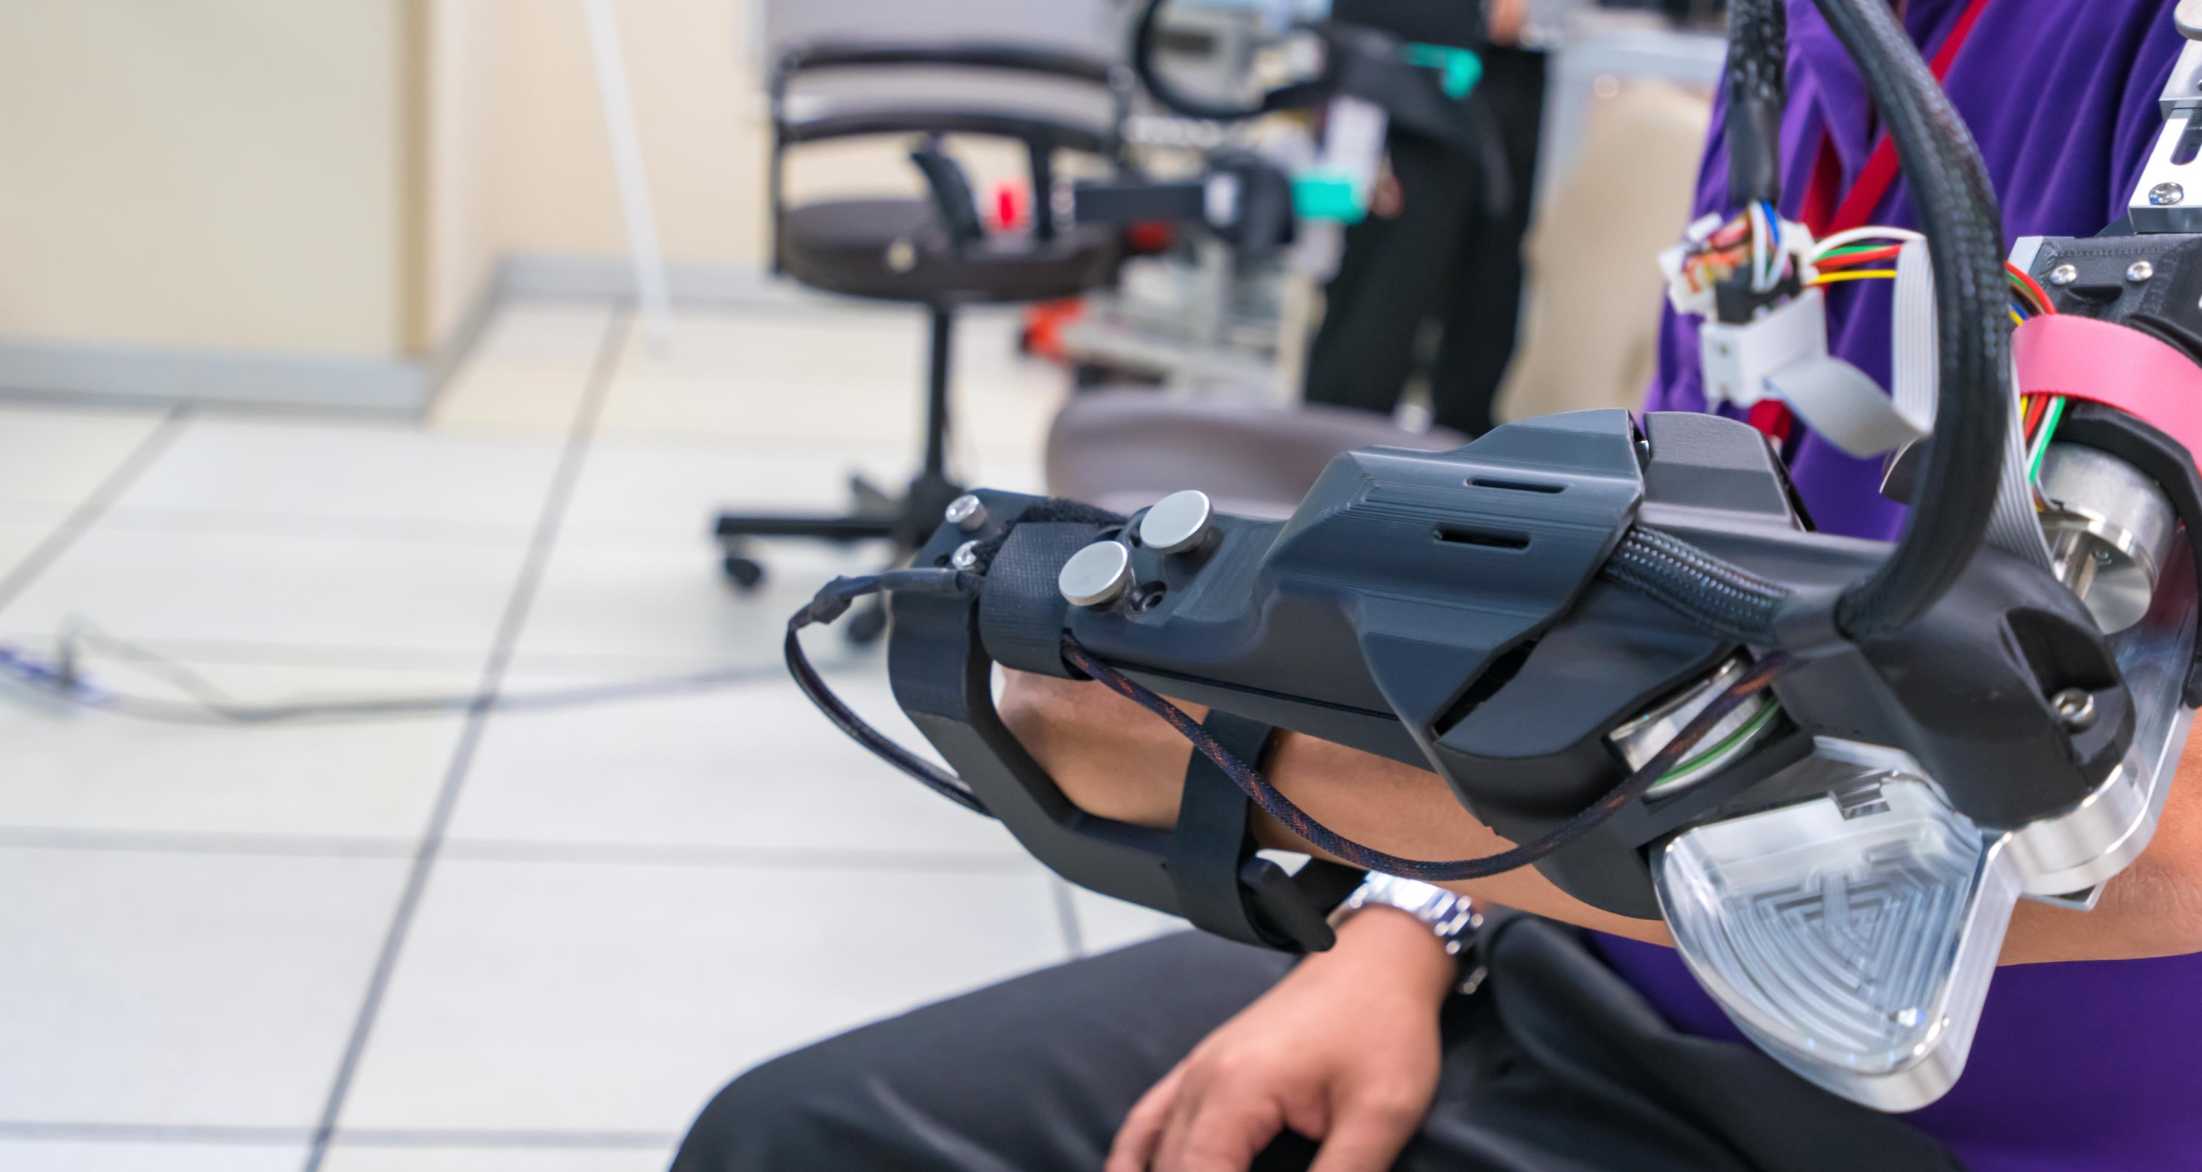
Contents
UK as the MedTech Launchpad
Opportunities for the UK MedTech Sector
How to Use This Material
The core UK offer areas:
Offer 1: Innovative Medical Devices
Offer 2: UK Diagnostics Expertise
Offer 3: Patient Facing Solutions
Offer 4: Clinical Trials, Assessments and Regulations
Offer 5: Design, Consultancy, Advisory and Services
Offer 6: Research and Innovation

Slide 3
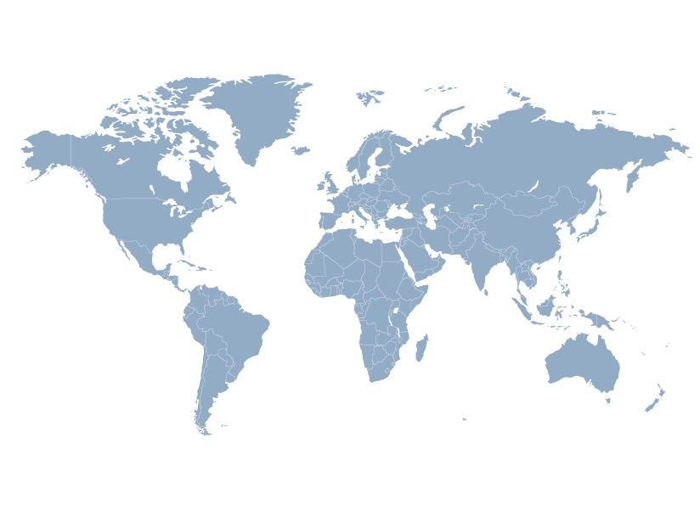
UK as the MedTech Launchpad
 | Why choose the UK | UK MedTech Sector | Innovative Medical Devices | UK Diagnostics Expertise | Patient Facing Solutions | Clinical Trials, Assessment & Regulations | Design, Consultancy & Services | Research & Innovation
Why Choose the UK
The UK is a leading global hub for MedTech, acting as a launchpad to the rest of the world for medical devices, diagnostics and digital health.
1. The UK is ranked 4th in the world for MedTech employment and is the 6th largest trader in the world and is the most globally connected economy. Life sciences is one of the UK’s top exporting sectors (£30bn/yr) with Medical Technologies exports valued at £3.9bn.
2. Scientific and Clinical Talent – our research and innovation data and infrastructure. Dedicated infrastructure for MedTech across the entire product innovation pathway supports UK and global evidence development.
3. Strong Industry – with underpinning excellence in innovative Medical Devices, Diagnostics and Digital Health, the UK has developed high quality approaches to Research and Innovation, Design, Service and Maintenance, the wider Supply Chain and Standards, Guidance and Regulation.
4. NHS as an innovation partner – the UK is a prime location to identify MedTech innovation and to research, develop and evaluate products and services in the NHS, one of the world's best healthcare systems.
5. The UK serves as a test bed for global market development, with well-established, pragmatic regulatory and guidance agencies working together to improve the national innovation pipeline and adoption process to streamline market entry aided by partnership working between Government and our Trade Associations.
Let us work with you to support your life science and healthcare needs in MedTech*
Underpinning excellence in innovative Medical Devices, Diagnostics and Digital Health, the UK has developed high quality approaches to the supporting areas of Research and Innovation, Design, Service and Maintenance and Standards, Guidance and Regulation.
*The company profiles and cases showcased in this offer are just a small selection of UK technologies. DIT has a database of suppliers that can fit your specific need, please get in touch to receive more information.

Slide 4
The UK offer: A rich, diverse, and internationally competitive ecosystem for life sciences innovation supported by active partnership between industry, the NHS, academia, charities and government
 | Why choose the UK | UK MedTech Sector | Innovative Medical Devices | UK Diagnostics Expertise | Patient Facing Solutions | Clinical Trials, Assessment & Regulations | Design, Consultancy & Services | Research & Innovation
Global hub for life sciences: A vibrant and growing life sciences hub, where inward investors can easily connect with researchers, supply chains, innovation networks and customers​
The NHS: An expert clinical, translational and research partner operating at scale in the National Health Service (NHS) to support global evidence development
Companies Benefit From
Science base: A leading science base, which offers industry access to world class talent, unique data and innovation infrastructure​
Partnership working: A comprehensive innovation ecosystem underpinned by a long-term Life Sciences Vision agreed between government and industry to achieve a vision for the future
Business environment: A globally competitive business and regulatory environment offers simplicity and value and enables access to new markets​

Slide 5
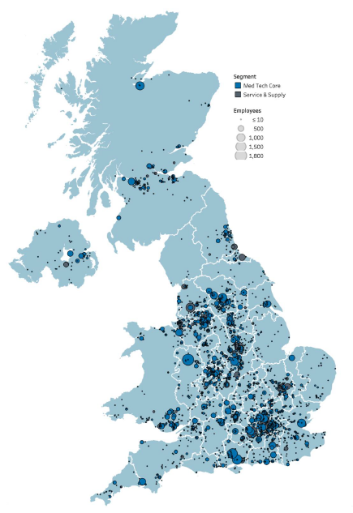
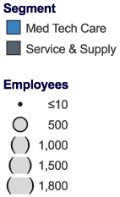
The UK MedTech Sector - Opportunities
 | Why choose the UK | UK MedTech Sector | Innovative Medical Devices | UK Diagnostics Expertise | Patient Facing Solutions | Clinical Trials, Assessment & Regulations | Design, Consultancy & Services | Research & Innovation
UK MedTech Opportunities
MedTech is a UK wide endeavour
Global trends of ageing populations, prevalence of chronic conditions and rising concerns over pandemics are leading enablers towards growth in the MedTech industry.
Medical technologies are converging together with the patient, software and clinician to optimise patient therapies to supporting better, longer, healthier lives. The UK is a global hotspot, with a strong domestic industry of MedTech innovators, expert services, supply chain and SME support.
Growth in precision medicine and companion diagnostics, along with a health system and consumer-led focus on preventative medicine and early detection of disease, has promoted extensive innovation, alongside advances in digital enabling of diagnostics, monitoring and treatment technologies.
The UK Core MedTech sector contains…
4,140 businesses…
…employing
138,000
people…
…with a turnover
of
£27.6bn
(2020)
…with the largest segment by turnover being in vitro diagnostics.

Slide 6
Innovative Medical Devices
 | Why choose the UK | UK MedTech Sector | Innovative Medical Devices | UK Diagnostics Expertise | Patient Facing Solutions | Clinical Trials, Assessment & Regulations | Design, Consultancy & Services | Research & Innovation
1
The UK has a strong history of Medical Device Innovation which is a growing area in the life sciences sector, as it seeks to better address patients' needs as part of routine care.
The UK leads the world in its research capabilities with world-class universities that consistently attract global talent, building on an existing rich history of ground-breaking medical innovations.
Innovators can take advantage of a unique and collaborative biomedical system with the NHS at its core, also offering a clear route to sell directly to it through the NHS Supply Chain.
Innovative Medical Devices

Slide 7
Innovative Medical Devices – supplier examples
 | Why choose the UK | UK MedTech Sector | Innovative Medical Devices | UK Diagnostics Expertise | Patient Facing Solutions | Clinical Trials, Assessment & Regulations | Design, Consultancy & Services | Research & Innovation
“CMR Surgical is a fast-growing global medical device company headquartered in Cambridge, UK that has developed a next-generation surgical robot, Versius®.
In 2019 it brought a versatile robotic system to the market. With Versius®, CMR aimed to disrupt the status quo and provide a new hospital-centric robotic solution to surgeons and hospitals, designed for high utilisation across multiple specialties.”
Blue Earth Diagnostics, an indirect subsidiary of Bracco Imaging S.p.A., is an international molecular imaging company developing and commercialising innovative diagnostic solutions that inform patient care and drive future therapies in cancer. Our expanding pipeline encompasses a variety of disease states, including prostate cancer and neuro-oncology. Blue Earth Diagnostics is committed to the timely development and commercialisation of precision radiopharmaceuticals for potential use in diagnostic imaging and therapy.
The Sentimag® localisation system, Magseed® marker and Magtrace® lymphatic tracer enable physicians to carry out localisation of tumours and support breast cancer staging, using just one platform. By adding greater flexibility and precision, and removing the need for both wires and radioactivity, the Sentimag is revolutionising breast cancer care worldwide.
Click the logo above to find out more
Click the logo above to find out more
Click the logo above to find out more
Click here for more examples of suppliers in this space

Slide 8
The UK has a complete ecosystem offer for MedTech innovation
 | Why choose the UK | UK MedTech Sector | Innovative Medical Devices | UK Diagnostics Expertise | Patient Facing Solutions | Clinical Trials, Assessment & Regulations | Design, Consultancy & Services | Research & Innovation
Invention & Creation
Identification of market value of concept, impact on outcomes and market access barriers.
Development (Prototype)
Development and refinement of product ready for regulatory assessment and clinical evaluation.
Development (Trials)
Clinical evaluation of product to demonstrate that it is safe and performs as intended.
Regulation
Assessment of product to ensure it conforms to the requirements for the relevant legislation in each jurisdiction in which the product is to be marketed.
Monitoring
Technology is continually monitored whilst on the market to ensure continued safety and efficacy compliance.
Commissioning & Adoption
Preparation for, and entry to market, development of business case & patient, economic and system impact and benefits.
Evaluation / Reimbursement
Evaluation and endorsement of the health and economic case, clarification of reimbursement approach.

Slide 9
UK Diagnostics Expertise
 | Why choose the UK | UK MedTech Sector | Innovative Medical Devices | UK Diagnostics Expertise | Patient Facing Solutions | Clinical Trials, Assessment & Regulations | Design, Consultancy & Services | Research & Innovation
2
Diagnostics are a growing segment of the UK healthcare landscape where approximately 70% of clinical decisions are based on In Vitro Diagnostics (IVD) tests including the application of genomics where the UK is world-leading. ​The NHS is the first national healthcare system to offer whole genome sequencing as part of routine care.​
This section of the offer is focused on diagnostic equipment covering the spectrum of devices, consumables, software and machines required to support patient diagnosis, for example, using imaging technology as well as diagnostics including imaging, genomics and diagnostics.
The NHS has announced 150 new NHS Community Diagnostics Hubs providing imaging, cardiorespiratory, pathology, endoscopy, and other services in recognition of the importance of the delivery of diagnostic modalities as close to the patient as possible.
UK Diagnostics Expertise

Slide 10
Diagnostics – supplier examples*
 | Why choose the UK | UK MedTech Sector | Innovative Medical Devices | UK Diagnostics Expertise | Patient Facing Solutions | Clinical Trials, Assessment & Regulations | Design, Consultancy & Services | Research & Innovation
Cognetivity | “Cognetivity is a technology company that has created a cognitive testing platform for use in medical, commercial and consumer environments. Cognetivity’s CognICATM uses Artificial Intelligence and machine learning techniques to help detect the earliest signs of cognitive impairment by testing the performance of large areas of the brain. CognICATM is currently available for clinical use in the USA, UK, UAE and Europe, with regulatory approval for other regions planned for 2022”. Click the logo to find out more… | ​
Yourgene Health | “Yourgene Health is a leading integrated technologies and services business headquartered in Manchester, UK, primarily developing and manufacturing simple and accurate molecular diagnostic solutions for reproductive health, precision medicine and infectious diseases. With facilities in Canada, Singapore and Taiwan and direct commercial presence in the USA, Columbia, France, Germany, India, Thailand and Australia they are truly a global business with a portfolio of over 100 products and services and customers in over 65 countries worldwide”. Click the logo to find out more… | ​
Owlstone | “Owlstone Medical’s vision is to save 100,000 lives through the development and application of Breath Biopsy®. This includes clinical diagnostic testing in the UK for digestive health, novel lung cancer and liver disease test development with clinical trials underway in Europe, North and South America, and providing breath research products and services to leading pharma and academic institutions worldwide”. Click the logo to find out more…
* Complementary diagnostic, supply and equipment companies are also highlighted in other publications including DIT's Covid 19 and Genomics offers.
Please get in touch to receive more information on our UK Offers.

Slide 11
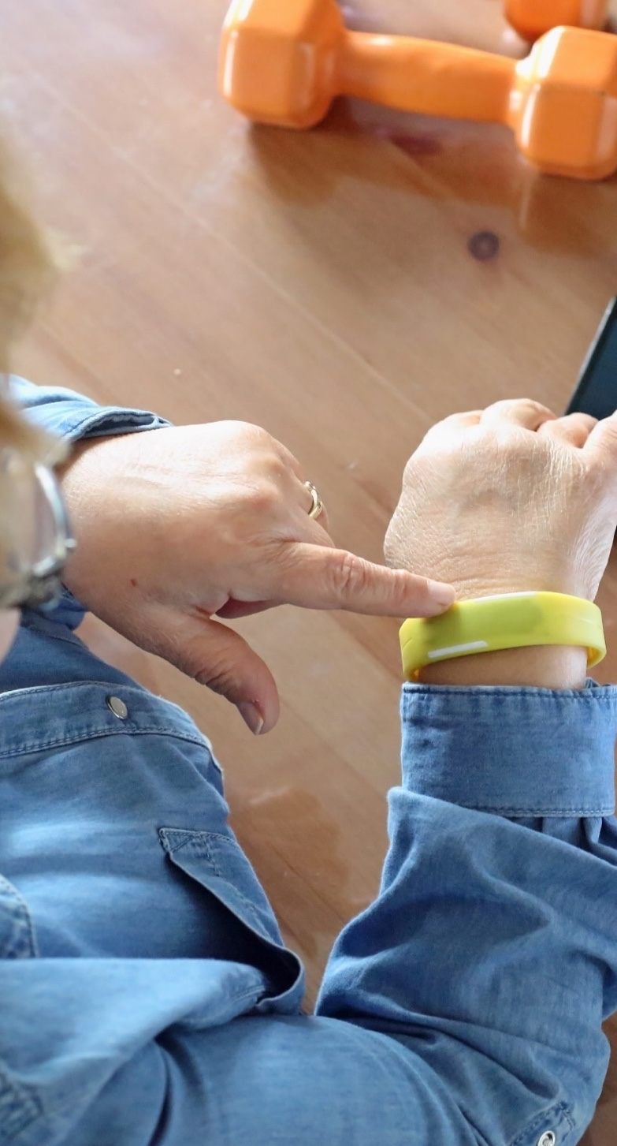
Patient Facing Solutions
 | Why choose the UK | UK MedTech Sector | Innovative Medical Devices | UK Diagnostics Expertise | Patient Facing Solutions | Clinical Trials, Assessment & Regulations | Design, Consultancy & Services | Research & Innovation
3
This offer focuses on new technologies that allow patients to better manage their own health and care alongside clinical support.
The NHS Long Term Plan states that people will be helped to stay well, to recognise important symptoms early, and to manage their own health, guided by digital tools.
Global value of wearable market will be $118.16bn by 2028.
There are various initiatives by government associations for the implementation of mobile focused health apps paving the way towards a wide range of suppliers that can fit your need.
https://transform.england.nhs.uk/key-tools-and-info/digital-technology-assessment-criteria-dtac/
Patient Facing Solutions

Slide 12
Patient Facing Solutions – supplier examples*
 | Why choose the UK | UK MedTech Sector | Innovative Medical Devices | UK Diagnostics Expertise | Patient Facing Solutions | Clinical Trials, Assessment & Regulations | Design, Consultancy & Services | Research & Innovation
Aparito | “Aparito digitises clinical trials, making it easier for patients to participate in rare disease studies and accelerate the drug development process. Their Atom5™ clinical trial platform provides Video Assessments, PROs, Telemedicine, EDC and eConsent, in 193 countries and 125 languages, all via one FDA 21 CFR Part 11 and GDPR compliant smartphone app”. Click the logo to find out more… | ​
Waire Health | “Waire Health operate in E.U., USA, UK, and Middle Eastern markets. Waire Health produce medical-grade wearable, autonomous, continuous, vital-signs monitors for use in hospitals and patient’s homes. Measuring a full range of vital-signs, all communications infrastructure is also incorporated internally within the sensor. This removes the need for infrastructure such as routers and hubs. All sensors have cellular, Wi-Fi and long-range Bluetooth 5 internally. Waire Health sensors also feature BP-Cuff integration, Weight Scale integration and Indoor Bluetooth beacon capability. Our sensors are platform agnostic and will integrate with any platform provider”. Click the logo to find out more… | ​
Neuro ProActive | “Neuro ProActive is a digital platform for rehabilitation and the management of long-term conditions. The platform is in the process of being adopted by a considerable proportion of NHS Trusts. Neuro ProActive addresses 33 of the 55 patient unmet needs defined by the National Institute of Health Research (NIHR). Developed to medical device standards, the platform can connect to various hospital systems and electronic patient records. Patients, therapists across six disciplines and family members combine for rehabilitation and long-term management”. Click the logo to find out more… | ​
The UK has an extensive offer of Digital Health solutions that can be found on our Digital Health First 100 Playbook: https://eu.eventscloud.com/ehome/200208923/first-100-digital/

Slide 13
Clinical Trials, Assessment & Regulations
 | Why choose the UK | UK MedTech Sector | Innovative Medical Devices | UK Diagnostics Expertise | Patient Facing Solutions | Clinical Trials, Assessment & Regulations | Design, Consultancy & Services | Research & Innovation
4
As a global MedTech innovator, the UK can be your partner for high quality evidence development.
The National Institute for Health and Care Research (NIHR) is the largest funder of health and care research including a national experimental medicine infrastructure and clinical trials network designed to work with industry.
Globally acknowledged regulatory environment delivered by Medicines and Healthcare Products Regulatory Agency (MHRA) and Health Technology Assessment (HTA).
The National Health Service (NHS) is the world’s largest integrated health system treating 1.4 million patients every 24 hours. Being the world first to adopt genomics, AI and early diagnostics. The NHS serves as a testbed for a global type market, promoting the use of emerging technologies and innovations.
Clinical Trials, Assessment & Regulations
In 2021/22, financial year, NIHR supported…
83 MedTech companies…
…and
18 CROs…
…to recruit
9,253
participants…
…into
137
MedTech studies.
That same year
27
MedTech studies closed…
...and, with our help
70%
Met their recruitment target on time.
of them

Slide 14
Clinical Trials, Assessment & Regulations
 | Why choose the UK | UK MedTech Sector | Innovative Medical Devices | UK Diagnostics Expertise | Patient Facing Solutions | Clinical Trials, Assessment & Regulations | Design, Consultancy & Services | Research & Innovation
NIHR partner with medical device, digital technology and diagnostic companies (collectively known as MedTech) to help them translate innovations into the health and care system, and on to market.
'Invention for Innovation' (i4i) is NIHR's dedicated research funding programme for MedTech, funding breakthrough technologies and de-risking projects for follow-on investment. Since launching, i4i has supported over 275 small and mid-sized enterprises, investing over £198 million.
NIHR's MedTech and In vitro diagnostic Co-operatives (MICs) are centres of excellence that bring together clinicians, health economists, statisticians and regulatory specialists to support industry. MICs support the identification of unmet needs to facilitate early-stage research, and foster collaboration to encourage adoption of innovations into the NHS.
National Institute for Health and Care Excellence (NICE)
NICE provides rigorous, independent assessment of medical technologies in order to balance the best care with value for money across the NHS and social care services. We identify and evaluate the most promising medical devices and diagnostics and aim to boost uptake where it is most needed. NICE also supports MedTech companies to demonstrate the value of their technologies. Find out more about our medical technologies guidance.
Provide an advisory service through NICE International – supporting international organisations to improve evidence-based decision making in health and social care. Contact NICE International to learn more about our approach to medtech.
Academic Health Science Networks – 15 operating across the UK
Yorkshire and Humber AHSN have a long track record of supporting international HealthTech companies on their UK market entry. One example is our Propel Bootcamp, in Leeds is our proven international accelerator programme. SMEs receive all the information that need to accelerate progress in the UK and NHS. Covering finance, legal, evidence generation, regulation and growth strategy. As well as getting direct engagement with NHS stakeholders to explore opportunities.
Click the logo above to find out more
Click the logo above to find out more
Click the logo above to find out more

Slide 15
Design, Consultancy and Services
 | Why choose the UK | UK MedTech Sector | Innovative Medical Devices | UK Diagnostics Expertise | Patient Facing Solutions | Clinical Trials, Assessment & Regulations | Design, Consultancy & Services | Research & Innovation
5
This offer illustrates the design, consultancy and services that are an integral element of the development, production and marketing process for high quality diagnostics.
Companies work hand in hand with our national network for NHS healthcare innovation supporting product design and development from NHS and independent innovators.
The UK boasts a variety of advisors in the diagnostics supply chain; from large multinationals to highly focused MedTech design houses.
Specialist consultants are the third largest group by turnover in the UK’s core MedTech service and supply sector.
Design, Consultancy and Services

Slide 16
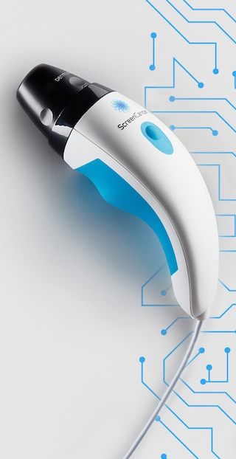
Design, Consultancy and Services – supplier examples*
 | Why choose the UK | UK MedTech Sector | Innovative Medical Devices | UK Diagnostics Expertise | Patient Facing Solutions | Clinical Trials, Assessment & Regulations | Design, Consultancy & Services | Research & Innovation
eg technology | “A Cambridge-based product design, engineering and development specialist, operating across UK, USA & Europe. We are ISO 13485 accredited with extensive MedTech experience, including microfluidics, diagnostics, surgical instruments and lateral flow. Our engineers are highly skilled in taking devices from concept through to transfer-to-manufacture, with compliance to standards for safety, quality, risk management and traceability”. Click the logo to find out more…
Loft Digital | “Loft is an award-winning digital consultancy and software developer with particular expertise in digital health. We design, build and manage systems and advise on tech and data strategies. We have been building ground-breaking digital technology since 2007, working with companies of all sizes from start-ups to major brands. Loft is headquartered in London and provides services globally”.
Haughton Design | “HD specialise in developing innovative new medical devices and technology to the highest international standards. Clients include some of the world’s largest companies in the medical device, IVD and pharmaceutical sectors – they value that HD develop user focused products, overcome challenges and deliver projects quickly. HD operate in the UK, EU, USA, Saudi Arabia and are eager to build new international relationships”. Click the logo to find out more…
Avensys | “Consist of 5 divisions; Repair and Maintenance, Endoscopy, Training, Resale, and Dental. They are part of the international VAMED Healthcare Vitality group - a global provider for hospitals and other facilities in the healthcare sector, operating out of 90 countries globally. A highly regarded supplier of Bio-Medical Training services working with the NHS (National Health Service) and private hospitals. Over the last 12 months they have trained more than 300 medical engineers including 120 apprenticeships for NHS clients, OEMs and 3rd party providers”. Click the logo to find out more…

Slide 17
Research and Innovation
 | Why choose the UK | UK MedTech Sector | Innovative Medical Devices | UK Diagnostics Expertise | Patient Facing Solutions | Clinical Trials, Assessment & Regulations | Design, Consultancy & Services | Research & Innovation
6
Extensive Government R&D funding and an integrated, supportive clinical environment with unparalleled patient data sources from the NHS ensure that the UK is at the forefront of clinical diagnostic research and innovation services highlighted in this offer. The UK is also the first nation in the world to apply whole genome sequencing at scale at the interface between cutting-edge research and clinical care, building on successful delivery of the 100,000 Genomes Project.
The UK ranks first in Europe for the number of early clinical trials and the UK system wide, multi-agency approach.
Research and Innovation

Slide 18
NIHR Children and Young People MedTech Cooperative (NIHR CYP MedTech) – supplier examples
 | Why choose the UK | UK MedTech Sector | Innovative Medical Devices | UK Diagnostics Expertise | Patient Facing Solutions | Clinical Trials, Assessment & Regulations | Design, Consultancy & Services | Research & Innovation
NIHR CYP MedTech is one of the most extensive child health technology networks in the world. It is one of the 11 MedTech and In Vitro Diagnostics Co-operatives (MICs) funded by the National Institute of Health and Care Research (NIHR) covering a wide variety of MedTech application themes.
NIHR CYP MedTech focuses on early-stage technology development and prioritises innovations that fit within their seven themes:
Cancer
Epilepsy, Movement, and Muscle Disorders
Neonatal Technologies
Rare Diseases
Respiratory, Sleep, and Ventilation
Surgical Technologies
Transition (cross-cutting theme)
Each theme is led by leading clinicians based at NHS Trusts across England.
The National Centre for Child Health Technology
The National Centre for Child Health Technology (NCCHT) will provide the world’s most advanced healthcare for children and young people. The NCCHT will drive child health technology research at pace and scale, stimulate technical innovation, attract inward investment, and support sustainable change to reduce costs to the NHS and other healthcare systems. The NCCHT will be an international centre of excellence supporting world-leading research and innovation through partnerships between industry, clinical and academic experts. It will develop technologies to address key national strategic priorities in child health including childhood obesity, child and adolescent mental health, cancer, disabilities, long term conditions and prevention. The ecosystem will bring together industry, academia, clinicians, patients, and families creating high value products to improve future and long-term health of children and young people.
The Centre, located at Sheffield Olympic Legacy Park, will:
Accelerate the development, evaluation and commercialization of child health technologies at a scale
Attract national and international inward investment, create highly skilled jobs and develop new companies, and rapidly accelerate the growth of existing companies
Reduce NHS and other healthcare system costs through early diffusion and adoption
Create long-term sustainable health change, reducing the burden of ill health for decades to come

Slide 19
UK Trade and Professional Associations
 | Why choose the UK | UK MedTech Sector | Innovative Medical Devices | UK Diagnostics Expertise | Patient Facing Solutions | Clinical Trials, Assessment & Regulations | Design, Consultancy & Services | Research & Innovation
ABHI | “ABHI is the UK’s leading industry association for health technology. We represent the industry to stakeholders, such as the government, NHS and regulators. ABHI’s 330 members account for approximately 80% of the sector by value”. Click the logo to find out more… | ​
BIVDA | “BIVDA is the national industry association for manufacturers and distributors of IVD products & technology in the UK. We represent more than 95% of the industry and 236 organisations ranging from British start-up companies to UK subsidiaries of multinational corporations. BIVDA members sales to the NHS were approximately £1.2 billion in 2021 and we have thriving export sales businesses, providing vital tests around the globe”. Click the logo to find out more…
GAMBICA | “GAMBICA is the trade association for Instrumentation, Control, Automation and Laboratory Technology in the UK. Join GAMBICA and become part of a community of likeminded businesses, share sector knowledge and increase your industry influence. Membership comes with many benefits from regular data and trend reports to free legal and HR services plus access to meeting spaces at our London office. GAMBICA also offers excellent opportunities to network and expand your international customer base by joining us at a variety of overseas events”. Click the logo to find out more…
Medilink | “Medilink UK is a professional association and specialist service provider for the Life Science Industry. Our mission is to enhance the competitiveness and profitability of life science businesses, academic and clinical communities by harnessing the collective strengths of our regional partners and by offering a range of specialist services, spanning ‘innovation, commercialisation & regulatory’, ‘marketing, communications & design’ and ‘international market access’. Medilink UK provides a gateway to secure global international trade & partnerships”. Click the logo to find out more…
AXREM | “AXREM is the trade association representing the suppliers of diagnostic medical imaging, radiotherapy, healthcare IT and care equipment in the UK”. Click the logo to find out more…
KTN | “KTN exists to connect innovators with new partners and new opportunities beyond their existing thinking – accelerating ambitious ideas into real-world solutions. Our diverse connections and deep expertise enable us to be a trusted guide through a global landscape of research, development and innovation”. Click the logo to find out more…

Slide 20
What Department for International Trade offer
The UK has a rich and diverse ecosystem with many private sector suppliers and public sector capabilities, across MedTech invention, development and adoption.
Department for International Trade (DIT) offer access to advice on Product and Service Development, Including Innovation, IP (Intellectual Property) and standards.
DIT link international businesses with the right UK partners and suppliers through meet-the-buyer events, networking receptions, and product launches.
Find out more here: https://www.events.great.gov.uk/ehome/index.php?eventid=200183029&
DIT also offers a comprehensive support for inward investors. You can also check out information about the market and a sample of investment opportunities on the Investment Atlas: https://www.great.gov.uk/international/investment/
This offer is meant to shine a spotlight on MedTech in the UK, but we are keen to connect on your specific requirements and how we can connect you to the UK opportunity that best matches your needs.

Slide 21
How DIT can help you?
The Department for International Trade (DIT) helps businesses export and grow into global markets. We provide practical support to UK businesses at home and to buyers overseas.
Support for UK exporters
We can provide support on:
Export strategy and planning
Identifying new market opportunities
Introductions to new supply chains, sales and marketing, including market knowledge and identifying possible business partners
Access to trade events, missions and webinars
Product and service development, including innovation, IP (intellectual property) and standards
Export operations, including legal and regulatory issues, export controls, documentation, logistics and distribution
Getting paid and export finance
Support for international buyers
We can provide support on:
Our find a supplier service allows international buyers to connect with UK businesses.
We link international businesses with the right UK partners and suppliers through meet-the-buyer events, networking receptions, and product launches.
Through UK Export Finance, we can provide loans to overseas buyers of goods and services from the UK. UKEF also can offer financial guarantees to banks, giving real reassurance to all sides of international trade deals, and allowing overseas buyers to benefit from the UK’s credit rating.
Contact us today: Lifescience@trade.gov.uk

Slide 22
November 2022

