Slide 1
Exporting to the English Speaking Caribbean
Presented by: Vincent Ramlochan
Senior Trade and Investment Advisor
DIT Caribbean Team
Notes:
Good Day, My name is Vincent Ramlochan- Senior Trade and Investment Advisor and the LS and Healthcare Sector Lead for the English Speaking Caribbean.
I will be providing you with a brief presentation on Exporting to the English Speaking Caribbean. My presentation will focus on an economic and sector overview, the regulatory environment for medical devices and opportunities for UK firms.

Slide 2
DIT Caribbean Team
Barbados
Jamaica
Trinidad and Tobago
Guyana
St Lucia
St Vincent and the Grenadines
Dominica
Suriname
Grenada
Antigua and Barbuda
St Kitts and Nevis
Notes:
The English Speaking Caribbean covered by DIT consists of 11 countries that all are all members of the Caribbean Community (CARICOM). However, DIT has offices in the following countries:
Trinidad and Tobago
Jamaica
Guyana – with responsibility for Suriname
Barbados- with responsibility for the following Organization of Eastern Caribbean States (OECS): St Lucia, St Vincent and the Grenadines, Dominica, Grenada, Antigua and Barbuda and St Kitts and Nevis.

Slide 3
Economic Overview of the English Speaking Caribbean
The IMF forecast that the region will grow by 3.7% in 2022
Debt remains a significant challenge for the Caribbean.
Upward pressure on inflation
High levels of foreign reserves.
Notes:
Caribbean economies were especially hard hit by the pandemic and lockdowns, contracting three times as much as the rest of the world in 2020. While tourism remains below pre-COVID levels for most countries, it is on the rebound and gaining momentum. And the IMF expects the region to grow by about 3.7 percent this year. On the back of a “solid” first half of the year, and despite an expected slowdown in the second half, the IMF forecast the region to grow by 3.0 percent this year, an upgrade from its April forecast of 2.5 percent. But it said the region faces “significant challenges,” including tightening global financial conditions, lower global growth, persistent inflation, and increasing social tensions amid growing food and energy insecurity. “These factors contribute to our downgrade in growth to 2.0 percent in 2023, 0.5 percentage point lower than anticipated in April,” the IMF said.
It said the strength of the post-pandemic recoveries has varied across the region.
Debt remains a significant challenge for the Caribbean, For most countries in the region, government debt is elevated, due in part to spending that was vital to the pandemic response—and tightening global financial conditions will increase the costs of servicing current debt, as well as in acquiring new financing. Tightening global financial conditions will also require added vigilance to preserve financial stability in the region, especially as debt suspension programs from earlier in the pandemic expire.
Still, there are big hurdles to overcome now and to build resilience for the future. Higher global food and fuel prices, exacerbated by the war in Ukraine, are putting upward pressure on inflation—stretching household budgets already stressed by the pandemic. Central banks in the region also have an important role. Like their counterparts around the world, those with independent monetary policy should act decisively to address inflation and communicate clearly.
There are high levels of foreign reserves sitting in most central banks due to the recent influx of emergency concessional finance. Maintaining this stability however is contingent on countries returning to a sustainable fiscal pathway in the coming years through both higher growth and prudent fiscal policies.
Together we can define the right economic policies that can tame inflation, protect the most vulnerable, address debt, and fight climate change—so as to reinforce the economic recovery, and build resilience to future shocks.
The Caribbean and the IMF: Building on a Strong Partnership

Slide 4
Overview of the Life Sciences Sector
The Small Island Developing States in the Caribbean rely heavily on importation to meet local demand.
The main opportunities for UK companies are in pharmaceuticals, non-pharmaceuticals, digital health, medical devices and the construction and outfitting of new hospitals.
There is over £1 billion in public sector opportunities for UK companies in Barbados, Guyana, Jamaica, Trinidad & Tobago and the Eastern Caribbean islands
Aid Funded procurement opportunities are available to UK companies from the World Bank, Inter-American Development Bank, Caribbean Development Bank and USAID
The CARIFORUM-UK Economic Partnership Agreement (EPA) guarantees UK exporters duty-free quota-free access to 14 Caribbean markets on approximately 80% of products on a phased basis.
Notes:
The Caribbean is a net importer and relies heavily on foreign suppliers to meet the countries’ healthcare needs. There is no manufacturing of medical devices in the Caribbean. Given this, the Caribbean imports approximately 100% of medical devices products. Donation as usually received from governments around the world.
The top supplying markets to the Caribbean are USA, Panama, UK, Germany and Canada.
There is over £250 million in public sector opportunities for medical devices in Barbados, Guyana, Jamaica and Trinidad & Tobago for UK companies.
Aid funded procurement opportunities are available to UK companies from the World Bank, Inter-American Development Bank, Caribbean Development Bank and the USAID focused mainly on the C-19 response.
As we seek to recover stronger from the Covid-19 pandemic, the CARIFORUM-UK Economic Partnership Agreement (EPA) has the potential to further stimulate and expand your exports to 14 dynamic markets in the Caribbean.
The EPA, which came into effect between the UK and 14 CARIFORUM States at the start of this year, provides UK firms with preferential market access to the region by progressively reducing or eliminating tariffs on approximately 80% of UK goods; including medical equipment.
It is further estimated by 2033, the vast majority of UK products will enter the Caribbean at a 0% tariff rate. This means that UK companies have a greater competitive advantage over other competitors, particularly those countries that do not have a trade partnership with the Caribbean.

Slide 5
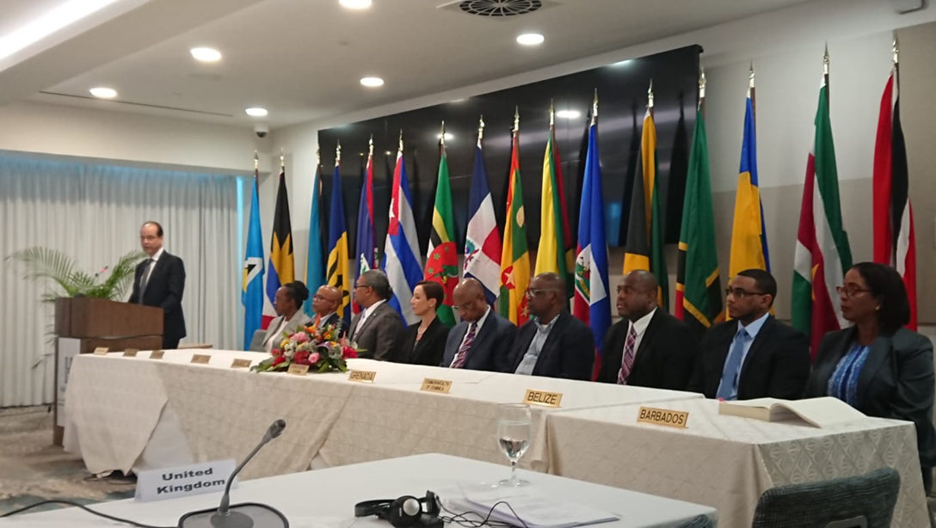
Introduction to the CARIFORUM-UK EPA (1)
1
A comprehensive trade and development partnership, designed to open up and enhance trade between the UK and Signatory CARIFORUM States.
2
Came into effect 1st January 2021 following the end of the UK/EU transition period.
3
Comprehensive agreement that contains important provisions on services, intellectual property, procurement, competition and other modern trade policy issues.
4
Replicates the effects of the existing CARIFORUM-EU EPA.
Signing of the CARIFORUM-UK Economic Partnership Agreement in March 2019
Same structure| rules| commitments
Continues tariff liberalisation schedule
Estimated that by 2033, the majority of UK products will enter CARIFORUM at a 0% tariff rate
Notes:
The EPA provides qualifying UK goods with preferential access to the market of Trinidad and Tobago and 13 other Caribbean countries, some products benefitting from immediate duty free access, while others, a gradual reduction to duty free access. The trade policy team continues to engage with partner countries to ensure that these preferences are implemented. Trinidad and Tobago enjoys duty free, quota free access to the UK’s market for qualifying goods (except arms and ammunition). The EPA also contains important provisions on services, investment, intellectual property, government procurement and other modern trade policy issues. The Agreement is an important lever to accessing the market of Trinidad and Tobago over other competitors that do not benefit from preferential treatment, as well as providing a more transparent and predictable trading regime.

Slide 6
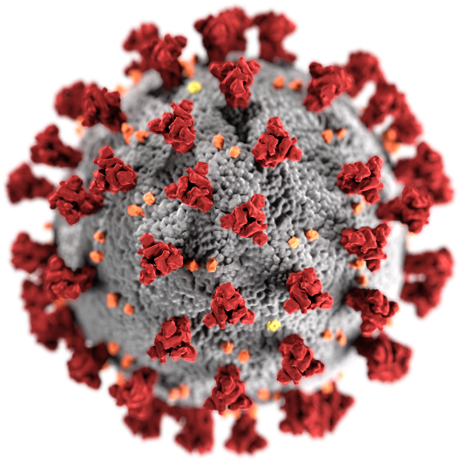
Regional Challenges
COVID 19 &
HIV/AIDS
MONKEY POX
NCDs
MENTAL HEALTH
Notes:
COVID-19
According to the World Bank, many small economies, including those that are tourism-dependent, were maintaining a positive growth rate prior to the onset of the COVID-19 pandemic. Although all countries have re-opened their borders to international travel the region is still faced with the issue of vaccine hesitancy.
Fifteen CARPHA member states have received vaccine deliveries from COVAX as of 8th August, 2022 (approx. 4,925,270 doses). Based on data collected in 24 CARPHA Member States from the Global Change Data Lab’s Our World in Data site on the share of persons vaccinated, between 2.2% and 88.02% of persons in the States with available data have been fully vaccinated In CARICOM, coverage ranges from 2.2% - 66.54%. Note: Time points for data presented differ among the CMS (e.g. Country 1 data as of September 2021, Country 4 data as of June 2022)
There are 6 CARICOM Member States with fully vaccination rates below 40% and 9 Member States over 40%. The following is a breakdown of the vaccination rate against C-19 as at 8th August 2022: Jamaica 25%, T&T 47%, Barbados 55%, and Guyana 57%)
MONKEY POX The World Health Organization (WHO) declared on 23 July, 2022, that the global spread of the monkeypox virus, constituted a Public Health Emergency of International Concern (PHEIC). The first known case of monkeypox was recorded in the Caribbean island of Jamaica. Health and Wellness Minister Dr Christopher Tufton made the announcement at an emergency press conference in Kingston on 6 July 2022. The Caribbean is on high alert and will be monitoring the virus closely and putting measures in place to prevent the spread.
As the region continues to fight the pandemic the issue of vaccine hesitancy continues to plague the region.
Non-Communicable Diseases (NCDs)
NCDs is a major cause of the Caribbean’s premature adult deaths and pose a serious threat to health and development.
On average, people in CARICOM countries have lower life expectancy at birth than those in Central or Latin America, a reversal of the situation that existed 30 to 40 years ago.
Heart attacks, stroke, diabetes and cancers are the leading causes of premature death with hypertension as the leading risk factor for death. According to reported by the Healthy Caribbean Coalition on 12 CARICOM countries:
10 to 25% of adults have diabetes; and
20% to over 50% suffer from high blood pressure.
HIV/AIDS
The Caribbean region has the second highest prevalence HIV rate in the world after sub-Saharan Africa, with an estimated adult prevalence rate of 1 percent and approximately 250,000 people living with HIV. Stigma and discrimination in the Caribbean is pervasive and severely limits key people access to critical life-saving services and drugs. This lack of access increases the risk of both acquiring HIV and transmitting it to one’s sexual partner.
MENTAL HEALTH
There is a combination of cultural, economic, social and political reasons, which explain why mental health has long been neglected in the Caribbean region. On average, a country from the Caribbean spends only 4.3 per cent of its healthcare budget on mental health. Globally health systems have not yet adequately responded to the burden of mental disorders and this is no different in the Caribbean.

Slide 7
Regional Priorities
* Environmental Health; * Strengthening Health Systems; * Chronic Non-communicable Diseases; * Mental Health including Substance Abuse; * Family Health: * Prevention and Control of Communicable Diseases; * Food and Nutrition; * Human Resource Development.
Notes:
Countries in the Caribbean share a similar history in the development of their health systems. They have often cooperated to deal with many of the challenges to health which they have had to confront. However, there is need for even greater collaboration and cooperation among the countries in the Region, given the increasing threats to the economies of these countries and the presence of newly emerging and re-emerging problems in the health sector. Efforts therefore have to be focused not only in the fight against disease, but in promoting healthy lifestyles, protecting the environment and increasing the capacity of the health sector to provide quality service and value for money.
The concept of the Caribbean Cooperation in Health Initiative (CCH) was introduced in 1984. In 1996, the CMH mandated a re-definition and re-formulation of the CCH Initiative for the period 1997-2001. The meeting selected eight(8) health priority areas, recommended strategies for implementation, and identified some areas of common concern which required joint action.
Participating Countries To date , the countries that have participated in the initiative include Antigua and Barbuda, Anguilla, The Bahamas, Barbados, Belize, Bermuda, The British Virgin Islands, the Caymans Islands, Dominica, Grenada, Guyana, Jamaica, Montserrat, Saint Lucia, St Vincent and the Grenadines, St Kitts and Nevis, Suriname, Trinidad and Tobago and the Turks and Caicos Islands. However, it is intended that the Initiative will become Caribbean in tandem with the integration movement.
Health Promotion Health Promotion has become essential in the changing Caribbean. Over the last forty years non-communicable diseases, along with violence, new sexually transmitted diseases and environmental hazards, have gained priority over infectious diseases as the major causes of mortality in the Caribbean. In times past, a focus on a curative approach to health care could be justified when infectious diseases were the major cause of mortality. Health technologies were either cheap( immunization) or yielded massive returns for the investment as in the case of pure water supply. The prevention and control of chronic diseases, on the other hand, has encountered massive difficulties. Prominent among them are the costs of medication, hospitalization and long term treatment with little and/or diminished potential. It has become evident that a preventive and broader approach to the problem of chronic disease and the protection of health is required. Health promotion is the approach that best achieves this goal. In its widest perspective it treats health as a primary tool in human and economic development, focusing on public policies conducive to prevention of disease and promotion of well-being and productivity. On an individual and community level, dynamic health education in an intersectoral approach enables people to originate initiatives to seek to control and modify personal practices and everyday living conditions that foster their health.
CARIBBEAN COOPERATION IN HEALTH INITIATIVE : PHASE II | CARICOMCARIBBEAN COOPERATION IN HEALTH INITIATIVE : PHASE II | CARICOM

Slide 8
Regulatory Environment
-There are no laws regulating medical devices in Trinidad and Tobago.
-The Ministry of Health is in the process of drafting legislation
-To participate in local tenders UK firms must have a local partner
-The registration of medical devices is executed through the Pharmaceutical & Regulatory Affairs Department (PRAD)
-Once registered or approved, products are allowed importation by way of permits granted by PRAD.
-There is no registration process for medical devices.
-UK companies must have a registered local distributor in market
-There are no laws regulating medical devices in Guyana.
-All medical devices require an import license issued by the Ministry of Tourism & Commerce.
-UK companies must have a registered local distributor to operate in the Guyanese market.
Notes:
Each country is different and has their own rules and regulatory agencies, which governs their product registration process. As such, UK companies seeking to do business in the Caribbean must understand the intricacies for each market.
Currently there are no laws in Trinidad and Tobago, Guyana, Barbados and the OECS member states as it relates to the registration of medical devices. However, there the regulatory bodies in the various countries can request documentation relating to quality certification, labelling, Medical Devices Single Audit Program (MDSA) certificate, Free Sale Certificate among others.
The government of T&T is in the process of creating a draft legislation to regulate medical devices
However, in Jamaica, certain medical devices require registration with the Ministry of Health and Wellness. In Jamaica, some products can be deemed safe enough to be placed on the market without formal registration. For these, the Ministry of Health grants a written approval
Import licenses and permits maybe required for specific products in different markets.

Slide 9
Opportunities in the English Speaking Caribbean
Trinidad and Tobago
£5 million for medical devices
Jamaica
£57 million for pharmaceuticals and medical devices
Guyana
£49 million design and construction of six new hospitals
Barbados and the EC
US$20 million C19 response loan from World Bank
£1 million retrofit and equip the Festival City Polyclinic to provide services which will include x-ray, dental, laboratory and rehabilitation services
£14.5 million for hospital construction work
$50 million IDB loan
£27 million for continued C-19 management
£50 million for QEH including purchase of equipment – Barbados
£2 million on St Jude's Hospital Rehabilitation – St Lucia
£300K purchase of equipment MCMH – St Vincent
£1.8 million C-19 response – Grenada
CDB procurement of dialysis and renal equipment
You can register to find out about opportunities in the Caribbean on https://www.great.gov.uk/export-opportunities/
Notes:
The T&T the national budget was read in October 2021 and one of the government’s priority is the procurement of medical devices. The government has allocated £5 million.
£5 million will be provided for the purchase of medical equipment with emphasis on the following:
NWRHA
Six (6) dialysis machines for POSGH;
Two (2) dental chairs and equipment inclusive of a dental suite for St. George Central (San Juan and Morvant Health Centres) and St. George West Health Centres
Six (6) birthing beds for POSGH
SWRHA
One (1) Central Sterile Services Department automatic washer and three (3) sterilisers for San Fernando General Hospital.
Labour ward equipment for the high risk patient suite
Two (2) autopsy tables and two (2) dissection benches for the mortuary.
ERHA
X-ray machine for Mayaro District Health Facility.
Equipment for facilities within the County of St. Andrew/St. David.
Medical equipment for facilities within the County of Nariva/Mayaro.
NCRHA
Equipment for the Radiology Unit;
Eight (8) infant warmers; and
Two (2) orthopaedic drills and modules with accessories for the Operating Theatres.
The World Bank Project has two components. 1. Emergency Response to COVID-19 component will provide immediate support to respond to the COVID-19 pandemic through the procurement of key medical equipment and supplies for the detection and treatment of COVID-19.
JAMAICA
Support for the Health Systems Strengthening for the Prevention and Care Management of Non-Communicable Diseases Programme
IDB Loan
$50Million
5 years (gained eligibility in 2019)
GUYANA
BARBADOS AND EC ISLANDS
The Project has two components. 1. Emergency Response to COVID-19 component will provide immediate support to respond to the COVID-19 pandemic through the procurement of key medical equipment and supplies for the detection and treatment of COVID-19.T
The United States Agency for International Development has announced US$2.5 million ($500m) in urgent COVID-19 assistance for countries in the Eastern Caribbean, The Bahamas, Guyana, Suriname and Trinidad & Tobago. A release yesterday from the US Embassy in Georgetown said that the assistance will provide support for the operational costs of COVID-19 vaccination campaigns, outreach activities to lower vaccine hesitancy in collaboration with local influencers and celebrities, vaccine hesitancy surveys, and equipment procurement to support the development of COVID-19 vaccine information systems, laboratory detection and storage of vaccines.
The OECS/PPS has gone into partnership with EASiBUY for a two-year contract period specifically for access to COVID-19 related supplies.
No Cost to register
On-going procurement process ( need basis)
https://oecs.easibuy.com/login
OECS/PPS will inform successful companies by formal letter when they are prequalified to participate in the tendering process
US$2.5 million The United States Agency for International Development has announced in urgent COVID-19 assistance for countries in the Eastern Caribbean, The Bahamas, Guyana, Suriname and Trinidad & Tobago.

Slide 10
Private Sector Opportunities
Testing Machines: Cholesterol, Diabetes, vital sign etc.
Home medical devices
Point of care analysers, lab equipment such as refrigeration units, centrifuges etc.
CPAP Machines
Hospital Sinks - stainless steel and copper products
Ophthalmology – ( lens and viscoelastic )
Surgical pumps PCA
Notes:
The Caribbean is a net importer and relies heavily on foreign suppliers to meet the countries’ healthcare needs. There is no manufacturing of medical devices in the Caribbean. Given this, the Caribbean imports approximately 100% of medical devices products. Donation as usually received from governments around the world.
The top supplying markets to the Caribbean are USA, Panama, UK, Germany and Canada.
There is over £250 million in public sector opportunities for medical devices in Barbados, Guyana, Jamaica and Trinidad & Tobago for UK companies.
Aid funded procurement opportunities are available to UK companies from the World Bank, Inter-American Development Bank, Caribbean Development Bank and the USAID focused mainly on the C-19 response.
As we seek to recover stronger from the Covid-19 pandemic, the CARIFORUM-UK Economic Partnership Agreement (EPA) has the potential to further stimulate and expand your exports to 14 dynamic markets in the Caribbean.
The EPA, which came into effect between the UK and 14 CARIFORUM States at the start of this year, provides UK firms with preferential market access to the region by progressively reducing or eliminating tariffs on approximately 80% of UK goods; including medical equipment.
It is further estimated by 2033, the vast majority of UK products will enter the Caribbean at a 0% tariff rate. This means that UK companies have a greater competitive advantage over other competitors, particularly those countries that do not have a trade partnership with the Caribbean.

Slide 11
Route to Market
Distributor Agreement ( per market or regional coverage)
Investment in the Caribbean – ( government incentives, access to markets in LATAC, USA, Canada, EU etc.)
Notes:
The Caribbean is a net importer and relies heavily on foreign suppliers to meet the countries’ healthcare needs. There is no manufacturing of medical devices in the Caribbean. Given this, the Caribbean imports approximately 100% of medical devices products. Donation as usually received from governments around the world.
The top supplying markets to the Caribbean are USA, Panama, UK, Germany and Canada.
There is over £250 million in public sector opportunities for medical devices in Barbados, Guyana, Jamaica and Trinidad & Tobago for UK companies.
Aid funded procurement opportunities are available to UK companies from the World Bank, Inter-American Development Bank, Caribbean Development Bank and the USAID focused mainly on the C-19 response.
As we seek to recover stronger from the Covid-19 pandemic, the CARIFORUM-UK Economic Partnership Agreement (EPA) has the potential to further stimulate and expand your exports to 14 dynamic markets in the Caribbean.
The EPA, which came into effect between the UK and 14 CARIFORUM States at the start of this year, provides UK firms with preferential market access to the region by progressively reducing or eliminating tariffs on approximately 80% of UK goods; including medical equipment.
It is further estimated by 2033, the vast majority of UK products will enter the Caribbean at a 0% tariff rate. This means that UK companies have a greater competitive advantage over other competitors, particularly those countries that do not have a trade partnership with the Caribbean.

Slide 12
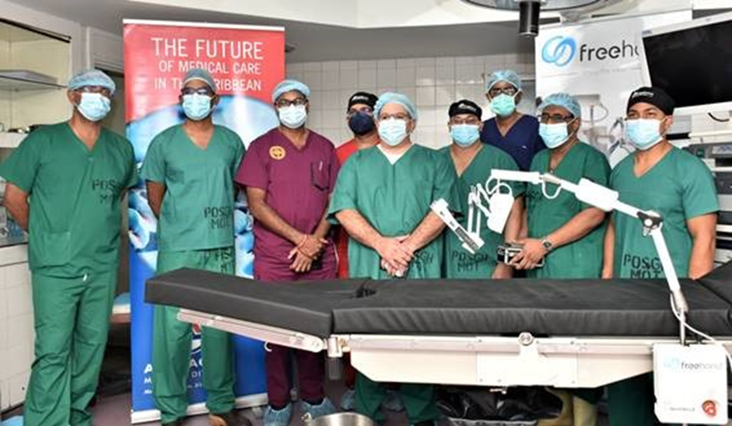
Success Story - FreeHand Collaborative Robot
DIT helped the company along its exporting journey from business pitch to product launch
Now expanding to other Caribbean islands ( Guyana , St Lucia)
Notes:
In the English-speaking Caribbean, the first robotic-assisted surgery using British technology was performed in September 2021 by an international partnership between surgeons from Trinidad and Tobago (T&T) and technology experts from the UK. Collaboration between the UK's Department of International Trade and local healthcare distributor AA Laquis led to a ground breaking initiative that became the world's first remote training for robotic surgery.
The elite group of doctors from the University of the West Indies (UWI), known as the Trinidad 6, performed a series of three meticulously coordinated minimally invasive surgeries, with the assistance of a surgical robot developed by UK MedTech Company FreeHand. The pilot procedures were conducted on patients who would have been candidates for gallbladder surgeries, and all three patients have recovered completely. Since then, local surgeons have performed over 20 medical procedures including gynaecology, cancer and general surgeries using the Freehand Collaborative Robot (CoBot). This technology though new to the Caribbean, has been used in more than 15,000 surgeries in over 25 countries including the UK, Europe, the US, and Japan.
Although the FreeHand technology was readily available from the UK, the C-19 pandemic and closure of T&T borders to international visitors made it difficult to train local surgeons. In response, a bespoke surgical training methodology was used to fill the gap between trainers in the UK and surgeons in the Caribbean.
Digital Resilience UK, an education specialist organisation, functioned as the technical design partner for the training method and enabled the online platform. The remote training represents a significant milestone in medical history and opens up massive opportunities to the UK MedTech industry. While the introduction of robotic technology is revolutionary to Trinidad and Tobago, the methodology transformed the way surgeons are trained and mentored. The team further trained surgeons in Jamaica and Malaysia. It enables access to world-class training and technology for surgeons in emerging economies.
This project’s success was the product of partnerships, bringing together the extensive medical experience and clinical training expertise of AA Laquis, the largest indigenous Healthcare Company in the English-Speaking Caribbean, the expert skills of the UWI’s finest surgeons, and the leadership of UK based, Imperial Medical Solutions Ltd (IMS). IMS, a physician led clinical strategy company, was instrumental in bringing the various stakeholders together to deliver this tremendous feat - getting the Anglophone Caribbean onto the robotic assisted surgery trajectory in less than 9 months, during a pandemic.
As we push the limits of technology and bring its benefits into improve medical procedures, it shows the importance of collaboration in achieving success. This UK-T&T success story makes that real and shows the strength of working together across international borders. Trinidadian expertise and British technology combined to improve lives.

Slide 13
Tips for doing business in the Caribbean
Don’t fall into the trap that every marker in the Caribbean is the same
The Caribbean is very relationship oriented and companies must be willing to visit the market
Investigate the market and focus on which goods/services are right for export
Understand that you will face bureaucracy so patience is important
Form business alliances through partnering with local firms
Pre- qualify and register to be included on local databases to be aware of new tender opportunities
Demonstrate the ability to deliver quality good/services on time and within budget
Be aware of local content requirements and knowledge transfer to local workforce ( if applicable)
Engage with UK Export Finance for credit risk insurance or to bring a financing proposal for major projects.
Use the DIT Team located in market
Notes:
It should be noted that there is a tendency for business to be relationship-based in the Caribbean, therefore it is highly advisable that UK companies make the time and effort to visit the market via the facilitation of programme arranging from DIT. The support from DIT, lends a certain amount of credibility to new entrants to the market and opens doors for local companies to enter into active conversations with UK players. Many have learned that cold calling or emailing results in radio silence from companies locally.
Our main competitors in the region are predominantly the Chinese, the Americans and the Canadians. In some sectors, the French and Germans are also active so competitive pricing and innovative solutions are essential.
Doing work in the relationship orientated markets of the Caribbean requires patience and perseverance. Although the majority of these markets rely heavily on imports due to their size, this in turn means the capacity for growth can be more limited. We would encourage UK companies operating in the following sectors to take advantage of the opportunities in the Caribbean: Education; Food and Drink; Fintech; Healthcare; Infrastructure; Renewable Energy; Cyber security, Security & Defence. There are also significant opportunities in the cross cutting sectors of Digitisation and programmes being run by the International Financial Institutions in the region.
With local content and workforce development being paramount for Small Island Developing States (SIDs), it’s important that UK companies look for opportunities to build local partnerships, establish overseas direct investments and establish a presence in market either though physical offices or after-sale service presence
Don’t fall into the trap of thinking every market in the Caribbean is the same. They are VERY distinct, and all have different regulations, fiscal incentives and operational structures so engage the DIT team early and they will provide the right local advice.
Don’t jump in head first lulled by the Caribbean warmth and welcome; these are sharp, commercial operators! So plan your approach, know your ask and build your intercultural knowledge and awareness by using the DIT Caribbean team. They will guide, help and support you, so make sure to use their expertise and guidance wisely.
Be prepared to invest enough time. Relationships are important and it could take multiple visits to secure business. Those who invest the time often find these are rewarded by customer loyalty as customers will buy, and keep buying, products that meet their needs
Finally, use the local DIT team in markets: Plan your approach, know your ask and build your intercultural knowledge and awareness by using the DIT Caribbean team. They will guide, help and support you, so make sure to use their expertise and guidance wisely. And although I have spoken about the Caribbean as a whole, each market is VERY distinct, and all have different regulations, fiscal incentives and operational structures so engage the DIT team early and they will provide the right local advice.
Trinidad & Tobago qualifies for about £4b in export cover.

Slide 14
How does DIT help UK firms?

Slide 15
For further information please contact:
Senior Trade and Investment Advisor
Department for International Trade British High Commission
Port of Spain
Trinidad
Tel: +1 868 350 0435
Mobile: +1868 299 3737
E-mail: Vincent.Ramlochan@fcdo.gov.uk
Notes:
For further information Please feel free to contact me using the information on the slide.
Thank You!

