Slide 1
Market Entry in India
September 2022

Slide 2
UK Government Trade and India
Market intelligence/research
International Trade Advisors (ITAs) and regional support.
Introductions to potential buyers/partners in UK and overseas.
Support accessing the market through business events and trade missions.
Working on market access barriers.
Bilateral engagement.
The India Healthcare campaign supports UK businesses who would like to export to India.
The support offered is varied and tailored to individual organisations depending on their readiness to export, including:
1:1 meetings
Trade missions (both in-person and virtual)
Networking events
Matching sellers with potential buyers
Advice and guidance on operating in India
DIT can help with market development in India & finding potential buyers.
The team in India are based across the country in embassies and High Commissions in Mumbai, Delhi, Chennai, Ahmedabad, Bangalore, and Hyderabad.

Slide 3
India Healthcare Market Overview
Ashwin Ravindran
India Head of Healthcare and Life sciences

Slide 4
India's fast growing Healthcare market
India is among the fastest growing healthcare economies in the world.
Improved health penetration, awareness, ageing populations & higher incomes is leading to increased healthcare expenditure and a growing favourable demographic for new/improved products and outcomes.
Healthcare is one of the fastest growing sectors in India (in revenue & employment), expected to surpass US$372bn by 2022.
Government spending on healthcare to increase to 3% GDP by 2022; Ayushman Bharat – largest government funded national health scheme: 125.7m families, 16,085 hospitals (8,059 private & 7,980 public).

Slide 5
Public and Private Healthcare Providers
Public Healthcare Providers
Private Healthcare Providers
The Government, i.e. public healthcare system comprises limited secondary and tertiary care institutions in key cities and focuses on providing basic healthcare facilities in the form of primary healthcare centres (PHCs) in rural areas.
In India health is a matter of the state government and therefore all states governments have control over their local government hospital affairs.
Procurement usually happens through state government tenders. Usually requires local partner.
Hospitals – single specialty / multi-specialty
Diagnostic providers – lab / radiology
Chain and franchise model deeper into Indian cities – Tier 2 and Tier 3
Diagnostic centres within hospitals
Private insurance players
Private home care segment
Online consultation / service delivery partners – tests / pharmacy / consultations
Procurement – multiple stakeholder involvement, hard negotiations, go-ahead required from each department

Slide 6
Healthcare Industry in India: Overview
Focus areas for Indian healthcare ecosystem that UK companies can tap into:
Remote patient monitoring
Point-of-care diagnostics
M-Health/Tele-health
Med-tech
Digital Health
AI in Healthcare
$ 6.72bn Hospitals & diagnostics centers investment (as of April 2020.)
$ 9bn Medical tourism industry $9bn (18% YoY). Diagnostics –US$9bn (27.5% growth ‘20-’25)
$ 372bn Projected size of healthcare industry by 2022. Expected to contribute 19.7% GDP ‘27 (as of Mar ‘20)
$ 132.8bn Projected value of Hospital industry (80% market) – 2023 (16-17% CAGR)
Growth in other key Healthcare markets in India:
UK healthcare technology seeing wide reception in India through DIT engagements and facilitation. Examples include CMR Surgical and Behold.Ai.
Digital Health market growing at 27% CAGR; estimated to be worth US$485bn by ‘24.
Point-of-care diagnostics market worth $46bn (by 2024; 14.6% CAGR).
AI in healthcare to be worth US$ 6bn by 2021.
Biopharma market worth ~$4bn (64% industry share) growing at 25-30% CAGR.​
Telemedicine is a US$32m market (CAGR 20%), to be $5.4bn by 2025.
Home health market US$ 21bn by 2027 (19.2% CAGR)
Health insurance grew 17.16% YoY to $7.39bn in FY20. C-19 has sped up demand.
Surgical robotics market growing at 20% CAGR, expected to be US$350m by 2025.

Slide 7
Why we are interested in India Healthcare
Demand outstrips supply.
1. Digital health
01
03
05
07
2. Clinical Services
Demographic growth & Living Longer
Increased medical tourism
Increased affordibility & awareness
Shortage of quality healthCare provision
3. Life Sciences
(incl. Medtech &
Pharma)
DIT priority areas:
Digital health
Med-tech
Pharma
Infrastructure
Commercially
Lucrative opportunities.
02
04
06
4. Infrastructure
Ayushman Bharat (launched 2018)
UK seen as partner of choice
high penetration of private players
5. Health Systems
Regulation, fraud prevention, monitoring, digital infrastructure, AI for diagnostics.
6. Education and Training
Notes:
- There are five key trends that are driving opportunities for the UK in SE Asia
- People in Asian economies are ageing and increasing need for complex care
- Rise in Diabetes, Cardiovascular, diabetes and mental health are the new epidemics
- Primary care, prevention and quality of care are seen as government priorities
- Young populations in Asia lifestyle connected to Smart Technology and Healthcare is responding
- The NHS and wider UK life science and academic sectors has incredible reputation and historical links. This combined with the progress to drive universal healthare coverage makes our system a great partner
We have also developed the UK offer that are promoted overseas. For all of you it’s a good compass to opportunities as it includes where we think UK strength lies in finding solutions to these changes in SE Asia. We have engaged business in developing these and include the following six areas.

Slide 8
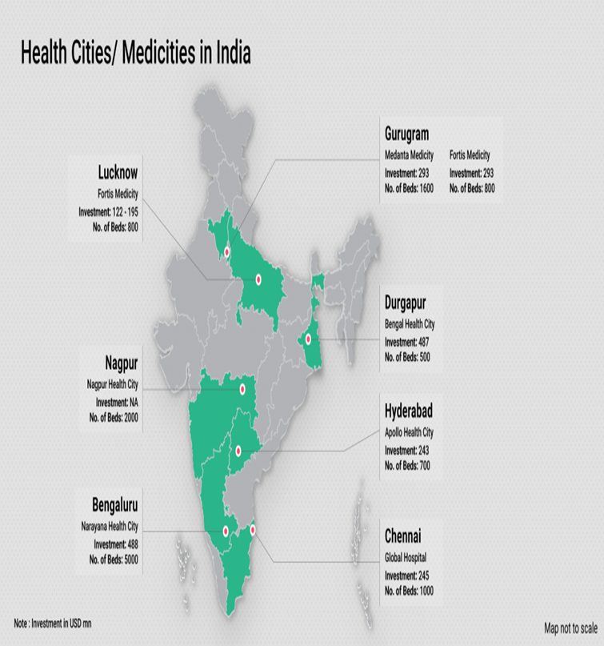
Regulatory Landscape & Government Policies
Ayushman Bharat– 5m+ free treatments delivered so far.
$ 9.87 billion towards healthcare (20-21 budget) and increased spending of 2-3% of GDP to healthcare.
GoI Mission Indradhanush to increase coverage of immunisation in India. (90% immunisation target).
Tax incentive for private healthcare providers in non-metro cities for 50+ bed hospitals and 100+ in rural hospitals.
Setting up state Telemedicine networks and e-health initiatives under National Health Mission to improve access to healthcare.
Rapid expansion of healthcare to Tier II & III cities to provide improved access to healthcare to address unmet need.
State/Central funded healthcare institutions to provide improved access to affordable care.
Door to door surveillance and health/wellness programs
Focus on ‘Make In India’ for medical-device and pharmaceutical manufacturing.
Source: Invest India

Slide 9
Overview of Medical Device industry in India
Medical device/Med-tech industry expected to grow to US$ 25bn by 2025. Roughly 80% of imported medical devices in the market.
Point-of-care diagnostics market to be worth US$ 46.7bn (2024, growing at 14.6% CAGR) and Ai in healthcare expected to cross US$ 6bn by 2022.
Impetus on the India Medical Devices (Medtech) sector
In 2019, GoI approved to establish four medical device parks in India to facilitate reduction in manufacturing cost of medical devices in the country and to setup world class common infrastructure facilities, testing facilities, etc.
65% of the manufacturers in India comprise of domestic players operating in the consumables segment. They mainly cater to local consumption and have limited exports. On the contrary, large MNCs lead the high technology end of the medical devices market with extensive service networks.
There are roughly 750 to 800 domestic medical devices manufacturers in India, with an average investment of GBP 1.61 to GBP 1.89 million and average turnover of GBP 4.34 to GBP 4.83 million
The current market for MedTech in India is expected to grow at CAGR of 9.7% to reach £10.1 bn by 2025

Slide 10
Growth drivers and opportunities
Govt. introduced a scheme called 'Promotion of Medical Device Parks" in March 2020 to exploit the benefits arising due to optimization of resources and economies of scale. Work is already progressing on cutting red tape for businesses following the UK-India Enhanced Trade Partnership launched last year, announcing new measures to make it easier to export UK-made medical devices to India and to ensure mutual recognition of UK higher education qualifications
Currently the only fully functional medical devices park is at Andhra Pradesh – Andhra Pradesh Med Tech Zone (AMTZ) 6 units are operational here. It will start full operation by the end of this year. • Kerala is on the verge of establishing a Park focusing on innovation • Two states (Uttar Pradesh & Tamil Nadu) have facilities/park that houses/can house medical devices companies • Six state governments have plans for setting up medical devices park • Goa • Gujarat • Karnataka • Maharashtra • Haryana • Punjab
From April 1, 2020 all manufacturers and importers of medical devices and medical equipment sold in India can not increase the maximum retail price of products by more than 10% within 12 months – Price capping and regulation.

Slide 11
Government incentives and initiatives
National Medical Devices Promotion Council
The council undertakes several activities including facilitation, promotion and development of the sector besides holding seminars and workshops to garner views of industry and understand best global policies and practices.
Production Linked Incentive Scheme for Medical Devices
The government has introduced a Production Linked Incentive (PLI) scheme for medical devices across 4 segments to encourage medtech companies (both domestic & foreign) to setup new manufacturing facility in India
Target Segment 1 - Cancer care/Radiotherapy medical devices
Target Segment 2 - Radiology & Imaging medical devices (both ionizing & non ionizing radiation products) and Nuclear Imaging Devices
Target Segment 3 - Anaesthetics & Cardio Respiratory medical devices including Catheters of Cardio Respiratory Category & Renal Care Medical Devices
Target Segment 4 - AII Implants including implantable electronic devices like cochlear implants and pacemakers

Slide 12
India’s MedTech Market: Recommendations
High volume products offering economies of scale
More advantageous and cost effective when manufactured in India. In FY20, foreign investments in the medical devices sector increased 98% YoY to Rs. 2,196 crore (US$ 301.01 million) as against Rs. 1,108 crore (US$ 151.87 million) in FY19.
There is a need of high-tech machinery for moulding and extrusion.
The currently assembly being done is not appropriate for medical device components and sub-assemblies is not at par with other countries.
As per the Technology and Quality Upgradation Support provided to MSMEs
25% of the project cost is provided as subsidy by Government of India and the balance amount is to be funded through loan from SIDBI/ banks/ financial institutions.
Collaborations with large healthcare institutions to set up medtech incubation centres to promote new development, prototyping, product testing etc.

Slide 13
Healthcare : Major Industry Players
Hospitals/Care providers
Apollo Hospitals
Narayana Health
Fortis Healthcare
Manipal Hospitals
Hinduja Hospitals
Max Hospitals
Medanta Hospitals
Aster DM Healthcare
Sakra World Hospitals
Tata Memorial Hospitals
Rainbow Hospitals
MIOT Hospitals
Cloudnine Hospitals
Med-Tech/Medical Devices
Phillips Healthcare
Wipro GE Healthcare
Skanray Technologies
BPL Technology
Smith & Nephew
Meril Life Sciences
Trivitron
Roche
Johnson & Johnson
Healthium
Siemens
Fujifilm
Bosch Healthcare
Telecomms
JIO Health platform
Digital health/E-health
Practo
Docsapp
1MG
Pharmeasy
M-fine
Care.fit
Intel
HCL Technologies
TCS/Tata digital health
Portea
Insurance Providers
ICICI Lombard
Max Insurance
Religare
IFFCO Tokyo

Slide 14
Events 2022-2023:
CPHI Worldwide 2022- 1-3 November 2022 (Germany)
Healthcare Trade Mission to India - February 2023 (In-country)

Slide 15
Doing Business in India

Slide 16
Market Entry Considerations
Adopt a flexible and considered pricing and commercial approach.
Consider a volume-based pricing approach which encourages adoption (consider cloud-based i.e. pay per use and early adopter discounts).
Outline the clinical benefits and financial case for the solution.
Be prepared to consider a range of partnership options.
Ensure quotes are sent in local currency (INR) and GBP and furnish proposals with all the collateral, product information and certifications.
Peer pressure is a common feature in this competitive market. Always target sales in the top enterprises and the others follow suit. Key Opinion Leader endorsement is very important.
Understand your product segment and requirement of distributors or partners.
Anticipate customisation effort (e.g. multilingual requirements), access to local data (AI) and options for white-labelling.
Handling regulatory issues (including current certifications such as CE/FDA ) and data privacy considerations.

Slide 17
For success in India…
Understand your audience
DIT can help you to interact with a variety of different buyers – understanding their needs is important.
Buyers are likely to have different levels of maturity and development: important to establish this early on.
India expects a faster turnaround on their requests so proposals to partner will need to be responded to in a month or else clients may lose interest.
Engage effectively
Always get confirmation over mail to ensure common understanding of what has been agreed.
When proposals/MoU/NDA have been agreed to be put in place, ensure action promptly. Regular follow-ups are a must especially when a new product is introduced.
Be prepared for hard commercial negotiations. Quick feedback is expected with responses as straight forward and direct as possible.
Commit to following up as soon as possible – persistence and a timely follow up is key.

Slide 18
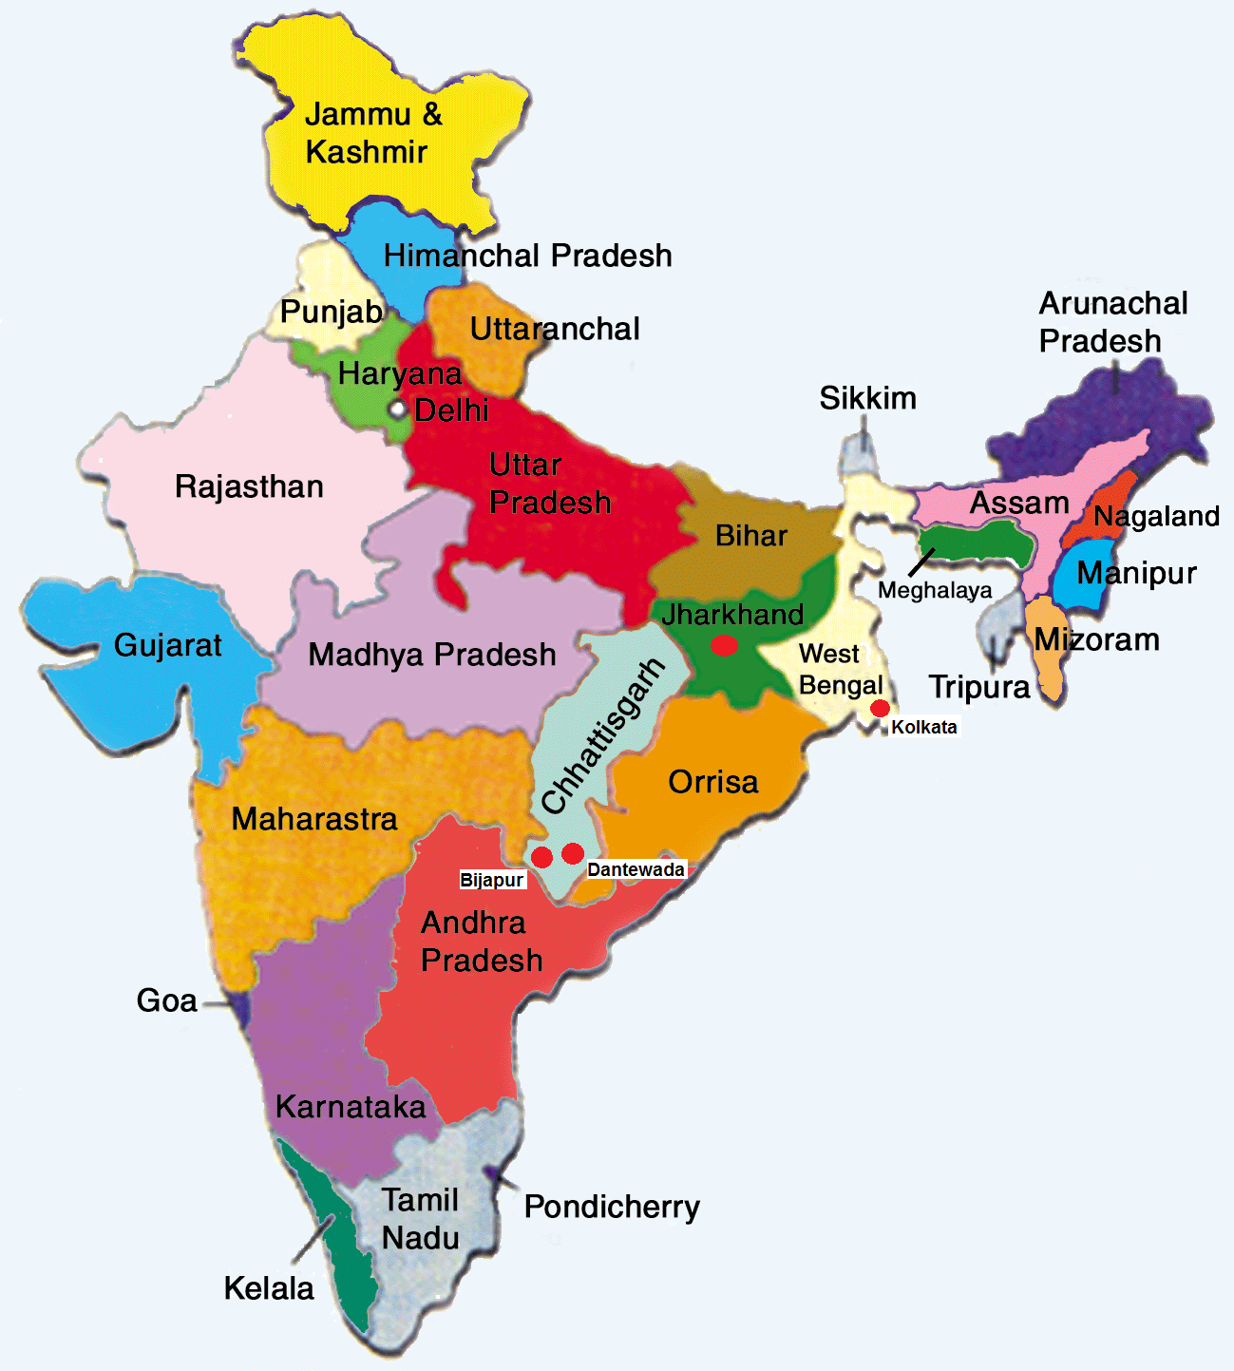
Our teams – here to help
DIT HQ London
Madhukar Bose (Team lead)
DIT India
Edna D’Souza (Cluster Lead)
Ashwin Ravindran (India Head)
Joiston Pereira
Harsh Indrarun
Harish Vaidyanathan
Simran Masand

Slide 19
Thanks for listening Any questions?

