Slide 1
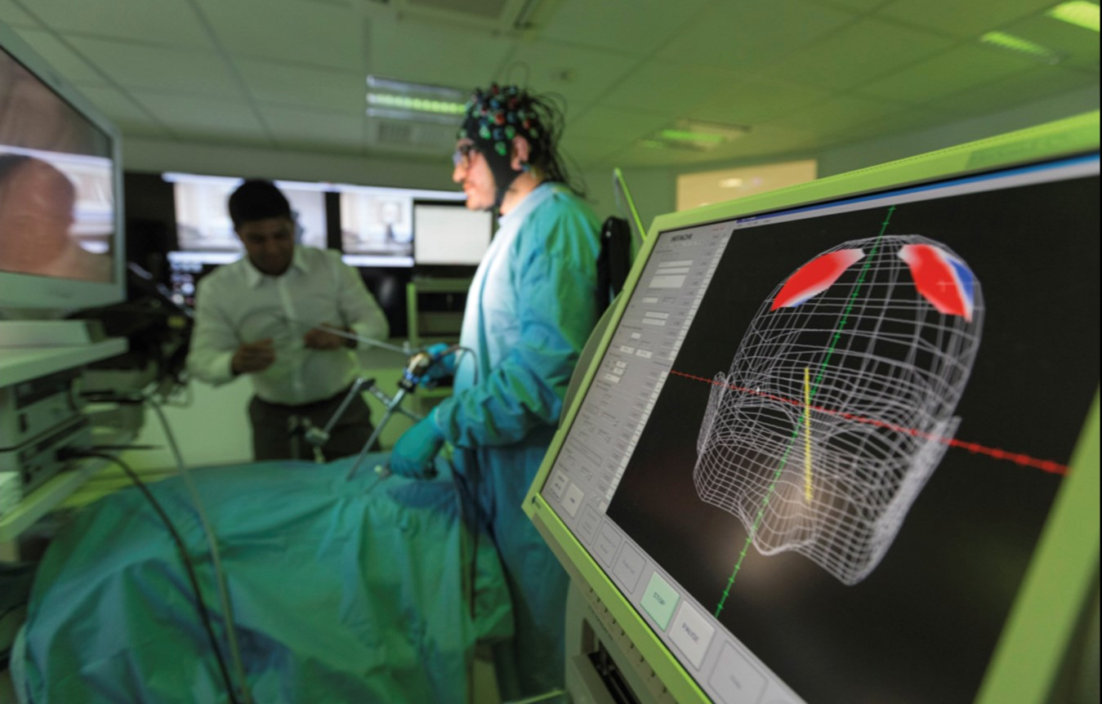
Medical Devices: Why China and where are the opportunities?
Rita Huang
British Consulate, Guangzhou
Oct 2022
Notes:
Hello, everyone. Thanks for joining the session today. First of all, I would like to introduce myself that I am Rita, based in DIT China Guangzhou’s medical device team. Glad to share with you the information of China market in the next an hour.

Slide 2
Content
China Market Overview
Subsector Opportunities
Case Studies
Doing Business in China
Events and DIT Support
Notes:
My topics today will cover
China Market Overview
Subsector Opportunities
Case Studies
Doing Business in China
Some of our upcoming events and what supports DIT can extend

Slide 3
China’s Healthcare post-Covid
China Market Overview
Accelerated pace of reform, overall INCREASE in public healthcare spend but drive for efficiency
Digital and primary healthcare PRIORITISED
Pharma and Medical Technology markets remain strong and hungry for INNNOVATIVE products
Chinese government will focus more on R&D for this sector, and possible licences in and licences out in the industry
Chinese government POLICIES to STIMULATE INNOVATION and manufacturing in China (Innovation path, Hainan, GBA, MAH)
Notes:
To start with the big picture about the market. Perhaps some of you might already know the market quite well and some may not. There are a few points that I would like highlight with you.
China is the world’s second-largest healthcare market and continues to develop at double-digit rates. In 2020, China spent around 7% of its GDP on healthcare expenditure which is far behind OECD countries (10%) at the moment.
The government accelerated pace of reform, increase public healthcare spend and drive for efficiency, and priorities digital and primary healthcare.
There are growing demand in private healthcare from middle classes. Chinese government focus more on R&D for pharma and medtech sector, so the market remains strong and hungry for innovative products.
Chinese government also encourages overseas companies to localise manufacturing in China and will treat them as Chinese products which means they can enjoy the same preferential policies during government procurement and product registration.
The government has launched different policies to accelerate the innovative products entering the market. For example, there is fast track registration for innovative products, there are policies in Hainan and Greater Bay Area that allows hospitals there to use certain unapproved medical devices but with CE/FDA certification. Also the change of MAH (Marketing Authorization Holder) policy allows more flexible routes.

Slide 4
China Market Overview
Market size: £59 billion, world’s 2nd largest market. 18K+ manufacturers, 20K distributors, 18% growth.
Access to the China market would allow you to reach as many patients as USA, Canada, South America, Australia, and Europe combined.
Mid to high end products still imported. Europe is largest source of imports (37%).
Opportunities for innovative products.
All devices manufactured outside China must obtain national approval; different options available for devices manufactured in China
Financing opportunities – Chinese companies looking to invest in innovative products to gain competitive advantage in market.
Notes:
China has the world’s second largest market for medical devices growing at 18% each year. Market size stands at £59 billion, with more than 18000 manufacturers and 20,000 distributors.
Access to the China market would allow you to reach as many patients as Canada, North America, South America, Australia, and Europe combined.
There are strong demand for mid to high end products which are still imported from overseas. Europe is the largest source of imports which takes 37%. The UK ranks No.6 in terms of medical device imports to China.
As I said earlier, the market is hungry for innovative products.
Regarding product registration, all devices manufactured outside China must obtain national approval. However, there are different options available for devices manufactured in China which will be treated as local products.
There is also financing opportunities for UK companies who wish to raise funds from China as many Chinese companies are looking to invest in innovative products to gain competitive advantages.

Slide 5
IVD – Overview
£15 billion in size in 2021, up 19.2%. ~2000 IVD companies. Imported products take 55%.
Three main segments: immunodiagnostics, biochemistry, and molecular diagnostics. Molecular and POCT grow rapidly.
Increasing investments on IVD.
Industry trend: cash rich post-COVID, set up R&D and manufacturing site overseas
Event: CACLP(China Association of Clinical Laboratory Practice Expo), xx 2022
Notes:
Now I would like to explain a bit more on some subsectors that our team has been focusing on. First one – IVD subsector.
IVD is the largest and fastest growing segment in the Medtech market in China, with £15 billion pounds in size in 2021, 2000 Chinese IVD companies. The China IVD market still relies heavily on imported products. Around 55% of the products are imported from overseas.
Currently immunodiagnostics is the largest segment in the IVD market in China taking 38%, Biochemistry and molecular diagnostics rank 2nd and 3rd. Molecular diagnostics and POCT experiencing the fastest growth rate.
IVD subsector receives much attention due to COVID-19 and becomes a cash rich subsector. Chinese IVD companies look for making investments on overseas companies for new tech or new product, and they aim to set up manufacturing sites overseas for geopolitical reasons.
In China, the biggest IVD trade show is called CACLP, which will be held in South China this year in June. Almost 90% of the Chinese IVD companies would attend the show.

Slide 6
IVD – China demand
Company | Main Business | Demand
Mindray | Biochemistry, immunodiagnostics | License in products in disease early screening/monitoring Set up an IVD division in the UK in 3 years’ time
BGI | Largest gene sequencing company in China, biggest market share in NIPT | Keen to invest in innovative UK IVD technologies/spin out from UK universities
Wondfo | Leading POCT company in China | Invest in immunodiagnostic and gene sequencing technologies, in CNS area
Hybribio | The biggest HPV diagnostic company | Invest and license in innovative UK IVD products, especially in the fields of gynaecology and reproductive health
Notes:
Here are some hot demands from some leading Chinese companies, for example, Mindray, the largest IVD company in China, would like to license in products in disease early screening and monitoring. BGI, keen to invest in innovative UK technologies spin out from UK universities. Wondfo - they would like to invest in immunodiagnostic and gene sequencing technologies in CNS area. Cooperation can be technology licensing out, distribution partnership, joint venture, etc.
If your products fall in these areas, please let us know, and we will help you connect with these key players. Most of them will attend MEDICA, so you might talk to them during MEIDCA.

Slide 7
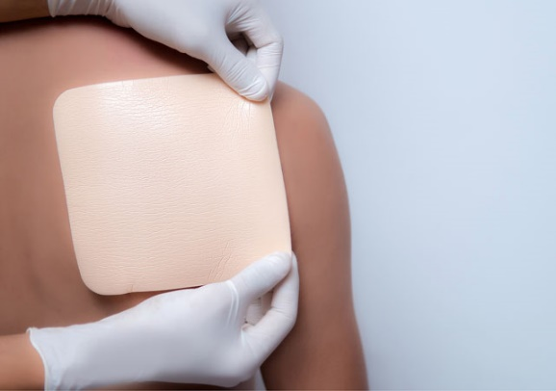
Wound Care - Overview
Opportunities
Market size
Approx. £2.7 billion in 2021 (mainly traditional& advanced),
4500+ manufacturers
Trend
Growing ageing population
Increasing chronic wounds/surgeries
More products to be covered by social insurance
Challenges
Government Procurement
Domestic brands preferred
Market
Dominated by MNCs (3M, Smith and Nephew, Coloplast, Mlnlycke)
Existing UK companies in the market: Smith & Nephew, ConvaTec, MedTrade,Tissuemed, etc
SMEs
Lack of USP
Early stage
High cost
Notes:
Now comes to wound care market.
Look at the opportunities in the market, the market size mainly for traditional& advanced (others: surgical, negative-pressure therapy device) is around £2.7 billion in 2021, and there are over 45,00 manufacturers.
Looking at the size it may be not big but the market is growing because
Firstly Growing ageing population
Secondly the increasing chronic wounds/surgeries.
Thirdly more medical products will be covered by social insurance, as most of the wound care dressings are not covered yet.
And how does the challenge look like?
So we mentioned about localizing manufacturing in China just now. The overall trend in China that the purchase of similar products are inclined to domestic brands, unless there is no suitable Chinese alternative. For wound care, the sector has seem product homogeneous competition. So it is suggested to localize the product then it has higher chance to win government bid.
Secondly the fierce competition. the China market is quite dominated by quite a few multinational companies, as they entered China very early and some of them also localized their products here. To compete with those leading brands, new comers will need to be patient and financial ready to get the market share.
Thirdly, we understand that UK has quite a lot of SMEs, for them, challenges including lacking of unique selling point, project at early development stage, cost to enter the market is high.

Slide 8
Wound Care - China Demand
Company | Demand
Zhende Medical | Innovative wound care products.
Winner Medical | License-in of flushable material or other innovative dressings.
AllMed | Mainly OEM/ODM opportunities.
Roosin | Innovative wound care products.
UMT Medical | Skin care dressings, absorbable hemostatic dressing, etc.
Notes:
Her are the demand for wound care products, . you can see all of them are looking for innovative products. They are top wound care companies in China.

Slide 9
High Value Consumables – Overview
Orthopedics, Cardiovascular, Neurology, Ophthalmology
Market size at CNY129 billion in 2019, with cardiovascular and orthopedics accounting for 35.74% and 26.74% respectively.
Heavily influenced by Volume-based Procurement which now applied on Vascular, non-pacemaker, vascular, ophthalmic productsm, artificial hip joint, artificial knee joint, defibrillator, occluder, orthopaedic material, stapler
Notes:
Now come to high value consumables, by which I mean products in Orthopedics, Cardiovascular, Neurology, Ophthalmology.
The Market size stands at CNY129 billion in 2019, with cardiovascular and orthopedics accounting for 35.74% and 26.74% respectively.
The sector is quite influenced by the country’s Volume-based Procurement policy which is now applied on vascular, non-pacemaker, artificial hip joint, artificial knee joint, defibrillator, etc.

Slide 10
High Value Consumables – Overview
Company | Demand
AK medical | Biomaterial
Microport | CardioVascular Intervention & Structural Heart Diseases; heart failure Electro Physiology & Cardiac Rhythm Management
Medprin | Neurosurgical, neuro interventional, cardiovascular, dental, ophthalmology. Implants preferred, also interested in equipment (treatment, diagnostics).
Notes:
So these are the specific demand from relevant companies, including biomaterial, CardioVascular product, Neurosurgical relevant products.

Slide 11
Imaging - Overview
China's demand for Diagnostic Medical Equipment has grown at a fast pace in the past decade, valued at £11.7b in 2021. It is estimated that the market size will reach £15.65b by 2025 with 7.5% compound annual growth rate.
Market segment: CT 22%, MRI 19%, Ultrasound 17%.
China’s high-end Imaging market is dominated by foreign brands and there is a huge room for growth.
The major factors driving growth of diagnostic imaging market include the rise of chronic diseases, increased adoption of advanced technologies and rise in an ageing population
Notes:
Next is about imaging market.
China's demand for Diagnostic Medical Equipment has grown at a fast pace in the past decade, valued at £11.7b in 2021. Market size will reach £15.65b by 2025.
Market segment: CT 22%, MRI 19%, Ultrasound 17%.
China’s high-end Imaging market is dominated by foreign brands and there is a huge room for growth.
The major factors driving growth of diagnostic imaging market include the rise of chronic diseases, increased adoption of advanced technologies and rise in an ageing population.

Slide 12
Imaging – China Demand
Company | Demand
United Imaging | R&D with UK Medical Centres
Airdoc (AI Imaging) | Working with hospitals , eye centers, other R&D collaborations.
Shenzhen Wisonic | M&A in Ultrasound, Life Support system
Roosin | Innovative wound care products.
UMT Medical | Skin care dressings, absorbable hemostatic dressing, etc.
License in, distribution, investment, JV, etc.
Notes:
Here are some of the demand, including R&D collaboration, innovative life support products, etc.

Slide 13
Other Subsector Opportunities
Assistive ageing devices: smart products for rehab, nursing care and companion.
Rehabilitation: Smart products for rehabilitation of postpartum, orthopaedic surgery, sports injury, disabled elderly, sleep disorders, depression.
Mother & childcare products: gynaecology and IVF.
Ophthalmology: closed-angle glaucoma treatment device.
Dental products: dental implant, orthodontic, denture, whitening product; raw materials and accessories.
Cosmetic medicine: Hyaluronic acid, sutures; laser, anti-aging effect equipment; anti-hair loss.
Notes:
Besides those areas mentioned just now, there are hot demands in areas of assistive ageing devices, rehabilitation, mother & childcare products, Ophthalmology, dental, cosmetic medicines. You can find the details here which we can share the presentation with you later.

Slide 14
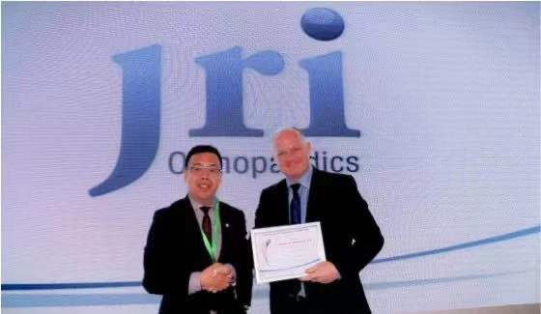
Case Study : AK Medical and JRI
UK China partnership
Business success
Engaged JRI in DIT events and supported to connect to potential distributors including AK Medical. AK acquired JRI in the end.
Innovation
Joint R&D centre in Sheffield developing new products for the international orthopaedic sector
Patient benefit
AK Medical distribution of high quality JRI orthopedics in China since 2014
Notes:
AK Medical and JRI, a story of imports to China leading to investment and a UK –China research partnership.
With the support of DIT, JRI was connected to the Chinese partner AK medical and start to import g high quality orthopaedic joints from JRI since 2014. Demand for the products and feedback on their quality was so good, that AK Medical invested in JRI and together the two companies opened a joint R&D centre in Sheffield.

Slide 15
Case Studies
Invite to DIT event to raise profile
Arrange one-to-one meetings with potential distributors/partners
Provide market reports & insights
Government lobby
Notes:
Besides the two pairs mentioned just now, we have been supporting many other UK companies on China market, mainly by
Inviting to DIT event to raise profile/brand awareness
Arranging one-to-one meetings with potential distributors/partners
Providing market reports & insights
Accessing to government contact
And we look forward to work with more in the future, which is why we are here today.

Slide 16
Doing Business in China
Why China?
Major export market
Opportunity to licence-out
Source of capital investment
Know your market
Localise your offer
Protect your IP
Get support
DIT
Export Support Service
China-Britain Business Council
Service providers for product registration etc.
Be patient - build a strategy - it takes 3 to 5 years!
China to help you grow
Notes:
So all in all, here are what you need to consider for entering the China market:
Does China fit into your global strategy?
Do you know the regulatory pathway, timelines and IP strategy in China?
China is such a big country, which region would you like to start with? How to identify distributors and investment etc.
Localise your offer- having a good quality interpreter and making product literature in Chinese language, these are all very important.
Be patient, there are lots of opportunities in China, however it also takes you time and resources…
Please consider to use support from China, DIT offers free of charge services for UK companies. You could also use other resources, for example, our international trade advisor based in the UK, who can help with export strategy and market knowledge, or Export Support Service, a DIT China specific programme to support companies before any plan for China market, or industry association like China Britain Business Council (CBBC), who can provide detailed market research reports for companies at a chargeable service. DIT can also introduce you to professional organisations like consulting companies on law, on product registration.

Slide 17
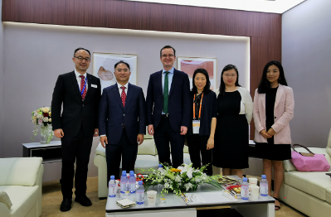
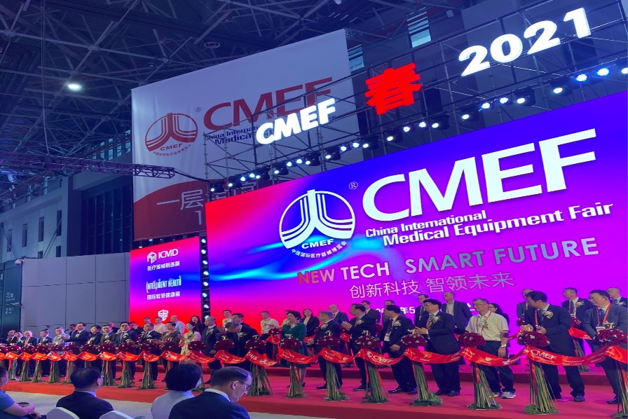
Events and DIT Support
DIT Support
Tailored individual market entry advice
Business matching support for SMEs
Missions, events
Series of focused webinars
CMEF, Shanghai, Apr 2024e
The largest medical device fair in China
28 countries represented
4K exhibitors
110K visitors
Notes:
During your journey to China, DIT can support you all the way along, which we already mentioned some of them just now.
• Make tailored individual market entry advice
• Provide business matching support for SMEs
• And organise missions, events and visits to help UK companies understand opportunities and find the right partner in China.
Here is the major event of the year: China Medical Equipment Fair (CMEF), the largest medical trade show in Asia which is held in May in Shanghai every year. We organise medtech roadshows and help UK companies to pitch to the Chinese medical device industry and identify partners. If you are interested in knowing more about the event or other similar event, pls feel free to contact us in China.

Slide 18
Upcoming Events 2022
Date | Topic | Description
10 Nov [TBC] | MedTech Investment Webinar/Dinner | Opportunities for more than 100 Chinese medical device investors/manufactures to understand UK MedTech ecosystem, investment environment and investment projects.
23 Nov | UK MedTech Roadshow in CMEF | Opportunity for UK business to pitch to China life science industry, for distribution and investment opportunities. DIT will organise roadshow in CMEF which is the largest medical device expo in China. This year the roadshow will be themed on Healthy Ageing.
Feb 2023 [TBC] | Diagnostic Webinar | Opportunity for UK diagnostics companies to meet with potential partners through business matching. Targeting 200 audiences in the area.
Notes:
And in the rest financial year before next Apr, we have a few events coming. We look for UK companies to engage with China audience offline or online. And if you are interested, please let us know. Actually we have quite a lot other events in the past half year. Contact us to register your interest and we can invite you to the relevant events.

Slide 19
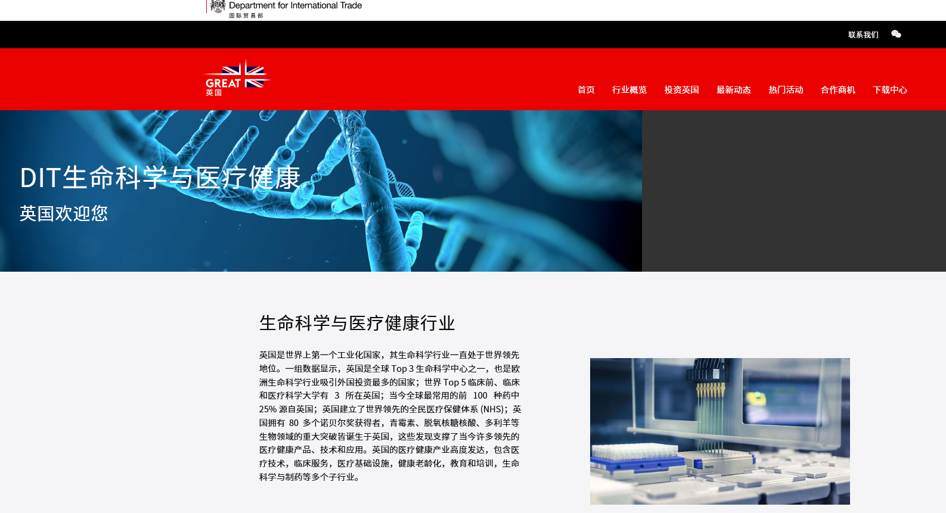
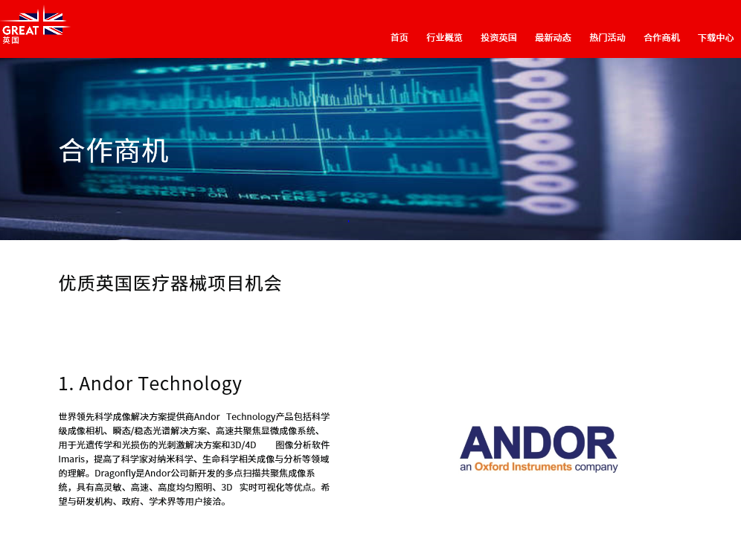
DIT Digital Platform
http://healthcare.ukbusinessinchina.com/
A platform (in Chinese ) to showcase UK medtech strength and introduce real business opportunities to Chinese industry
Scan the QR code to
visit the platform
Notes:
At last, I would like to mention that DIT just set up its digital platform to showcase UK medtech strength and introduce real business opportunities to Chinese industry. So if you are looking for Chinese partners, this is one of the ways that we can promote your project and attract potential partners.

Slide 20
Contact Us
Emily Liang, IVD Lead
British Consulate-General Guangzhou
Emily.liang@fcdowebmail.fcdo.gov.uk
Victoria Li, High Value Consumables Lead
British Embassy Beijing
Victoria.li@fcdo.gov.uk
Rita Huang, Wound Care Lead
British Consulate-General Guangzhou
Rita.huang@fcdo.gov.uk
Cynthia Han, Imaging Lead
British Consulate- General Shanghai
Cynthia.han@fcdo.gov.uk
Q & A
Notes:
So here is our contact information we have colleagues responsible for different subsectors, you can contact us accordingly. My colleagues are all here today as well and be ready to answer your questions. You can type in the chat box or unmute yourself to raise the questions.

