Slide 1
Life Sciences Opportunities
Mexico 2022

Slide 2
Mexico – Market Overview
Economy
Population
Government Priorities
15th
Largest economy, according to the IMF, and world’s 9th largest by 2030.
Population: 130 million (2022 estimate)
Life Expectancy: 75 years old
Language: Spanish
Capital: Mexico City
Size: 1,972,550 km²
Primary Healthcare (PHC)
Education & Training
Digital Health
Improving quality health care
$27.90 US billion
Market value worth in 2020
Free trade Access to the US and Canadian market through the revised NAFTA (USMCA)
6.2% GDP
Healthcare expenditure has risen to 6.2% (OECD, 2020). This fact, along with continuing strong market growth, makes the market more attractive to potential new UK entrants.

Slide 3
Fastest growing market for medical devices in the world. Mainly supplied by foreign manufacturers.
Mexico – Market Overview
2nd
Exporter of medical devices in Latin America.
7th
Largest exporter of medical devices worldwide.
11th

Slide 4
Mexico – Health System
Health services in Mexico are provided through a variety of sub-systems, depending on employment
Mexican Institute of Social Security
Institute for Social Security and Services for State Workers
Health Institute
for Welfare
Provides health insurance and health care services, as well as pensions for Mexicans in salaried private employment.
Provides similar social security (SS) for federal government employees.
Health programme covering those who do not have any social security system (Previously known as Seguro Poular).
47% of the total health expenditure is private with being out-of-pocket

Slide 5
Mexico – Health System
For such a system to be sustainable, services in the providers block should be subject to rigorous analysis and control:
Centre for Health Technology Excellence (CENETEC)
Federal Committee for Protection from Sanitary Risks (COFEPRIS)
Health Technology Assessment agency that evaluates novel equipment, devices and medication; as well as promoting the correct use and management of medical technologies.
Department within the MoH that deals with controlling health facilities, sanitary control of advertising activities, and monitoring the manufacturing, import, or export of health products.

Slide 6
Mexico – Key Opportunities and Challenges
Demographic change and transition to non-communicable diseases and injuries pain represent an opportunity for the healthcare industry.
The establishment of research clusters in Mexico can generate demand for equipment and technology to support the increasing research and development of new pharmaceuticals and biotechnology products.
Medical Devices
Pharmaceutical Products
Mexico imports a total of 6,900 MUSD.
Growth of 27% in the last year.
Some multinational companies with operations in Mexico: B.Barn, Bard, Baxter, Becton Dickinson, Greatbatch, Medliene, Medtronic, Nellcor Puritian Bennett, Ossur, Smiths Medical
Mexico imports a total of 4,649 MUSD.
Growth of 10% in the last year.
Some multinational companies with operations in Mexico: Pfizer Inc., Johnson & Johnson, Novartis, Merck & Co., Roche, Abbot Laboratories, AstraZeneca, Bayer, Eli Lilly & Co., Bristol-Myers, GlaxoSmith Kline.
.
Regulatory timeframes are one of the biggest obstacles to entering the Mexican market.

Slide 7
Mexico – DIT Support
Working Remotely
Identify market demands
Support UK companies with comercial barriers
Updates regarding activities and events
7

Slide 8
Mexico – DIT Support
Julio Evaristo
Head of Education
Pablo Velasco
Senior Trade Officer
Cassandra Vargas
Trade Officer.
Maria Fernanda Wardah
Intern
8

Slide 9
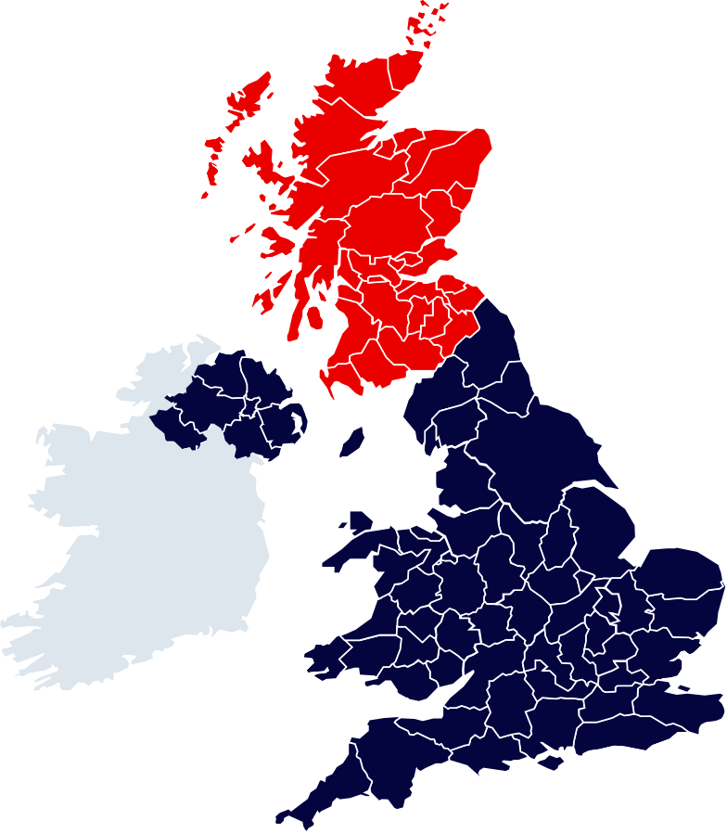
Why UK?
United Kingdom offers one of the strongest and most productive life science sectors in the world.
+5,500
Companies in Life Sciences
£30 bn
In Exports
#1
In foreign investment in Europe
3
TOP
In Europe in clinical portfolio in all its phases
Of the world's leading pharmaceutical companies operate in the UK
20
Source: Choose UK Life Sciences 2018, Department for International Trade.

Slide 10
UK Offer
Orthopedics
Cardiovascular
Diabetes
Medical Imaging Equipment
Wound Treatment
Cancer and Oncology
Cancer Diagnosis

Slide 11
UK Offer
Clinical research
Antimicrobial resistance
Cell Therapy and Genetics
Diagnosis of infectious diseases
Genomic technologies and personalized medicine
Digital Health

Slide 12
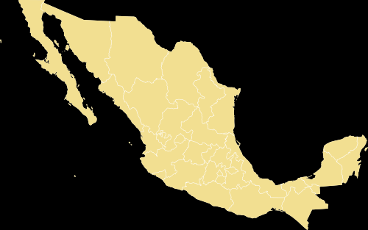
Covid-19
Though not the most affected country in LATAM, Mexico has been highly affected by the pandemic having one of the highest number of Covid-19 deaths in the world.
Government response has focused on treating patients and vaccine procurement (7 different vaccines available in the country).
COFEPRIS main priority is the approval of products related to COVID-19 ( vaccines, medications, diagnostic tests, etc.).

Slide 13
Market Access Barriers
Opportunities in Life Sciences
Approval Processes and Registry
Evaluation of health technologies
Procurement of healthcare products
Intellectual property
Vaccines and Coronavirus response
Over the counter medicines
Packaging regulations
Challenges
Government’s campaign of austerity to fight corruption
Restructuration of the many areas of the MoH
Active Barriers
Approval Processes at COFEPRIS
Mexico - Pharma - Open International Tender
Approval process for influenza vaccine
Strengthening of the HTA Agency in Mexico

Slide 14
Thank you

