Slide 1
Where the opportunities lie in the US market John Vislosky, DIT USA Autumn Waska, DIT USA
First slide – Department for International Trade

Slide 2
Session overview
US Market Overview
Where do UK companies have an edge?
Where can companies get support?

Slide 3
US Market Overview
First slide – Department for International Trade

Slide 4
US Healthcare System
Similar issues faced in much of the Western world
Ageing population
Rising cost of healthcare
Opportunity in digital and data
Digitisation of health systems and clinical trials
Decentralisation of clinical trials

Slide 5
US Healthcare System
Less budget pressure than UK
Similar problems – but viewed through a different lens
Increased efficiency vs increased output
Taking cost out of the system in a fee-for-service environment doesn’t help
Not exclusively the case, particularly for payer-provider combinations like Kaiser Permanente or Geisinger
US healthcare expenditure:
$3.65 trillion in 2018
$6.2 trillion in 2028 (forecast at 5% CAGR)

Slide 6
US Market
Primary Clusters
Boston
San Francisco
Greater New York
Minneapolis
San Diego

Slide 7
What is the UK’s edge?
First slide – Department for International Trade

Slide 8
UK Edge
US market likes solutions that are proven in a difficult environment
NHS is rigorous in the value it expects for patients.
NICE – need to have evidence
Data environment in the UK/NHS – train AI on a bigger database.
Diagnostics developed e.g. with UK Biobank may allow more advanced technological models
UK known for scientific excellence.
UK companies can use scientific heritage, proven in difficult market to get pilot in the US, use pilot to be selling point for the rest of the country

Slide 9
UK Success
Babylon
“UK’s Babylon Health Sees 'Huge Demand' in US Driven by Unique, Digital-First Solution”
Paxman Scalp Cooling
“PAXMAN announces that the company now has installed or signed delivery agreements for just over 500 scalp cooling systems preventing hair loss in connection with chemotherapy in the USA, only two years after receiving FDA approval. The company is now actively supporting large-scale coverage and reimbursement for the treatment.”
Adaptimmune
“Adaptimmune Cuts Ribbon on U.S. Headquarters at the Navy Yard in Philadelphia”

Slide 10
Where companies can get support
First slide – Department for International Trade

Slide 11
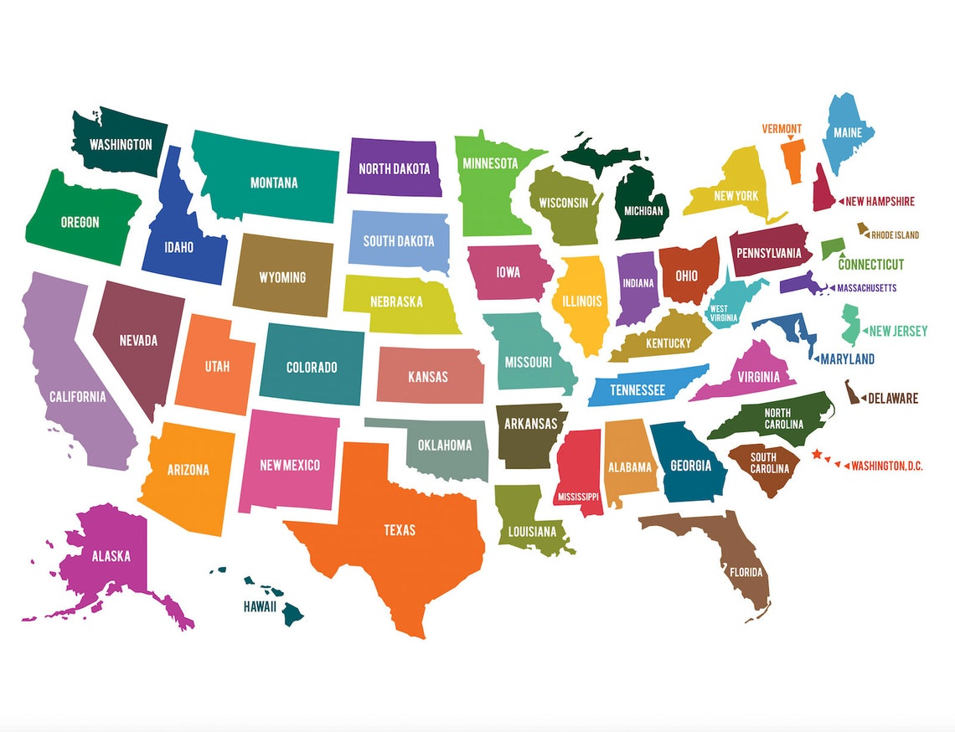
DIT’s overseas network
USA Life Sciences Team: 18 staff across 7 consulates
Chicago
Boston
New York
Washington DC
Houston
Los Angeles
San Francisco

Slide 12
UK Network
Who DIT works with in the UK?
ITA Network
ABHI – HealthTech Association with US Accelerator Programme
Medilink
BIA – UK BioIndustry Association
Midlands Engine
Northern Powerhouse
Academic Health Science Network (AHSNs)

Slide 13
Events
HLTH
13-16 November 2022, Las Vegas
JP Morgan Healthcare Conference
9-12 January 2023, San Francisco
HIMSS Global Health Conference
17-21 April 2023, Chicago
BIO International Conference
5-8 June 2023, Boston
AdvaMed’s MedTech Conference
September/October 2023 (Date/Location TBD)

Slide 14
Thank you, and get in touch: john.vislosky@trade.gov.uk
Slide 9 Ministerial Strategy Directorate

Slide 15
Opportunities in Texas
Autumn Waska, Vice Consul, Trade & Investment Officer British Consulate Houston
22 October 2020

Slide 16
Top-Ranked Emerging Life Science Clusters
Ranked on the basis of recent life sciences employment growth, number and concentration of key scientists, NIH funding, quality and quantity of (1) educational institutions providing life science graduates and (2) medical research and health services institutions, and number and concentration of high-tech workers.
Seattle
Houston
Austin
Minneapolis
Denver
St. Louis
Dallas/Fort Worth
Atlanta
Pittsburgh
“There was already a pool of talent down there. ... If we had gone to San Diego or Boston, it probably would have taken longer to make the right connections,”
-Innovative Trauma Care (Canadian Company)
Launched US base in San Antonio, TX

Slide 17
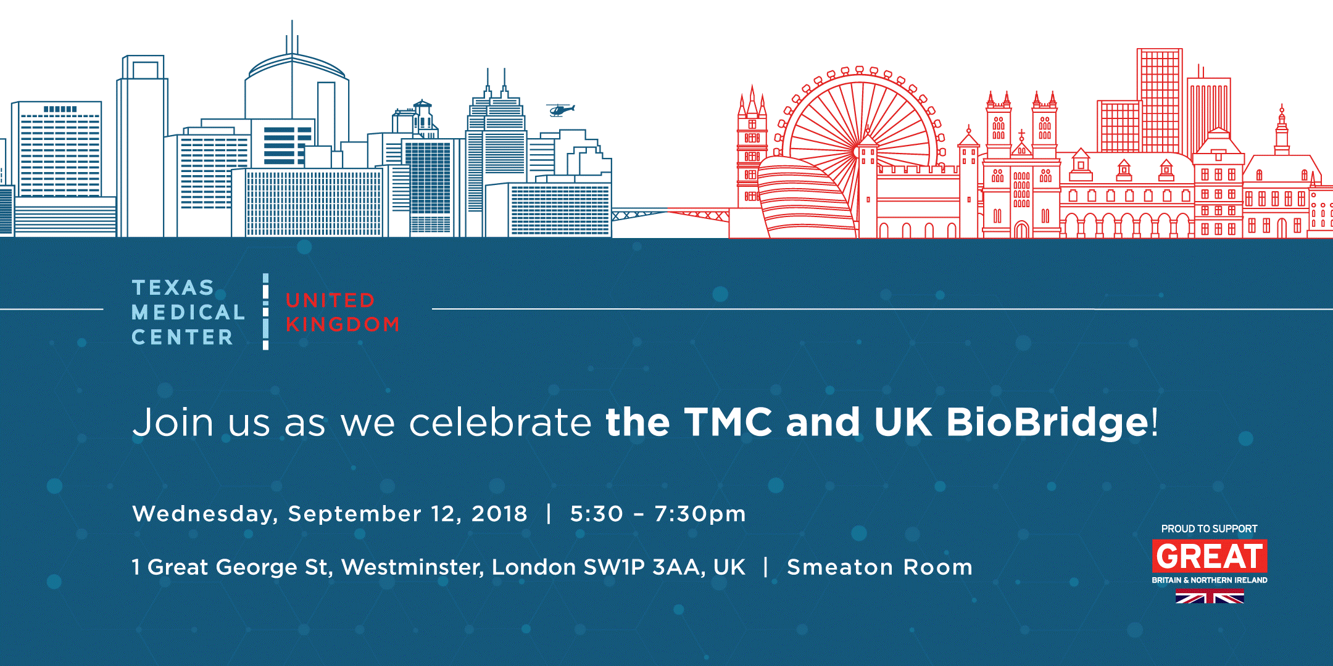
Texas Medical Center (TMC)
10 Million Patient Encounters per year
180k+ annual surgeries
106k+ employees
8th Largest business district in the US
TMC3 – Four industry research sites
60 Member institutions within 2.5 sq mi campus
20 Hospital Systems
UK TMC BioBridge - Strategic partnership between DIT and TMC to facilitate and promote research and innovation between the UK and the Texas Medical Center

Slide 18
UK TMC BioBridge
10 UK companies completed accelerator
4 UK companies housed within DIT coworking space at TMCx+
Outcomes include:
Co-development with Hospital Systems including Houston Methodist, Memorial Hermann, and MD Anderson
Continued participation in pitch competitions, Demo days, round tables, etc.
Network of clinicians, KOLs, access to mentors and consultants for Reimbursement strategy, FDA strategy, and hospital procurement process
Pilot studies with Hospitals
Contracts/Sales

