Slide 1
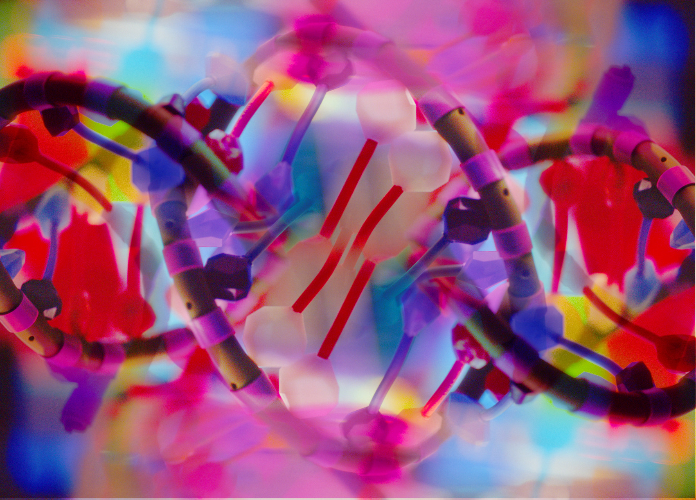
Italy
Carolina Della Ventura | Export Growth Adviser

Slide 2
Department for International Trade
The UK’s Department for International Trade (DIT) has overall responsibility for promoting UK trade across the world and attracting foreign investment to our economy. We are a specialised government body with responsibility for negotiating international trade policy, supporting business, as well as delivering an outward-looking trade diplomacy strategy.

Slide 3
Our support
DIT Italy presence in Italy:
British Embassy in Rome, British Consulate-General in Milan
Services to UK life sciences companies:
tailored market strategy advice,
assistance to overcome market access issues,
identification of local partners,
organisation of round tables, events and workshops,
organisation of introductory calls with key stakeholders

Slide 4
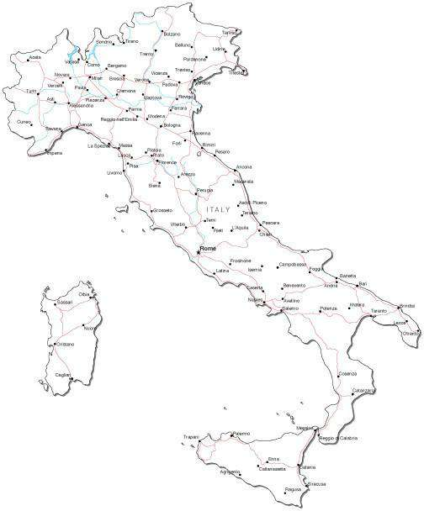
Italy – key facts
Parliamentary republic
20 regions
Population: 58.9 million (as at Q1 2022)
Europe’s fourth largest economy second biggest manufacturer after Germany (GDP as at 2021)
One of the UK’s largest export markets and top destination for UK tourists with > 5 million UK tourists (pre-pandemic data)

Slide 5
Italy and Life sciences sector
One of the best and fastest growing life science sector in Europe;
Accounts for 8.4% of Italy’s GDP (as per 2020);
Strong LS ecosystem supporting growth, innovation and exports;
One of the largest pharmaceutical industry, competing with Germany and France to be ranked first in Europe for pharma production;
Steady growth of the biotechnology industry, characterized by the strong presence of innovative SMEs (roughly 80%);
Roughly 4,000 companies active in the biomedical sector – strong import flows from foreign countries to meet quality and innovative products’ demand.

Slide 6
LS ecosystem
Source: ITA – Italian Trade Agency

Slide 7
National healthcare system
Overview:
Public system (Beveridge model): universal assistance to all;
Regional organisation;
Challenges: i) Ageing society; ii) Higher costs vs public resources tightening; iii) Health staff turnover – shortages; iv) Long waiting lists.

Slide 8
Opportunities
EU Recovery fund – health pillar € 15.63 bn
To be invested for the digital and technological upgrade of the Italian healthcare system between 2021 and 2026 (8.6% of EU recovery funds allocated to Italy).
OBJ 1: PROXIMITY NETWORKS, STRUCTURES AND TELEMEDICINE FOR TERRITORIAL HEALTHCARE ASSISTANCE
€ 7.00 billion
OBJ 2: INNOVATION, RESEARCH AND DIGITALISATION OF THE ITALIAN NHS
€ 8.63 billion
Build 381 community hospitals for patients requiring short term stays;
Health services for >65 not self sufficient population with chronic diseases;
Telemedicine, home automation and digitalisation to create a shared home care model;
Launch 1,288 community health houses to strengthen home care and integrate health and social services.
Upgrading hospital technology (total investment € 4.05 bn), including acquisition of 3,133 new hospital high technological equipment (CTs, magnetic resonance, linear accelerators, fixed radiological systems, angiographs – by December 2024);
3,500 new beds in intensive care and 4,225 new beds in semi intensive care;
Empower the electronic health record (EHR);
Hospital anti-seismic upgrades to make hospitals safer and more sustainable;
Create 5 operational centres: 4 innovative technology R&D centres + 1 strategic infrastructure dedicated to the response to future pandemics;

Slide 9
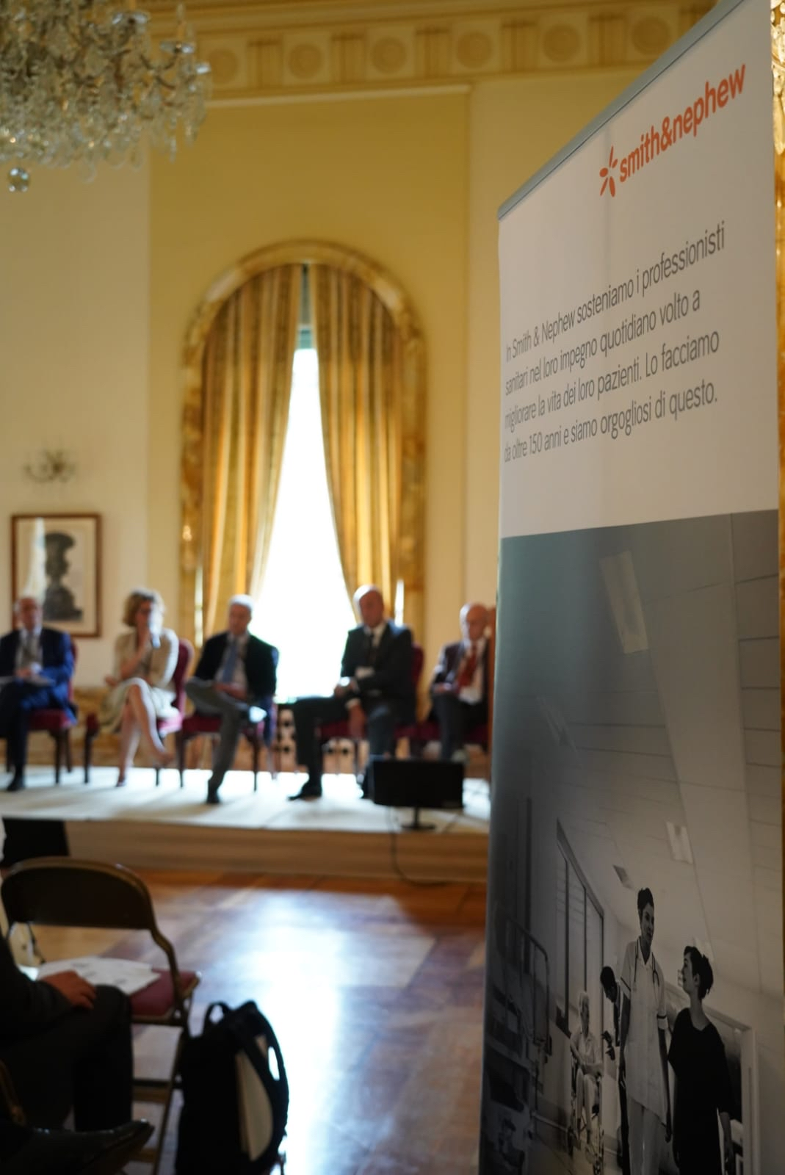
Case study 1: Smith & Nephew
Who: Smith & Nephew
UK multinational company. Wide presence across the globe, active in the production of orthopaedic devices, trauma and clinical therapy products, advanced wound management products.
Need: To promote their navigator robot for orthopaedic surgery in the Italian market.
Service provided: Organisation of a one day promotional/ marketing event held at the British Ambassador residence in Rome.

Slide 10
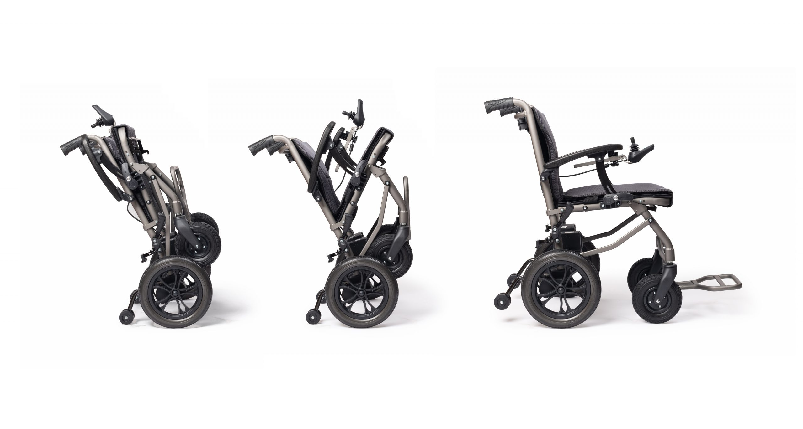
Case study 2: Suntech - Efoldi
Who: Suntech – eFoldi
Manufacturer of the lightest and most compact folding mobility scooter and power chair.
Need: To identify a partner in Italy for product distribution.
Service provided: Support and assistance with their entry strategy in the Italian market providing information over the healthcare system, relevant exhibition for the orthopaedic/ devices sector, distributors' details, orthopaedic retail shops and organisation in the country, device registration process with the Italian MoH.

Slide 11
How to do business in Italy
Business etiquette
Italy was a founder member of the EU and is an advanced and sophisticated market. As such there are no particular national characteristics that UK exporters should be aware of apart from normal business practice and behaviour.
Business in Italy is built on the basis of personal contact and at the outset relationships are usually conducted in a fairly formal manner. Do not immediately use first names unless you are invited to do so, ensure that you have an adequate supply of business cards and pay attention to Italian business cards.
While many Italian business representatives speak English it is unlikely to be perfect and even less likely to be punctuated with trendy phrases known only to mother-tongue English speakers - keep your conversation clear and coherent.
Do not expect immediate results. You must be prepared to invest time and money in the market and can expect to wait some time before seeing a real return.

Slide 12
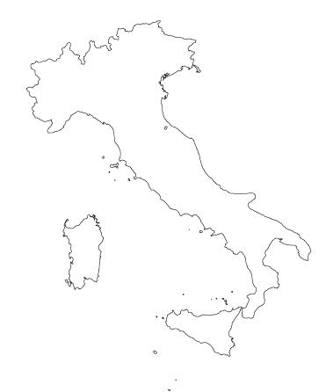
Contact us
Carolina Della Ventura
Export Growth Adviser
DIT – British Consulate-General Milan
Carolina.DellaVentura@fcdo.gov.uk
Claudia Giunchiglia
Senior Trade Advisor Life Sciences & Healthcare
DIT – British Embassy Rome
Claudia.Giunchiglia@fcdo.gov.uk

