Slide 1
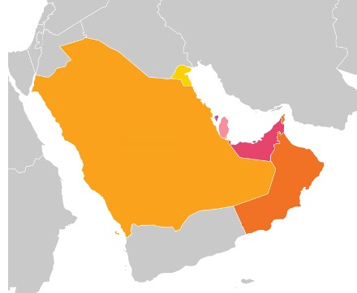
Welcome to a market entry overview on the The UAE Healthcare and Life Sciences Sector Medica 2021
Pippa Russo, Life Sciences Advisor
Pippa Russo, Life Sciences Advisor
Pippa Russo, Life Sciences Advisor
Notes:
Intro – I am the LS Advisor and work within the Department for International Trade at the Embassy. I’ve been in this role for a year now and work within the HCLS cluster. I cover the LS sector for whole of UAE which means I engage with all the Emirates and their health authorities along with the federal authority. I will take you through a market overview today – share my slides. Happy to take questions after the presentation.

Slide 2
The UAE Healthcare and Life Sciences Sector
Sizeable healthcare market with a relatively young and still highly transient population (10m, with a median age of 33.5).
Public healthcare provision with significant private sector participation.
Fragmentation in terms of regulation and public healthcare provision between Abu Dhabi, Dubai, and the other 5 Emirates, potentially offering numerous market entry points.
Overall, a maturing market with selective oversupply (both geographical and clinical areas), recognized need for further quality improvement and a strong appetite of the country's leadership for innovation.
Healthcare is a top government priority: Vision 2021- ‘World-Class Healthcare’ and 50 year comprehensive development plan.
Annual spend expected to rise to $21.3bn in 2021, projected to be 4.6% of GDP 2026
Large and growing private healthcare market.
Pharmaceuticals and medial devices are still primarily imported into the country.
Notes:
Vision 2021: achieving world-class healthcare one of its priority goals and accrediting all public and private hospitals according to clear national and international standards. Reduce prevalence of diabetes, obesity, smoking amongst population.
New manufacturing in PPE and vaccines as result of pandemic (C-19 vaccine Hayat-Vax).

Slide 3
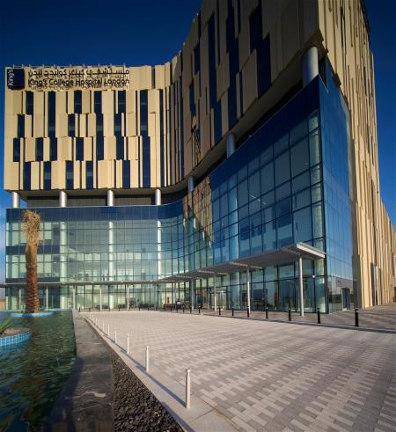
The UAE Healthcare and Life Sciences Sector
The Private Sector has an increasingly important role to play.
Competitive sector – differentiation through innovation, focus on patient experience, building loyalty to brand
Large groups include: VPS Healthcare, Mediclinic, NMC Group, Aster DM, Thumbay Group, UE Medical
UK brand presence: King’s College Hospital, Imperial College London, Maudsley Health, Moorfields, Priory Group
The Ministry of Health and Prevention expects that the government’s share of total health expenditure will fall from 71.3% in 2015 to 60.7% by 2025

Slide 4
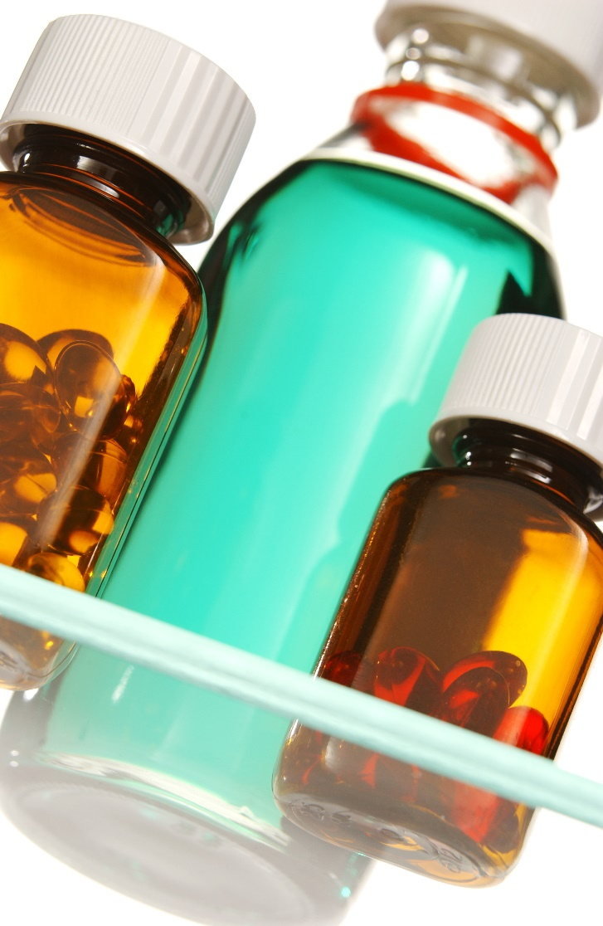
The UAE Healthcare Challenges
Poor lifestyle habits – prevalence of fast food, sedentary lifestyle and high incidence of smoking.
As a result, non-communicable diseases (NCDs), such as obesity, diabetes, cardiovascular diseases and cancers continue to be prevalent in the country.
Keeping up with growing need for clinical staff (shortage of Emirati clinical professionals)
Cost containment: wastage and a culture of prescribing branded drugs is an issue
Tightening budgets in the public sector – efforts to contain costs
An increasingly ageing population- from 1.1% over 65yrs to 4.4% by 2030, stimulates demand for geriatric care
Notes:
Cardiovascular disease is leading cause of deaths in UAE: 2/3 of deaths. Strokes are main cause of disability and third greatest cause of death. Cancer 15% of all deaths. Diabetes widespread and care is lagging behind rest of the world.
There tends to be high turnover among expatriate medical staff, as many medical personnel consider the U.A.E. either a temporary locale or a stepping-stone to gain experience before seeking careers in the West.20 To mitigate the above issues, the U.A.E announced in November 2020 its intent to expand the 10-year golden visa system to all doctors, PhD holders, and highly skilled workers.
From 2018, MOHAP issued circular to curb over-prescription of antibiotics. Roll out dispensing generic medicine.

Slide 5
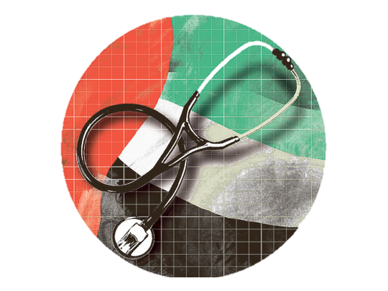
The UAE HCLS Opportunities
Biotech: diagnostic tests, vaccines, antibiotics, cold chain vaccine companies (Hope Consortium)​
BioPharma & Pharmaceuticals: drugs, medicines, antibodies including indigenous manufacturing and R&D​
BioMedical: genetics, genomics, gene therapy, bio-engineering, cell biology, clinical research (with UK Universities)​
MedTech: Medical Devices and equipment​
Education and Training​
Facilities Management​
Rising Medical Tourism – key focus of Government ​
Digital Health / AI – accelerated by about a decade ​
Treatment of non-communicable diseases increasingly a priority (PPP Projects)​
Long term care facilities – due to increase in aging population and chronic diseases
Notes:
Pharma: UAE imports most of its drugs but this is beginning to change and some international pharma giants have partnered with local manufacturers. C-19 pandemic has sharpened UAE’s focus in investing in LS as has interest in clinical research and genomics (Emirati Genome Programme). Growing market for MedTech – we know a number of distributors who are looking for new innovative tech. Holding our own MedTech MTB in a couple of weeks.
Ever increasing demand for medical professionals and new hospitals being built or in future plans.
AD and Dubai rose to top 10 of destinations for medical treatment.
UAE is ideal regional hub for businesses – UAE are actively supporting and encouraging companies to set up here and incentives on offer.

Slide 6
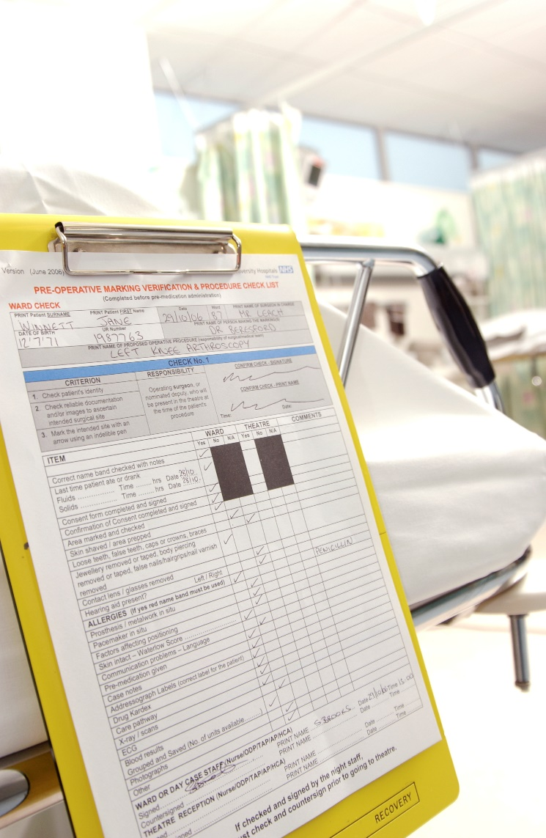
The UAE Life Sciences Regulation (Federal)
Ministry of Health & Prevention (MOHAP) www.mohap.gov.ae
Oversees implementation of govt policy in healthcare sector
Medical device registration
Drug registration
Licenses and controls pricing for drugs and devices
Health services and regulation in the Northern Emirates (17 hospitals, 80 clinics)
Insurance Authority www.ia.gov.ae
Regulates and supervises the insurance sector
Notes:
MOHAP: funds almost all non-private healthcare in the northern emirates. Our Doing Business Guide details specific information about medical device and drug registration. Lots of information on the MOHAP website.
Insurance is mandatory – very competitive and limited profitability.

Slide 7
The UAE Healthcare Regulation (Emirate Level)
Dubai Health Authority (DHA) www.dha.gov.ae
Regulation, licensing, strategy for Dubai
Also – operates 4 public sector hospitals. Expansion and new facilities.
Department of Health - Abu Dhabi (DOH) www.doh.gov.ae
Regulation, licensing, strategy for AD – 85 new initiatives
Separate government health operator – SEHA – 13 hospitals, 36 clinics
Sharjah Health Authority – Sharjah (SHA) www.sha.gov.ae
Regulation, licensing, strategy for Sharjah
Development and management of Sharjah Healthcare City (freezone)
Notes:
Dubai Healthcare Strategy 2021: Aimed to provide high-quality medical care to patients with chronic diseases, as well as promote a culture of early detection and regular check-ups. It also sought to create a high-quality, comprehensive and integrated health service system and improve the efficiency of public hospitals. Dubai Healthcare City Authority: Regulates the freezone, licensing of all professionals and operators. Sets and maintains international best practices in healthcare delivery and patient care. Works closely with DHA.
DOH is responsible for monitoring and regulating the healthcare industry; and overseeing the process to upgrade the hospitals and clinics in accordance with accredited international standards
SEHA: Owns and operates all public hospitals and clinics across AD. Also 24 other specialised care facilities and 64 ambulances. Annually can accommodate 100k inpatients and treat 5m outpatients. Employs 18,700 people. ADQ holding company owns SEHA and RAFED (group purchasing organisation to procure health related products and services).
New developments in Sharjah including Sharjah Healthcare City and Sharjah Research, Technology and Innovation park.

Slide 8
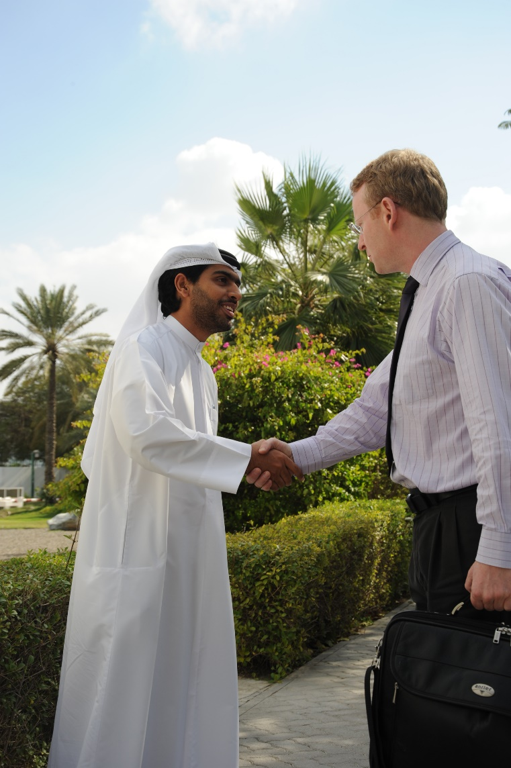
The UAE Routes to Market/Tips for Doing Business
Most common routes to market are as follows:
Agent / Distributor – Local representative (access to tenders)
Limited Liability Company – 51:49 Local Partner
Free Zone set-up
Develop networks and relationships
Overseas Delivery Partners – BCB in Dubai (trade/ incubator services)
100% foreign ownership onshore is new development TBC
** DUE DILIGENCE & LEGAL ADVICE RECOMMENDED**
Notes:
BCB will cease on 1st January to be replaced by in-house Enhanced International Support Service.
Your ITAs will receive Market entry for Pharma products is most commonly via distributors/sales agents and after-sales reps. The right distributor should have the correct valid licences in place (to import, advertise and sell products), be well-connected into the sector, and would know, have access to the main tenders, where to find the relevant information, and to pro-actively market solutions with potential buyers. Once a presence has been established (or a local agent with the right licences appointed), you will need to check whether your pharmaceutical products must be registered with the Ministry for Health and Prevention (MOHAP) (even those intended to be imported) before they are distributed.
Free zones offer investors tax free duty benefits and a framework which allows companies to trade easily in the UAE e.g. 100% foreign ownership, tax exemptions, no custom duties etc.
An amendment to the Commercial Companies Law (CCL) allows 100% foreign ownership of UAE mainland companies, effective 1 June 2021. However, not all types of businesses will qualify, the Department of Economic Development (“DED”) of each Emirate will specify business activities open to 100% foreign ownership
We hold a distributors list and Doing Business Guide – just email me.
Our services include the provision of market intelligence, sourcing and developing lists of agents/potential partners, providing information on key market players or potential customers; establishing the interest of such contacts in working with the company; and arranging introductions as necessary. In addition, we also organise events around exhibitions such as Arab Health where we can assist with introductions and/or promote a company and its products/services.

Slide 9
Summary: What UK organisations need to consider
Challenges for UK Suppliers:​
Local partnerships are key
Understanding local culture and business practices is essential
The markets are diverse and should be approached individually – there are also geopolitical tensions which should be considered
Relationship building is important, and its value should not be underestimated
Funding to help setup and risk appetite. SMEs should try and win contracts first before committing to market.
Understanding of the local customs, laws, regulations and communication tools (Whatsapp)
UK supplier interest high but takes the right organisation to play (Differentiator and awareness of local and overseas competition)
Political uncertainty and geo-political tensions
Expensive to visit but important to build relationships multiple times – “face-to-face” environment.
Takes a long time to build a project and progress it - Do not come into the market merely trying to sell products. Instead, focus on solving problems and creating solutions that will help the country. ​
​
.​
​
Notes:
Some feedback listed here from companies who have experience in the market and good to make you aware of specific challenges when considering if this is the right market for you.
Market is relatively small (10m people) and limits profitability of certain healthcare enterprises that depend on scale.
VFM – UAE wants to make cost savings and achieve greater efficiencies.

Slide 10
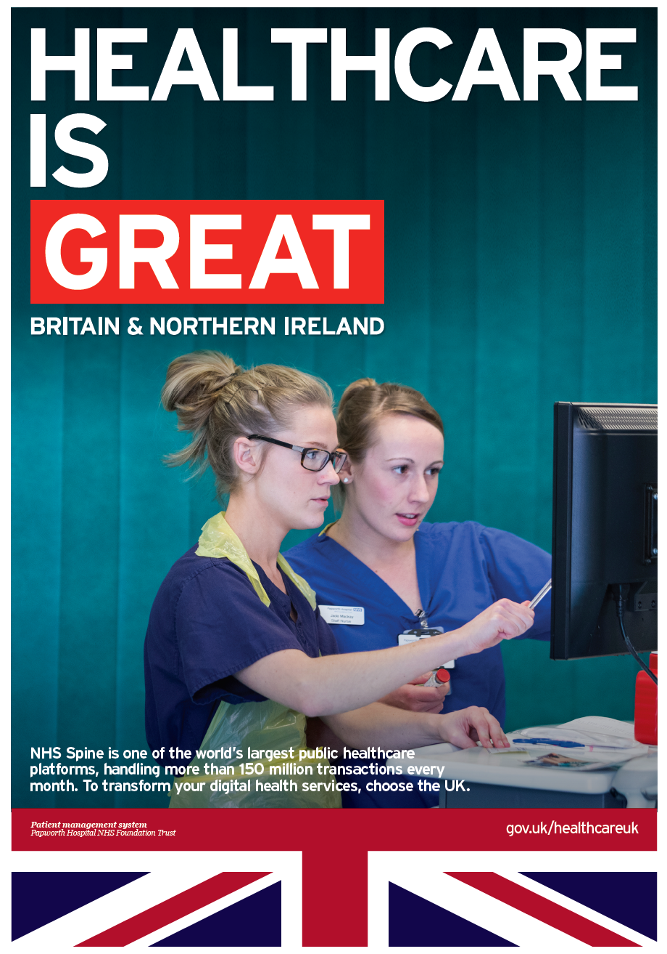
Contact: Pippa Russo, Life Sciences Advisor, UAE pippa.russo@fcdo.gov.uk Finola Hegarty, Healthcare Advisor, UAE finola.hegarty@fcdo.gov.uk Seema Mangoo, Healthcare and Life Sciences Officer, UAE seema.mangoo@fcdo.gov.uk QUESTIONS?

