Slide 1
Doing Business in Argentina
An introduction to the Health Sector & MedTech
Department for International Trade – Buenos Aires
November 2022

Slide 2
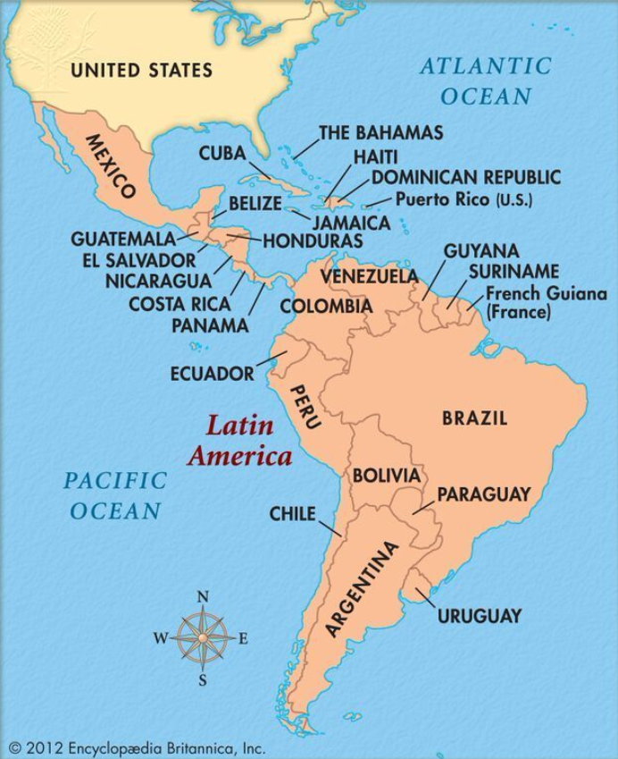
Argentina: Location & Size of the Economy
3rd largest economy in LATAM
28th largest economy in the world
Member of Mercosur trading bloc
Largest trading bloc in S. America
2nd largest economy in South America
2nd largest GDP in S. America (USD 491 B)

Slide 3
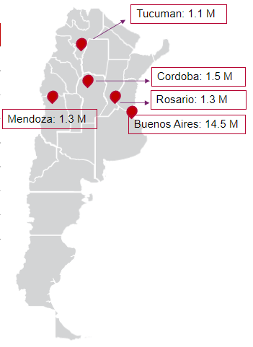
Argentina – Basic Facts
ARGENTINA: 11 times larger than the UK
POPULATION: 47.3 M
91% Urban
BUENOS AIRES: Country’s hub for most industries
OFFICIAL LANGUAGE: Spanish (English for trade)
Familiar, European business culture
+100 BRITISH SUBSIDIARIES
BRITCHAM
+100 years
ENTRY ROUTE to other Spanish speaking countries
BRITISH HOSPITAL
178 years
Oldest Nursing School
Source: World Bank; INDEC.

Slide 4
Argentina: Health System
Sources: CAEME - Cámara Argentina de Especialidades Medicinales; Sociedad Argentina de Cardiología, I-Brokers Consultants
PUBLIC SECTOR | SOCIAL SECURITY SECTOR | PRIVATE SECTOR
Public finance & supply | Obligatory social security organised by trade unions of different activities & PAMI (public medical insurance for retired people) | Voluntary but regulated by national government
Provincial & National Health Ministries and public hospital network | 3% of the employee’s salargy | Middle-high income population.
38% of population | 63% of population | 15% of population
Uninsured people, informal workers and unemployed people | 200 social schemes; hire private contractors | 6 companies represent 80% of market

Slide 5
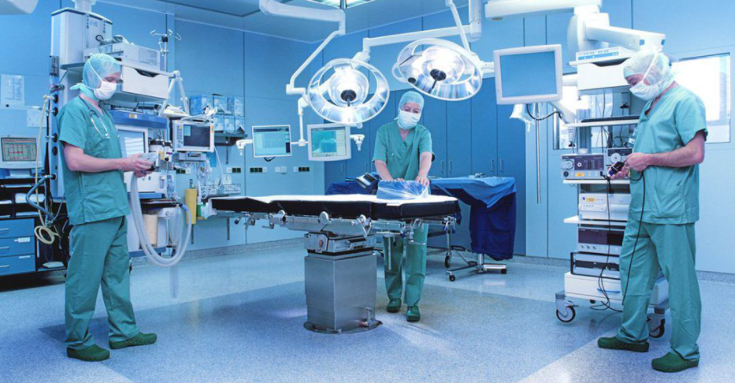
Argentina: Health Sector - Basic Facts
QUALIFIED MEDICAL DOCTORS & UNIVERSITIES
39.6 DOCTORS PER 10,000 PEOPLE
HEALTH SECTOR
27,432 Health Establishments
(PUBLIC & PRIVATE)
68% NATIONAL
32% FOREIGN
354
PHARMA
LABS
One of the most developed health
systems in the region
Source: Sector contacts, Sociedad Argentina de Cardiologia

Slide 6
Argentina: Health Sector – Medical Devices
655 IMPORTERS 7,000 EMPLOYEES
274
PRODUCERS 4,300 EMPLOYEES
DOMINATED BY IMPORTS
+70% OF TOTAL MARKET
SOURCES: USA, CHINA, GERMANY, JAPAN, MEXICO & OTHERS
LOCAL STANDARDS ALIGNED WITH CE & FDA
APPETITE FOR HIGH-END TECHNOLOGY
MAIN IMPORTS + USD 800 million (before COVID19 )
Source: Industry contacts, CADIEM – Supplies, Implants and Medical Equipment Assn; I-Brokers Consultant

Slide 7
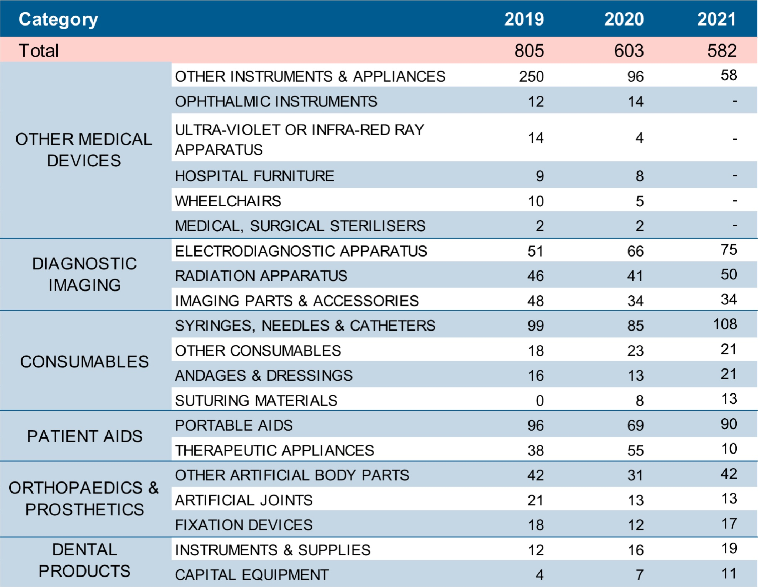
Argentina: Medical Devices Imports by Product Area
Source: I-Brokers Consultants

Slide 8
Argentina: Med-tech Export Opportunities
Orthopaedics, ophthalmology, odontology
E-health technologies, software and data integration
High-end technology products, e.g. diagnostic imaging equipment, specialized medical equipment and devices not competing with local production.
Implants, stents, cardiac valves, pacemakers, specialized catheters and cannulas, and other specialized disposables.
Patient aids

Slide 9
Argentina: Tips for Doing Business
REGISTRATION: medical devices require an import license issued by ANMAT (Ministry of Health), requested by a local authorized partner.
OWNERSHIP OF REGISTRATION : Owned by local company with ANMAT import license.
EXCLUSIVE AGENT:
experienced medical equipment importer.
REGISTRATION TIMELINE:
1-4 months (depending on the class of product).
IMPORT DUTIES FOR MEDICAL DEVICES:
14-16%
OTHER TAXES: advanced tax payments that make landed cost 70-80% above the freight & cost of the goods placed in BA
PRODUCTS APPROVED & MARKETED IN UK: Faster pathways
HARMONISED SYSTEM (HS) for classification of goods
Source: I-Brokers Consultant

Slide 10
Argentina: Trade Barriers
Health sector – less restrictions
Difficulties to access official foreign currency to pay imports
Expensive imports
Price sensitivity
Strict capital controls (economic instability)
Non-automatic import licenses

Slide 11
Argentina: Final Thoughts
ARGENTINA
interesting business opportunities: Argentina imports most of the medical products.
HIGH DEMAND
Despite the trade barriers, there is a demand for imported essential & specialized medical equipment
Reasonable regulatory approval timeline
APPROVAL TIMELINE
Highly-qualified healthcare professionals
Developed health system in LATAM
Need to upgrade hospitals

Slide 12
Contact Information
THANK YOU!
Marisa Leoncini, Trade & Investment Adviser
Marisa.leoncini@fcdo.gov.uk
Available at Medica 2022, Düsseldorf
Whatsapp 54-9-11-5114-2012

