Slide 1



Consumer Healthcare
CE Market Overview

Slide 2
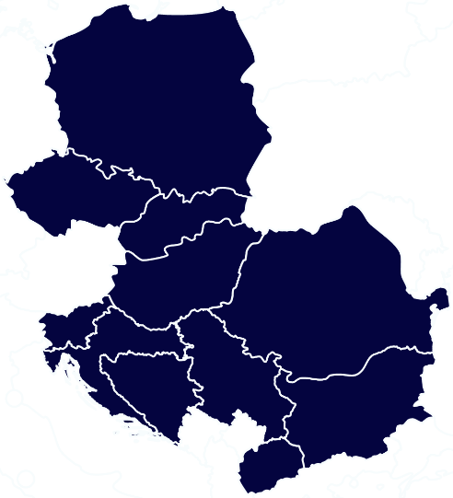
CE Healthcare Landscape
Challenges of public healthcare. Public healthcare spending in Central Europe remains below the OECD average. This leads to serious challenges including accessibility of physicians and quality of services provided.
Importance of private healthcare providers. Growing purchasing power and willingness to pay out of pocket for healthcare services contributed to tremendous development of private providers. The largest market for private healthcare in the region is Poland with 2.6 million Poles having a private medical insurance as of 2019. Private health insurance remains a common employee benefit.
Openness towards new technologies and international cooperation. Private healthcare providers are pioneers in introducing the telemedical solutions.
Existing legal frameworks and government strategies. Telemedicine services would not be possible without legal framework, which CE countries have already introduced.
Change of habits due to pandemic. Pandemic forced the healthcare sector to adapt quickly and provide majority of consultations remotely.
IT-competences. The IT sector is especially strong in Poland and Czech Republic.

Slide 3




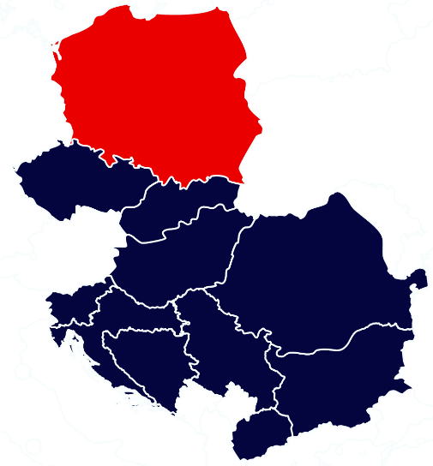
Poland Healthcare Landscape
38m
Population
6.45%
Public spending on health (% of GDP, 2019)
£556
Private health expenditure
per capita (2019)
951
Number of hospitals
Key Characteristics
Opportunities
Poland intends to improve the availability and quality of healthcare by modernizing existing facilities.
Alongside government financing, EU funding is also of great importance.
The private healthcare system in Poland is growing steadily from one year to another, with an average growth rate of 7% per year.
Poland imports 80% of its medical equipment.
Poland is experiencing the fastest aging population in Europe – technologies and services related to the ageing sociaty are required
COVID-19 pandemic has accelerated the development of the e-health sector.

Slide 4
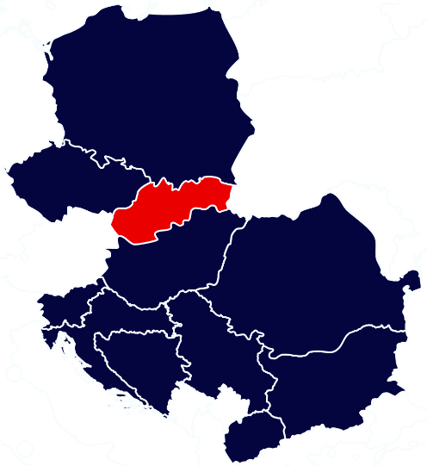
Slovakia Healthcare Landscape
5.4m
Population
6.96%
Public spending on health (% of GDP, 2019)
£380
Private health expenditure
per capita (2020)
78
Number of hospitals
Key Characteristics
Opportunities
The Slovak Ministry of Health plans to restructure the Slovak public healthcare infrastructure and limit the number of hospitals to 46 by 2030.
Hospitals losing their status based on failing the complexity, accessibility, and quality criteria will be transformed into healthcare facilities.
Slovakia has been investing in building new state of the art hospitals.
Slovakia’s e-health program introduces many significant changes to the Slovak health system.
Future opportunities may lie within e-health domains such as:
  Publicly accessible relevant information sharing;
  Medication/prescription (e-Medication, e-Pharmacy);
  Telemedicine;
  Picture archiving and communication system.

Slide 5
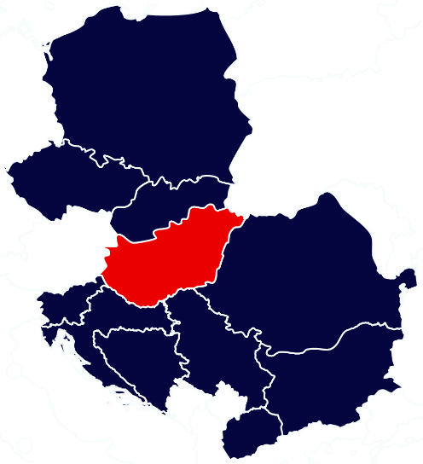
Hungary Healthcare Landscape
9.7m
Population
6.35%
Public spending on health (% of GDP, 2019)
£591
Private health expenditure
per capita (2020)
165
Number of hospitals
Key Characteristics
Opportunities
The Hungarian health system has been the largest beneficiary of EU funds dedicated to health.
Hungary’s medical device manufacturing sector is skilled yet remains relatively small.
More than 70% of the Hungarian medical device market is dominated by imports mainly from the European Union and China.
Medical device suppliers can benefit from Budapest’s hospital redevelopment project, to be completed by 2025.
Hungary has market opportunities in the fields of innovative health therapies and equipment, dental care equipment, and devices that increase efficiency and reduce occupancy rates in hospitals.

Slide 6
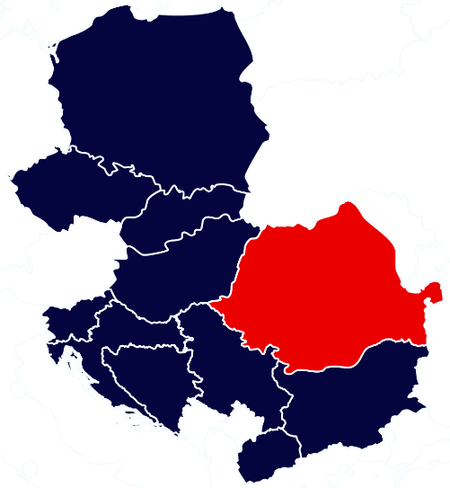
Romania Healthcare Landscape
19.3m
Population
5.74%
Public spending on health (% of GDP, 2019)
£126
Private health expenditure
per capita (2020)
425
Number of hospitals
Key Characteristics
Opportunities
Romania’s health care and insurance systems are predominantly state owned.
The private sector is moving fast. Consolidation of clinics and laboratories resulted in big medical chains of laboratories, diagnosis centers and hospitals
Special attention is paid to oncology (5 centers), cardio-vascular diseases and medical recovery.
The Government announced an ambitious program of investments in modernization of 14 hospitals and construction of 8 new regional hospitals.
Romania does not have a domestic industry of modern medical technology, most of its needs being covered by imports.
About €6.1 bn will be allocated to the health system in the next 7 years: €1.9 bn through the National Recovery and Resilience Program and €4.9 bn under the EU budget 2021 – 2027 cohesion funds.

Slide 7
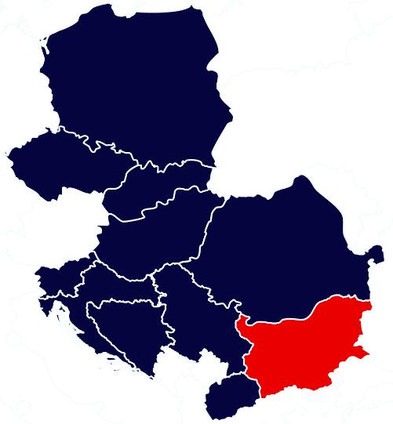
Bulgaria Healthcare Landscape
6.9m
Population
7.13%
Public spending on health (% of GDP, 2019)
£245
Private health expenditure
per capita (2020)
319
Number of hospitals
Key Characteristics
Opportunities
Healthcare in Bulgaria is undermined by an underpaid healthcare workforce and state hospitals fail to offer quality services.
There have been modest improvements in healthcare outcomes. Patients additionally pay out of pocket in order to receive proper treatment.
Life expectancy in Bulgaria has been slowly declining due to cancer, stroke and heart attack.
Bulgaria ranks top 20 in the world in clinical trials performed.
Dietary food supplements are one of the bestselling segments with a steady growth in the last years. The most popular category is probiotic supplements.
Digital health and intensive population screening (prenatal, cancer, diabetes, etc) are one of the major themes in the 2030 strategy for public health.
.

Slide 8

CEN Healthcare post COVID-19
Building a steady supply of medical equipment
The need for rapid digitisation across the sector
Covid-19 pandemic has drawn attention to the importance of medical equipment supplies. As of March 2020, the local government of Mazowieckie voivodeship was the first Polish region to mobilize EU funds for the purchase of various medical equipment for local hospitals. Nearly 50 contracts with suppliers have been signed for the total value of PLN150 mln. Contracts implemented relate to the purchase of ventilators, computer tomographs, x-ray machines, defibrillators, cardiomonitors, decontamination devices, intensive care beds or specialized vehicles with a separate driver's space.
Digitisation can generate substantial cost-savings by reducing the cost of services
Examples of digitisation:
Telemedicine (remote medical consultations)
Electronic health systems & records
Remote monitoring devices and biosensors to improve disease surveillance and, consequently, health outcomes.
Data analytics and artificial intelligence to identify high-risk patients and provide targeted treatments.
The impact of COVID-19 has heightened awareness of the limitations of healthcare systems and the need for new digital approaches to healthcare delivery.

Slide 9

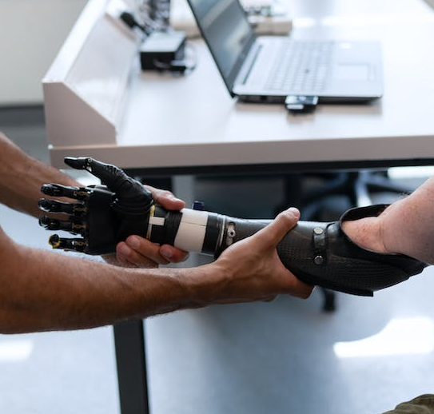


High Potential Opportunities
Digital Health Services
Increased use of digital solutions increases the risk of cyberattacks, therefore creating an opportunity in promoting UK cybersecurity solutions.
Digital Health Technologies
Central European markets are interested in more advanced digital health services and technologies such as: artificial intelligence in diagnostics and radiology, robotic systems.
Healthcare Infrastructure
Among services from modelling, financing and design to construction and operation, medical equipment.
Pharmaceutical products
Pharmaceutical industry focuses on accelerating research and development using technology. With powerful computing power to analyze billions of data sets, Artificial Intelligence (AI) can be a key tool.

Slide 10

Event and DIT Support
AI IN HEALTHCARE COALITION
“AI in Health” is the annual regional conference taking place in Poland dedicated to artificial intelligence and innovation in health. Previous editions of the event brought together key stakeholders and institutions, including prominent panellists from the UK, Bulgaria, Slovakia and Hungary.
The “AI in Health” conference is a response to the increasingly wider and wider range of technological changes in the field of artificial intelligence, which also have a transformative impact on the health care system, research development and patient care. It is considered the leading forum dedicated to artificial intelligence and innovation in health in Central and Eastern Europe.
Next edition of the AI in Healthcare event in June 2023

Slide 11
CEN DIT Healthcare Team
Magdalena Ociepa-Wroblewska
Director and Central Europe Lead, Poland
magdalena.ociepa-wroblewska@fcdo.gov.uk
Martina Patakova
Senior Trade Adviser, Slovakia
martina.patakova@fcdo.gov.uk
Zsuzsa Nemedi
Senior Trade Adviser, Hungary
zsuzsa.nemedi@fcdo.gov.uk
Adriana Marin,
Senior Trade Adviser, Romania
adriana.marin@fcdo.gov.uk
Ekaterina Simeonova
Senior Commercial Officer, Bulgaria
ekaterina.simeonova@fcdo.gov.uk

Slide 12
Thank you!
Magdalena Ociepa-Wróblewska

